Slide 1
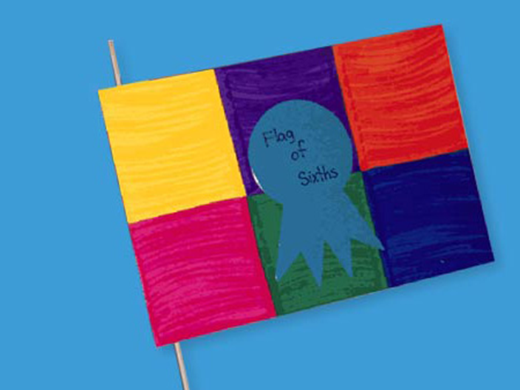
Spelling
Purple Group seven seventeen clothes garden yesterday swimming sure before never fruit believe decided another quiet quite | Orange Group phone photograph graph phantom alphabet elephant dolphin trophy
Rainbow spell Free choice spell Speed spell
Reading
With the book you’ve chosen at home complete the following tasks…. Draw a picture of your favourite character and describe their appearance and personality Look up tricky words in a dictionary Find out 4 facts about the author
Maths
Quick 10 https://www.topmarks.co.uk/maths-games/daily10 (choose Level 2, Division, Division by 6,7,8)
Number Talks Remember to talk about how you solved these chilli challenges – if you can others to join in you can teach them the hand signals.
https://www.kidsolr.com/math/fractions.html Have a look at the first two sections (‘What is a Fraction?’ & ‘Fraction Practice’ Can you design your own Fraction Flag… this one is 1/6 yellow, 1/6 pink, 2/6 blue, 1/6 green and 1/6 red. What will yours be? Upload them on to our ‘P4 Team’.
16+20 16+25 16+30 16+36 | 17+10 17+14 17+30 17+35 | 29+10 29+15 29+20 29+24
French
Can you find out 10 facts about the France – you can write these as a list, design a poster, make a PowerPoint – it’s up to you!
RME
Please complete the ‘Eid-al-Fitr’ reading comprehension posted on the class blog. https://blogs.glowscotland.org.uk/nl/public/p42020/uploads/sites/39479/2020/03/19132719/t2-e-2248-ks2-eid-al-fitr-differentiated-reading-comprehension-activity_ver_3.pdf
Handwriting
Please complete one of the Handwriting sheets previously posted on the class blog. https://blogs.glowscotland.org.uk/nl/p42020/2020/03/19/handwriting/
Music
I have uploaded a file on the Blog called ‘Music from The Gladiator’ – hope you enjoy it!
Remember I will also be posting Daily Challenges on the Glow P4 Team, our Class Blog on the school website and on Twitter (@MrsSteel_LWell). If you have any questions please email me AlisonSteel@ladywell.n-Lanark.sch.uk

