Slide 2
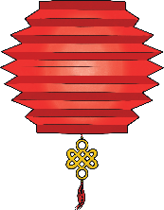
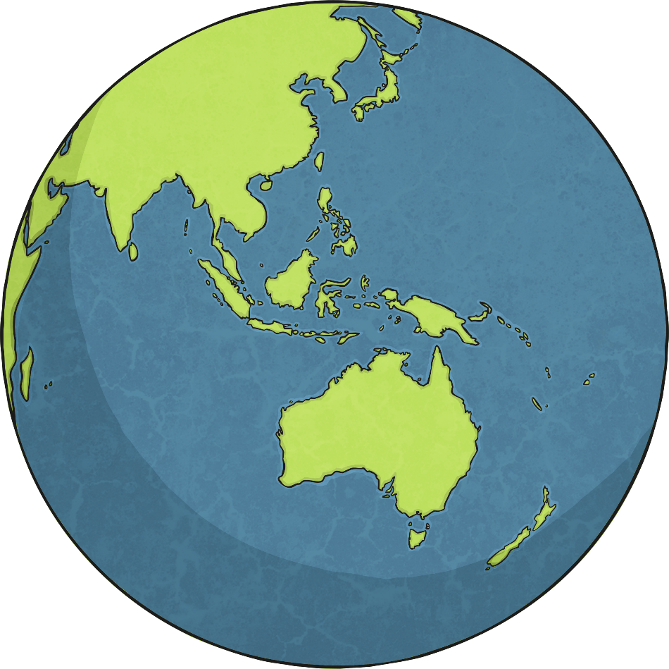
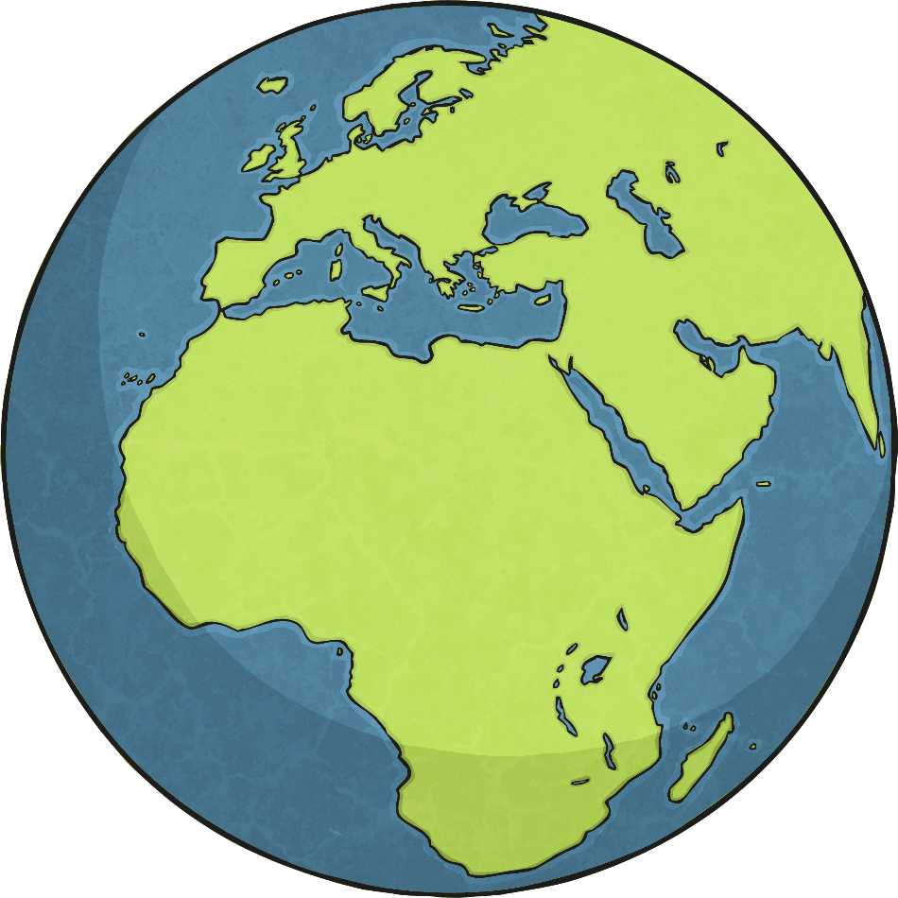
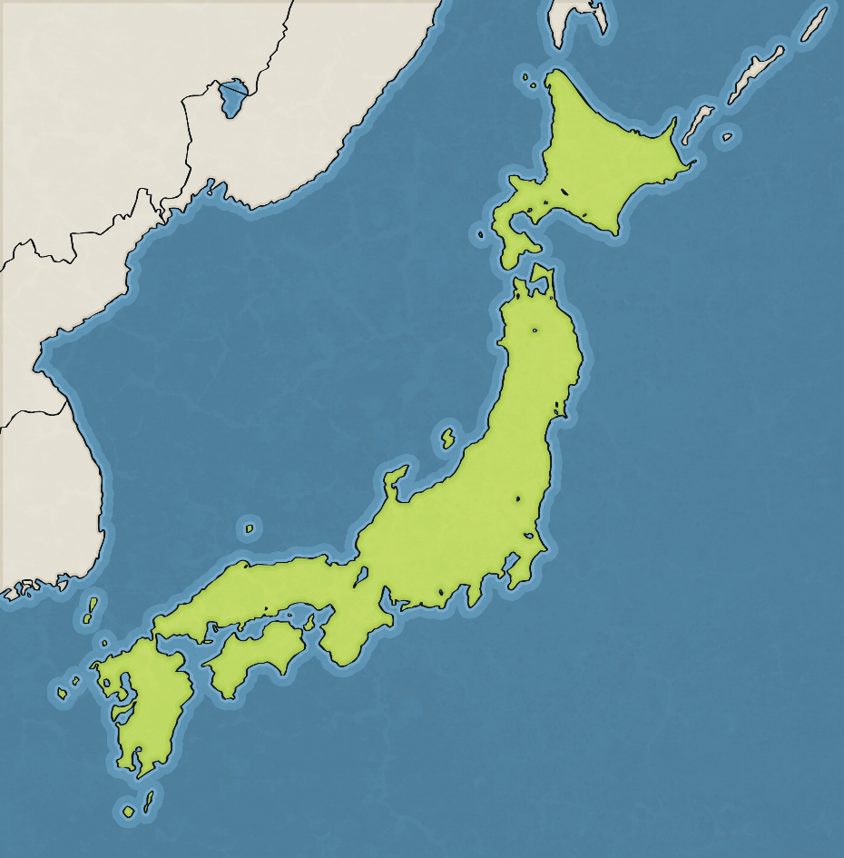
Where is Tokyo?
Tokyo is located in the country
of Japan.
Tokyo is on the eastern coast of Japan and is the capital. Tokyo was first named Edo but was renamed Tokyo in 1868. The name Tokyo translates to
‘Eastern Capital’.

Slide 3
All about Tokyo
Tokyo is the most populated district in Japan and is considered one of the most important and powerful cities in the world.
Tokyo is made up of special wards, cities and islands.
Many of the buildings in Tokyo are modern and contemporary in design.
Many of the streets in Tokyo are lit up with neon lights. Tokyo has more neon lights than anywhere else in the world.
Most people in Tokyo speak Japanese.

Slide 4
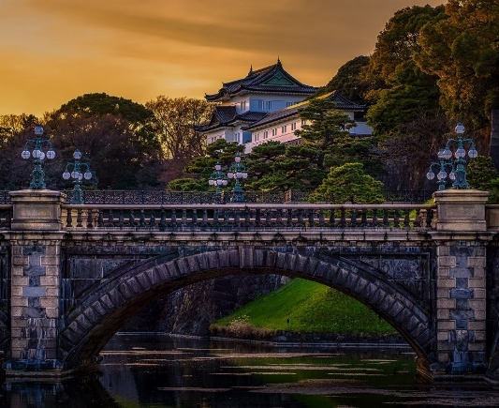
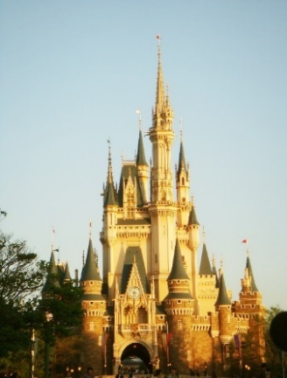
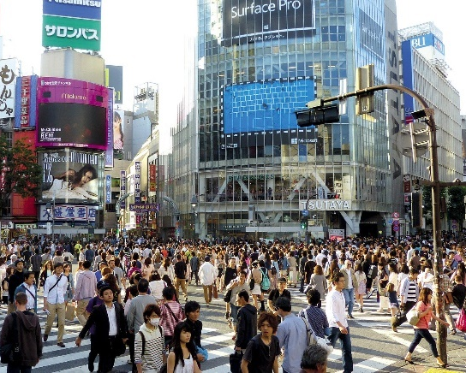
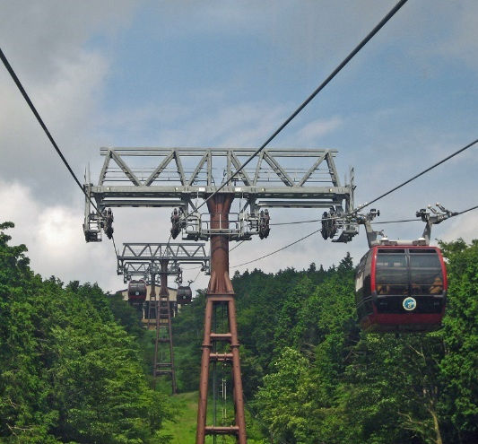
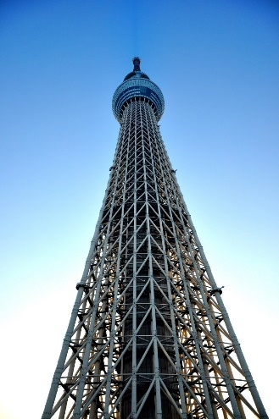
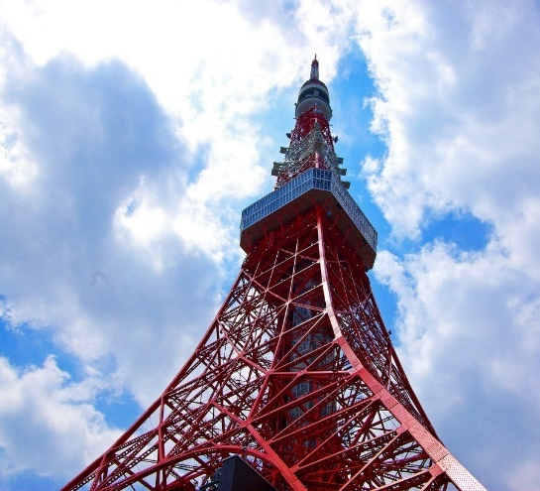
Famous Landmarks
More Info
The Imperial Palace
Disneyland
Shibuya
Mount Takao
Skytree
Tokyo Tower

Slide 5
The Imperial Palace
The Imperial Place is the home of Japan’s Imperial Family.
It is located in the centre of Tokyo.
The Imperial Palace is a large park area, surrounded by moats and stone walls.
Two bridges, called the Nijubashi are at the entrance of the inner palace grounds. These bridges can be seen by members of the public.
Back
More info

Slide 6
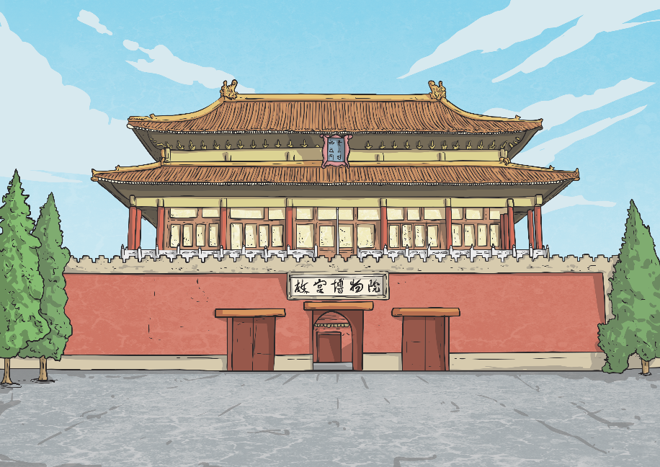
The Imperial Palace
Back
The public do not often get the opportunity to visit the inner palace grounds.
The Imperial Palace East Gardens are next to the inner grounds of the palace and are open to the public all year round.

Slide 7
Disneyland
Back
Tokyo Disneyland opened in 1983 and was the first Disney park to be built outside of the United States.
It is a very popular tourist attraction and hosts millions of visitors each year.
The park has seven themed areas.
A second Disney park, Tokyo DisneySea opened in 2001. This park has a
nautical theme.

Slide 8
Shibuya
Back
Shibuya is one of the Japan’s busiest districts.
It is a popular for shopping, entertainment and nightlife.
Two of the train stations in Shibuya are the busiest in the world.
Shibuya crossing, outside Shibuya, is one of the busiest crossings in the world and as has featured in movies and television shows.

Slide 9
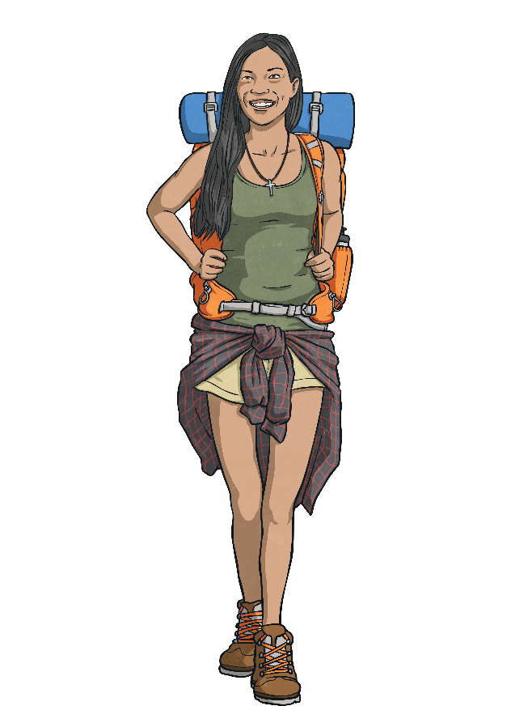
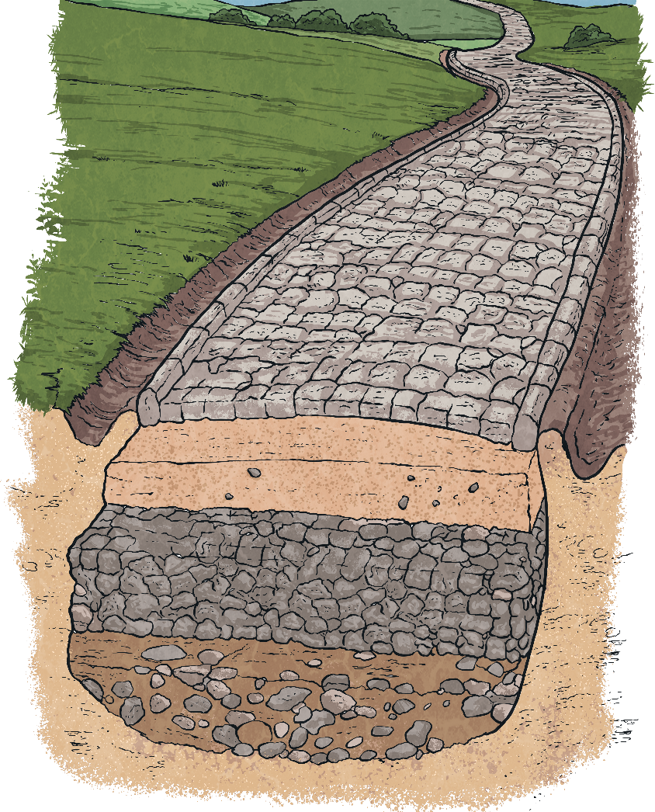
Mount Takao
Back
Mount Takao is located in Hachiōji, Japan and is a popular hiking spot.
It is 599 metres tall.
There are several trails up Mount Takao and trail one takes around 90 minutes.
There is a cable car that can take visitors half way up the mountain.
On a clear day you can see Mount Fuji from the observation deck at the cable car’s top station.

Slide 10
Tokyo Tower
Back
Tokyo Tower is a communications and observation tower and is the second-tallest structure in Japan.
The design of the tower is based on the Eiffel Tower in Paris.
It is painted white and orange due to air safety regulations.
It is painted every five years and takes around one year to paint.
It is a popular tourist attraction and visitors can take a lift up to the observation decks of the tower.

Slide 11
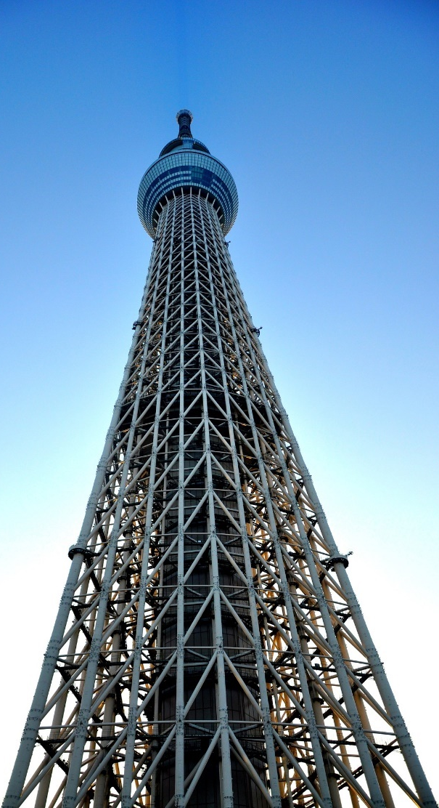
Skytree
Back
Skytree is the world’s tallest tower at 634 metres high and the second tallest structure in the world.
It is a broadcasting and observation tower and broadcasts television and radio.
Its design includes features to help it withstand earthquakes.
Construction began in 2008 and it opened to the public in 2012.

Slide 12
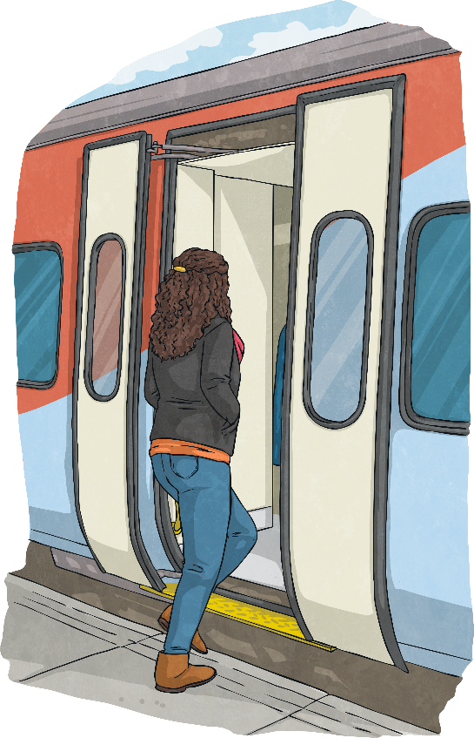
Transport
Trains, subways and buses are all popular modes of transport in Tokyo.
Oshiya, or passenger arrangement staff, are station staff that are employed to push passengers onto trains during peak times.
Shinjuku station is the largest and busiest station in the world with an average of 3.7 million passengers passing through each day.

Slide 13
Lifestyle
Seafood is very popular in Japan. The Japanese dish sushi, which is made with rice, vegetables and seafood, is served in many sushi bars across Tokyo.
Sumo wrestling is a popular and
well-respected sport.
Tokyo is one of the safest places to live and visit with very low rates of crime.
Living in and visiting Tokyo can
be expensive.

Slide 14
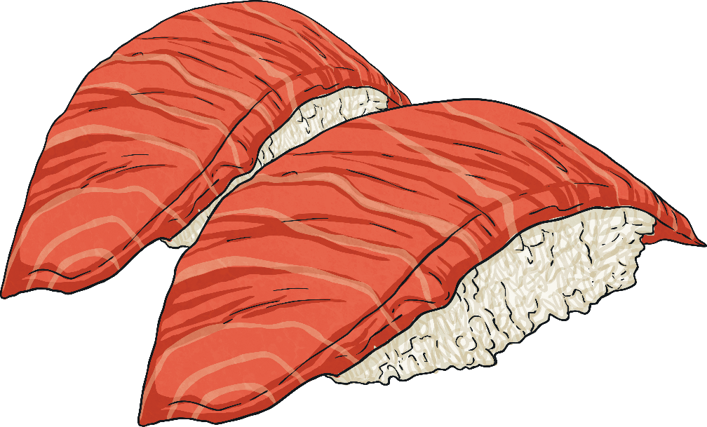
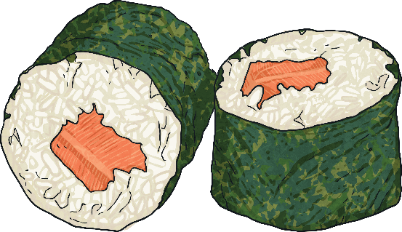
Food
Food in Tokyo is very important; there are more top-rated restaurants than anywhere in the world.
The fish market, Toyosu is the largest in the world and visitors can visit the market to watch tuna auctions or eat at one of the restaurants onsite.

Slide 15
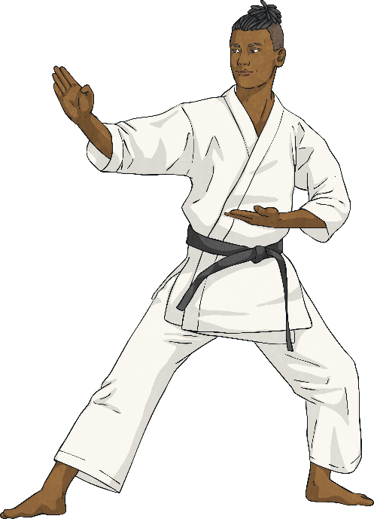
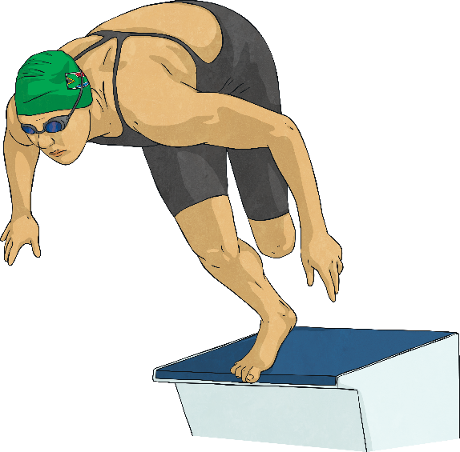
The Olympics 2020
The Olympic Games will begin on the 24th of July 2020. This will be the second time Tokyo has hosted.
The Olympic Games in Tokyo will feature 33 different sports and 22 sports in the Paralympic Games.
Karate, sport climbing, surfing and skateboarding will be introduced in the Olympic Games for the first time.

Slide 16
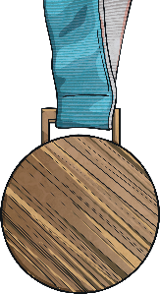
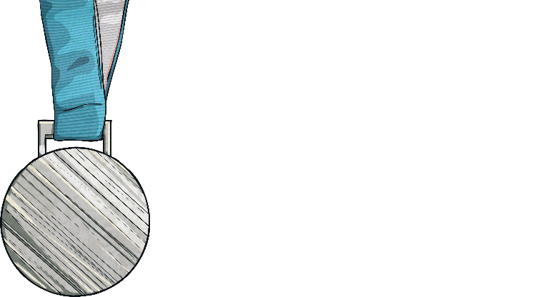
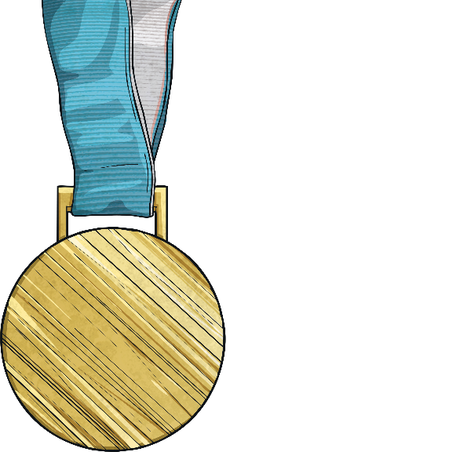
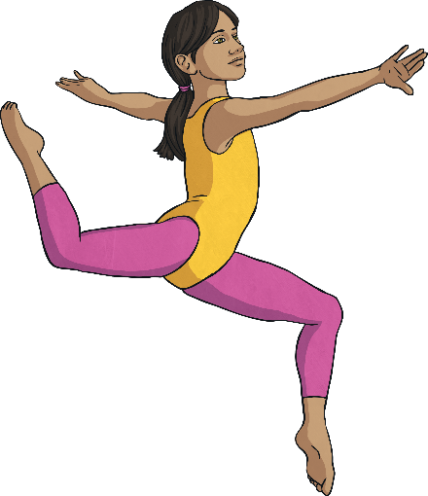
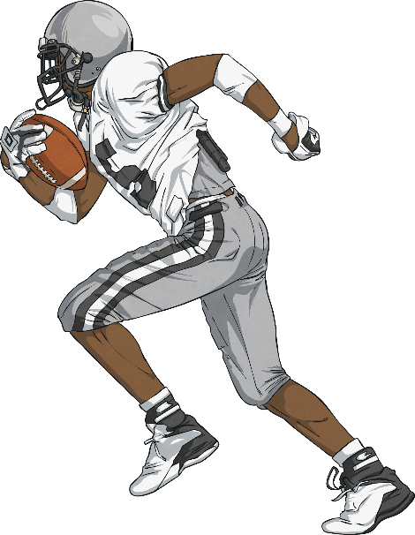
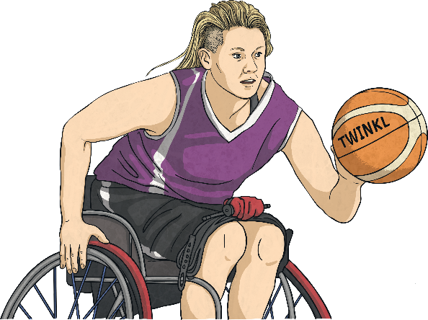
The Olympics 2020
Eleven new venues are under construction in preparation for the games.
A new National Olympic Stadium has been built in place of the previous National Stadium. It has a larger capacity and will host the opening and closing ceremonies, in addition to hosting athletics, rugby and some football matches.

