Slide 1
Orchard Primary and LCSC Newsletter
November 2022

Slide 2
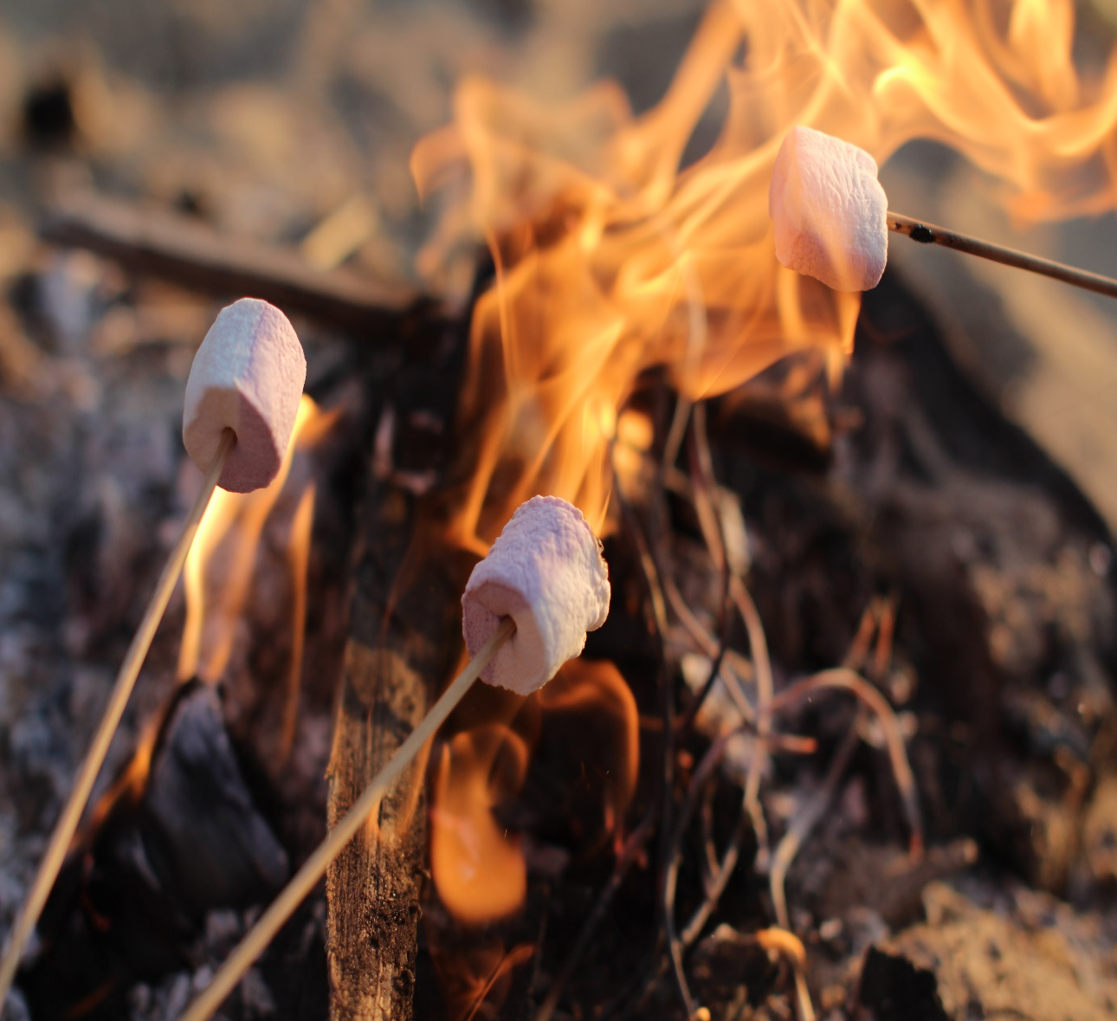
Due to Parental Feedback we will now send monthly Newsletters and alert you on the School’s Twitter Page when they have been sent.
Thank you to everyone who responded we now have a clearer picture of Improvements we can make in regards to Communication.
The survey will be open until Friday, please consider completing if you haven’t already done so.
If you would like a paper copy of the survey please email the enquiries box.
Enquiries-at-orchard@northlan.org.uk
This Photo by Unknown author is licensed under CC BY-NC.
This Photo by Unknown author is licensed under CC BY.

Slide 3
staffing update
We have a new addition to our staffing, Lorrraine Rieley, ASNA Mon-Wed in Mrs Young’s class.
Due to Mrs Scallan’s absence her class have been temporarily moved into other classes while we await a replacement.

Slide 4
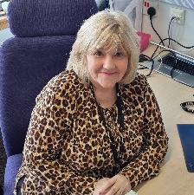
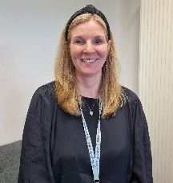
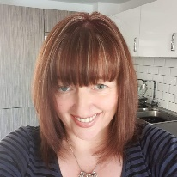
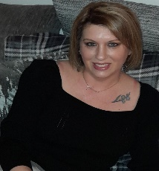
Contact us
Mrs Mackenzie is our Headteacher (Acting) with overall responsibility for the whole school. Mrs Mackenzie can be contacted on the phone number below or by email at:
enquiries-at-orchard@northlan.org.uk
Mrs Sneddon is the Acting Depute Head Teacher with responsibility for the LCSC so we ask that in the first instance, if your child is in our LCSC that you contact her with any issues or concerns you may have.
Mrs Dyer is the Principal Teacher with responsibility for Primaries 1-4 so we ask that in the first instance, if your child is in these classes that you contact her with any issues or concerns you may have.
Mrs Bowden is the Principal Teacher with responsibility for Nursery and Primaries 5-7 so we ask that in the first instance, if your child is in our Nursery or these classes that you contact her with any issues or concerns you may have.
Our school telephone number is 01698 274984

Slide 5
Attendance & ABSENCE
Section 30 of the 1980 Education Act places a duty on
every parent of a child of ‘school age’ to ensure that their
child attends school regularly. Attendance must be recorded
twice a day, morning and afternoon.
North Lanarkshire Council values attendance at school and aims to optimise attendance to impact on teaching and learning.
At Orchard we would love to see your children at school every day but understand that this isn’t always possible due illness and other reasons.
If you child is going to be absent from school then we would ask that you phone the school to let us know and to provide a reason for the absence.
If your child’s absence rate is causing concern then we will invite you to a meeting to discuss the reasons for the absence and to see if there is anything we can do to help.
1993 requires each child’s absence from school to be recorded in the school register as authorised or unauthorised: As defined by the Scottish Government.

Slide 6
After school & lunchtime clubs
Lunchtime Clubs
These clubs will run from 12.05pm – 12.30pm
Gardening Club Mrs Monaghan 25/10/22, 01/11/22
Music Club Mr Macleod 04/05/23, 11/05/23
18/05/23
Hamma Beads Club Mrs Kent Dates TBC
Sewing Club Mrs Clemenson June ’23

Slide 7
After school & lunchtime clubs
After School Clubs
These clubs will run from 2.50pm – 3.50pm
Cross Stitch Club Mrs McDonagh 28/11/22, 05/12/22,
12/12/22
Christmas Craft Club Miss Craig 08/12/22, 15/12/22
Netball Club Mrs Garvie 18/01/23, 25/01/23
01/02/23, 08/02/23
15/02/23, 22/02/23
01/03/23, 08/03/23
15/03/23, 22/03/23
Running Club Mr Dornan 30/01/23, 06/02/23
13/02/23, 20/02/23
27/02/23
Running Club Miss Karran 13/03/23, 20/03/23
Miss Wilson 27/03/23, 17/04/23
24/04/23
Board Games Club Mrs Hill 03/05/23, 10/05/23
17/05/23

Slide 8
After school & lunchtime clubs
After School Clubs
These clubs will run from 2.50pm – 3.50pm
Football Football Coach 24/10/22, 31/10/22,
7/11/22
Dance Dance Coach 27/10/22, 3/11/22,
10/11/22, 17/11/22

Slide 9
Parent council & PARENT SUPPORT GROUP
The Parent Council Meetings will be held on the following dates. Meetings are held in school in the Conference Room from 6.45pm – 9.00pm. Parents are encouraged to join the Parent Council and become part of the life of the school.
Tuesday 1st November 2022
Tuesday 10th January 2023
Tuesday 7th March 2023
Tuesday 9th May 2023
Tuesday 6th June 2023
Further dates will follow in due
course,.
The Parent Support Group for our LCSC families and families of children with Autism in our Mainstream will meet on the following dates. Meetings are held in school in the Conference Room AT 9.30AM.
Monday 7th November 2022
Monday 9th January 2023
Monday 6th February 2023
Monday 6th March 2023
Monday 17th April 2023
Monday 15th May 2023
Monday 5th June 2023

Slide 10
Dates for your diary 2022-2023
Dates | What’s happening?
10/11/2022 | P7 taster visits to CVHS
14/11/2022 | Inservice Day 3 (holiday for pupils)
15/11/2022-18/11/2022 | Stay and Learn Week (See next slide, L5/6/7B date to follow)
18/11/2022 | Children in Need
23/11/2022 | LCSC Sensory Pantomine
5/12/2022 | Mainstream Pantomine (permission forms to follow)
8/12/2022 | P7 and L5/6/7C Christmas Party
9/12/2022 | P6, L5/6/7A and L5/6/7B Christmas Party
Dates | What’s happening?
Dates | What’s happening?
12/12/2022 | P5 and L5 Christmas Party
13/12/2022 | P4, L4/5/6 and L4/5 Christmas Party
14/12/2022 | P3 and L2/3B Christmas Party
15/12/2022 | P2 and L2/3A Christmas Party
16/12/2022 | P1, L1 and L1/2 Christmas Party
19/12/2022 Change of date | Nativity – Evening performance 6.30pm
21/12/2022 | Nativity – Afternoon performance 1pm
23/12/2022-09/01/2023 | Christmas and New Year holiday

Slide 11
Stay and Learn
Date | Class | Time
Tue 15th Nov | L1/2 Mr McLeod Mainstream P5, P6 & P7 | 10.40am 1.30pm
Wed 16th Nov | L 2/3B Mrs Garvie L5/6/7B Miss Cassels Mainstream P1-4 L4/5/6 Mrs Young L2/3A Mrs Kydd | 9.20am 10.40am 1.30pm 1.30pm 2.00pm
Thu 17th Nov | L5 Mrs Monaghan L5/6/7A Mrs Clemenson L3 Mrs Kent L4/5 Mr Dornan | 9.30am 12.45pm 1.15pm 2pm
Fri 18th Nov | L1 Mrs Brownlie | 9.30am

