Slide 1
Clyde in the classroom
By Marie and Craig

Slide 2
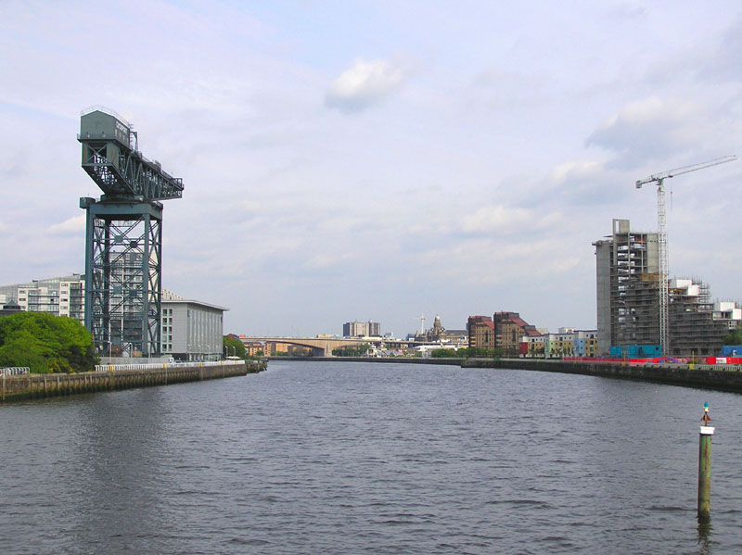
What is Clyde in the classroom
Clyde in the classroom is where children around the river Clyde get to grow baby fish and launch them out into the sea. In Orchard primary school Primary 6 are growing and we will tell you facts.

Slide 3
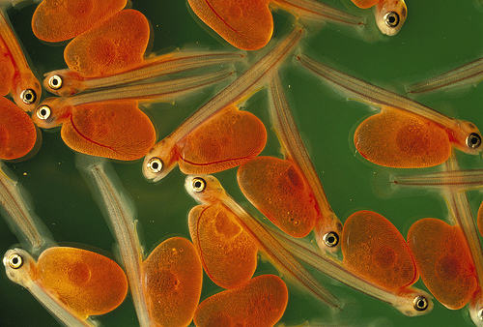
Facts about Alevins
As the eggs develop you can see trout ova develop with in them.
Alevins are baby fish
The newly hatched trout are called alevins and they live In the gravel /feeing off the remaining yolk that is attached to their body for 19-30 days again temperature influencing their rate of development

Slide 4
Facts about Fry
A fry is the second stage of a brown trout.
They start to turn black when they turn into a fry
They are 1 one of the 3000 fish spieces in the world
It is one of the life cycle of a brown trout

Slide 5
How we look after the fish
We keep our fish in a hatchery
There is a tank a and a tank b
We have to bring in frozen water bottles to keep the fish cool
We will launch them on Monday at the Motherwell bridge next to M and D
They like the temperature at nine

Slide 6
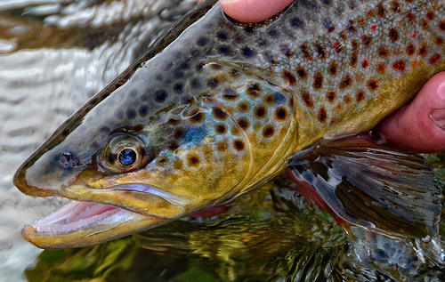
Life cycle of a brown trout
They are an egg and then they turn into Alevins. Then a little fry. Then a parr.
And then the trout

Slide 7
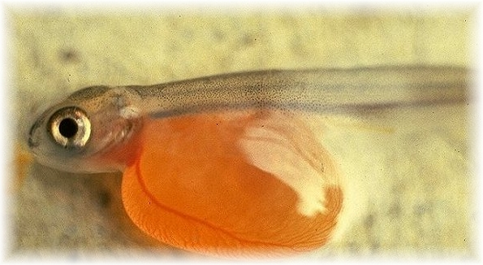
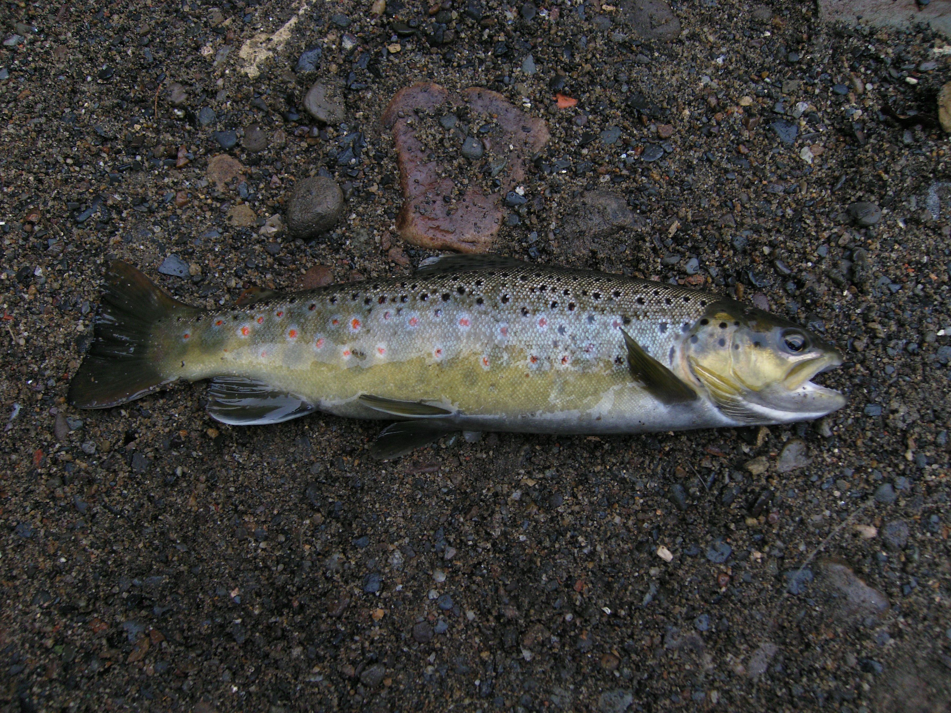
pictures

Slide 8
quiz
What is the 4th part of a brown trout lifes?
Do we use a tank to keep the fish in?
Tell us a fry fact please!

Slide 9
Answers of fish
Parr is the 4th part of a brown trout lifes
We don’t keep the fish in a tank
Whatever you gave us

