Slide 1
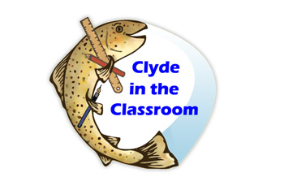
By Abbey and Isla☺

Slide 2
What is clyde in the classroom?
Clyde in the classroom is a fun, educational project for senior pupils all over Scotland. The project includes looking after brown trout and doing fun activities. After the fish have grown they are released into the River Clyde.

Slide 3
The fishy tank fun facts☺
you get the tank from Clyde in the classroom. the tank has at least 200 fish in It. In the tank you will need to put Frozen water bottles in it so the water is cold for the fish. Also there is an air pump which will take away the chlorine.

Slide 4
Taking care for the Brown trout
Every day we have two people who check the temperature of the fish. They also put in ice water bottles to keep the tank cool. Dead fish also need to be taken out.

Slide 5
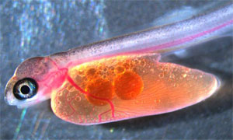
Baby alivens
Spine
Tail
The aliven is the next stage from an egg. At this point they don’t need fed as they have got and food sack filled with fat.
Blood Vessels
Eye
Fat

Slide 6
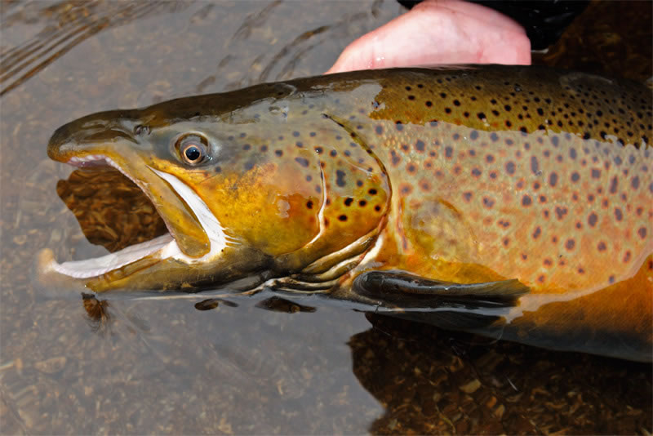
Brown trout facts
The brown trout is an European fish.
The Brown trout is a relative of the salmon.
Its likely that in the Clyde the trout's mum or dad could eat them.
The brown trout lives most of its life in the ocean.
Brown trout can lay more than 10,000 eggs at one time.

Slide 7
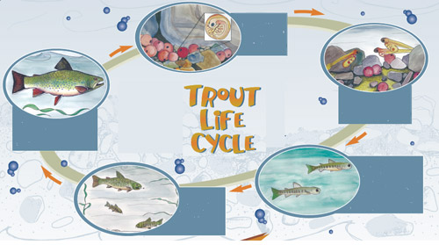

Slide 8
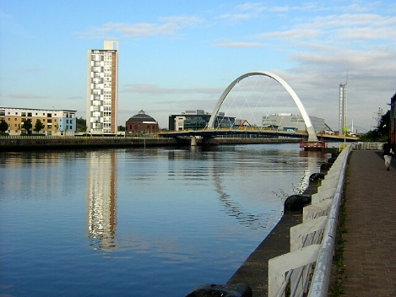
The River Clyde is a river, that flows into the Firth of Clyde in Scotland. It is the eighth-longest river in the United Kingdom, and the second-longest in Scotland. It also flows through the major city of Glasgow.
The river Clyde

Slide 9
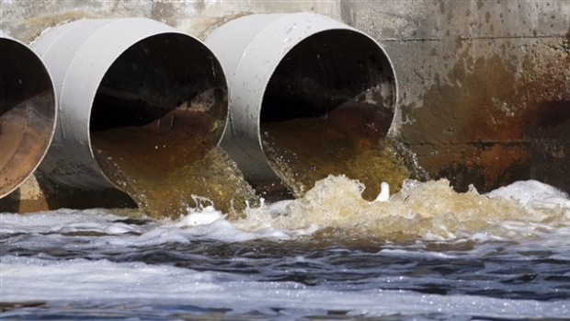
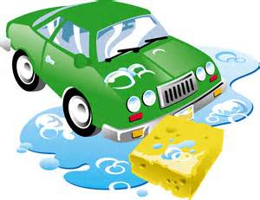
Water Pollution
Water pollution is what is making fish die a lot. That’s why Clyde in the Classroom has started so that more fish will survive. Water pollution is caused by a lot of things.
Can you think of any other ways water pollution is caused?

Slide 10
Random fishy facts
Electric eels and electric rays have enough electricity to kill a horse.
Most fish have taste buds all over their body.
Sharks are the only fish that have eyelids.
Most brands of lipstick contain fish scales.
Starfish are not fish. Neither are jellyfish.

Slide 11
QUIZ
How many fish do you get?
200
2. WHAT IS THE NEXT STAGE FROM AN EGG?
ALIVEN
3. HOW MANY EGGS CAN BROWN TROUT LAY AT ONCE?
10,000
4. WHAT MAJOR CITY DOES THE RIVER CLYDE FLOW THROUGH?
GLASGOW
EITHER GLASS BOTTLES, SEWAGE, LEAFS AND CAR WASHING SOAP
5. NAME 1 THING THAT IS CAUSING POLLUTION?

Slide 12
Thanks for watching

