Slide 1
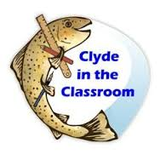
Clyde in the classroom
Brown trout
BY Chloe and Ryan

Slide 2
brown trout are a fish native to the river clyde in Scotland and every contery in the world

Slide 3
Among the best of sporting fish it enjoys a worldwide reputation for its fight and as a valuable food resource which has been farmed extensively for many years.

Slide 4
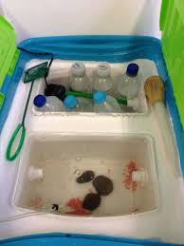
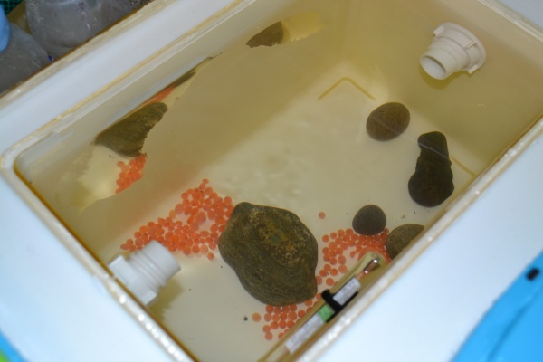
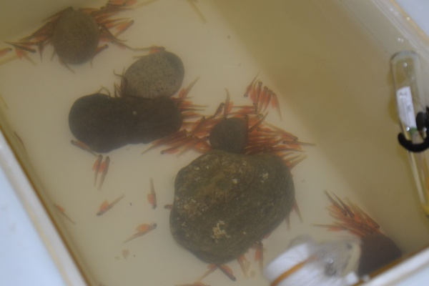
What Is Clyde in the Classroom
Clyde in the classroom is a project that the River Clyde Foundation have been doing for 17 year so now in 2017 Orchard Primary School will get to do it .

Slide 5
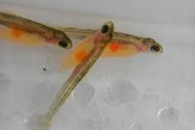
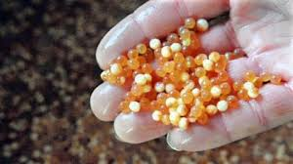
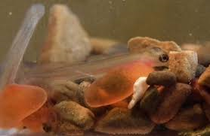
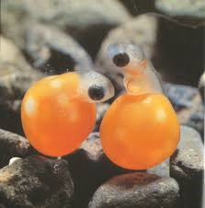
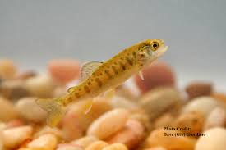
Here is some Pics

Slide 6
Here is a video
https://www.youtube.com/watch?v=XILuSckgYlw

Slide 7
Hope you were listening

Slide 9
Quiz
Fry
What do you call a trout after its called an alevin ?
Do you have to feed alevins ?
Why do we need to keep the fish cool ?
No
Because if you didn’t they would die

Slide 10
