Slide 1
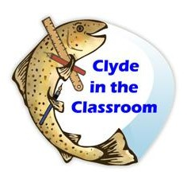
By Lauren

Slide 2
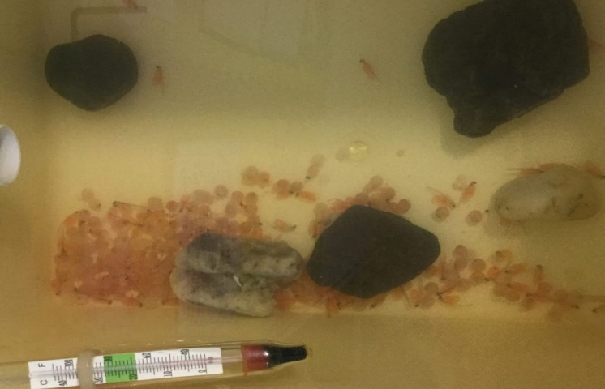
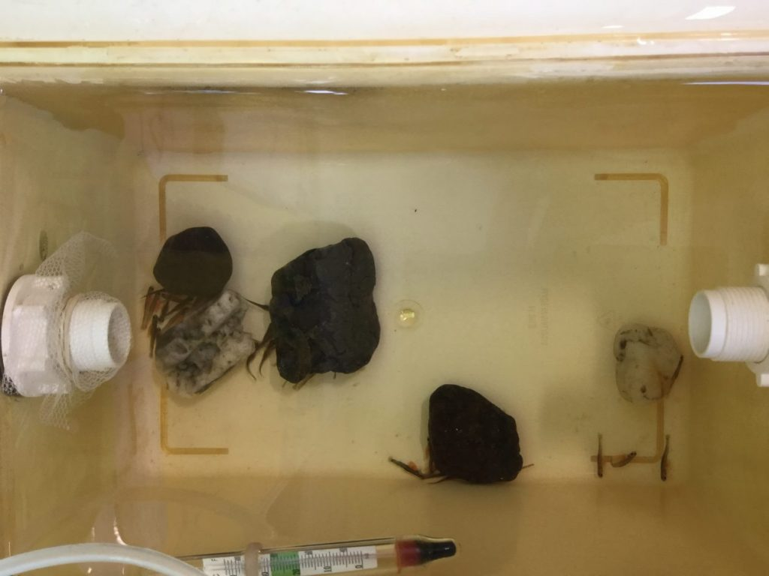
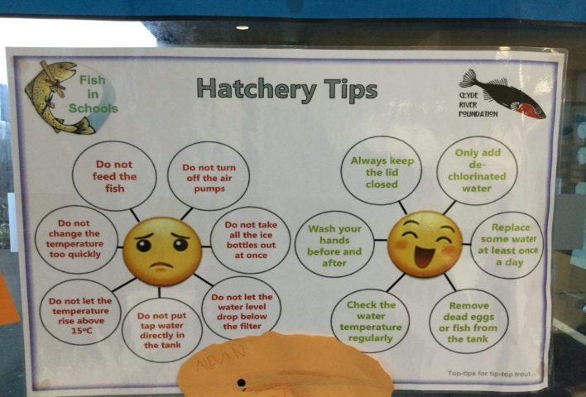
What Clyde in the classroom is
Clyde in the classroom is a wonderful and dynamic project and an amazing opportunity. Since this is a vitally important project I will explain more throughout the PowerPoint. We have a hatchery in our classroom to see how the fish grow and live in the wild and how they survive.

Slide 3
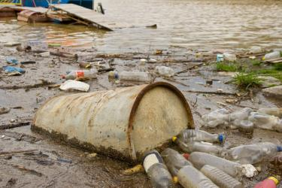
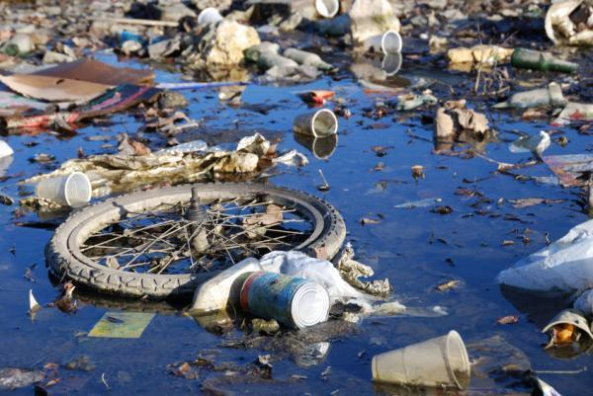
Caring for our fish
Caring for our fish is stupendous. We love and care for our fish we think they are our pets. We are but not really wanting to set them free. We are keeping these fish because some fish are born in the polluted river the river Clyde if you were to go down to the Clyde you would see it is appalling atrocious dreadful disastrous and an outrage that’s only a couple of words to describe it.
THE RIVER CLYDE NOW!!

Slide 4
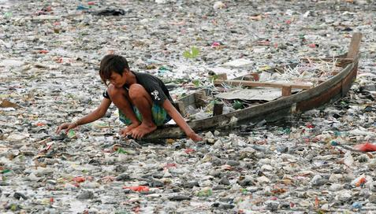
Water pollution
Water pollution is contaminated water that is caused by humans and rubbish. This is an atrocious thing because we use the exact same water even though it has been filtered think if it hadn't you could die and the eco system is dying because of us polluting the water. Think again before throwing y our rubbish.
RIVER IN INDIOSIA

Slide 5
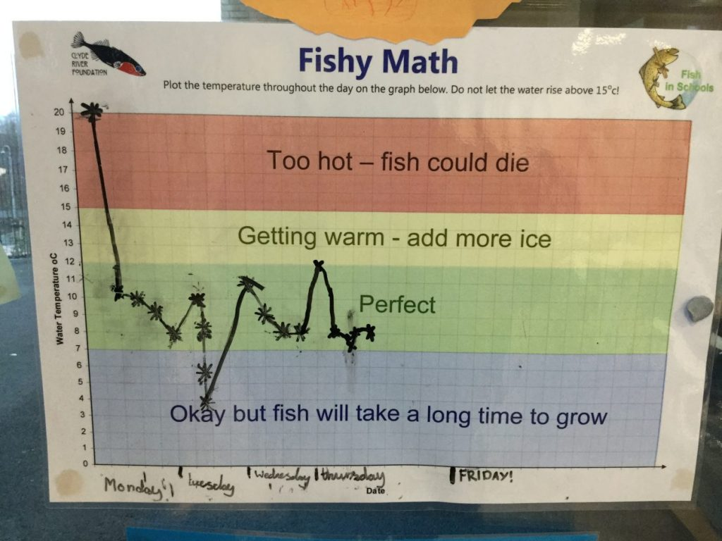
Learning about our fish
Learning about our fish was fun because following it was eco survival and LIFE and growth. We are also basically spoiling our fish by making the water so cold that they love it. Our main job is to basically BE RESPONSIBLE!!

Slide 6
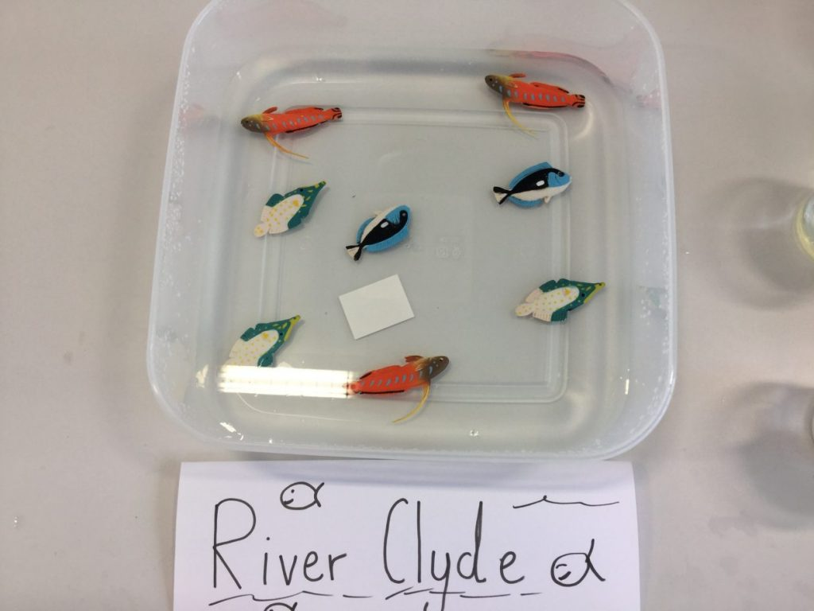
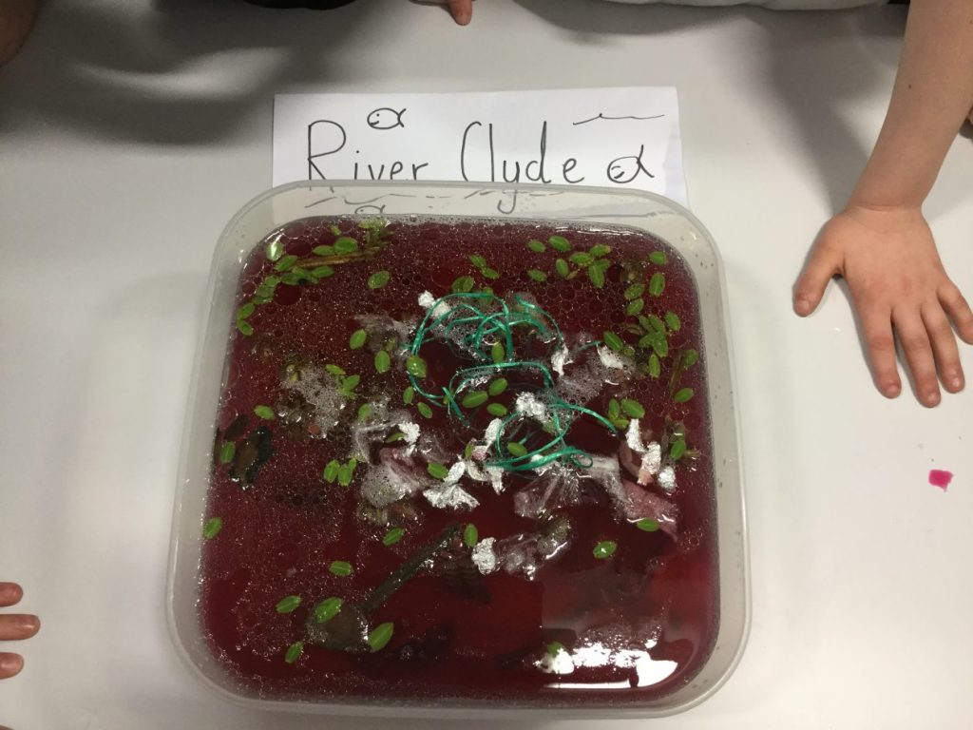
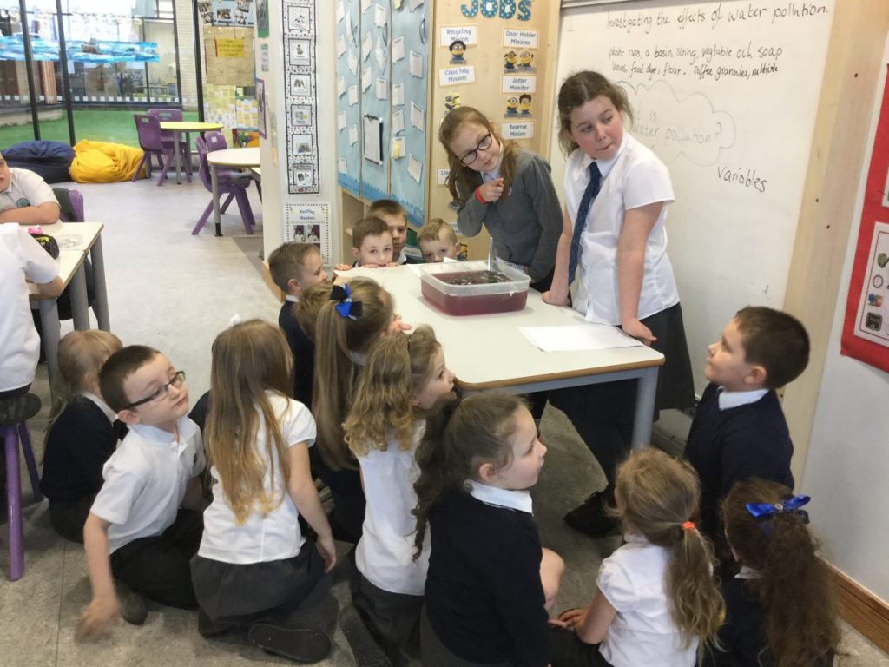
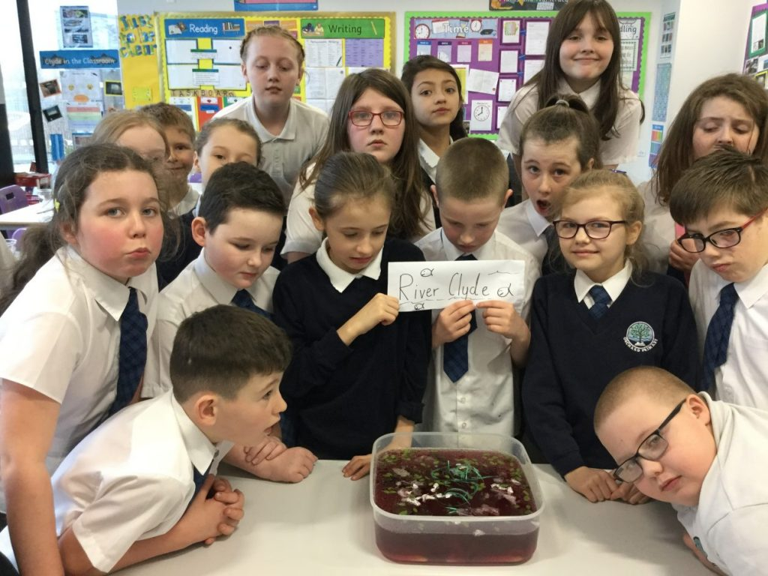
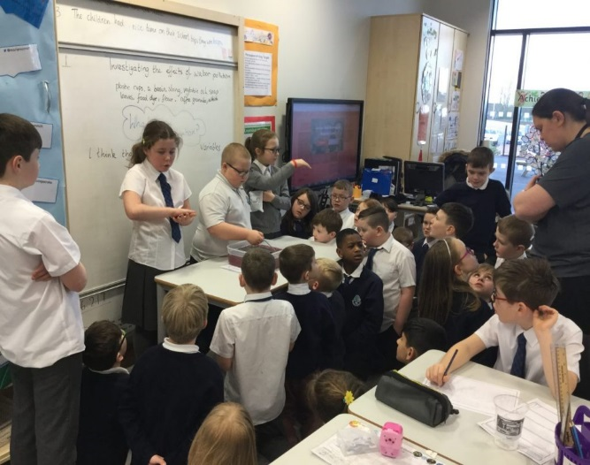
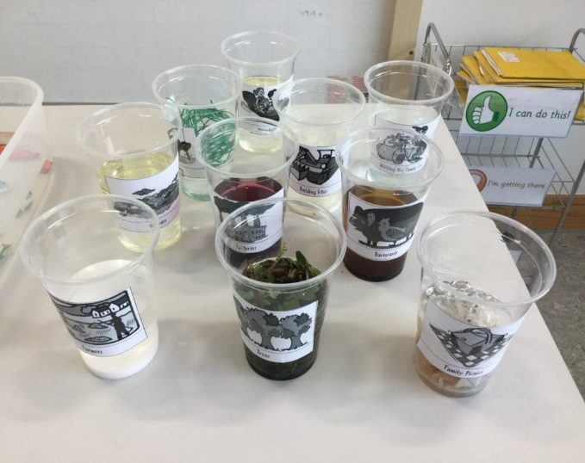
OUR EXPERIMENT
https://vimeo.com/204372594 This is our link to our pollution experiment

Slide 7
Brown trout
Adult salmon or brown trout lay their eggs in gravel and make a special nest called a redd in mid autumn in fresh water. The eggs soon hatch In the spring. Hatching whilst still under gravel they have yolk sacks and are called alevins.

Slide 8
egg
alevin
Adult trout
fry
trout

Slide 9
THE RIVER CLYDE
The River Clyde is a river, that flows into the Firth of Clyde in Scotland. It is the eighth-longest river in the United Kingdom, and the second-longest in Scotland. There are over 70 bridges spanning the River Clyde, including the distinctive Clyde Arc. The Clyde Tunnel, which opened in 1963, took 7 years to build and is the length of 7 football pitches.
Shipbuilding was an important industry on the Clyde during the 20th century, especially during World War 2. The QE2 and the Royal yacht Britannia were built on the river.
The last ocean going paddle steamer in the world, the Waverley, was built on the Clyde in 1947. It still operates today, providing river excursions to tourists

Slide 10
QUIZ
WHAT IS WATER POLLUTION?
WHAT WAS THE STORY ABOUT?(OUR EXPERIMENT)
WHAT WAS OUR MAIN JOB?
WHAT 2 WORDS DID I USE TO DESCRIBE OUR PROJECT
WHEN DID SHIPBUILDING START?

