Slide 1
All About Fish!!!
Fishy facts with Michael and Jennifer.

Slide 2
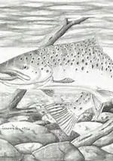
Brown trout!!!
Brown trout are one of the most genetically diverse vertebrates known. There is far more genetic variation present across British populations of wild brown trout than between any populations in the entire human race.
Brown trout have between 38 and 42 pairs of chromosomes. Humans have only 23 pairs.
. Brown trout (including sea trout) belong to a single, polytypic, species. They are, however, so variable and adaptable that attempts have been made to assign them to at least 50 separate species.

Slide 3
small trout!!!
alevens
fry
Alevens are like small minnows with a yoak sack. A yoak sack is a little sack at there bellies where they get there food from. Alevens usally like the water temputer to be round about 9-15 deegrees.
A fry is small trout witch no longer has a yoak sack. So they need to find there own food in the wild and find there own part of a river (lakes sea)for the temputer they like

Slide 4
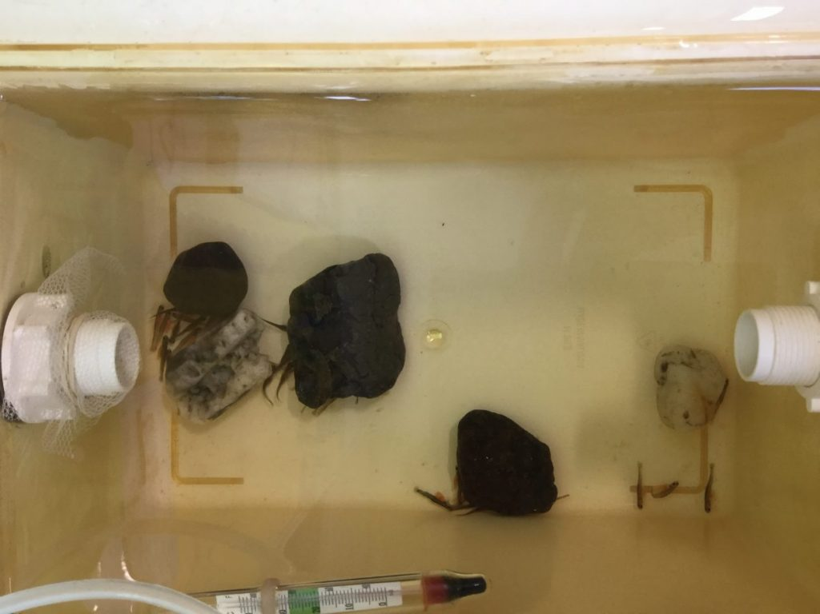
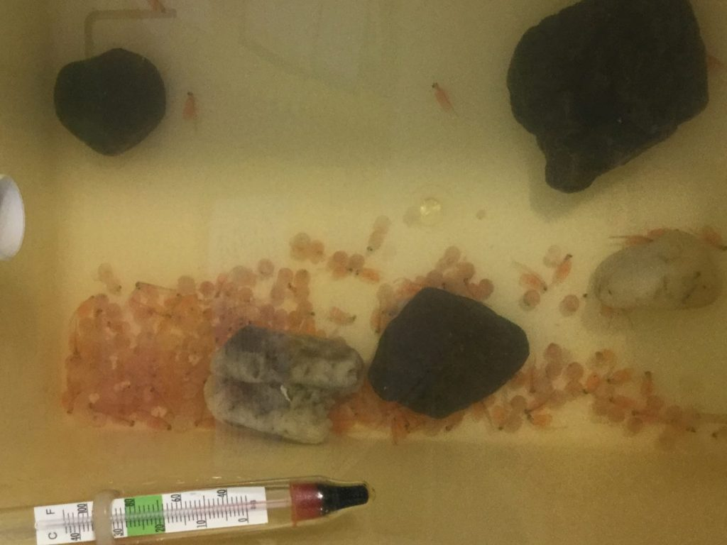
Clyde in the classroom!!!

Slide 5
Clyde in the classroom facts!!!
Clyde in the classroom is project that includes MILLIONS!!! Of exiting things.
You can never feed the fish in the fake redd (redd is a den)or in genrel because it could kill them.
Never ever put tap water in the redd (the water needs to be cloirn free or it could kill them.
Always keep the lid closed not unless you are putting ice bottles in or cheking the temperature.

Slide 6
The river clyde !!!
M.C.A.A Control the lower part of the River Clyde from Dalmarnock Bridge in Glasgow, upriver to Bothwell Bridge in Lanarkshire.
Fishing for all species fishing the river, permits are NOT on sale from bailiffs or river warden. including coarse species is by permit only, you must purchase a permit prior to

Slide 7
More river clyde facts!!!
The River Clyde is Scotland’s third longest river and the 9th longest in the UK. It is 109 miles long and flows from near Daer Water to the Firth of Clyde.
There are over 70 bridges spanning the River Clyde, including the distinctive Clyde Arc. The Clyde Tunnel, which opened in 1963, took 7 years to build and is the length of 7 football pitches.

Slide 8
Pollution!!!
Water covers over 70% of the Earth’s surface. It is a very important resource for people and the environment. Water pollution affects drinking water, rivers, lakes and oceans all over the world. In many developing countries, it is usually a leading cause of death, by people drinking from polluted water sources.

Slide 9
Goodbye!!!!!!!!!!!!!!!!!!!!!!!!!!!!!!!!!!!!!!!!!!!!!!!!!!!!!!!!!!!!!!!!!.

