Slide 1
Introduction to philosophy – lesson 4
Our Lady's High School
Religious Education Department

Slide 2
Watch the video about induction & deduction
https://youtu.be/IV-8YsyghbU
Take some notes whilst you watch

Slide 3
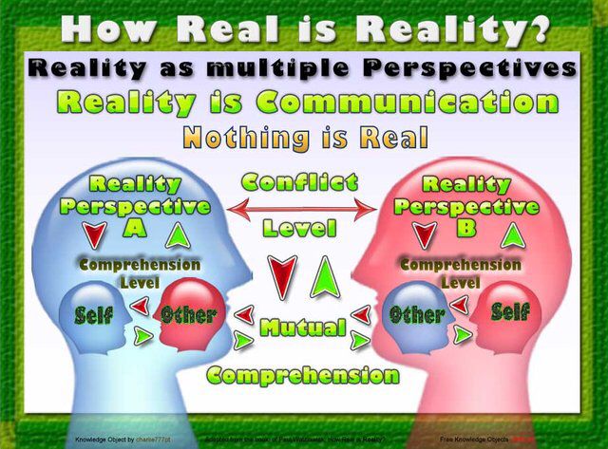
What is real?
Consider the difference between what is real and what you think is real.
Do you think that it is possible that our understanding of reality is not reality at all? Explain your answer.

Slide 4
What is real?
Explain the difference between appearance and reality.

