Slide 1
Introduction to philosophy – lesson 3
Our Lady's High School
Religious Education Department

Slide 2
Watch the video about induction & deduction
https://youtu.be/-wrCpLJ1XAw
Take some notes whilst you watch

Slide 3
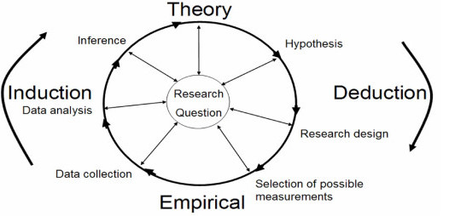
Induction
Using past experiences, we can predict the future
We use arguments and counter arguments
Induction relies on the predictability of nature. In other words, we can be confident that the past will shape the future.
This is not certain, only likely.

Slide 4
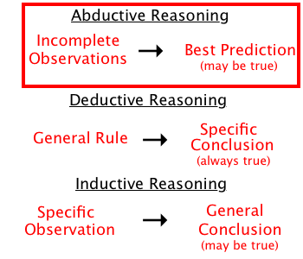
Abduction
Where inference is the best method for understanding.

Slide 5
Counter argument
Socratic method

Slide 6
Task
Explain what is meant by induction.
What is meant be abduction?
The goal of the philosopher is to find the truth.

