Slide 1
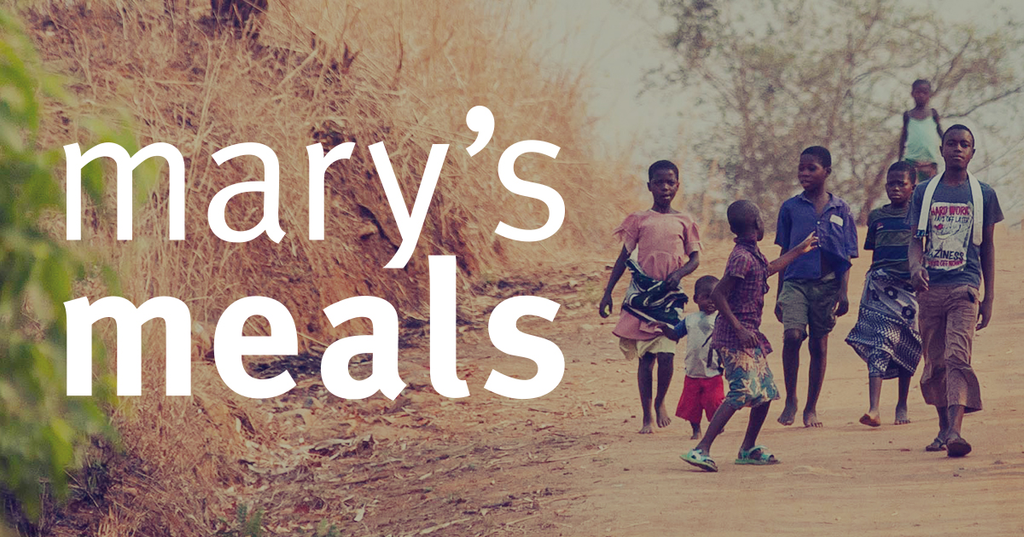
I have considered the Christian vision of the dignity of the human person, made in the image and likeness of God.
I have reflected upon how this has contributed to my becoming the person I am today 3-02A.

Slide 2
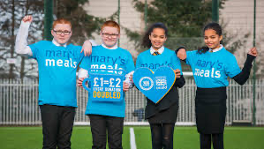
Gifts from a faraway land
An explanation of The Backpack Project and a short description of an exciting delivery for children in Liberia.

Slide 3
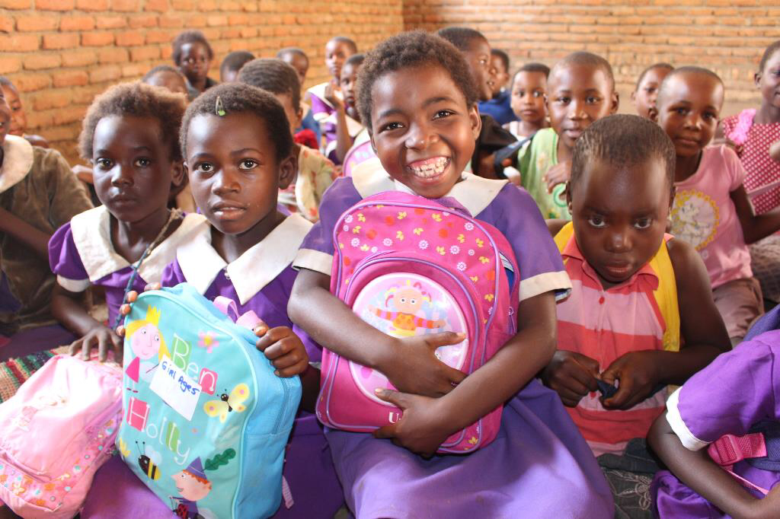
Mary’s Meals
Another new initiative born in Liberia, which ran parallel to and complemented Mary’s Meals, was our Backpack Project. In Malawi and Liberia we had begun to notice that many of the children coming to school because of the meals had nothing with which to learn– no pencils, jotters or any other basics. When we talked about this someone suggested that we adapt our ‘Shoebox Appeals’, through which children in Scotland had for many years been filling shoeboxes with gifts for impoverished children in Eastern Europe, in order to address this need. We began to ask schools to invite their pupils to fill school bags with basic educational items so we could ship these to Africa. The response from schools was overwhelming. The teachers loved the project because it allowed them to introduce a strong educational element about the places and people to which these gifts would be sent, and also because the filling of a backpack allowed a child to learn that they, personally, could do something to help a child in poverty. In Liberia, and then Malawi, the distribution of backpacks became the most joyous of events and another incentive for children to come to school.

Slide 4
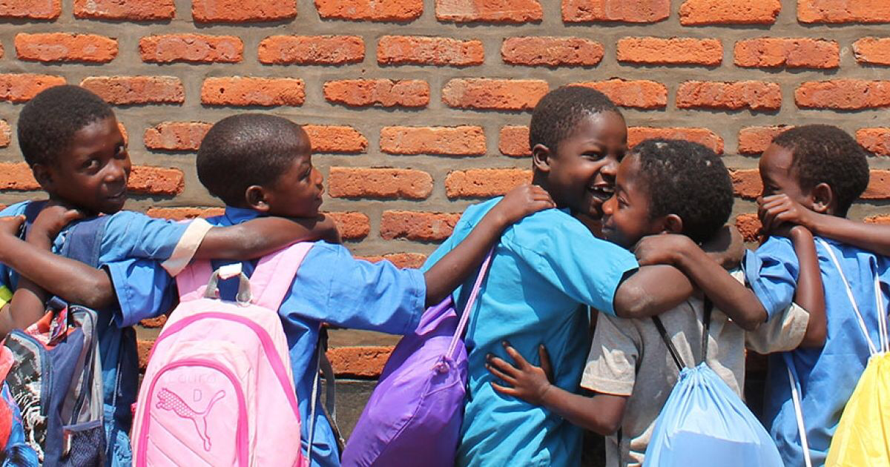
Likuni phala
‘You know, there are more possessions in one of these backpacks than an entire household would normally own here,’ Joseph, our Liberian Head of Operations observed as we bounced towards a village school with another truck of backpacks, part of a container-load recently arrived from Glasgow into the port in Monrovia. I marvelled once again at the excitement and unbridled joy of the kids who unpacked the backpacks in their classrooms, showing each other, with looks of disbelief, the exercise books, crayons, tennis balls and T-shirts that had just been given to them from someone they did not know in a faraway land. And later, when I visited some of their homes in the village, I did a little mental assessment and concluded that Joseph’s startling statement was certainly no exaggeration. In the years to come many people – including primary-school kids (and others), all over the UK, Ireland, Germany, Austria, Croatia and Italy – took part in this project, selecting items from our list and placing them with love in their backpacks. When I last checked we had sent over 400,000 of these bags to children in Liberia and Malawi.

Slide 5
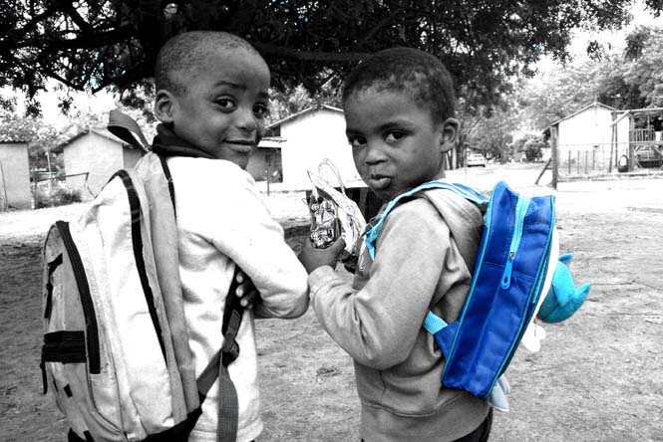
Task
Now answer the following questions:
1. What is the best gift that you have ever received and how did it make you feel?
2. If you could only keep three of your possessions, what would they be and why?
3. If you were to involve your class or school in The Backpack Project how would you go about it?
Now look up the meanings of the word.
Initiative
Write down its meaning.

