Slide 1
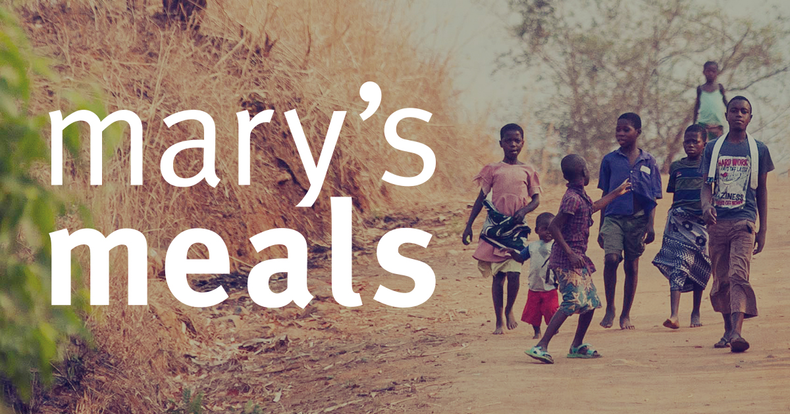
I have considered the Christian vision of the dignity of the human person, made in the image and likeness of God.
I have reflected upon how this has contributed to my becoming the person I am today 3-02A.

Slide 2
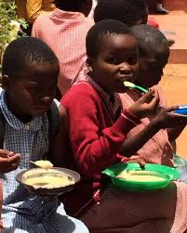
Likuni phala
An account of the first school feeding by Mary’s Meals in two schools in Malawi.

Slide 3
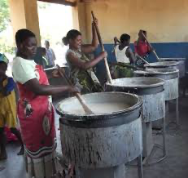
Mary’s Meals
From the outset we were convinced that Mary’s Meals could only be effective and long- lasting, if the local community ‘owned it’. We felt strongly that each school community needed to believe in this project and have a desire to support it at least as much as us. We wanted to avoid, at all costs, the mistake of imposing an idea on people; rather, we wanted it to be theirs more than ours. This would require a genuine respectful partnership in which the local community would give what they could to enable the provision of daily meals to their children, while we would support by providing the food and other required assistance that they were unable to afford. Specifically, this concept would depend on local volunteers making a commitment to organize and carry out the daily work of cooking and serving

Slide 4
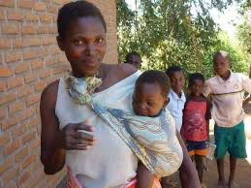
Likuni phala
the food. We were determined to ensure this was not seen as another emergency feeding project, but a very specific, community-owned intervention aimed at schoolchildrenand linked always to education. At Chilomoni, it became clear that the Parent Teachers’ Association (PTA) was the appropriate local body through which to organize. Following some community meetings at which a huge desire and enthusiasm for the Mary’s Meals project was amply demonstrated, the PTA agreed to take responsibility for organizing a rota of parents and grandparents who would take their turn in giving up a morning to prepare the meals.

Slide 5
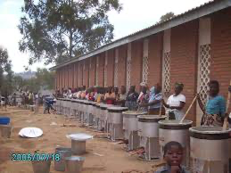
Likuni phala
Another thing we felt very strongly about was that, whenever possible, the food we provided should be locally grown rather than imported. We wanted to support the economy of the country and the local farmers at every opportunity. In Malawi there was an extremely popular porridge for children called Likuni Phala (‘Likuni’ being the name of the place where the dish had been carefully formulated for growing children by some pioneering nuns several years earlier, while ‘Phala’ simply means porridge). It consists of maize, soya and sugar, and is fortified with vitamins and minerals. It has become the dish of choice for Malawian children and their families. Gay knew a company who manufactured Likuni Phala, by buying the raw ingredients from smallholder farmers all over Malawi and processing them into a ready-mix that simply required cooking in boiling water before serving. The choice of this, as the food we could buy and serve, was a very straightforward one. The ingredients – aside from some of the added vitamins, which came from South Africa – were all grown within Malawi and the product was readily available, easy to transport and simple to cook. It was also wonderfully inexpensive!

Slide 6
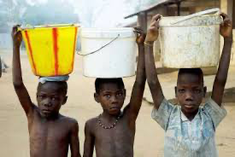
Likuni phala
During January 2003, the first Mary’s Meals were cooked and served at Chilomoni. That same week exactly the same thing was happening for the first time in those remote and hungry villages in Chipini. There, the impressive Medical Missionaries of Mary sisters had organized the school feeding programme, based on exactly the same model of local volunteers cooking Likuni Phala, for seven small primary schools. The rates of child malnutrition were particularly high there, and many children did not attend school because of hunger and poverty. And so it was that Mary’s Meals began in an urban and rural setting simultaneously.

Slide 7
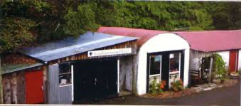
Likuni phala
My first visit to Chipini after the start of Mary’s Meals was, sadly, during another famine, forin 2003 food shortages here were more acute than ever. At Chinyazi primary school, skinny children queued quietly for their Mary’s Meals. Far too quietly. Many of the children walked past me, the white man with the camera, as if I wasn’t there: none of the usual laughing and jostling to get in the picture. It was already noon and they were more interested in eatingfor the first time that day. Little groups of children sat down in the dust and silently ate their porridge. For most of them this would be their only meal of the day. Near the school, outside a mud hut, I saw a ‘gogo’ (grandmother) sitting with her youngest grandchildren and I paid her a visit. She explained that her daughter, the children’s mother, had died and that she was the children’s sole carer. She told me in despairing tones that there was now no maize she could

Slide 8
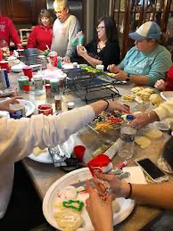
Likuni phala
afford to buy in this whole area. Later on, her two older grandchildren, Allieta and Kondwande, arrived back from school carrying their grubby jotters and empty mugs (in which they had been served their Mary’s Meals). They had more energy now. They laughed when they saw me at their home and proudly showed Granny their schoolwork. They explained that the daily porridge was enabling them to attend school for the first time.

Slide 9
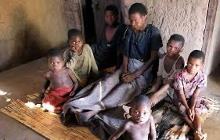
Likuni phala
Within a few months of serving Mary’s Meals a few things became obvious. First of all it was plain to see that this was not just a nice idea. It was something that would actually work.The schools began to report that, after the introduction of the daily meals, children whose attendance rates had previously been very poor, because of illness and hunger, were now attending every day. They also began to see significant increases in enrolment. Children who had never been to school were coming for the first time, sent by parents who were assured their children would now eat every day and were therefore happy to give up the help they might have been providing in the fields and at home.

Slide 10
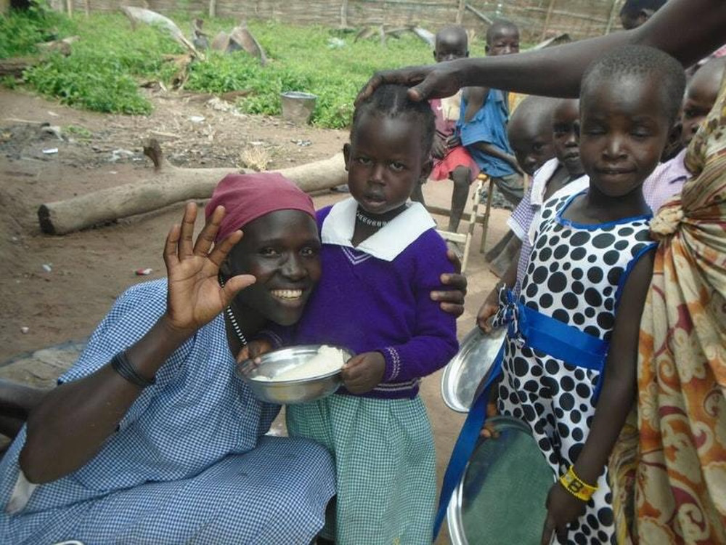
Task
Now answer the following questions:
1. Why do you think that it is important that the Mary’s Meals programme is ‘owned’ by the local community?
2. What are the benefits of purchasing local produce for the meals?
3. What can you do to help people in need?
4. What do the following words mean:
Vitamins
Jostling
Enrollment
Write a definition for each of the words.

