Slide 1
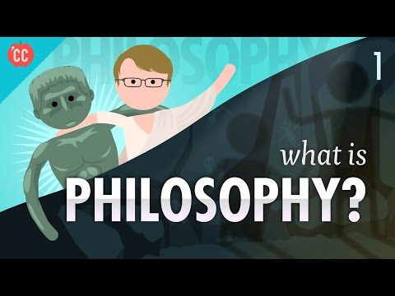
Fourth Year Our Lady's High School Religious Education
Lesson 1

Slide 2
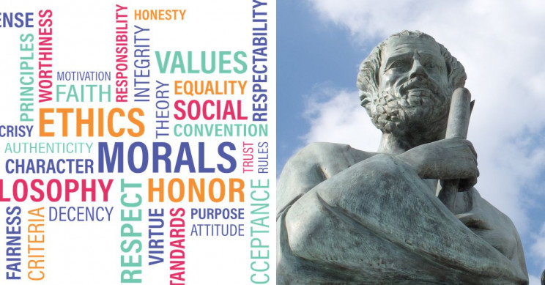
What is Philosophy?
We will have the chance to evaluate our decisions.
Philosophy is the study of 'making sense of the world'.
We will be thinking about 'Big Questions'. What is the world like? What is the nature of reality? Is there a God? What kind of being am I? Do I have a soul

Slide 3
There are three main branches of Philosophy
Metaphysics
The branch of philosophy that studies the nature of reality (the world, the universe and being)
Epistemology
The branch of philosophy that studies the nature and scope of knowledge (e.g Is the world really what I think it is? Is everything I see, think and experience true? how do i know that I am right?)
Value Theory
Ethics - the study of how humans should live with each other.
Aesthetics - the study of beauty and art. (What beauty is and if it even exists)
____________________________
Logic is the philosophers toolbox
Reasoning - what philosophers use to help them answer the difficult questions.

Slide 4
What is Philosophy?
You do philosophy all the time in your daily life.
Try to understand - get inside an idea
Critical evaluation – challenge your understanding of the view of the world.

Slide 5
What is Philosophy?
Let's have a go at doing some Philosophy.
Answer the following question.
What is knowledge?
Don't worry if you can't answer it easily. The point is to get you thinking.

