Slide 1
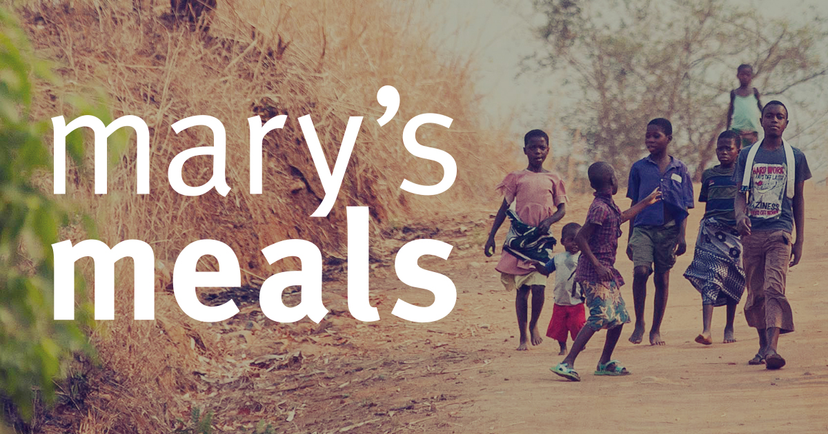
I have considered the Christian vision of the dignity of the human person, made in the image and likeness of God.
I have reflected upon how this has contributed to my becoming the person I am today 3-02A.

Slide 2
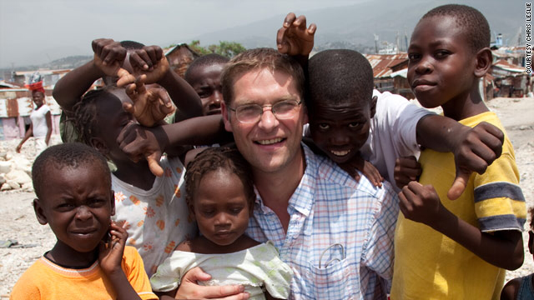
Mary’s Meals
Magnus recalls meeting with 14-year-old Edward, an encounter that inspired the beginning of Mary’s Meals.

Slide 3
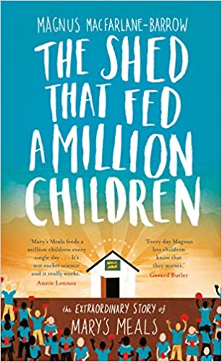
Mary’s Meals
A couple of hours’ drive from Namitembo, along dirt track roads through dry fields, is the parish of Balaka. On arrival here the Italian priests led me to a church which we entered through a side door. I was taken completely by surprise to find myself on the altar, staring down on 550 young children sitting silently in rows. Every one of them was an orphan. Ten years previously the priests here had decided to find sponsors in Italy to support the ten orphans they knew of in their parish. They didn’t intend to do any more than that as they saw no further need. Now there were 8,000 orphans in their parish with the number growing every day. And incredibly, here, and all over Malawi, nearly all of those children orphaned by AIDS were cared for by members of their extended families. Street children and orphanages were not yet known in Malawi. I wondered how different our response in the West might be if we were faced with a disaster that resulted in hundreds of thousands of orphans.

Slide 4
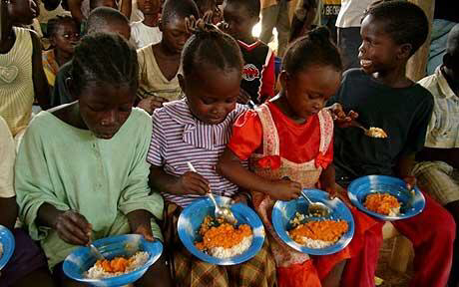
Edward
Father Gamba, a young friendly priest, then asked me if I would like to accompany him to the home of one of his parishioners, who was near death. Thus it was I came to meet that family whose picture remains on the wall above my desk: Emma surrounded by her six children, including fourteen-year-old Edward, who, when I asked him about his hopes in life, gave me an answer I will never forget. ‘I would like to have enough food to eat and I would like to be able to go to school one day’ had been his stark, shocking reply to my question.

Slide 5
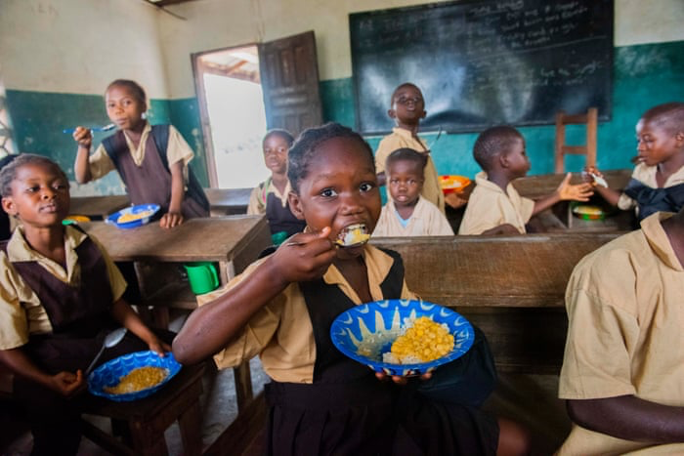
Edward
The extent of the ambitions of that fourteen-year-old boy, spoken as if they were a daring dream, shook me for a few reasons. The greatest of these was a conversation I had been having with Tony Smith, the man from England who had reintroduced us to Gay. He continued to support the work to build the cross, which was now evolving into a more ambitious project which would eventually see the building of an exact replica of the church in Medjugorje and the placing of identical Stations of the Cross up Michiru Mountain. His stays at Gay’s house overlapped with my own and he had been talking to me about something that happened to him about two years previously.

Slide 6
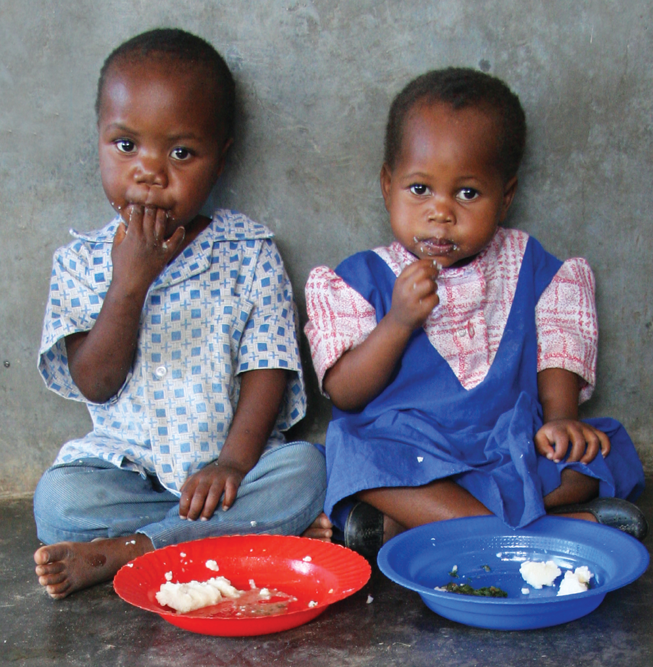
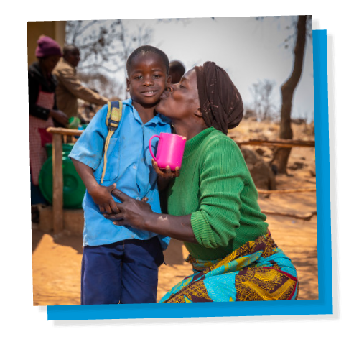
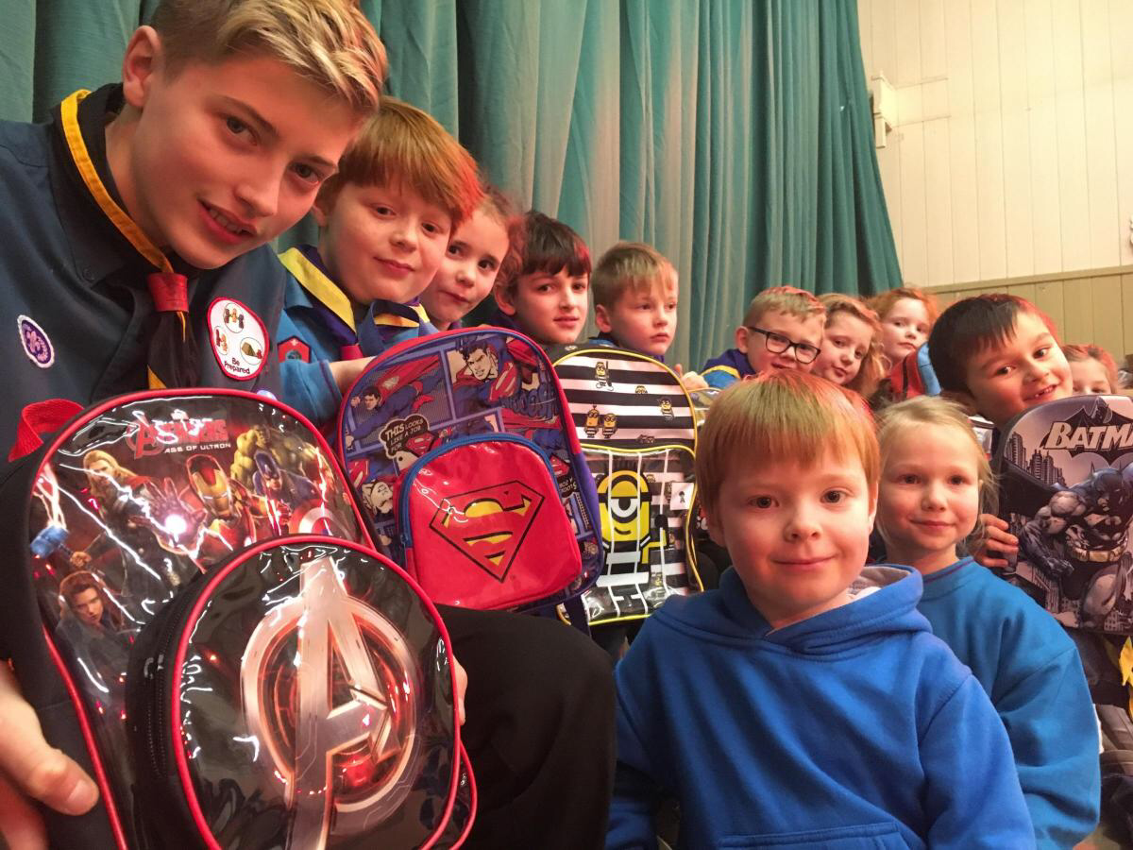
Edward
He had been staying at Gay’s house and feeling depressed at the suffering he saw in Malawi, especially that endured by hungry children. One evening, back at Gay’s, he turned on the TV and found himself watching a speech made by the American Senator George McGovern in which he stated, with some passion, that if America decided to fund the provision of one daily meal in a place of education for every child in the world’s poorest countries it would act like a ‘Marshall Plan’ that would lift the developing world out of poverty. Tony said when he heard this speech he was inspired with the thought that if someone took that concept, gave it to Mary, the mother of Jesus, and called it Mary’s Meals, then it would actually happen. He had talked to Gay about this at the time and discussed the idea of beginning such a programme in Malawi. However, the famine situation then began to unfold in Malawi and the funds he sent to Gay under the name of ‘Mary’s Meals’ were instead used for desperately needed emergency food distribution in an area called Chipini, through some nuns we had now met and were also supporting.

Slide 7
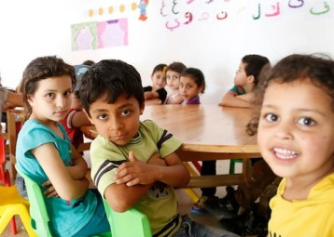
Edward
So much of our experience over the last twenty years came together within this one simple concept. Our devotion to Mary, the mother of Jesus, and our surprising encounter with herin Bosnia-Herzegovina as teenagers, the numerous meetings with impoverished children in the years since who were unable to go to school because of poverty and hunger, the words I had just heard Edward speak, and a growing recognition that the problems faced by the world’s poorest communities would only ever be overcome by people who were healthy and who had, at least, a basic education. The promise of a meal could enable those children who worked for their daily bread now to attend class instead, and would encourage parents to send their children to school rather than keeping them at home to help. We had already seen this happen in a very small way in our project begun a couple of years earlier in Targu Mures for the Roma children.

Slide 8
Edward
Edward was certainly not alone in missing class. Around 30 per cent of the children in Malawi of primary-school age were not enrolled in school, despite the fact there were free school places for all. The need to find food, grow food, do paid casual work, care for dying parents and younger siblings was keeping children out of the classroom. Even if they did enrol, all too often they were unable to concentrate and learn because of their hunger, or their attendance rates were dismal because of their own illnesses. Hungry, malnourished children cannot be good students and many, like Edward, had never even had the chance to try.

Slide 9
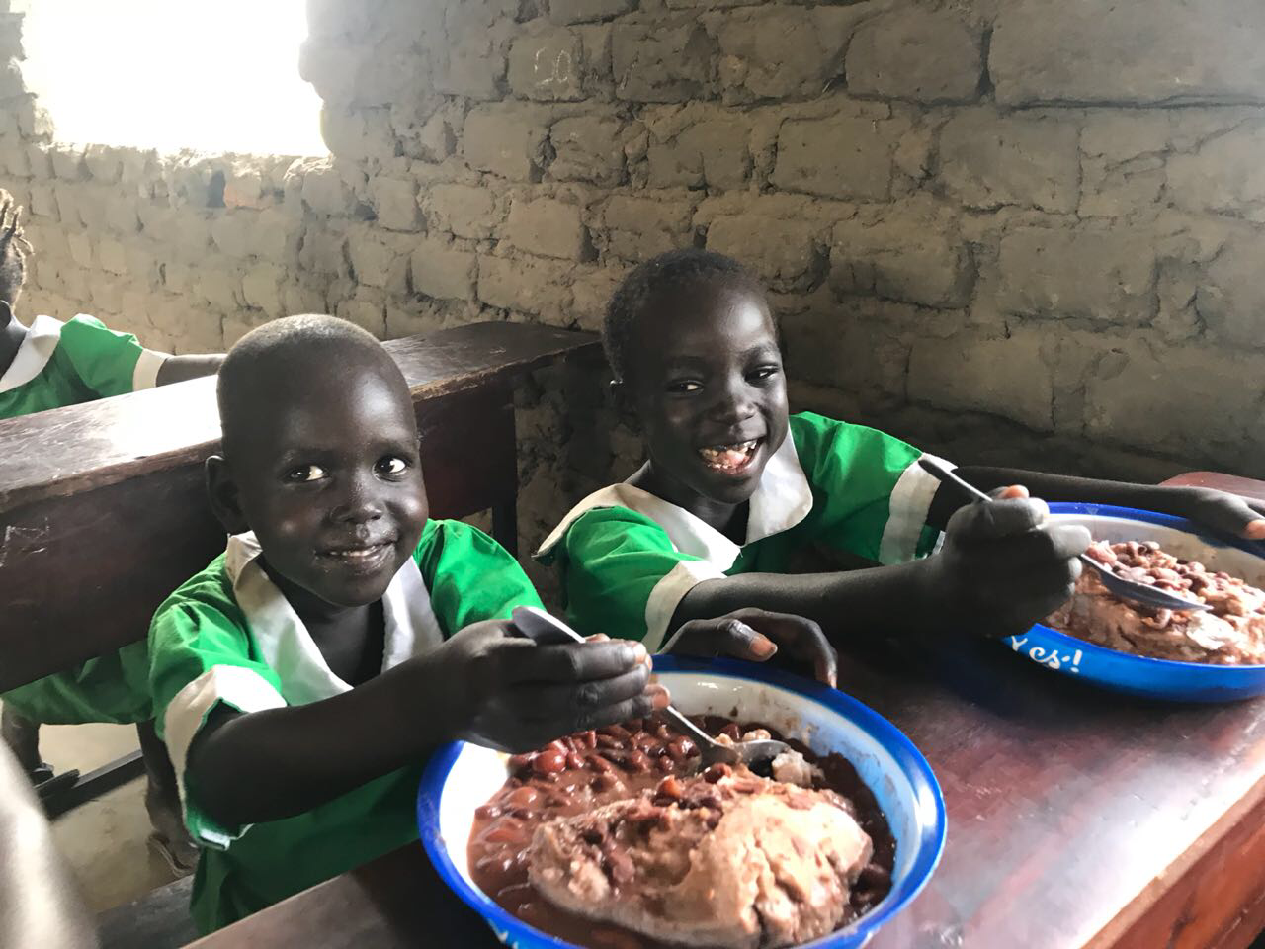
Edward
Over a third of children who die in the world each year do so because of hunger-related causes. Hunger and malnutrition remain, in the twenty-first century, the biggest global health threat, causing more deaths than AIDS, malaria and tuberculosis put together.
Hunger is caused by poverty and poverty is caused by hunger. People suffer chronic hunger not because there is no food, but because they cannot afford to buy it. The world produces considerably more than enough food for everyone. Even in that dire famine situation, Edward, if he’d had money, could have travelled into town and bought his family food. But he had no money and so they starved.

Slide 10
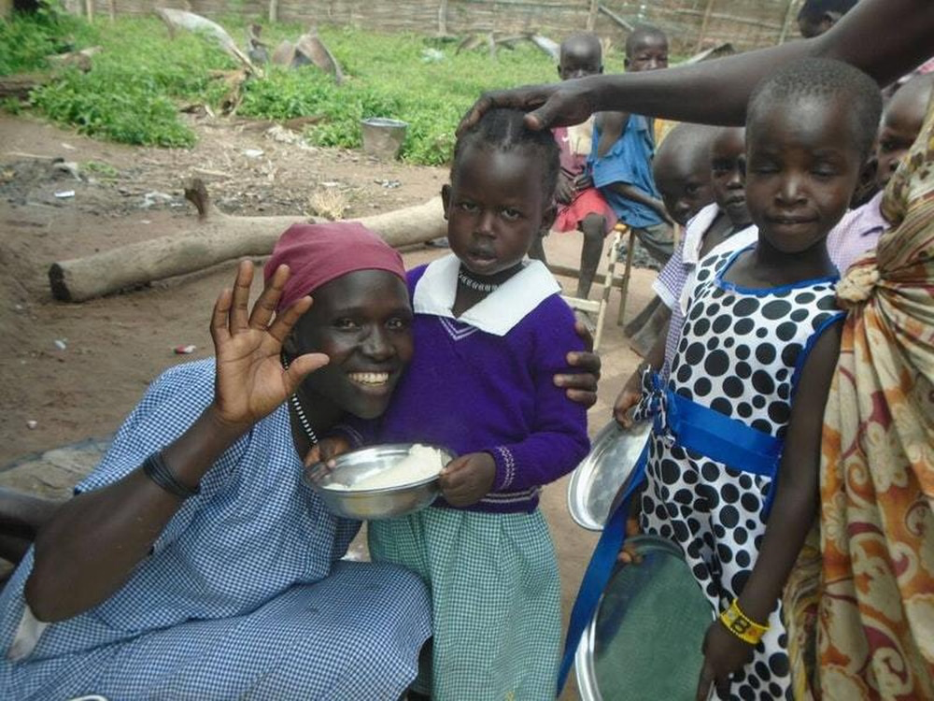
Edward
Chronically hungry children cannot develop physically and mentally, nor can they learn at school, and for both these reasons they are deprived of the ability to work productively and support their families as adults. They cannot live the independent dignified life that every person craves. In the developing world, 43 per cent of children are stunted. They will, for the rest of their lives, be smaller in stature than they should have been (and those lives might be very short given that it is estimated that around 18,000 children die of hunger-related causes every day), while 775 million illiterate adults face an almost impossible struggle to earn enough to survive.

Slide 11
Edward
The first thing to do for the hungry child is to give them food. Every parent, every person, knows that. But it is clear that the gift of even a basic education is essential too, if chronic hunger is to be truly vanquished. How can people learn how to irrigate their fields, make fertilizer or diversify their crops if they cannot read or write? How can they pursue other ways to make a living and create wealth beyond growing what they eat? How can illiterate people hold their governments to account? How can they defend themselves against corruption? Or combat the spread of HIV/AIDS? How can other pressing health needs be addressed without first ensuring the growing child has enough to eat?

Slide 12
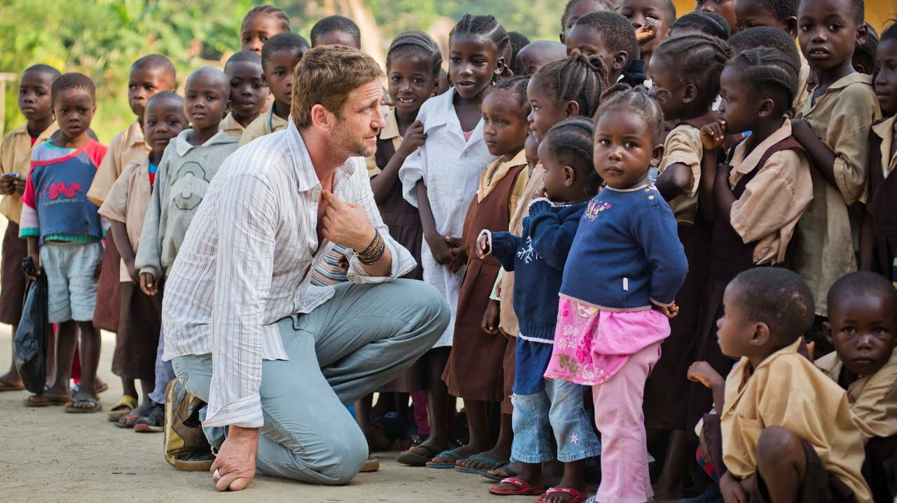
Edward
Thus, the mission of Mary’s Meals, to provide one good meal every day in a place of education, for hungry impoverished children, was launched by Edward’s words.

Slide 13
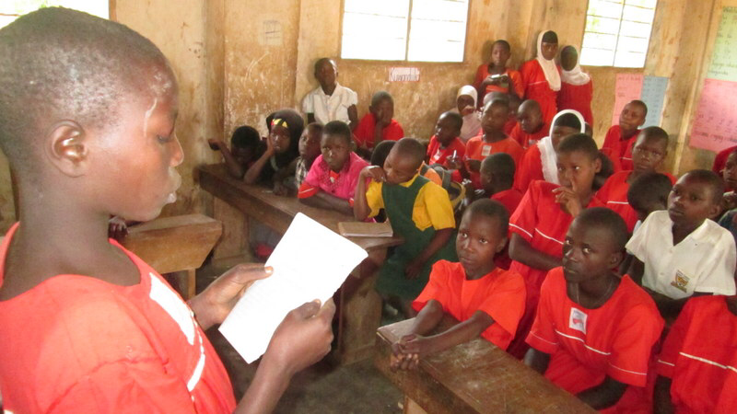
Task
Now answer the following questions:
1. What are your hopes and dreams for the future?
2. How do your hopes and dreams contrast with Edward’s?
3. Imagine you were not able to read or write, how would that restrict you in your daily life? How might this make you feel?
4. What do the following words mean:
Ambitions
Malnourished
Stunted
Illiterate
Vanquished
Corruption
Write a definition for each of the words.

