Slide 1
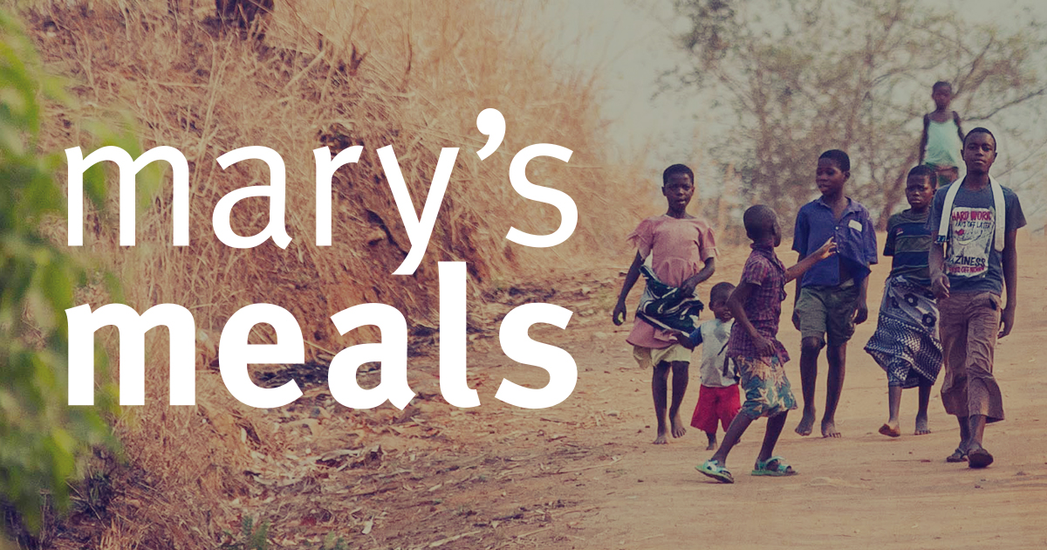
I have considered the Christian vision of the dignity of the human person, made in the image and likeness of God.
I have reflected upon how this has contributed to my becoming the person I am today 3-02A.

Slide 2
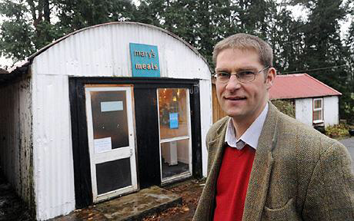
Mary’s Meals
Mary’s Meals provides one good meal to some of the world’s poorest children every school day.Our work is named after Mary, the mother of Jesus, who brought up her own child in poverty. Mary’s Meals consists of, respects, and reaches out to people of all faiths and of none.

Slide 3
Mary’s Meals
‘The Shed that Fed a Million Children’ was written by the founder of Mary’s Meals, Magnus MacFarlane-Barrow. The next few lessons will focus on extracts from that book.

Slide 4
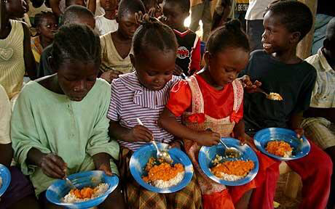
Where to Begin?
Of course the idea of serving meals in school is hardly original. Most school children take it for granted they will eat each day. I certainly did. Each morning in our little primary school in the Scottish Highlands, a sense of anticipation built as a van carrying steel containersof food, cooked at the bigger school at the other end of the loch, arrived at our gates. At least I think that is where it came from – it was always a bit of a mystery to me. We would carry them inside, guessing what might be in them. To find that the bigger containers held steaming meatballs and mashed potatoes made it a good day, although that was a short- lived feeling if the smaller lids were then opened to reveal rhubarb crumble. But I cannot ever remember going through a school day without eating, or even contemplating such a thing.

Slide 5
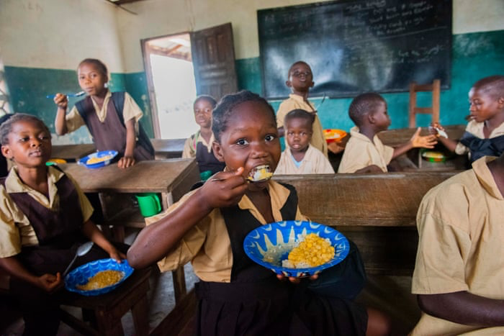
Where to Begin?
School meals are accepted as essential across the developed world, whether they are funded by governments or by parents handing over ‘dinner money’. In fact, globally, around 368 million children are fed daily at school, but while nearly every child benefits in this way in the world’s richest countries, only around 20 per cent of children in the developing world are provided school meals, with the UN’s World Food Programme feeding nearly 15 million of them. Meanwhile 57 million impoverished children remain out of school, while 66 million more attend the classroom hungry and unable to learn properly.

Slide 6
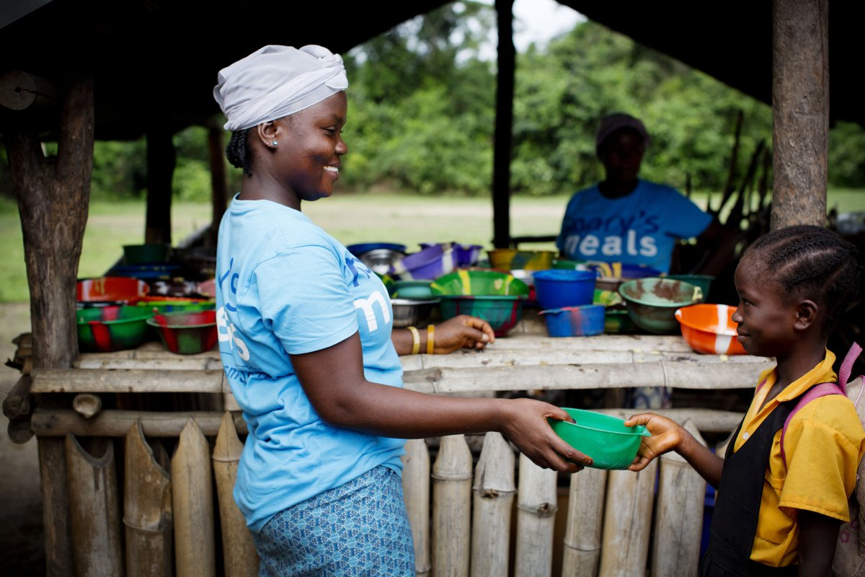
Where to Begin?
The more we talked and thought about Mary’s Meals, the more the beauty of this idea captured Ruth and me. The board and all those involved in Scottish International Relief back home were immediately supportive of the proposal to start this new campaign. We decidedto set up a branch of Scottish International Relief in Malawi to begin this work there (as wellas the various other projects we were by now committed to in that country). Gay Russell dida huge amount of work to get the organisation set up in the right way, roping in a friend in Blantyre who was a lawyer, and before long she joined Tony Smith and me as the first Trustees of the new Malawi organisation. Meanwhile we began fundraising for our new Mary’s Meals campaign.

Slide 7
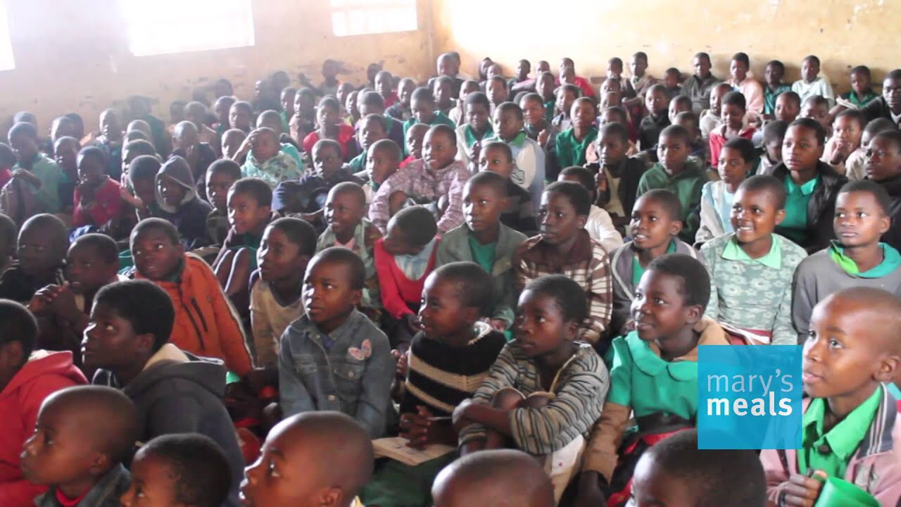
Where to Begin?
We all agreed that the vision of Mary’s Meals should be for every child to receive a daily meal in their place of education. Clearly there was a lot of work ahead of us. We just had to decide where to begin.

Slide 8
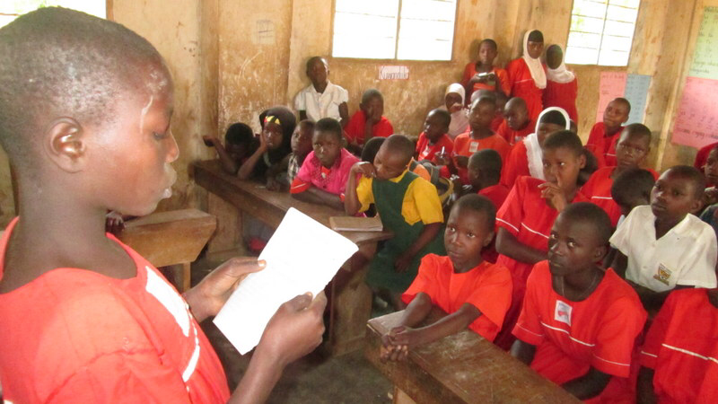
Task
Now answer the following questions:
1. Describe the link between food and learning?
2. Do you remember a time when you couldn’t do something because you were hungry? Give an account of that time.
3. Can you think about some of the reasons why so many impoverished children remain out of school or unable to learn.
4. What does the word impoverished mean? Write a definition for impoverished and give a few examples of “impoverished” situations.

