Slide 1
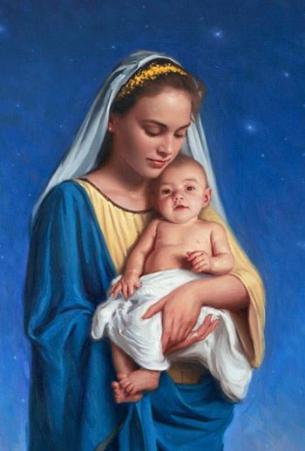
Honouring Mary in the Catholic Tradition
Mary
Second Year

Slide 2
Honouring Mary in the Catholic Tradition
By the end of the lesson I will be able to explain the place of Mary in the Church’s Liturgy.
I will be able to describe the place of Mary in the prayer life of individual Christians.
I will have considered the importance of Mary in my own prayer life.

Slide 3
Mary in the Prayer Life of Catholics
Catholic families bring their children up to love, Mary, the Mother of God.
Catholics sometimes carry Miraculous Medals, and use rosary beads when they pray. A lot of Catholics love praying the Hail Mary, the Hail Holy Queen and the Memorare which are devotional prayers to Our Lady.

Slide 4
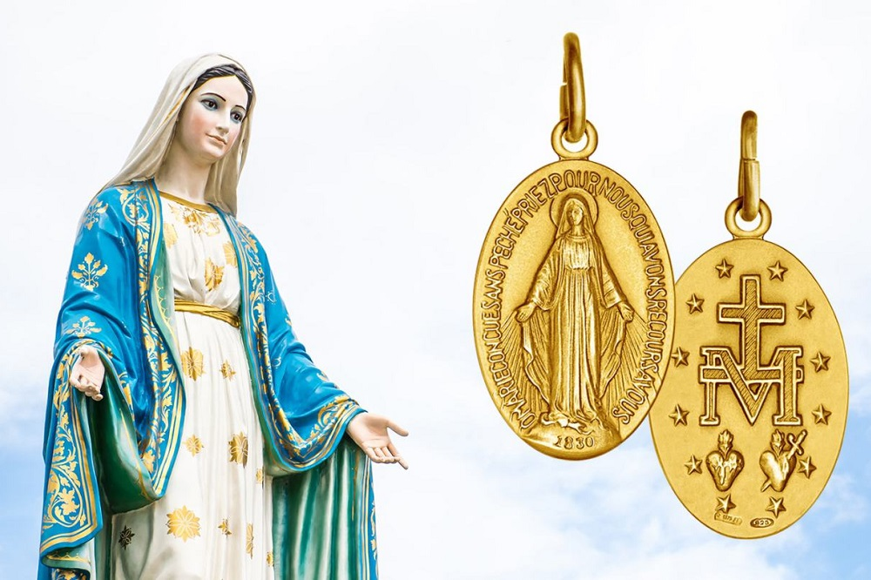
The Miraculous Medal
The Miraculous Medal is a symbol of devotion and love to Our Lady.
Many Catholics believe that the Medal provides them with a special grace and supports them when they are experiencing difficult times in their lives.
Some Catholics use the Miraculous medal to remind them that they are not alone. They believe that The Medal is a reminder that their perfect and loving Mother, Mary is supporting and sustaining them throughout their lives.

Slide 5
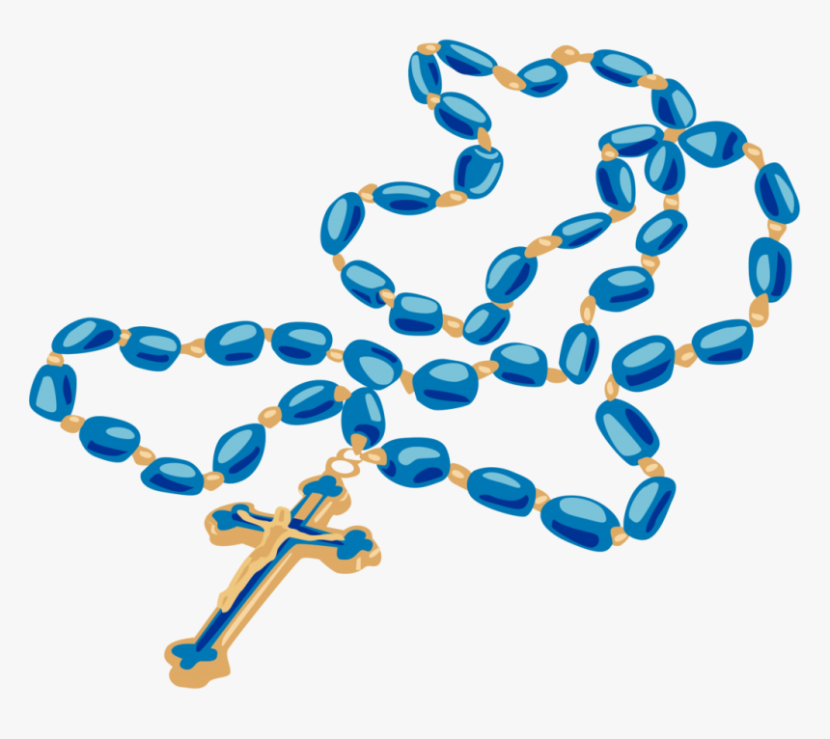
The Holy Rosary
Catholics pray the Rosary to ask God for special favours. These might include: helping a loved one recover from illness, or to thank God for blessings received.
When they pray the Rosary, Catholics are asking Mary to intercede for them. This means that they want her to pray to God on their behalf.
Catholics use Rosary beads to help them keep track of the prayers.

Slide 6
The Holy Rosary
Who Can Pray the Rosary?
Anyone who knows six easy prayers can pray the Rosary.
There are twenty Mysteries to meditate upon as you pray.
.The Order of Prayers
The Rosary begins with the Apostles Creed, followed by one Our Father, three Hail Marys (traditionally offered for an increase in faith, hope and a Glory Be.
Next come five mysteries, each consisting of one Our Father, ten Hail Marys, and a Glory Be. Conclude with the Hail Holy Queen.

Slide 7
The Mysteries of the Holy Rosary
The purpose of the Rosary for Catholics is to remember some important events in the history of our salvation.
There are twenty mysteries reflected upon in the Rosary, and these are divided into:
the five Joyful Mysteries
the five Luminous Mysteries
the five Sorrowful Mysteries
and the five Glorious Mysteries

Slide 8
Task A:
Find out as much as you can about the Miraculous Medal.
Produce a leaflet explaining what it is and how Catholics use it.
OR
Make a users guide which explains how to pray the Rosary using a set of rosary beads.

Slide 9
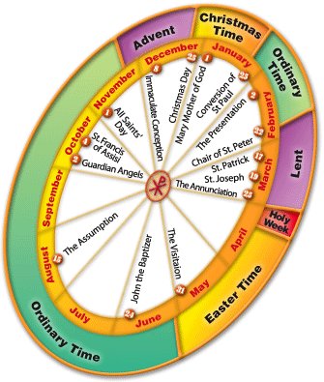
Mary in the Liturgical Calendar
The Church organises its calendar around the liturgical Year. This allow the year to be divided into seasons and also marks special feast days.
Mary is such an important figure for Catholics that there are a large number of Feast days dedicated to her. Some of the Marian feast days which Catholics celebrate are:
1 January – Mary Mother of God.
25 March – Annunciation
15 August – Assumption
September 8 – Our Lady’s birthday
October 7 – Our Lady of the Rosary
December 8 – The Immaculate Conception
Catholics dedicate the Month of May to Our Lady and the month of October to the Holy Rosary.

Slide 10
Task B
Choose a Marian Feast day and plan a celebration for that day (you should include some prayer, some food and a list of people that you would want to invite)
Or
Make an information poster about one of Our Lady’s Feast Days.

Slide 11
Mary in my own faith life
Write a paragraph for you journal which explains how Mary impacts your own faith.
Do you pray to Mary?
Do you enjoy singing hymns to Our Lady.
Give as much detail in your answers as you can.

Slide 12
I can:
Explain the special place that Mary has in the Catholic Church’s Liturgy, by referring to the Liturgical year and the Feast days dedicated to Our Lady.
Describe the important place of Mary in the prayer life of Catholics by explaining the significance of the Holy Rosary or Miraculous Medal to Catholics.
Reflect on the importance of Mary in my own prayer life.

