Slide 1
Holy Week
Our Lady’s High School

Slide 2
Introduction
This year, our Lent has been somewhat overshadowed by what is going on in the world.
More than ever before, we are experiencing what it means to go without. We are having to give up coming to school and seeing our friends, we are missing out on our clubs and sports that we take part in after school, we are not getting to see our grandparents. It’s hard on all of us.
On Easter Sunday, we will share the joy of Jesus’ resurrection.

Slide 3
Passion Sunday
Holy Week begins on the Sunday before Easter, with Passion Sunday. On Passion Sunday we remember that Jesus came in to Jerusalem, like a celebrity and everyone cheered and waved palms.
Task (on your own or with your family)
Trace round your palm (as many times as you like)
Colour the hand in and write the name of people you wish to thank, you can do this many times and make a colourful Palm tree.

Slide 4
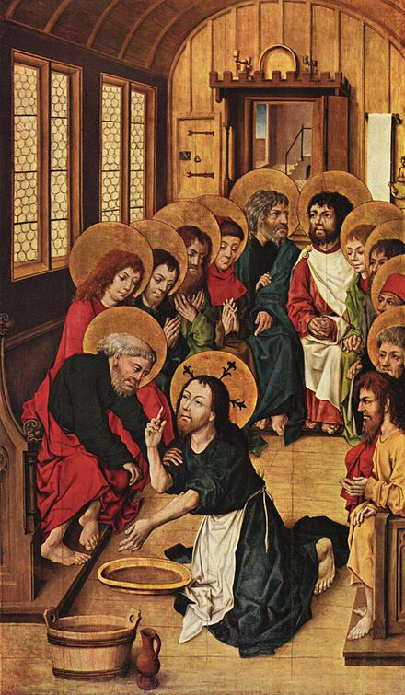
Holy Thursday
On Holy Thursday, Jesus washed the feet of his disciples.
This year, we are more aware than ever of the need to keep clean, soap has even become difficult to get in the supermarket.
In Biblical times, servants were given the job of washing the feet. Jesus was showing his disciples that he wasn’t just here on earth to be a king or celebrity, but to serve others.
Task:- Be like Jesus and be a servant, do something kind for someone in your family.

Slide 5
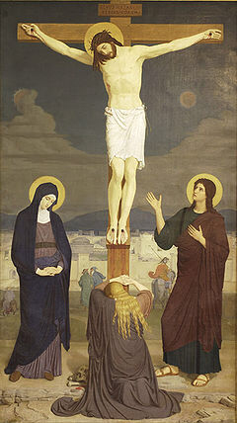
Good Friday
Good Friday is known amongst Catholics as the darkest day in the year. On this day, the tabernacle is left bare. For us, this year, it will be darker than ever. We won’t be able to go to Church on Good Friday to kiss the cross.
Task:- Kiss a crucifix at home.
Watch your parish 3pm service online.

Slide 6
Easter Sunday
Rejoice – Alleluia!!!
There is hope – Jesus has risen from the dead. Alleluia!
Task:-
Make some hard boiled eggs and paint them, or use felt tipped pens. Remember that Jesus has Risen – the egg is the symbol of New life and hope. We have hope that soon we will get to go back to school, that we will see all of our friends and that we will get our Freedom Back.

Slide 7
Wishing you and all your family a very happy and holy Easter. From everyone in The RE department at Our lady’s High School.

