Slide 1
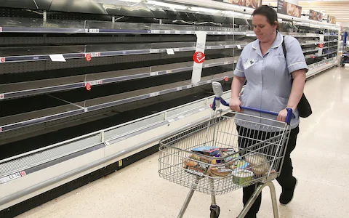
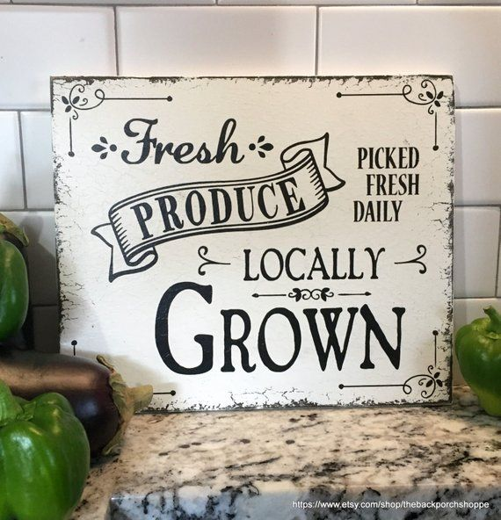
Contemporary Food Issues
Lockdown - May 2020
We have been learning about different topics throughout S3.
In this current lockdown situation we are all living through, the way we shop and eat will have changed for many of us.

Slide 2
Contemporary Food Issues - a country in lockdown
Let’s think about some contemporary food issues we are facing right now, which are new to us.
Cafes, coffee shops and restaurants are now closed. What happens to all this food which they would normally order for their business?
Many take-away shops are closed, or doing deliveries only, which can take a long time to receive your delivery.
Supermarkets are operating reduced opening hours
Consumers are facing shortages of some food items
Some food items are being restricted to only 2-3 per customer, to allow more shoppers to buy items they need.
More people are now baking and cooking meals at home for the family.
Local food businesses and suppliers are working harder than ever to supply and deliver food to those most in need.

Slide 3
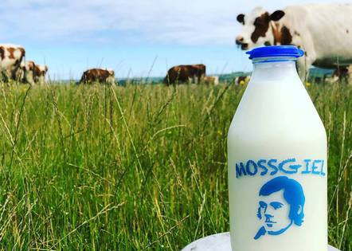
Watch
One farmer in East Ayrshire is dealing with the crisis to his business and how he is helping the local community. Click on the website to find out more.
Mossgiel Farm
https://mossgielfarm.co.uk/community-support/

Slide 4
Pupil Writing Task
Write a paragraph or prepare a short powerpoint presentation on how this lockdown has affected the way you shop and prepare food.
Some of the things you could talk about could include:
Some of the meals you have been eating at home, who is doing most of the cooking at home.
Learning new skills to prepare, cook or bake food at home. Have you cooked any meals for the family?
Who is doing most of the shopping for food? Talk to them and ask them if there were any food items they could not get, and what they do about it.
Have you been getting any local food delivered?
How has this lockdown affected you and your family

