Slide 1
Home Economics at a distance
Let’s continue improving our skills in your kitchens for a change ☺
Use this time at home as an opportunity to show your family what you have learned so far in Home Economics.

Slide 2
Our plan…
Hopefully this PowerPoint will give you ideas on how you can continue to improve your cookery skills and processes whilst not in school. Here is a quick reminder on what these are.
Don’t forget about:
Weighting and Measuring, Hygiene and Safety , Testing for Readiness
Cookery Skills | Cookery Processes
Chopping Slicing Dicing Peeling Grating Rolling Whisking Kneading Creaming | Boiling Simmering Baking Roasting Frying Grilling Stewing Steaming Poaching

Slide 3
weighing and measuring
When BAKING, weighing and measuring has to be exact for the cake to rise, cookies to cook evenly and most important of them to taste good at the end.
Whereas COOKING is a little bit different. You can add more/less of some ingredients to suit your tastebuds.
*Measuring Jug - in ml – over 50ml.
*Measuring Spoons in ml – under 50ml.
*Scales - in grams (g).

Slide 4
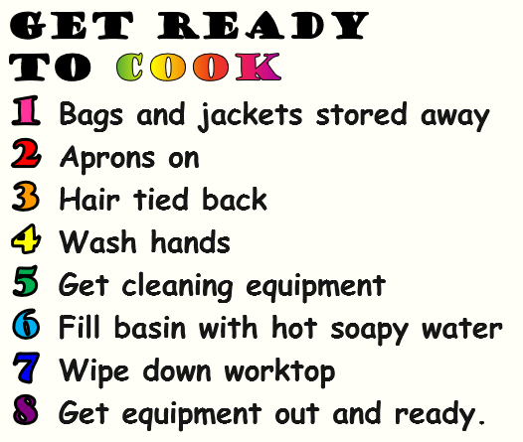
Safety and Hygiene
Being hygienic is rule #1 when in the kitchen, you don’t want to make someone ill because of poor hygiene. You can follow the basic instructions which we use in class.
Your safety is important and if you are not confident using the cooker on your own then ask for an adult to supervise.
Remember to use oven gloves, turn pot handles in, turn cooker off after use and remember it can take some time to cool down.

Slide 5
Testing for readiness
There are a lot of ways to test for readiness and it will depend on what you are cooking/baking. One of main ways to know it is ready is by following the time given on the recipe so remember to check the clock or set a timer at the start of cooking time. However, every cooker is a but different so we have to use tests for readniess.
Cut Test
Cutting food tells you everything you need to know. Can you see any raw/pinkness? Was the veg easy to cut? etc.
Touch Test
With some food we are able to use our sense of touch to see if it’s ready for example cakes will be springy to touch.
Taste Test
With some foods such as soup the food is boiling or simmering for a long time and you are tasting to see if the flavours have developed.

Slide 6
Week 1 – Prepare a Veg
This week we are going to be looking at Cookery Skills. Preparing ingredients is a good way to improve concentration, accuracy and time management.
Task 1
Find a fruit or vegetable that you are allowed to chop. There is a selection of recipes which you can use to make something later so the ingredient doesn’t go to waste.
You will also need a Vegetable Knife and a chopping board. You might need a Peeler and Grater.

Slide 7
Week 1 – Prepare a Veg
Task 2
You are now going to chop our chosen vegetable/fruit. If there is a skin on it and you don’t want to eat it, peel it.
Now there is many ways we can prepare a vegetable. On the next slide will be different ways to cut them.
Ranging from Easy to Hard. Do the one you feel most comfortable with but also think about what food you have. Grating an onion is not easy, but slicing is so you have options.

Slide 8
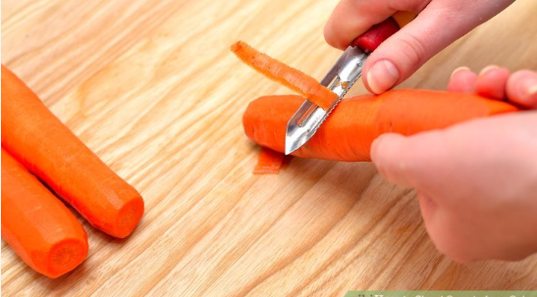
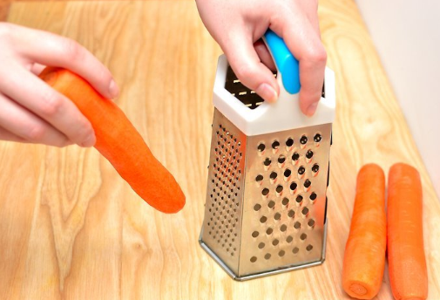
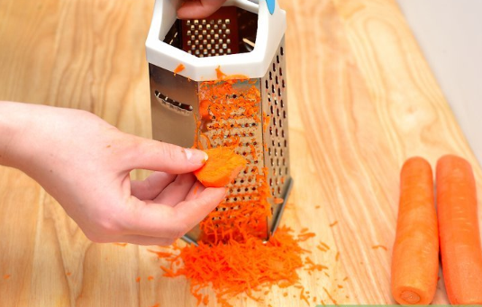
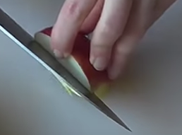
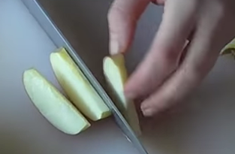
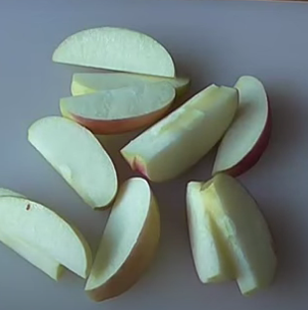
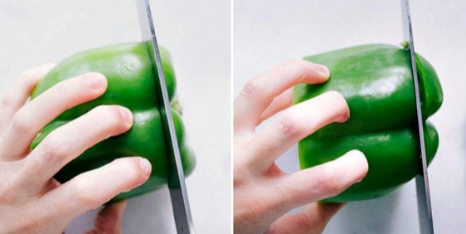
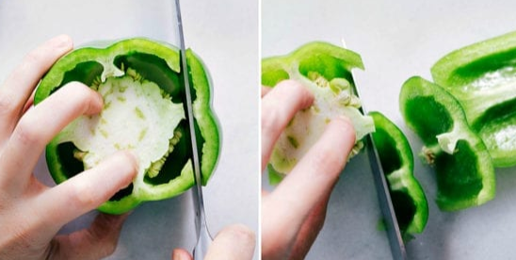
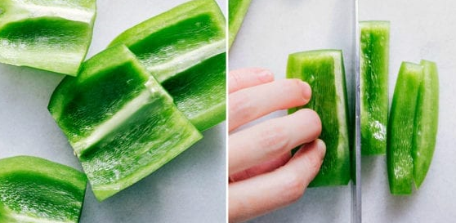
1.
2.
3.
4.
Grate
Chop
Slice
Dice

Slide 9
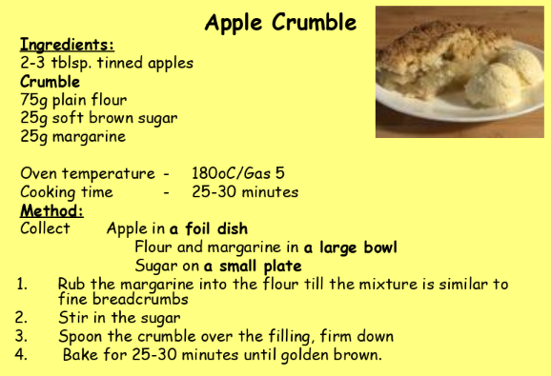
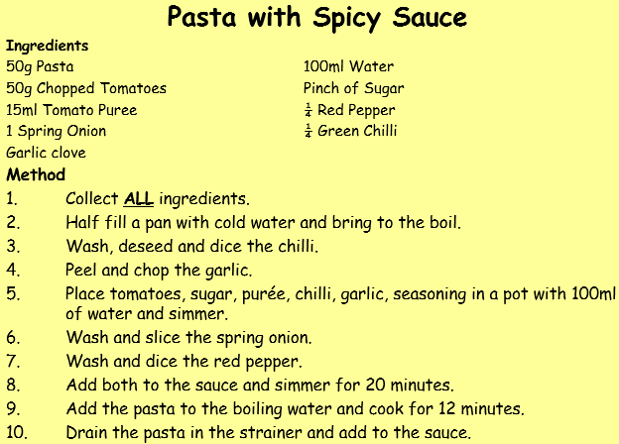
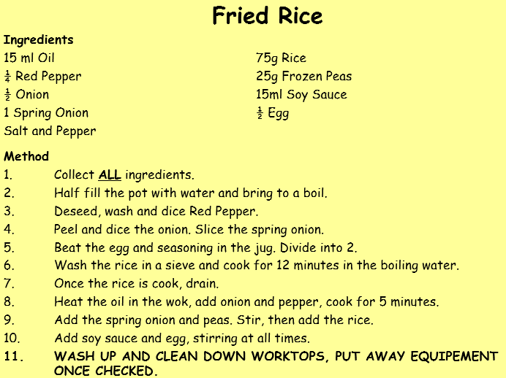
Recipes for Week 1
Chopped Fruit can make a lovely Fruit Crumble
Any veg cuts can be made into Tomato sauce for pasta
Any veg cuts can be made into Stir Fry, just change rice to noodles =)
OR EAT THEM RAW!!

Slide 10
Week 1 – Next steps
We want to see what you have achieved this week.
Photos of you in the kitchen preparing would be great, email them to your teacher. This will help with next year course too.
If you want to get fancy with TikTok, send us a video of you preparing and celebrating your skills improving!!

Slide 11
Week 2 – Boil vs Simmer
Ok, so this week we are going to be looking at Cookery Processes, mainly Boiling and Simmering. It is one of the easiest ways of cooking.
Task 1
Hob Safety. When using the Hob, you need to remember to keep handles turned in, the pot/pan will get hot too and sometimes, depending on the type of handles your pot/pan has, it can get hot too. Make sure the surface around the hob is clear, specially if you have a gas hob. Also, NEVER use metal spoons to stir, leave utensils in the pan/pot or in the hole of the handle.

Slide 12
Week 2 – Boil vs Simmer
For Boiling and Simmering, you will need to collect:
Your equipment may be different to what we have in the classroom kitchen, but don’t worry it will still work the same.
Task 2
There are many things we can boil. Some ingredients need prepared such as potatoes whilst some do not like pasta and eggs. On the next slide, there is a range of ingredients which you can boil. Pick one which you are allowed to use in the kitchen.
Pot/Pan with it’s Lid,
Wooden Spoon,
Oven Gloves,
Sieve/Colander

Slide 13
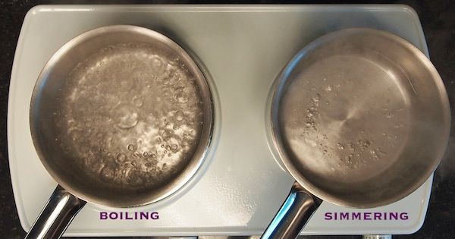
Week 2 – Boil vs Simmer
But first ... We need to know the different between Boiling and Simmering.
Task 3
When working with water, we need to be very careful.
A simple way to remember which one which…
Big bubbles = Boil
Small bubbles = Simmer
Big bubbles for Boiling
BB
Small bubbles for Simmering
SS

Slide 14
Ingredient | Prep Required | Approx Time Required | Level of Easiness | Possible Dish Idea
Egg | None | Soft boil: 5-7 mins Hard boil: 10-12 mins | 4 | Egg Mayo Sandwich Egg and Soldiers Eggy Mashy in a Cuppy
Root Veg such as Potato, Carrots, Parsnips | Wash, peel and chop into even sizes | Depends on size but from 10-30 mins | 2 | Potato Salad Boiled Carrots as a side Root Veg Mash
Pasta | Weigh out into a bowl | 8-12 mins | 5 | Macaroni Cheese Pasta Bake Spaghetti Bolognese
Rice | Weigh out into a bowl, rinse the rice under cold water. | 15-20 mins | 5 | Chilli and Rice Curry and Rice Rice Pudding
Cous Cous | Weigh out into a bowl | 3-5 mins | 5 | Cous Cous Salad Roast Veg + Cous Cous Tagine + Cous Cous
Noodles | Weigh out into a bowl | 4-8 mins | 5 | Stir Fry Ramen/Noodle Soup Chow Mein
Tin of Baked Beans or Soup | Open the tin | 3-6 mins | 4 | Beans on Toast Soup and a roll

Slide 15
Week 2 – Next steps?
We would love to see what you have achieved this week.
Photos of you in the kitchen boiling and simmering would be great. Email them to your teacher to show the good work you are doing. This will help with next year course too.
If you want to get fancy with TikTok, send us a video of your boil and simmer as well as celebrating your skills improving!!

Slide 16
Week 3 – Organisation and Baking
Organisational skills are very important in Home Economics. Think about the units it our classroom, everything has a place so we know where to find it and therefore save time meaning we can focus on the task set.
Task 1
Find a cupboard that needs organised. It doesn’t have to be kitchen related, it can be in your bedroom, under the sink in the bathroom or cupboard under the stairs.
You are going to take a photo Before. Take everything out, maybe a photo for During. Look through everything, do you need it? Is this the best place for it to be kept?

Slide 17
Week 3 – Tips for Cleaning
You might find some upbeat music helps to motivate you.
Sort into piles. Keep, Bin, Donate.
What about categories? All the pasta together, tinned peaches, herbs and spices etc.
Don’t forget to clean the cupboard after you have emptied it. Fairy Liquid and water is great to remove dirt and grease. You might need to use some of your muscles to remove some strains. Also remember to dry the cupboard.

Slide 18
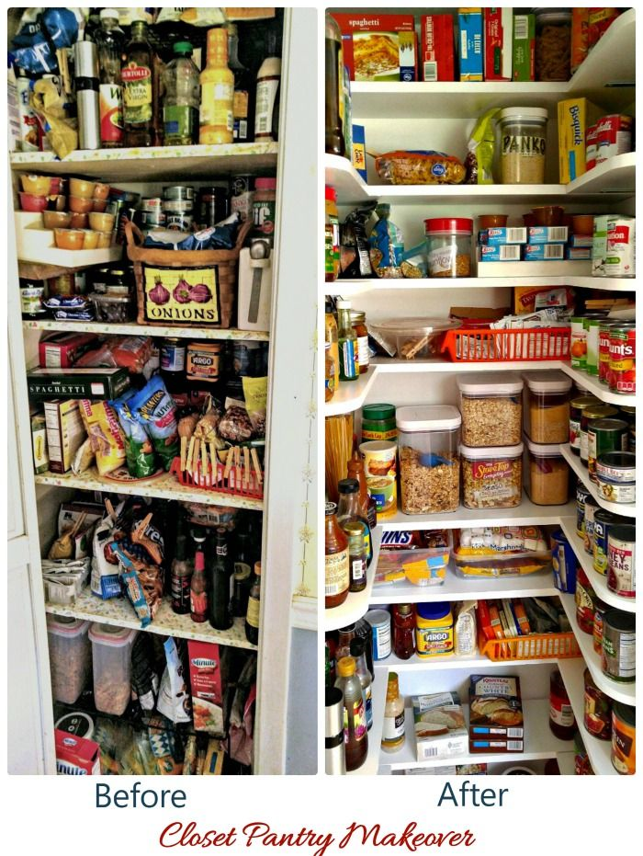
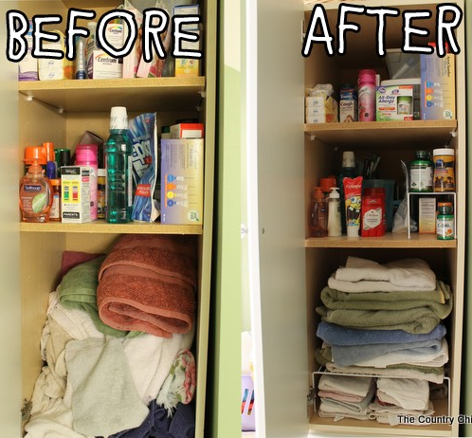
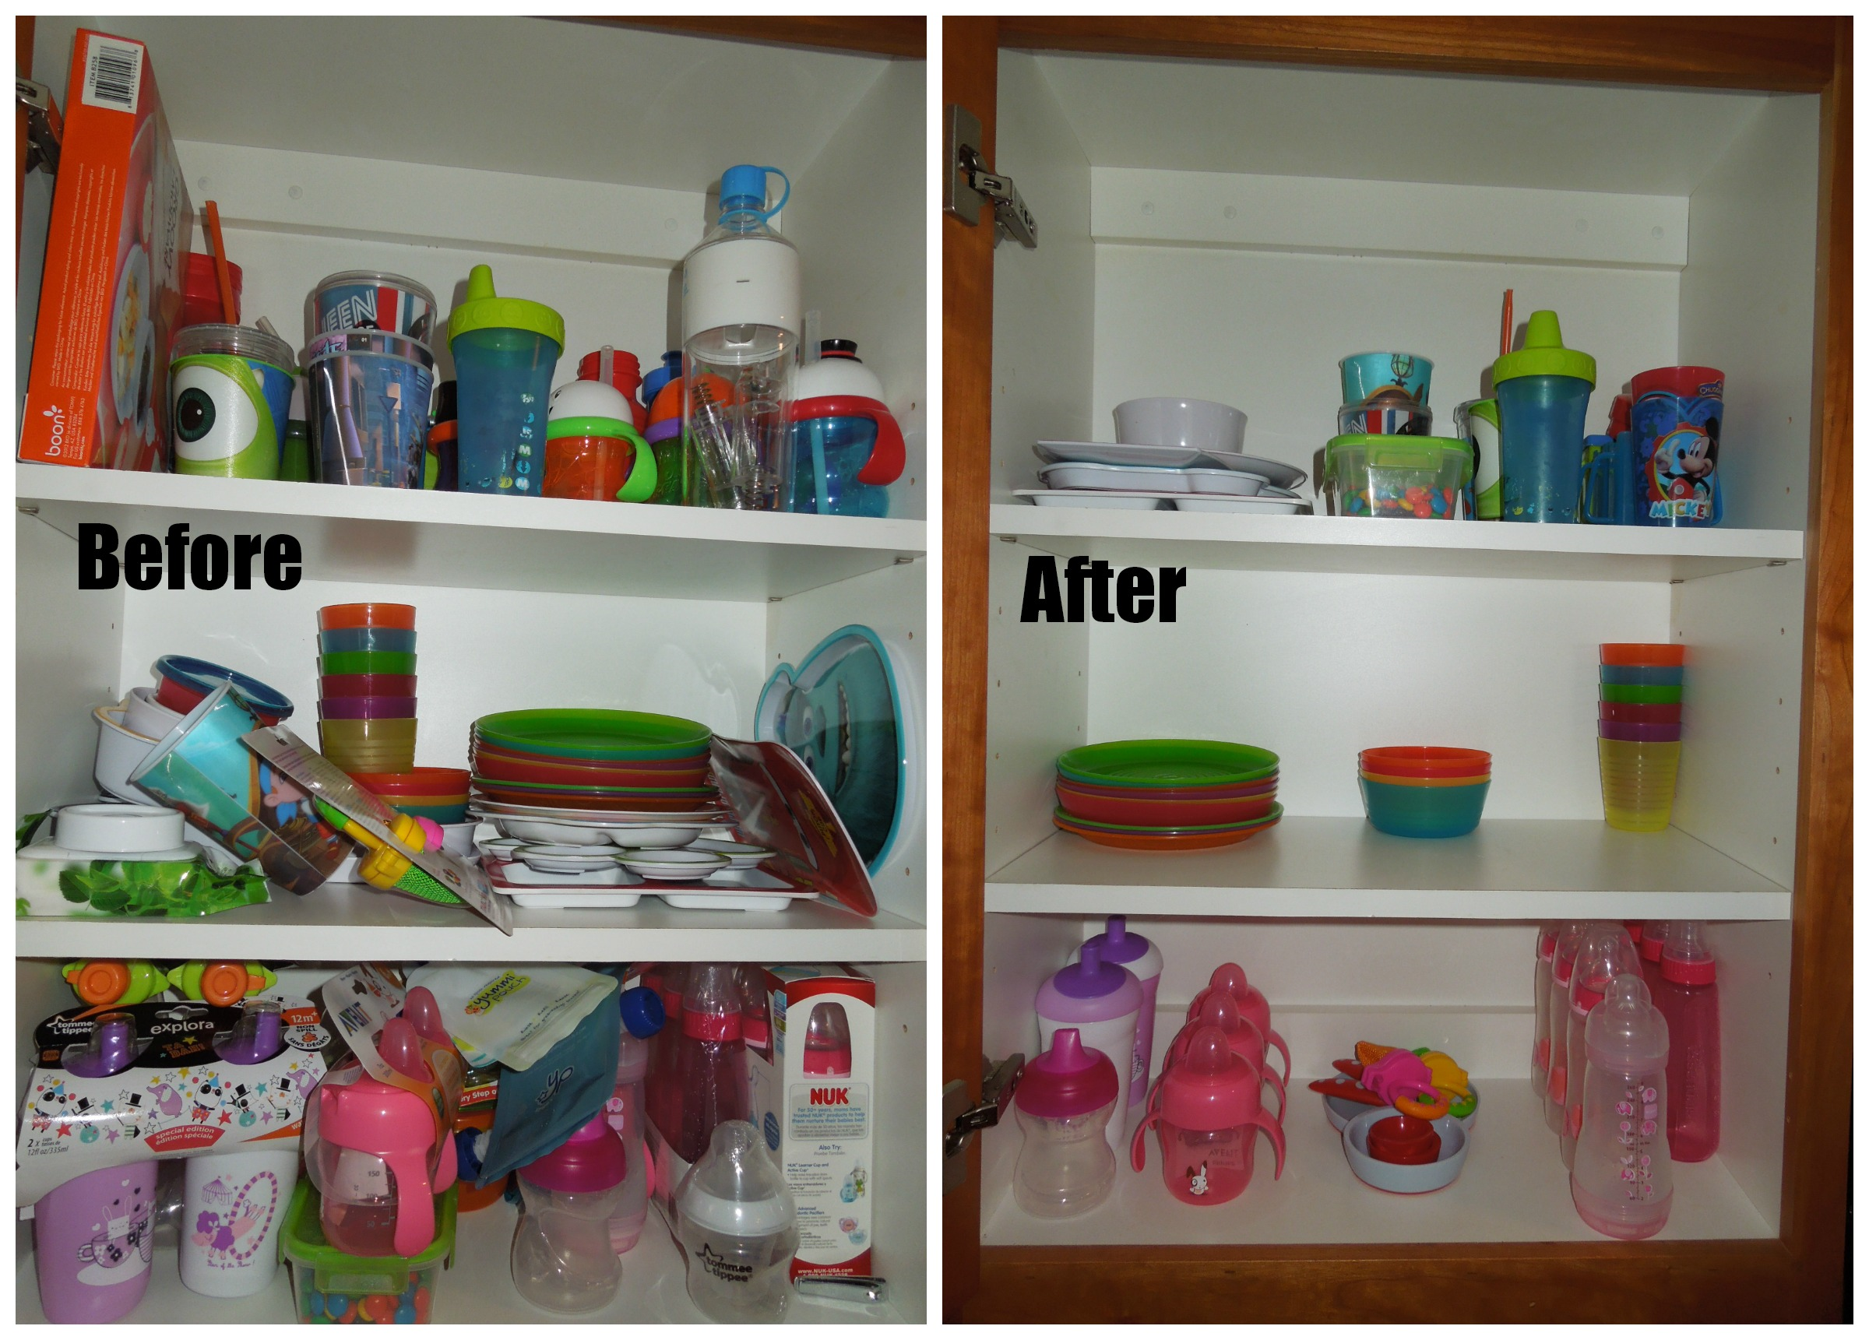
Week 3 – Before and After
Here is a collection of some Before and Afters of Cupboard cleaning.

Slide 19
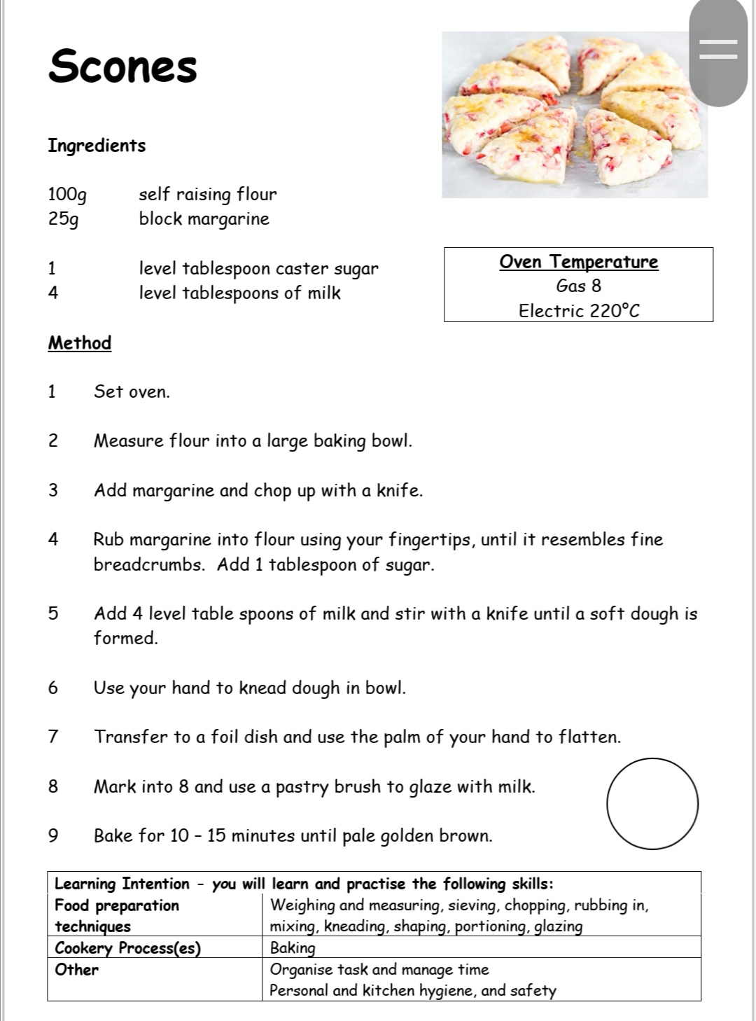
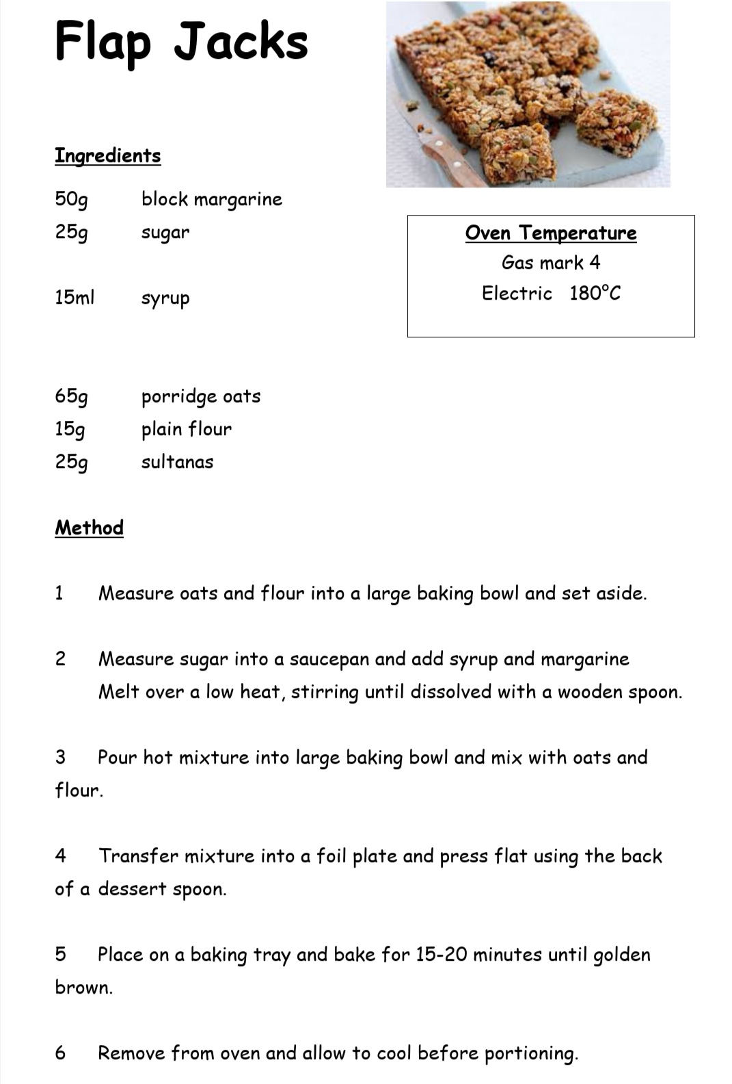
Week 3 – Baking

Slide 20
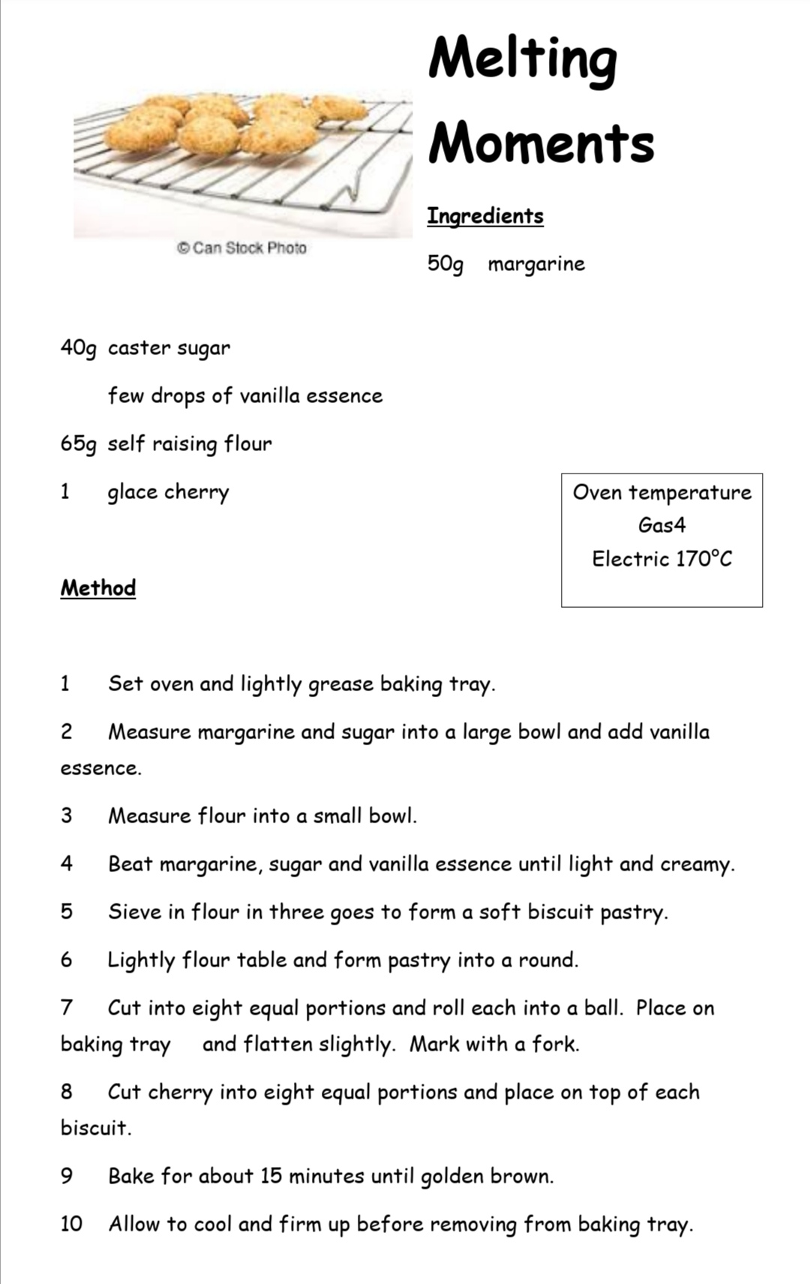
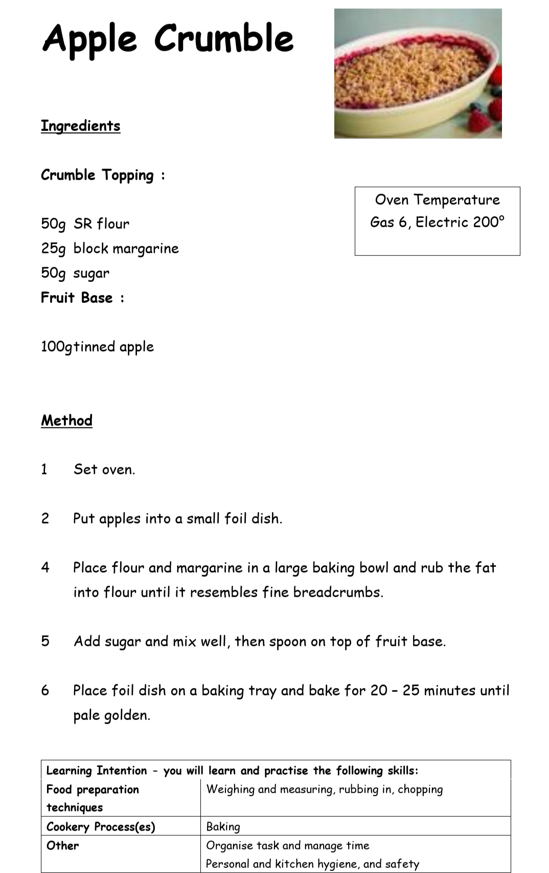
Week 3 – Baking

Slide 21
Week 3 – Now what?
We want to see what you have achieved this week.
Photos of you cleaning with your before and after would be great, also if you have baked this week. Email them to your teacher to show the great work you are doing your work.
If you want to get fancy with TikTok, send us a video of your bakes and cleaning as well as celebrating your skills improving!!

Slide 22
Week 4 – Chef for a day
This week we are going to be looking at all of your practical food skills. The goal is to cook a dish for your family. This will help your organisational skills, time management as well as all the skills we have covered the past 3 weeks.
Task 1
You will be cooking for more than one person, you are going to have to do some numeracy to make sure you have enough food to feed everyone. On the next slide, there will be some simple recipes for ONE person, which you will have to work out how to make for the number you are cooking for. You can add different vegetables, protein sources to meet the needs of your family e.g. if they are vegan etc and also what food you have available. Plan in advance so that you can give the person doing the weekly shop a list of what you will need.

Slide 23
Week 4 – Chef for a day
Recipe | Remember these are for 1 person. Multiply as required (2,3,4 etc)
Cottage Pie | 1 potato | 10ml milk | ¼ onion | ½ carrot | 50g mice | 40ml stock | 2.5ml flour | 2.5ml Worcester sauce | 20g cheese
Spaghetti Bolognaise | 50g mince | ½ onion | ½ carrot | 15ml tomato puree | 2 mushroom | 150ml stock | 2.5ml mixed herbs | 50ml chopped tomatoes | 75g spaghetti
Tuna Pasta Bake | 75g pasta | 25g plain flour | 25g margarine | 250ml milk | 75g tuna | 50g peas | 1 slice of bread | 50g cheese
Chicken Curry and Rice | 10ml oil | 100g chicken | ½ pepper | 1 small onion | 50g rice | 2.5ml chilli powder | 15ml curry paste | 25g sultanas | 300ml stock
Macaroni Cheese | 50g macaroni | 15ml plain flour | 15g margarine | 125ml milk | 40g cheese | 1 tomato slice
Vegetable Stir Fry | 1 garlic | 1 piece of ginger | ½ onion | 1 mushroom | ¼ pepper | ½ carrot | 50g noodles | 2.5ml five spice | 30ml soy sauce
Mushroom Risotto | 10ml oil | 50g peas | 1 small onion | 100g rice | 100g mushroom | 200ml stock | 1 rasher of bacon | ¼ red pepper

Slide 24
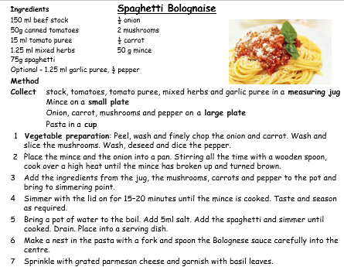
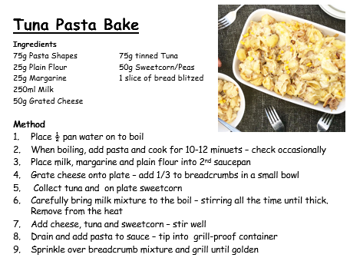
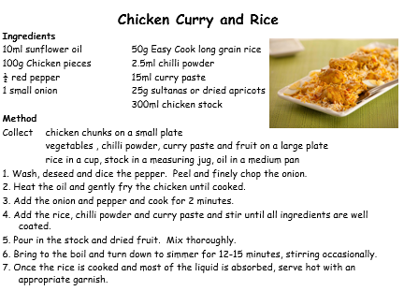

Slide 25
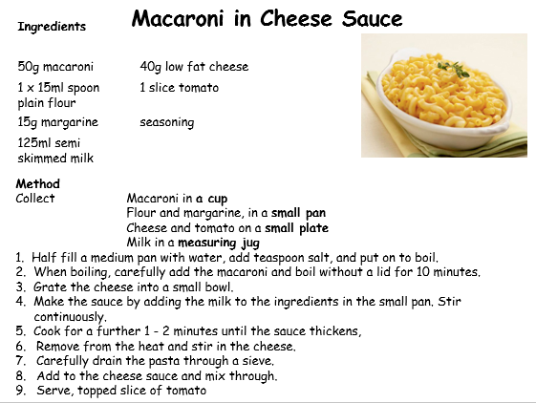
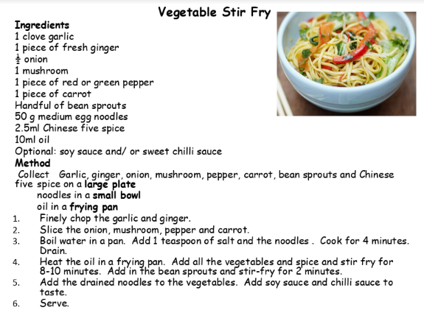
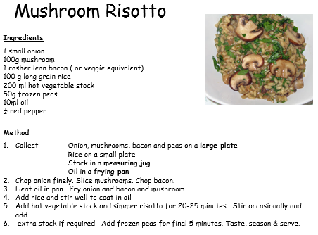
Use the recipes for the methods but remember to multiply correctly.
1 person | 2 people | 3 people | 4 people
15ml | 30ml | 45ml | 60ml
25g | 50g | 75g | 100g
40g | 80g | 120g | 160g
50g | 100g | 150g | 200g
75g | 150g | 225g | 300g
125ml | 250ml | 375ml | 400ml
250ml | 500ml | 750ml | 1000ml

Slide 26
Week 4 – Next steps?
We would love to see what you have achieved this week.
Photos of you in the kitchen being in charge would be great. Email them to your teacher to prove you are doing your work. This will help with next year course too.
Make use of this time at home to increase your practical food skills.
Lots of parents are working from home therefore you could help by making the family lunch/dinner but it is VERY important that you clean your work area after you have finished just like you do when you are in class.
Stay home, stay safe and keep cooking.

