Slide 1
S2 Reading for Meaning Answers
Non-Fiction

Slide 2
Contents
3 – Diamond Dogs
9 – Teen Reading – A Contradiction in Terms?
16 – Why plastic is the scourge of sea life
23 – Spectacles? Cool? Can’t see it, myself
31 – Death Threat at the Olympics
38 – Only Snobs Sneer at McDiploma Graduates
43 – Let adult fatties eat themselves to death
57 – Save our Sundays – shut all the shops
63 – Is Our children reading?
70 – Scientists develop non-stick gum

Slide 3
Diamond Dogs

Slide 4
(1)
(2)
Alliteration. [1]
“pooch perfumes” OR “pampering your pet” OR ”super style” OR “ functional rather than fashionable” [2]

Slide 5
(3)
elegant/designer/indulgence/diamonds/fine perfume/organic/boutique/glitz. [3]
(4)
The “surprising twist” is that it is the dogs that are dressed up rather than their celebrity owners. [1]

Slide 6
.
(5)
The dash is used to introduce a comment on what has went before. [1]
“Functional” means designed for a particular purpose (not to look good). “Fashionable” means to that something has be stylish. [2]
(6)

Slide 7
.
(7)
Long sentence suggests the extent of this trend. [2]
“comfort blankets” [1]
(8)

Slide 8
(9)
“vignette” means a literary description. [1]
(10)
Marks awarded for using words in an interesting sentence.

Slide 9
Teen Reading – A Contradiction in Terms?

Slide 10
(1)
(2)
“explosion of digital media” OWN WORDS- sudden increase/in internet, computer or mobile phone technology. [2]
Colon used to introduce title of the report. [1]

Slide 11
(3)
The report establishes that children read different things from their parents and that they react to things they have read in a way in their own way. [2]
(4)
“dominated” [1]

Slide 12
.
(5)
You would not expect the loved and loathed lists to contain the same text. [2]
(6)
The Harry Potter Series [1]

Slide 13
(7)
dominated – to conquer, to control, to have a strong presence. [1]
(8)
Marks awarded for using words in an interesting sentence.

Slide 14
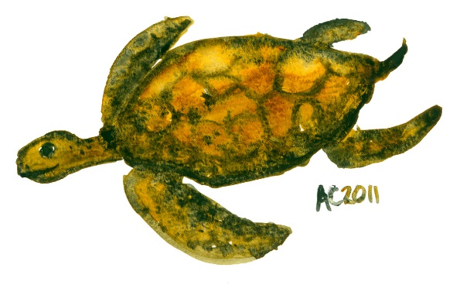
Why plastic is the scourge of sea life

Slide 15
(1)
(2)
A cigarette lighter, a toothbrush and a toy robot. [3]
Many seabirds die as they eat plastic rubbish left in the sea. [1]

Slide 16
(3)
He uses parenthesis to explain what fulmars are. Needs to be more specific than just “extra information”. [1]
(4)
There were 1,603 items of plastic. [1]

Slide 17
.
(5)
The sentence structure emphasises the damage caused as it uses a short emphatic sentence to start. There is also a list of other sea creatures that are harmed. [2]
(6)
Lessen our use=“curb our consumption”. [1]

Slide 18
(7)
“innocuous” means harmless. [1]
(8)
The word that means the opposite of “innocuous” is “toxic”.

Slide 19
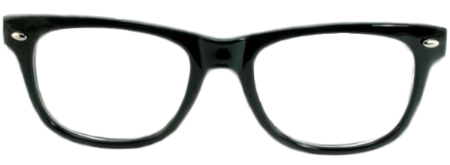
Spectacles? Cool? Can’t see it, myself

Slide 20
(1)
(2)
“pivotal” [1]
The effect of the dash is to introduce the writer’s feelings/description of the glasses. [1]

Slide 21
(3)
The sentence structure is short which makes the statement emphatic/ to summarise the effect of the glasses. [2]
(4)
He could now see better/ but he felt worse about himself/lost confidence. [2]

Slide 22
.
(5)
“myopic” [1]
(6)
The dash is used to introduce humour to the passage. [2]

Slide 23
.
(7)
His class mates thought he was a “swot” (intelligent/someone who always studied/a teacher’s pet) His teachers thought he should have been cleverer and thought he was stupid. [2]
(8)
Johnny Depp and Harry Potter. [2]

Slide 24
(9)
What is ironic about that the glasses they wear are thought of as cool now but the same ones were deeply unfashionable in the 1970s. [2]
(10)
Humorous/ Light-hearted Suitable quote to support this. e.g." this stuff never happened to Johann Cruyff” [1]

Slide 25
Death Threat at the Olympics

Slide 26
(1)
(2a)
Mehboba Andyar overcame pressure and threats to her life. [1]
She will be wearing a loose fitting track suit and a veil. [1]

Slide 27
(2b)
For her Religion/Modesty reasons. [1]
(3)
“perilous” [1]

Slide 28
.
(4)
“Bombarded” has connotations of being bombed or attacked to suggest that there were several death threats. [2]
(5)
Her “shrug” suggests she is not put off easily/she is resigned to such abuse. [2]

Slide 29
.
(6a)
She is unaware of the names of famous athletes. [1]
(6b)
She is unlikely to have seen them on television due to war and restrictions. [1]

Slide 30
Only Snobs Sneer at McDiploma Graduates

Slide 31
(1)
(2)
“burger giant” [1]
It has shown prejudice: - about junk food - the way the US runs franchises - about those who work in at a basic level in serving food. [3]

Slide 32
(3)
He uses a rhetorical question to get the readers to agree with the his point. [1]
(4)
“qualms” [1]

Slide 33
.
(5)
It is a prosperous/wealthy/affluent company and it provides young people with experience and expertise that will help them in the work place. [2]
(6)
“ethical” means principled/moral/fair. [1]

Slide 34
.
(6b)
Marks awarded for using words in an interesting sentence.

Slide 35
Let adult fatties eat themselves to death

Slide 36
(1)
(2a)
The writer thinks that the government should concentrate on educating young people about healthy living. [1]
Metaphor: “one of the biggest threats we face”/“just like operations in Afghanistan and Iraq” [1]

Slide 37
(2b)
It suggests that the government sees obesity as dangerous and potentially fatal. [2]
(3)
Parenthesis is used to give extra information about obesity in a simple way. [2]

Slide 38
.
(4)
“armoury” [1]
(5a)
Plethora means an excess of/an overabundance. [1]

Slide 39
(5b)
Marks awarded for using words in an interesting sentence.

Slide 40
Save our Sundays – shut all the shops.

Slide 41
(1)
(2)
The atmosphere was different in Bilbao as all the shops were closed on Sunday whereas they would be open in the UK. [2]
The structure is different as it uses a list of different days that shops are open. The extra information strengthens the writer’s point. [2]

Slide 42
(3a)
Personification. [1]
(3b)
It suggest that the shops demand attention from people/they have to respond. [2]

Slide 43
.
(4)
“crisis” [1]
(5a)
Metaphor. [1]

Slide 44
(5b)
It suggest that we are not really bothered about environmental issues as we continue to consume. [2]
(6)
The word “littered” has connotations of a lot of something to suggest there were a large number of children dressed up. [2]

Slide 45
(7)
The effect of sharing quality time is to lower tension. [1]
(8)
It suggests that we need to question our current obsession with shopping. The short sentence makes the point in a forceful way. [2]

Slide 46
Is Our children reading?

Slide 47
(1)
(2)
George Bush should have asked, “Are our children reading?” [1]
The colon is used to introduce a quotation. [2]

Slide 48
(3)
Children are meant to be replacing books with computer games. [1]
(4)
“scapegoat” [1]

Slide 49
.
(5)
“crisis” [1]
(6)
“supposedly” [1]

Slide 50
(6)
The writer thinks that there aren’t enough good books to appeal to young people. [2]
(7)
“discriminating” [1]

Slide 51
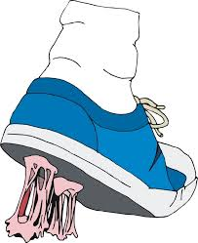
Scientists develop non-stick gum.

Slide 52
(1)
(2)
The sentence structure begins with a list of the damage that gum can cause. [2]
Parenthesis is used here to give extra-information about the properties of the new gum. [2]

Slide 53
(3)
The new chewing gum is less adhesive than normal gum and will eventually disappear. [2]
(4)
“degrades” [1]

Slide 54
.
(5)
The three main advantages of the new chewing gum are: i) It will not stick . ii) It tastes as nice as ordinary gum. iii) It will save councils millions of pounds in removing discarded gum. [3]

Slide 55
(6a)
Estimated means approximately/round about/roughly. [1]
(6b)
Marks awarded for using words in an interesting sentence.

