Slide 1
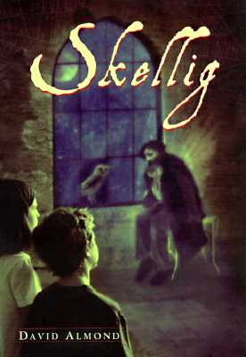
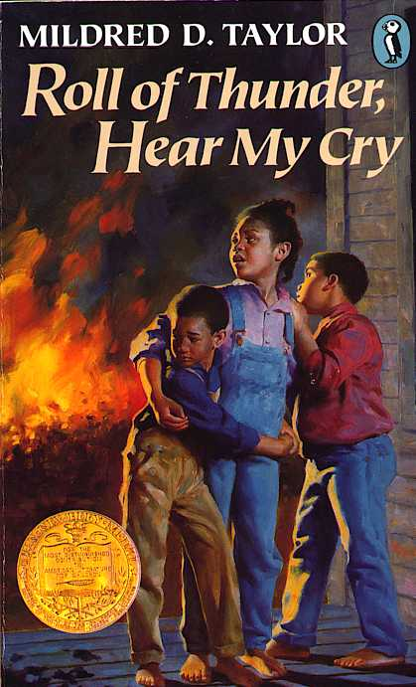
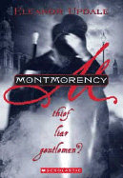
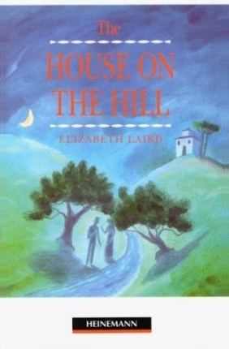
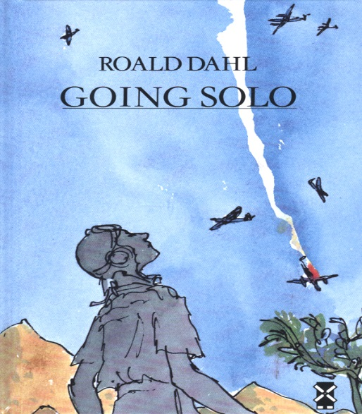
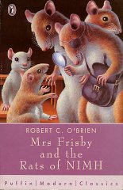
S2 Reading for Meaning
Fiction

Slide 2
Contents
3 – Skellig
9 – Roll of Thunder Hear my Cry
16 – Montmorency
23 – The House on the Hill
31 – Going Solo
38 – The Wonderful World of Henry Sugar
43 – Call of the Wild
51 – Mrs Frisby and the Rats of Nimh
57 – Flour Babies
63 – Whispers in the Graveyard
70 – Holes

Slide 3
Skellig

Slide 4
(1)
(2)
Michael goes to the garage. [1]
The entrance is barred/ inaccessible The roof is worn/dilapidated. [2]

Slide 5
(3)
It was too dangerous and tricky for the people to clear out. [1]
(4)
The writer uses a long sentence to show there is a lot of rubbish. [2]

Slide 6
.
“stank of rot and dust” [1]
(5)
“the bricks were crumbling like they couldn’t bear the weight any more” OR “the whole thing was sick of itself” [1]
(6a)

Slide 7
Personification. [1]
(6b)
(7)
Michael thinks it will fall down/cave in. [1]

Slide 8
(8)
timbers – wood, logs, planks sagging – drooping, slumped, bending bulldozed - flatten, level, demolish [3]
(9)
One mark for each word used in a sentence.

Slide 9
Roll of Thunder Hear my Cry

Slide 10
(1)
(2a)
She means a long line or large convoy/procession of cars. [1]
“like cats eyes in the night” [1]

Slide 11
(2b)
(3)
It is effective as she compares the light from the cars to that of cat’s eyes in the night. This suggests the reflective light in the darkness. [2]
Jason feels scared/nervous/restless. [1]

Slide 12
(4)
Jason hides out of view. [1]
(5)
The writer uses a short sentences to build up tension. [2]

Slide 13
.
Shadowy figure: can’t be seen clearly seems sinister [2]
(6)
I think the writer has done this to focus on the tense atmosphere. [1]
(7)

Slide 14
Simile. [1]
(8a)
(8b)
This is effective because it compares the light to that of burning ashes to suggest the colour and brightness of the lights OR that it suggests their potential danger. [2]

Slide 15
(9)
skittish – nervous, excited, playful slunk – skulk, creep embers – ashes, cinders, residue [3]
(10)
One mark for each word used in a sentence.

Slide 16
Roll of Thunder Hear my Cry

Slide 17
(1a)
(1b)
The writer uses a long sentence. [1]
In order to include lots of vivid and detailed description. [1]

Slide 18
(2a)
(2b)
“the town’s lungs” personification. [1]
It suggest the green space was a place where you could breathe./ It suggests it was important as a place that provided clean air in the dirty city. [2]

Slide 19
(3)
Busy road filled with people and vehicles and a quiet park. [1]
(4)
One is noisy and loud the other is more silent. [2]

Slide 20
.
“Hurrying” and “Leisurely” [2]
(5)
How they dressed/held their gloves/ handled their canes/bowing to each other. [3]
(6)

Slide 21
“mechanically” [1]
(7)

Slide 22
(9)
curdled – to become sour/go off smog – mixture of smoke and fog sprawl – spread out conducted – carry/out, perform mechanically – without thinking, automatic acquaintance – friend [6]
(10)
One mark for each word used in a sentence.

Slide 23
The House on the Hill

Slide 24
(1a)
(1b)
Simile/ “wet yellow leaves lay like skin” [1]
It is effective because it shows the closeness of the leaves to the pavement/conveys a creepy atmosphere. [2]

Slide 25
(2a)
The fog moved slowly and covers everything. [2]
(2b)
“slipped” “coiling lazily” “blanketing” [2]

Slide 26
.
“slipped”- moved without being noticed “blanketed”- completely covered “coiling”- twisting “lazily”- slowly [2]
(3a)
(3b)
tense/creepy/unnerving [1]

Slide 27
Personification. [1]
(4a)
(4b)
It is effective because it gives the idea that the bad weather is upsetting/ conveys the extent of the fog. [2]

Slide 28
The writer has used short sentences. [1]
(5a)
(5b)
It is effective because it builds up interest into what they were waiting for. [2]

Slide 29
Serious/sad/Melancholy/ Sinister. [1]
(6a)
(6b)
unexpected/upsetting/eerie/drove [2]

Slide 30
(7)
adrip – to drip, trickle, dribble fawnish – brownish, tan colour ornamental – decorative gauzy – think, delicate inclination – feeling, liking, fondness
(8)
One mark for each word used in a sentence.

Slide 31
Going Solo

Slide 32
(1)
(2)
The writer uses a short sentence. [1]
I think the writer has written it like this to draw attention to it/gain the reader’s interest. [1]

Slide 33
(3)
He did not want to disturb/alarm them. [1]
(4)
Tranquillity/calm/contentment etc. [1]

Slide 34
.
(5a)
Simile: “like suits they had inherited from larger ancestors” [1]
It suggests that the elephants seemed to have excess skin and this made them look peculiar/funny. [2]
(5b)

Slide 35
(6)
Both vegetarians/did not hunt for their food. [1]
Mankind. [1]
(7)

Slide 36
(8)
The writer is disgusted with them. [1]
(9)
“foul” OR “horrors” [1]

Slide 37
(10)
tusker - An elephant that has tusks astern - Behind/at the rear serenity - peacefulness/calmness ancestors - forefathers/ the people you are descended from [4]
(11)
One mark for each word used in a sentence.

Slide 38
The Wonderful Story of Henry Sugar

Slide 39
(1)
(2)
He has so much money as he had inherited his wealth from his father. He did not marry because he wanted all his money for himself. [2]
Tall, neat hair, well dressed, white teeth. [4]

Slide 40
(3)
Turtle-oil. [1]
(4)
“capped at incredible expense”. [1]

Slide 41
.
(5)
He spends so much money on his teeth as they were stained. [1]
He is a vain man who spends a lot of money on making himself look good. [2]
(6)

Slide 42
(7)
manicure - to trim and shape your fingernails. capped - to cover an existing tooth with a new surface. / to put an upper limit on something. tinge - a slight colour or smell. [3]
(8)
One mark for each word used in a sentence.

Slide 43
Call of the Wild

Slide 44
(1)
(2)
“Staggered” has connotations of exhaustion to suggest he was tired. [2]
“he fell down and remained down”. [1]

Slide 45
(3)
He only managed to get back up when he was physically beaten. [1]
(4)
His hair was no longer shiny OR His muscles had disappeared OR He had lost lots of weight. [2]

Slide 46
(5)
Lengthy sentence to clearly show the numerous changes in Buck. [2]
.
(6)
‘with Buck’ refers back to the description of Buck in the previous paragraph, ‘so it was with his mates.’ looks forward, implying that the description of the rest of the dogs will come in the next paragraph. [2]

Slide 47
(7)
“skeletons”/ “bags of bones”. [1]

Slide 48
(8a)
Repetition Or Alliteration in “dull and distant”. [1]
(8b)
Repetition= stresses their sense of dislocation. They feel somewhat numb. [2] OR Alliteration= repetition of “d” sound suggests the harshness of the dogs’ lives. [2]

Slide 49
(9)
The overall tone of the passage is sympathetic to Buck or bleak in its description of Buck’s treatment. [1]

Slide 50
draggled - to made wet or dirty by being dragged on the ground knotty - bumpy, gnarled tangled in knots perambulating - to walk, stroll insensible - unaware, indifferent [3]
(10)
(11)
One mark for each word used in a sentence.

Slide 51
Mrs Frisby and the Rats of Nimh

Slide 52
(1)
(2)
She was thinking about whether Mr Ages had any medicine that could help Timothy OR thinking of Timothy’s health. [1]
Slithered suggests the noise she made OR suggest she slipped unsteadily or awkwardly. [1]

Slide 53
(3)
“she gasped in terror”. [1]
(4)
“whirled” OR “ dash”. [1]

Slide 54
.
(5)
The hole was not big enough for her to fit. [1]
Parenthesis. Gives you extra information of her precise location. [2]
(6)

Slide 55
(7)
Vantage point means a position giving clear view, it says that this point enabled her to ‘see better’. [1]

Slide 56
(8)
slithered - to slip or slide in an awkward way. whirled - to turn round or spin quickly. vantage point - a place that gives a clear view. [3]
(9)
One mark for each word used in a sentence.

Slide 57
Flour Babies

Slide 58
(1)
(2)
He stands next to the bush so he can hide the flour baby from his team mates. [1]
“thrust” has connotations of pushing or shoving to suggests that he launched/threw the bag with force. [2]

Slide 59
(3)
He is more concerned about not losing his place on the Flour Baby project and not getting targeted by ‘snoopers’. [1]
(4)
He wants to see the “Glorious Explosion”. [1]

Slide 60
.
(5)
The word “brilliant” is in italics to stress its importance. [1]
(6)
It acts as a link as ‘and’ refers back to the previous sentence about the Glorious Explosion. ‘Brilliant’ looks forward to the next paragraph which deals with Simon’s thoughts about the explosion. [2]

Slide 61
(7a)
The children must look after their bags of flour at all times as if they were their babies. [1]
(7b)
The purpose of the project is that children learn to be responsible/ be aware of what it takes to look after a baby. [1]

Slide 62
(8)
meagre - a very little amount Snoopers - a spy misheard - did not hear correctly [3]
(9)
One mark for each word used in a sentence.

Slide 63
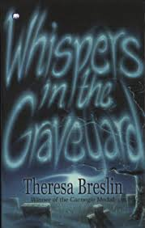
Whispers in the Graveyard

Slide 64
(1a)
(1b)
The sentences are very short. [1]
To create tension/To state facts simply. [2]

Slide 65
(2)
Solomon’s dad is sleeping on the sofa. [1]
(3)
“are ghostly shadows”. [1]

Slide 66
.
(4)
He thought that the images shrank and returned back through the wires. [1]
“telly”. [1]
(5)

Slide 67
(6a)
Simile.[1]
(6b)
His Dad is compared to a tree that has been cut down to suggests his dad is heavy/solid and difficult to move. [2]

Slide 68
(7)
He finds it difficult to read because he is dyslexic and has poor eyesight. [1]

Slide 69
(8)
captured - to detain distortion - warped/ misrepresent/alter sensible - sane/wise/rational slack - loose/limp/sagging [4]
(9)
One mark for each word used in a sentence.

Slide 70
Holes

Slide 71
(1a)
(1b)
The writer has used short sentences. [1]
Sums up situation. Stresses Stanley’s feelings. [4]

Slide 72
(2a)
“Maybe”. [1]
(2b)
To suggest Stanley’s uncertainty. [1]

Slide 73
.
(3)
As he thought it was his mind playing tricks on him. [1]
A mirage is an hallucination, vision. [1]
(4)

Slide 74
(5a)
Metaphor: “shimmering waves of heat” [1]
(5b)
Heat is compared to waves, suggest the power of the heat /how it distorts the landscape’s appearance/fits with vision of water. [2]

Slide 75
.
(6)
Focuses on Stanley’s plight. [1]

Slide 76
.
(7a)
Long sentence. [1]
Suggests the long length of time taken. [1]
(7b)

Slide 77
(8)
mirage - optical illusion which gives the impression of water. Shimmering - to shine with a flickering light Haze - smoke or dust cloud [3]
(9)
One mark for each word used in a sentence.

