Slide 1
ICT & The Environment

Slide 2
A Digital World
Technology has had a massive impact on our daily lives.
Task: think of as many ways you can as to how ICT has affected the way we live our lives today – be ready to feedback to the class.

Slide 3
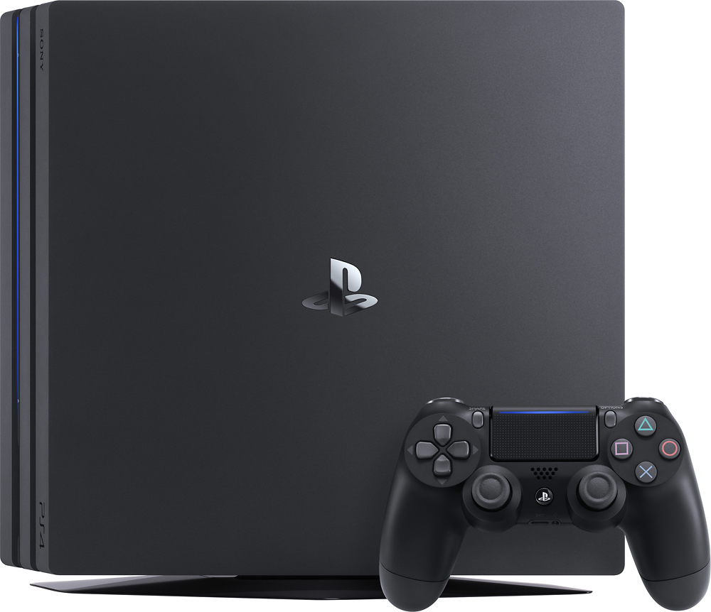
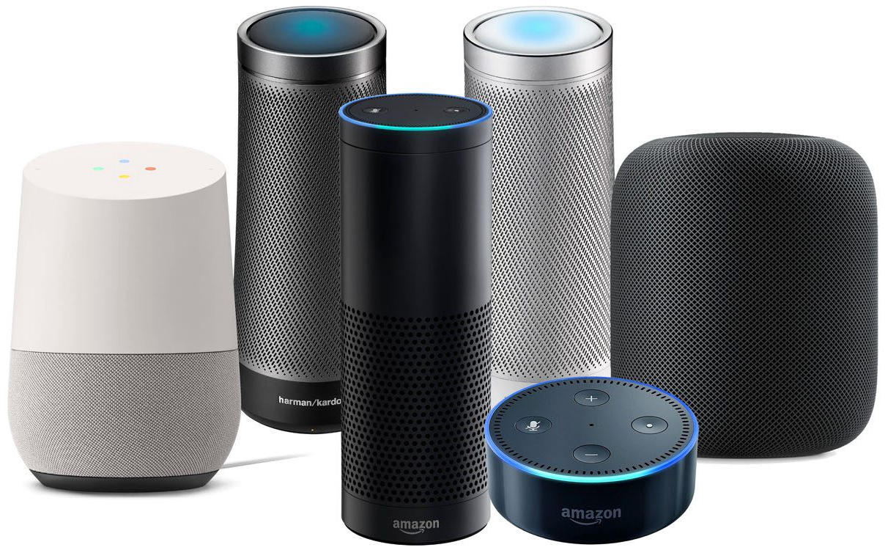
A Digital World
How many different computer/electronic devices do you have in your house?
What impact do you think these devices have on the environment?
What do you think is the most common device used today is?

Slide 4
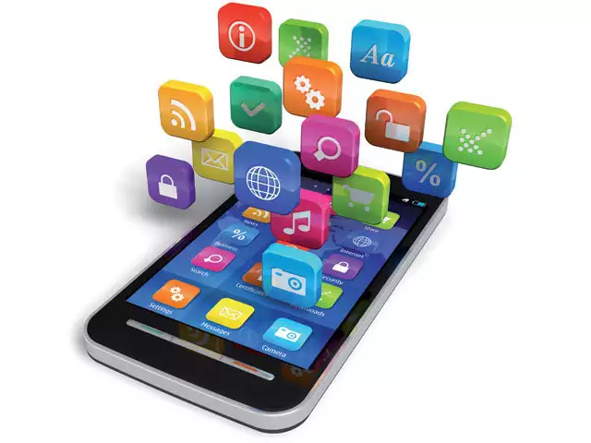
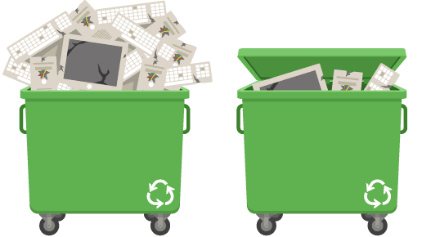
Mobile Phones
Do you know how many resources go
into making a mobile phone?
Mobile Phones
Why is it important to dispose of your old phone (or any other electronic device) properly?

Slide 5
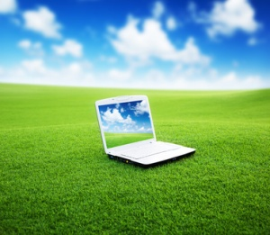
Computers & Energy
Making & using our tablets, smartphones, sat nav’s
& laptops etc. all require natural resources.
Fossil fuels such as oil & gas, along with water, are required to power the factories that make these devices.
But it’s not just the factories – every time we plug in & charge our devices we are also using fossil fuels/energy.
Burning fossil fuels adds to climate change.

Slide 6
Computers & Energy
Energy costs money!
An average laptop uses 72 kilowatts per hour.
If electricity costs £0.10 per kilowatt hour then for every hour you use your laptop it will cost you:
72 x £0.10 = £0.72
72p doesn’t sound like a lot of money, but think of how long you spend watching YouTube videos and how often you may leave your laptop plugged in but not be using it then it all adds up!

Slide 7
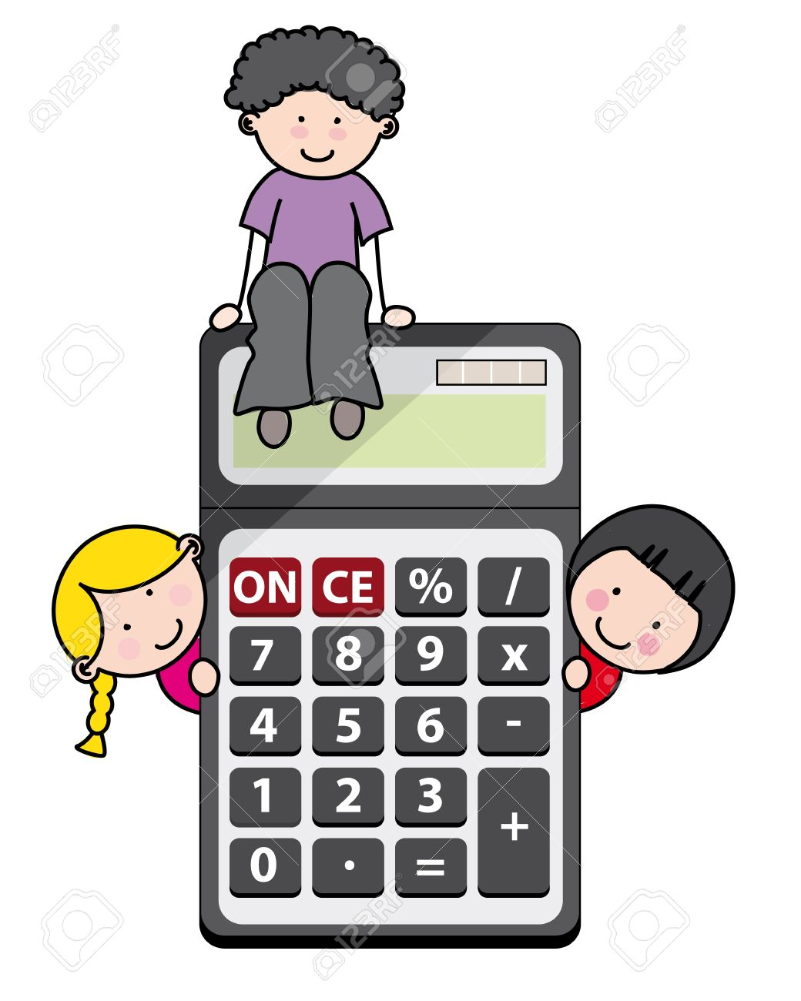
Computers & Energy
Task: in pairs calculate the cost of running the
computers in your ICT class for a school day/week/
year.
An average desktop computer uses 140 watts per
hour and LCD monitor 35 watts per hour.
In your calculation assume electricity is £0.10 per kilowatt hour.
An average school day is 6.5 hours long and the school year is 39 weeks long.

Slide 8
Computers & Energy
There’s no denying using computers means using energy.
However some electronics manufacturers are developing low-power alternatives. E.g. Samsung have some monitors which only use around 6 watts per hour (remember the average LCD monitor uses 35 watts per hour!)
Task: use the internet to find details of some
low-power computers and monitors that are
available today.

Slide 9
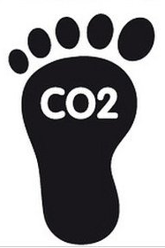
Carbon Footprint
Carbon footprint is the impact that making using a
product has on the environment.
Due to the amount of computer devices we use today the computing industry produces the same amount of pollution (CO₂) in a year as all the aeroplanes that fly in the sky!
Many computer manufacturers now provide information about the carbon footprint of their products.
Task: use the internet to research the carbon footprint information from computer manufacturers such as Apple and Intel.

Slide 10
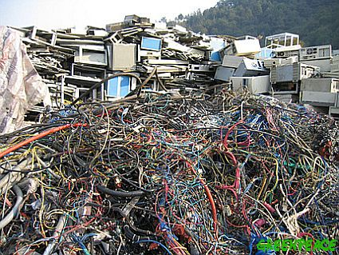
Computers & Pollution
Our tablets, smartphones & computers are made of many different materials such as plastic, glass, lead, mercury and steel.
If we throw these devices into a normal rubbish bin that is taken to a landfill site the chemicals in them will absorb into the earth and may pollution the earth, air and water around us.
Computer devices should be disposed of properly or recycled so they do not cause damage to the environment.

Slide 11
Computers & Pollution
Task: in groups use the internet to research how computer devices can be disposed of or recycled in your area.

Slide 12
Technological Positives
Is it all bad news?
Can you think of some examples of ways in which computers and technology are having a positive impact on the environment?
E.g. more people are streaming music through
sites such as Spotify. This means that less CD’s
are being produced in factories.

Slide 13
ICT & The Environment
Use all the information you have gained throughout this unit to create a presentation outlining the effects that ICT can have on the environment – both positive & negative.
Your presentation could take the form of:
Powerpoint
MS Publisher leaflet
Poster
MS Word handout

