Slide 1
Microsoft Teams
Welcome to your Teams Manual

Slide 2
GLOW Sign In
Log in to Glow using your username and individual password.

Slide 3
Accepting Cookies
If this screen appears-Click the ‘I accept the cookie policies’ box then Launch RM Unify.

Slide 4
Launch Pad
This is the Old Monkland launch pad. You will find lots of tiles for sites that may help you with your learning.

Slide 5
Personal Launch Pad
By clicking the ‘person’ you will access your own launch pad. Here you can see the tiles specifically for you and the apps you use.

Slide 6
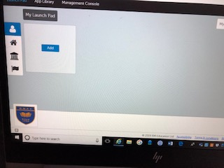
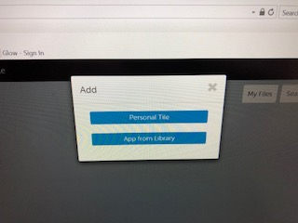
Adding The Teams Tile
Click the add button. This will allow you to add tiles to your personal dashboard. These tiles will be there for you to use every time you log in to GLOW.
When prompted, choose to add an app from the library.

Slide 7
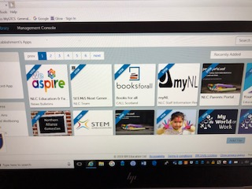
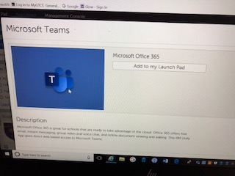
This is the app library. In here, you can choose lots of different apps which will help you learn. In the search bar, type ‘TEAMS’.
The Microsoft Teams app will appear. Click on the Teams app and then select ‘Add to my Launch Pad’.

Slide 8
If you are using a phone or tablet you may need to install the free Teams app. You will also need to use your email address to log in to this. Your email address is beside you username. It is your username with @glow.sch.uk at the end.
The Teams app will now be in your Launchpad to use.

Slide 9
Select ‘Dismiss’ for notifications.

Slide 10
You have lots of help options where you can search for what you want to do and follow the instructions given.

Slide 11
Use the student guide to answer your questions/get help if you need it.
Use the student guide to answer your questions/get help if you need it.

Slide 12
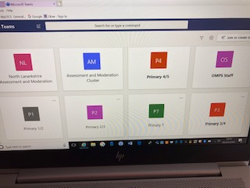
To access the screen you see here. Go the tool bar on the left and click Teams. This will show you the teams that you have been allocated. Click on the tile allocated to your class.
To access the screen you see here. Go the tool bar on the left and click Teams. This will show you the teams that you have been allocated. Click on the tile allocated to your class.
To access the screen you see here. Go the tool bar on the left and click Teams. This will show you the teams that you have been allocated. Click on the tile allocated to your class.
To access the screen you see here. Go the tool bar on the left and click Teams. This will show you the teams that you have been allocated. Click on the tile allocated to your class.
To access the screen you see here. Go the tool bar on the left and click Teams. This will show you the teams that you have been allocated. Click on the tile allocated to your class.

Slide 13
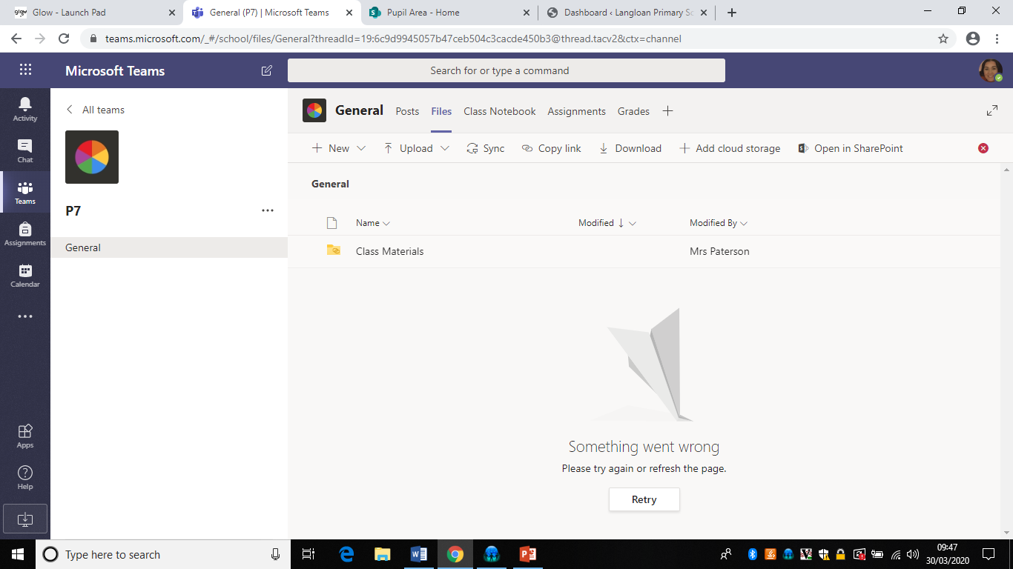
You can also upload photos into this area too so that your teacher can see all of your hard work and make a comment on it. Do this by using the upload button.
When you click on your class tile, you will see something that looks like this inside. The blue arrow is pointing to the class toolbar. You will click on the tabs above to see posts, files your teacher has uploaded or access assignments set by your teacher.

Slide 14
Remember:
It is your responsibility to look after your username and remember your unique password
Never share your password with anyone
Contact your teachers if you see anything on Teams that upsets you
Use the help guides
Always be kind, polite and respectful when commenting
Always think carefully and check what you have written before posting.

Slide 15
Glow Rules
BE SECURE Always keep your Glow password to yourself. Always sign out of Glow when you are no longer using it. | BE POLITE Always treat others with respect. Never post or share a message, document, image, video or any other content that is inappropriate or likely to cause harm or offence to others.
BE SAFE Always remember to be careful when communicating over the internet – other users may not be who they seem. Don’t share your personal details with other people. Never agree to meet someone in person who you have only met on the internet unless accompanied by a parent, carer or other known and trusted adult. Speak to an adult immediately if you see a message, image or anything else on the internet that concerns you. | BE RESPONSIBLE Always be mindful that once you put something online, that information may be beyond your control. Never post or share a message, document, image, video or any other content online that you would not wish other learners, teachers, or parents to see. Remember that anything you do can be traced back to you. If you misuse Glow, this can be reported to your school.
BE LEGAL Never post or share a message, document, image, video or any other content that you do not have permission to use.

