Slide 1
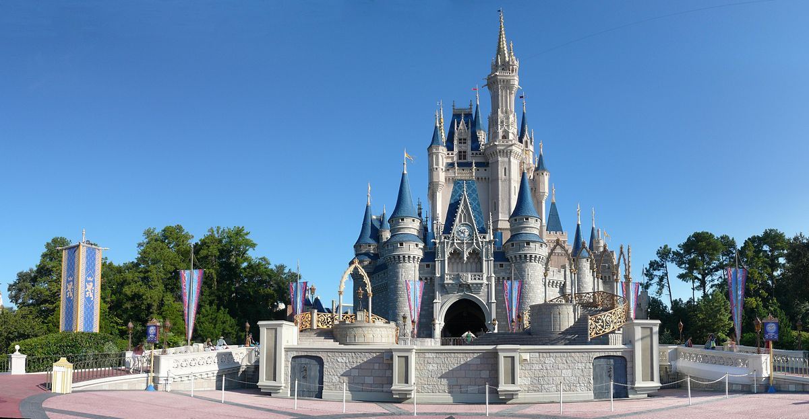
Disney Virtual Trip
Primary 4/5

Slide 2
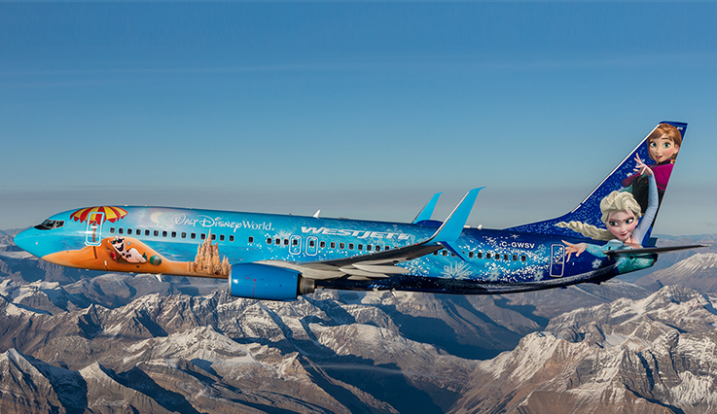
Get your seatbelts on, Primary 4/5. We are jetting off to Florida!

Slide 3
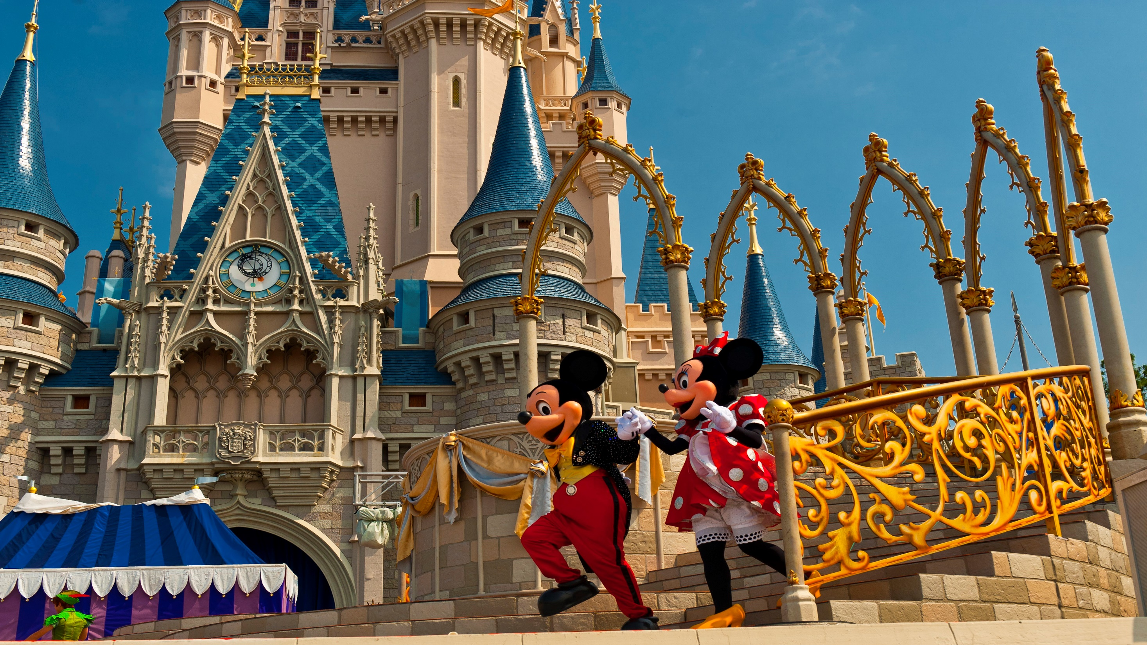
Day 1

Slide 4
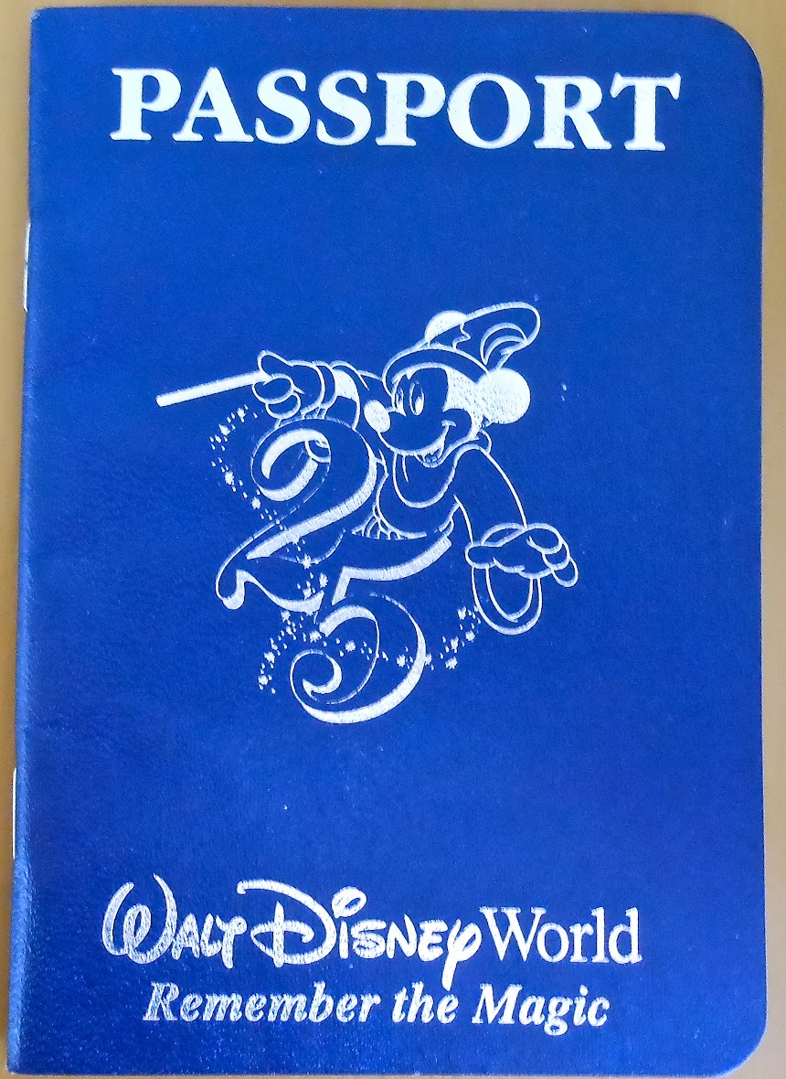
Art
Create a passport that you can use during your trip.
Remember to include a front cover, your name, a picture of yourself and lots of space for characters names!
Each time you see a character this week in a ride, video or song, make sure to write their name in your passport!
How many characters will you meet by the end of the week?
Learning Intention: I am learning to create an eye-catching passport.
Success Criteria:
I can create a front cover.
I can include: my name, date of birth and a picture of myself.

Slide 5
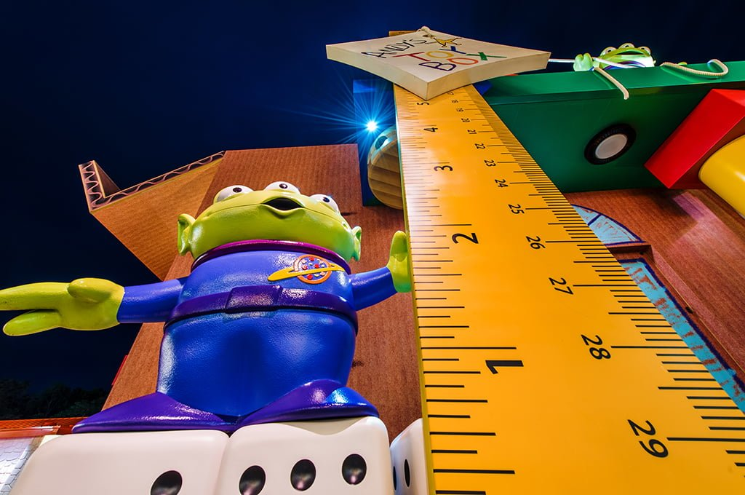
Numeracy
To go on today’s the rides you must be taller than 1 meter.
Estimate and then measure whether you are tall enough to ride!
Can you find 3 things that are taller and 3 things that are shorter than you around your house? Measure the height of each thing.
Learning Intention: I am learning to measure and estimate height.
Success Criteria:
I can use a tape measure/ruler accurately.
I can compare heights.

Slide 6
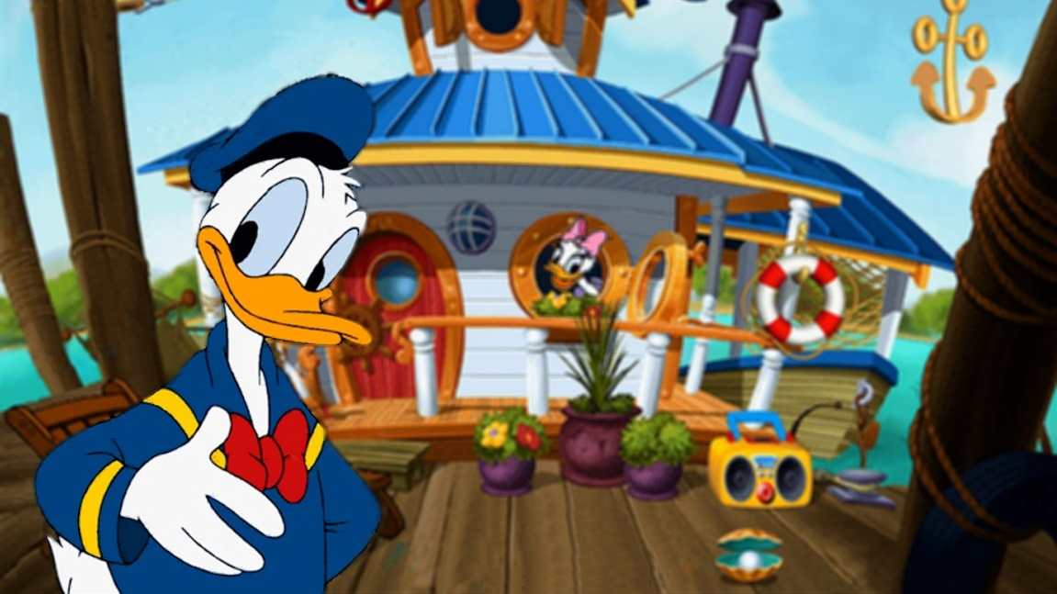
Writing
Take a tour of Donald Duck’s house boat.
What can you see? Draw and label 5 things that you can see inside his house. Use adjectives to create better descriptions.
Next, write about how Donald Duck’s house is different to yours. For example, my windows are not circles and I do not dry my washing on my roof!
https://www.youtube.com/watch?v=XERRGapwSVQ&t=17s
Learning Intention: I am learning to write about a setting.
Success Criteria:
I can identify differences.
I can improve my sentences by using adjectives.

Slide 7
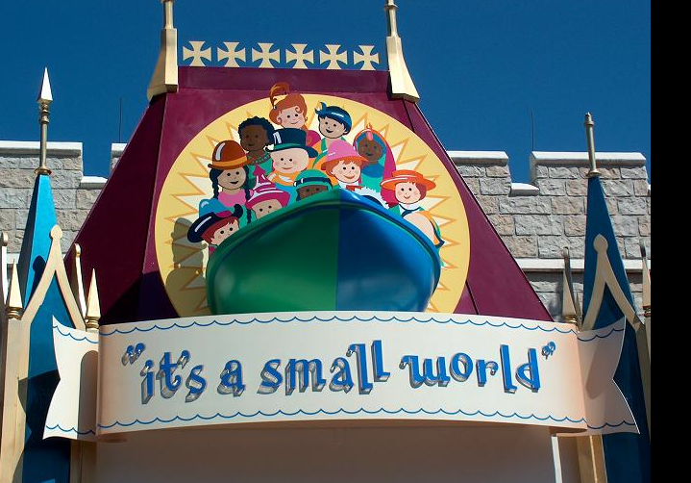
Social Studies
Task: Enjoy the ‘It’s a Small World’ ride. The ride shows many countries and places around the world.
Compare Scotland with another country. You might think about: weather, food, attractions/scenery, events and celebrations, flags or anything else you are interested in. You could present your information in a poster or by telling someone at home what you have found out.
https://www.youtube.com/watch?v=I2Do309e4YU
Learning Intention: I am learning about other countries and cultures.
Success Criteria:
I can find out information about a country.
I can think about how this compares to Scotland.

Slide 8
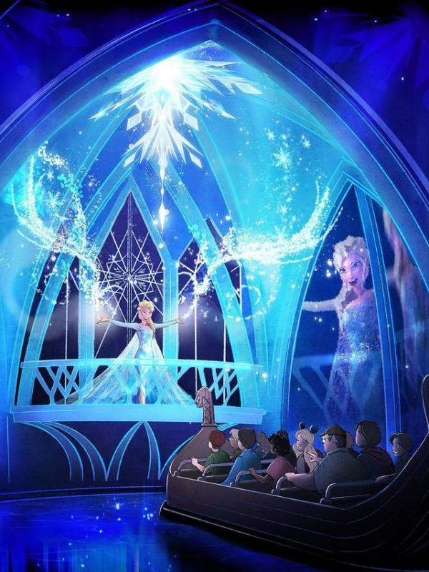
Writing
Watch the Frozen ride.
How many words can you think of that rhyme with snow?
https://www.youtube.com/watch?v=J8OHP9OriMA&t=33s
Write down your list and create a silly sentence/story using rhyming words.
Learning Intention: I am learning to using rhyme in my writing.
Success Criteria:
I can write a silly sentence or story using rhyming words.

Slide 9
Don’t forget to write in your passport the names of each character you met today.

Slide 10
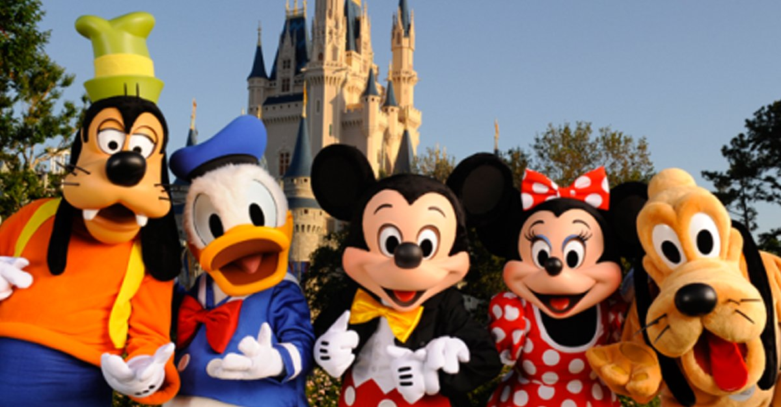
Day 2

Slide 11
Health and Wellbeing
Safety Rules
Look at the video of Disney Land. Can you think of any rules or things that you would need to do to keep safe at the park? Think about what you should do on rides, who you would speak to if you need help and any extra rules that you can think of.
Create a safety poster to display the rules.
https://www.youtube.com/watch?v=HyZfIlxwsfI
Learning Intention: I am learning to identify ways to keep myself safe.
Success Criteria:
I can explain how to keep myself and others safe.
I can display my ideas in an effective way.

Slide 12
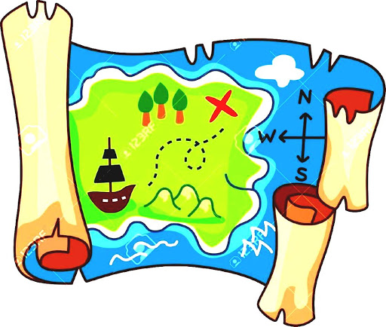
Numeracy
Look at the map of Disney Land. Can you find your way through the map? (Map is on the next slide)
1 Start at the Entrance and go to Donald’s house boat.
2 Start at the log flume and go to the rollercoaster.
3 Start at the pond and go to the Frozen ride.
Can you give detailed directions on how to get from each place to the next. For example, “Turn left then go straight until you get to the pond”.
Learning Intention: I am learning to read a map and give directions.
Success Criteria:
I can give detailed directions on how to get somewhere.

Slide 13
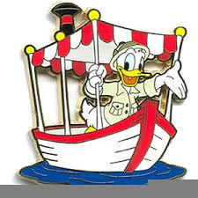
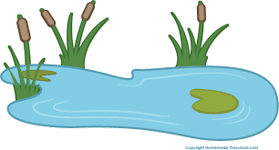
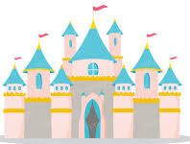
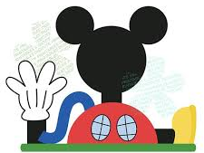
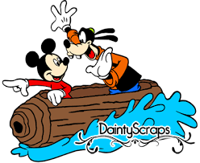

Slide 14
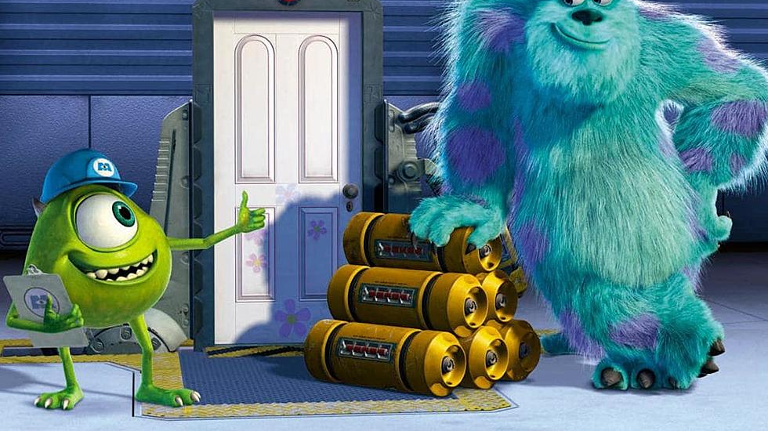
Writing
Watch the Monsters Inc ride clip, it is a 360 degree experience so you can drag the screen to see all around you.
Design your own monster. Are they kind, scary, fluffy, angry? Can you think of any other ways to describe them?
Next, create a story where your monster is the main character.
https://www.youtube.com/watch?v=vDNUXa5sIHU
Learning Intention: I am learning to describe a character.
Success Criteria:
I can create a character.
I can write a story with a main character.

Slide 15
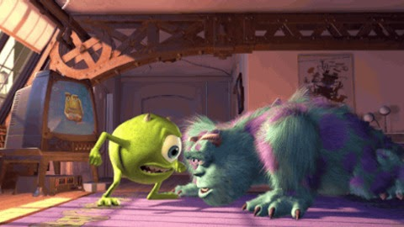
Do 10 monster press ups.
Remember to roar after each one.

Slide 16
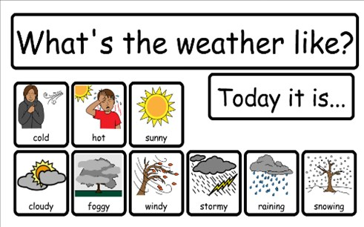
Planet Earth - Weather
Disney Land is in Orlando in America.
Find out what the weather is like in Orlando today. Is it sunny, cloudy or windy? What is the temperature?
What is the weather and temperature here? Is it hotter or colder?
How many degrees hotter/colder is Orlando than Clackmannanshire today?
Learning Intention: I am learning to identify and compare the weather in various places.
Success Criteria:
I can find out the temperature in various parts of the world.
I can compare temperatures.

Slide 17
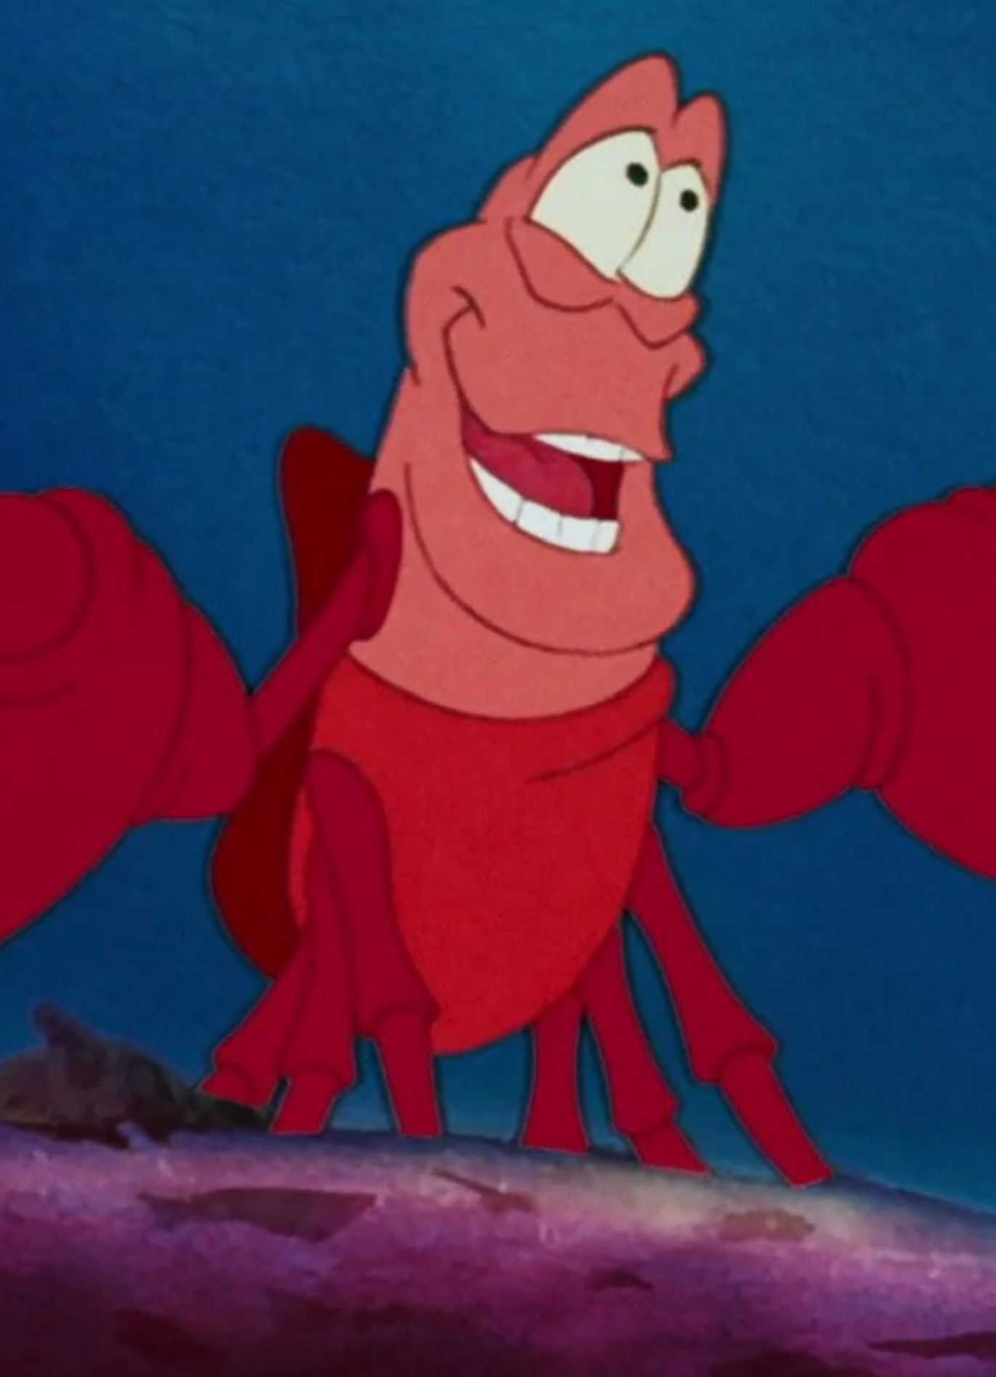
Listening and Talking
Listen to ‘Under the Sea’.
https://www.youtube.com/watch?v=GC_mV1IpjWA
Why does Sebastian think it is better to live under the sea?
Think of 2 reasons why it might be better to live on land.
Create something to convince Sebastian. You could create a poster, a song or simply write down your reasons.
Learning Intention: I am learning to listen for understanding.
Success Criteria:
I can recall information that I have heard.
I can question what I have heard – do I agree? Is that really best?

Slide 18
Don’t forget to write in your passport the names of each character you met today.

Slide 19
Day 3

Slide 20
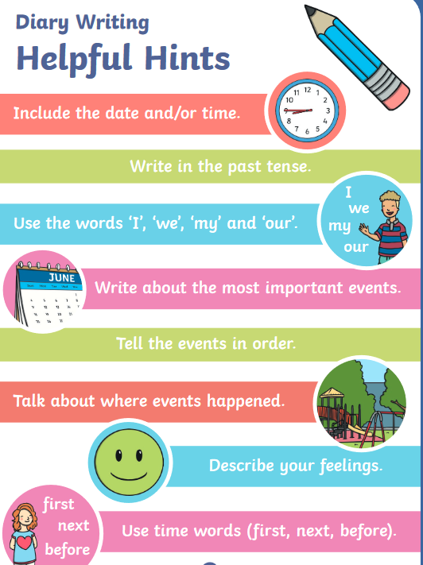
Writing
Write a diary entry about your day at Disney Land, remember to include what you did at various times throughout the day.
How descriptive can you be?
Learning Intention: I am learning to share my experiences in a diary entry.
Success Criteria:
I can share my experiences.
I can add detail to make my writing more interesting.
I can tell events in order.

Slide 21
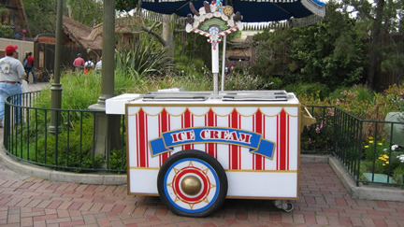
Numeracy
There is a snack menu from Disney Land on the next page.
Circle 2 snacks that you would like, how much will it cost all together? Use the coins to pay for the items.
Challenge: How many ice creams could you get for £1?
Learning Intention: I am learning to use coins to make amounts.
Success Criteria:
I can use coins to make amounts.
I can give change.
I can add amounts together.

Slide 22
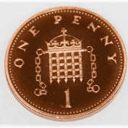
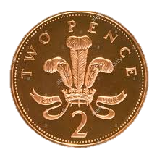
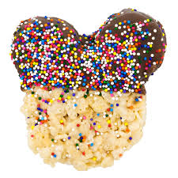
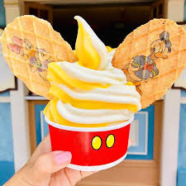
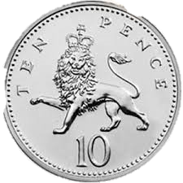
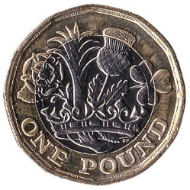
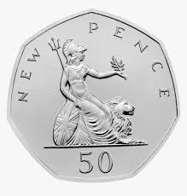
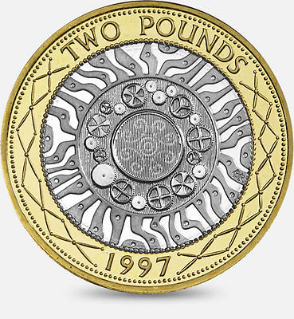
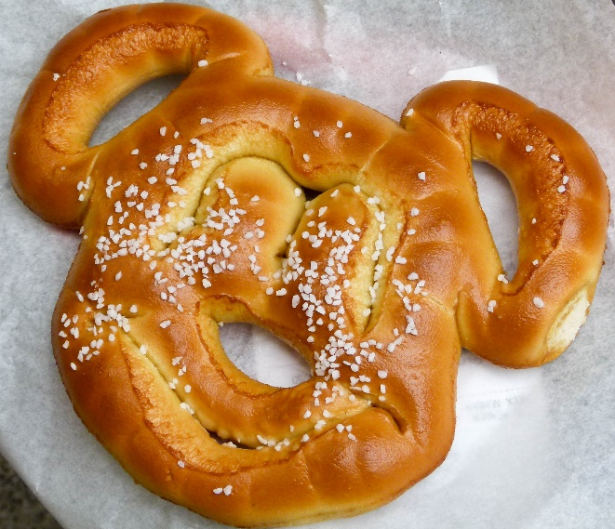
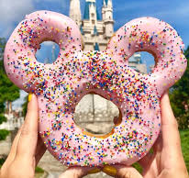
Mickey’s Snack Menu
Aladdin fruit skewers 25p | Pizza 37p
Ice cream 42p | Rice crispy treat 18p
Pretzel 19p | Doughnut 15p

Slide 23
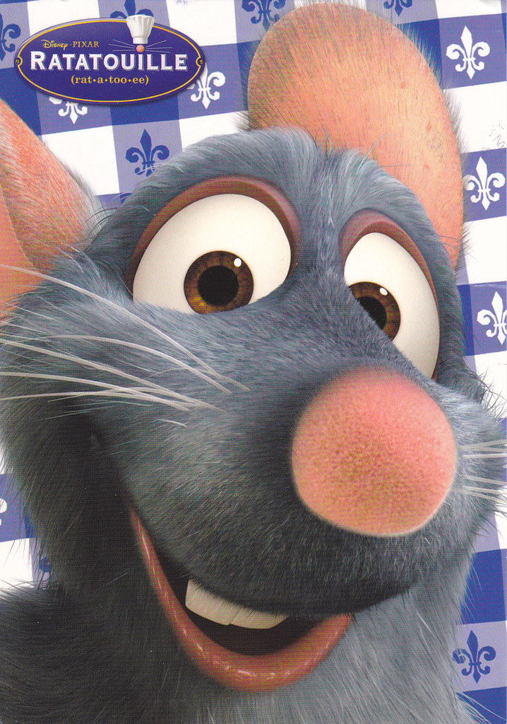
Health and Wellbeing
Watch the clip of Ratatouille. Can you help to prepare a meal or snack today? You could look at a recipe with an adult if they are using one.
https://www.youtube.com/watch?v=jwLKPDJqldw
You could write down the recipe/instructions for somebody to follow.
Learning Intention: I am learning to prepare and cook food.
Success Criteria:
I can follow a recipe.
I can chop, peel and spread.
I can be safe in the kitchen.

Slide 24
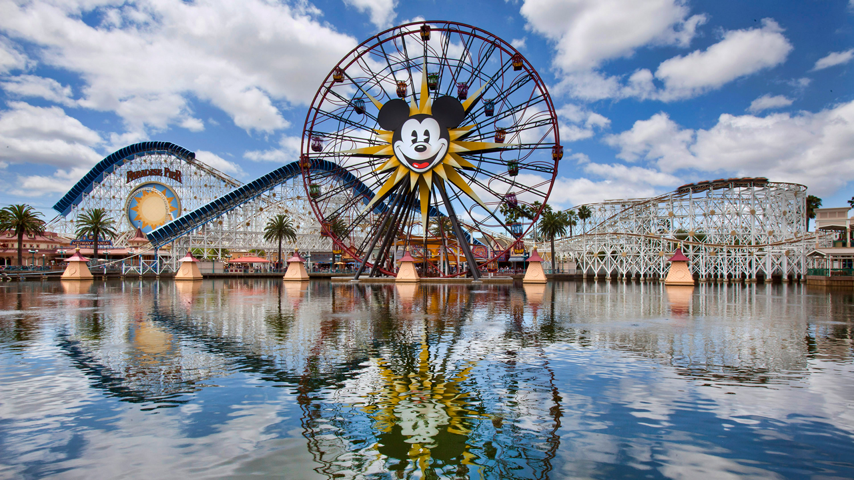
Design Challenge
Mickey has asked for your help to design a new ride for Disney Land!
You could draw your ride, video yourself describing it, or build it out of blocks, recycling etc.
Then make a poster to advertise your ride. Remember to include the price, height limit and any safety rules that you have.
Learning Intention: I am learning to design a rollercoaster.
Success Criteria:
I can plan my design.
I can think about how to make the ride interesting.
I can think about safety features.

Slide 25
Don’t forget to write in your passport the names of each character you met today.

Slide 26
Day 4

Slide 27
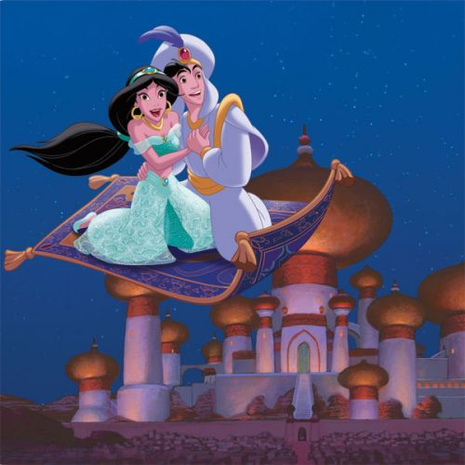
Writing
Task: We’re Flying Through the Air! Enjoy the Aladdin ride, where you fly through the sky on a magic carpet!
Where would you fly to on a magic carpet and why? Describe the setting using your most descriptive words! What would you see, hear, smell, touch and taste in the setting?
https://www.youtube.com/watch?v=fcbWb1FkSC0
Learning Intention: I am learning to describe a setting.
Success Criteria:
I can use descriptive words.
I can describe a setting to the reader.

Slide 28
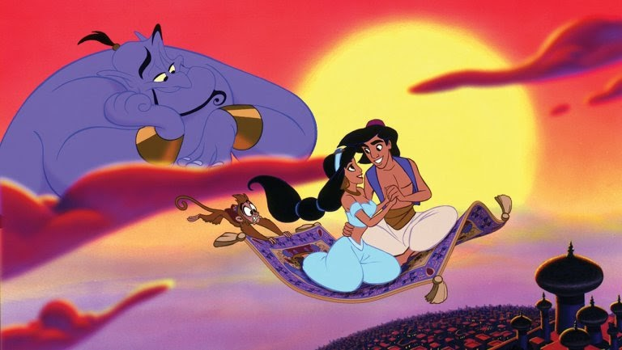
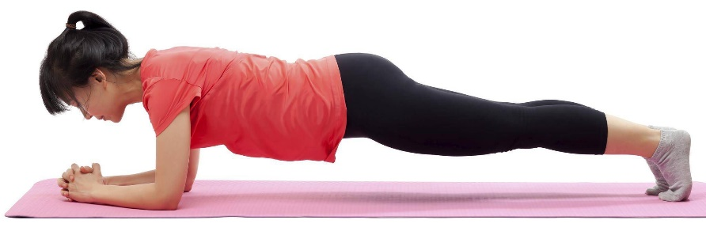
Do a magic carpet plank.
Hold for 30 seconds.
How many times can you do it?

Slide 29
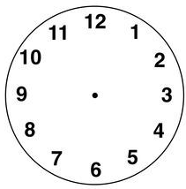
Numeracy
Draw the hour and minute hands to show the time.
The park opens at quarter past 9.
You go on the log flumes at half past 11.
You visit Mickey’s house at quarter to 3.
Challenge: The park closes at 25 past 8.

Slide 30
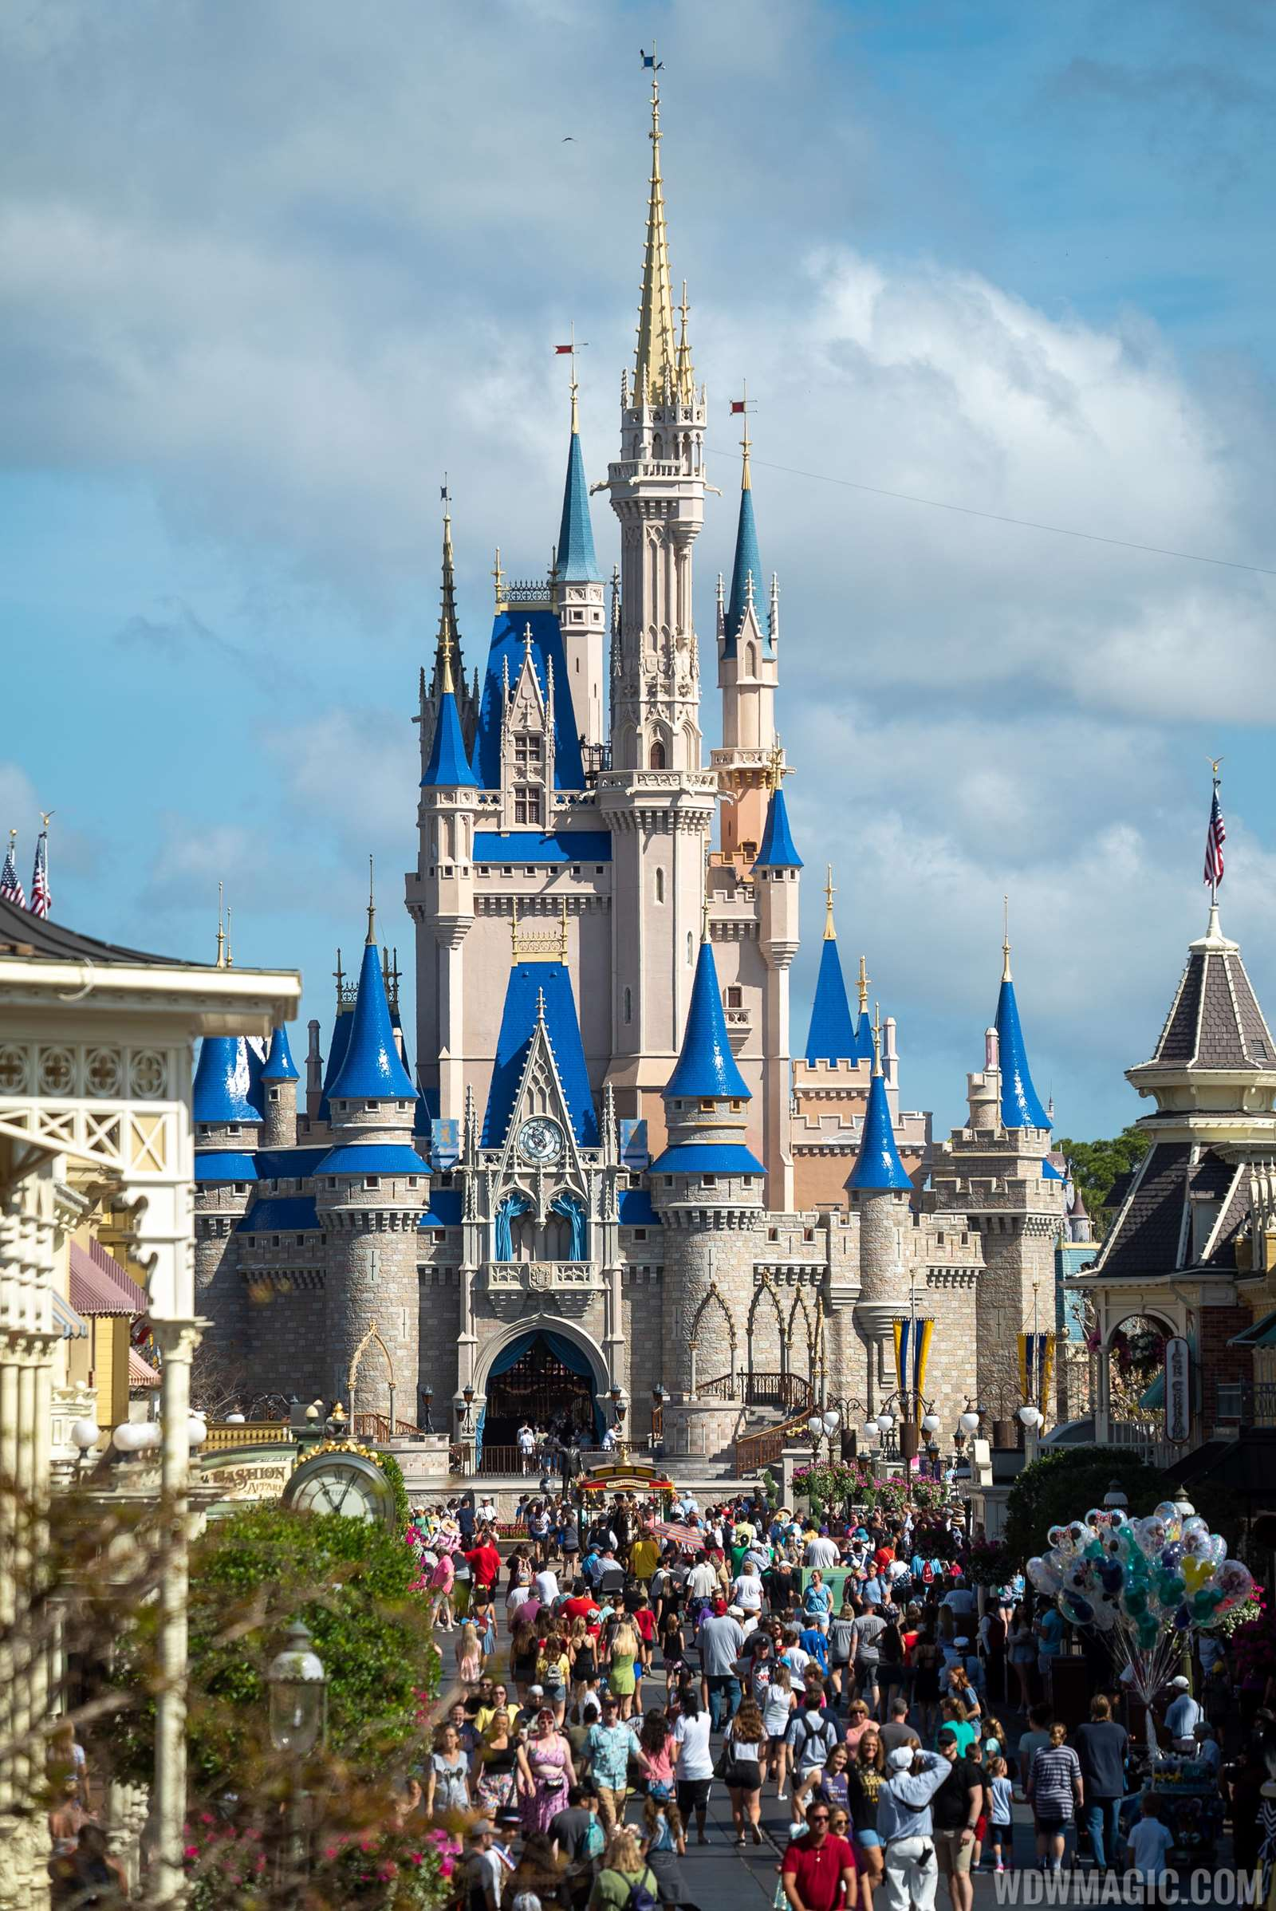
STEM
Look at the picture of Cinderella’s castle. Can you create your own castle using materials of your choice?
You could use sticks, blocks, or anything else that you wish. Be as creative as you can!
Learning Intention: I am learning to build a design.
Success Criteria:
I can select materials that will work for my design.
I can create an interesting design.
I can create a design that is stable and stays up.
There are some example castles on the next slide.

Slide 31
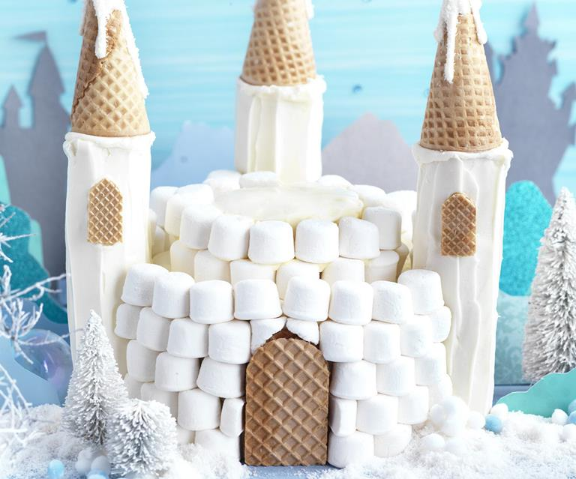

Slide 32
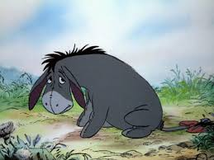
Health and Wellbeing
Eeyore is known for being sad sometimes.
What could you do when you are feeling sad to make yourself feel a bit better?
How could you help a friend who was feeling sad?
Discuss this with someone at home.
Learning Intention: I am learning to identify and manage my emotions.
Success Criteria:
I can explain ways that I could try to cheer myself up when I am sad.
I can think about how to help others too.

Slide 33
Don’t forget to write in your passport the names of each character you met today.

Slide 34
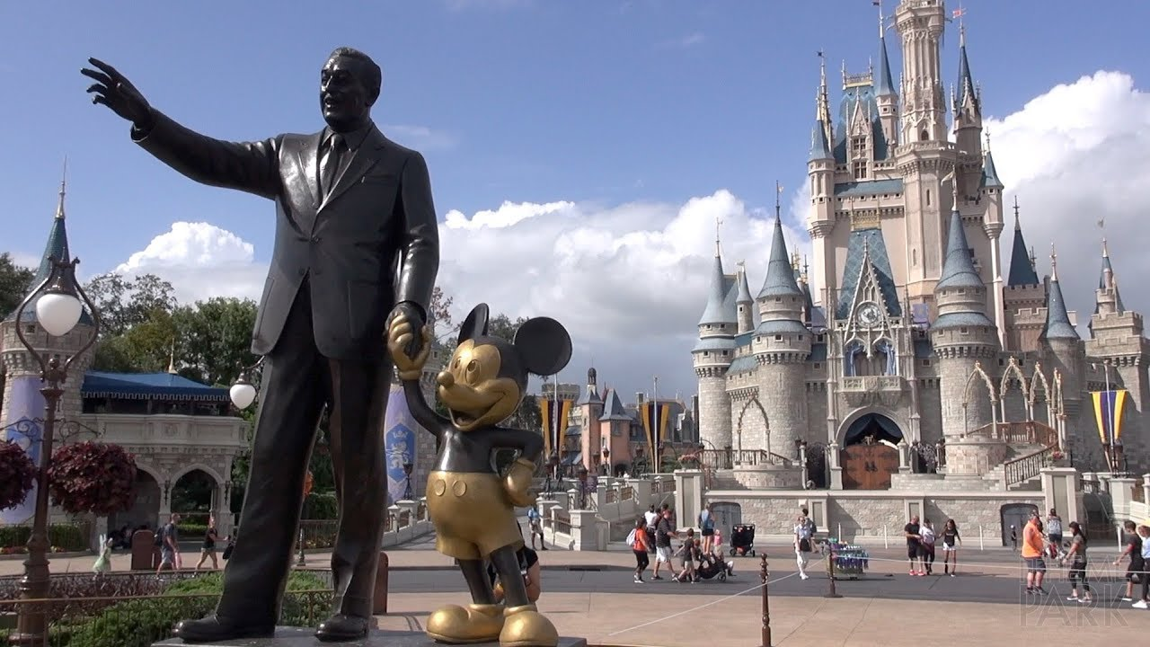
Day 5

Slide 35
Planet Earth
Look at this picture from the movie ‘Moana’.
Only 1 in 1000 turtles live to be adults, they need our help!
Can you help the baby turtle to get to the sea by pointing out all of the obstacles.
What do humans need to do when they are on the beach to keep turtles safe?
Can you make a leaflet or poster to tell beach-goers how they can protect the environment?
Learning Intention: I am learning to care for the planet and its animals.
Success Criteria:
I can identify risks to the turtles.
I can explain what we can do to look after the turtles/planet.
I can present my ideas clearly through a recording or poster/leaflet.

Slide 36
Comprehension
Watch the clip from ‘Moana’ and answer the questions:
https://www.youtube.com/watch?v=KGqBfyQFG_g
What did Moana find on the beach?
Where did the turtle go?
Why did Moana want to go back to the beach?
Next, think of some more questions about the clip. Ask someone at home the questions to check that they were watching carefully!
Learning Intention: I am learning to answer questions about what I have seen/heard.
Success Criteria:
I can watch and think carefully about what is happening in the clip.
I can answer questions about what I have seen.
I can create my own questions.

Slide 37
Writing
Enjoy the Toy Story ride. https://www.youtube.com/watch?v=_oqkZbkZ6gg
The Toy Story characters are all very good friends. Can you write a letter to one of your friends? You might want to tell them a piece of news, or what you enjoy doing with them.

Slide 38
Expressive Arts
Watch the video of the parade. Can you join in with any of the dancing?
https://www.youtube.com/watch?v=rR-KP8KH1Ng
Learning Intention: I am learning to follow movements that I see.
Success Criteria:
I can follow movements.
I can create my own dance.

Slide 39
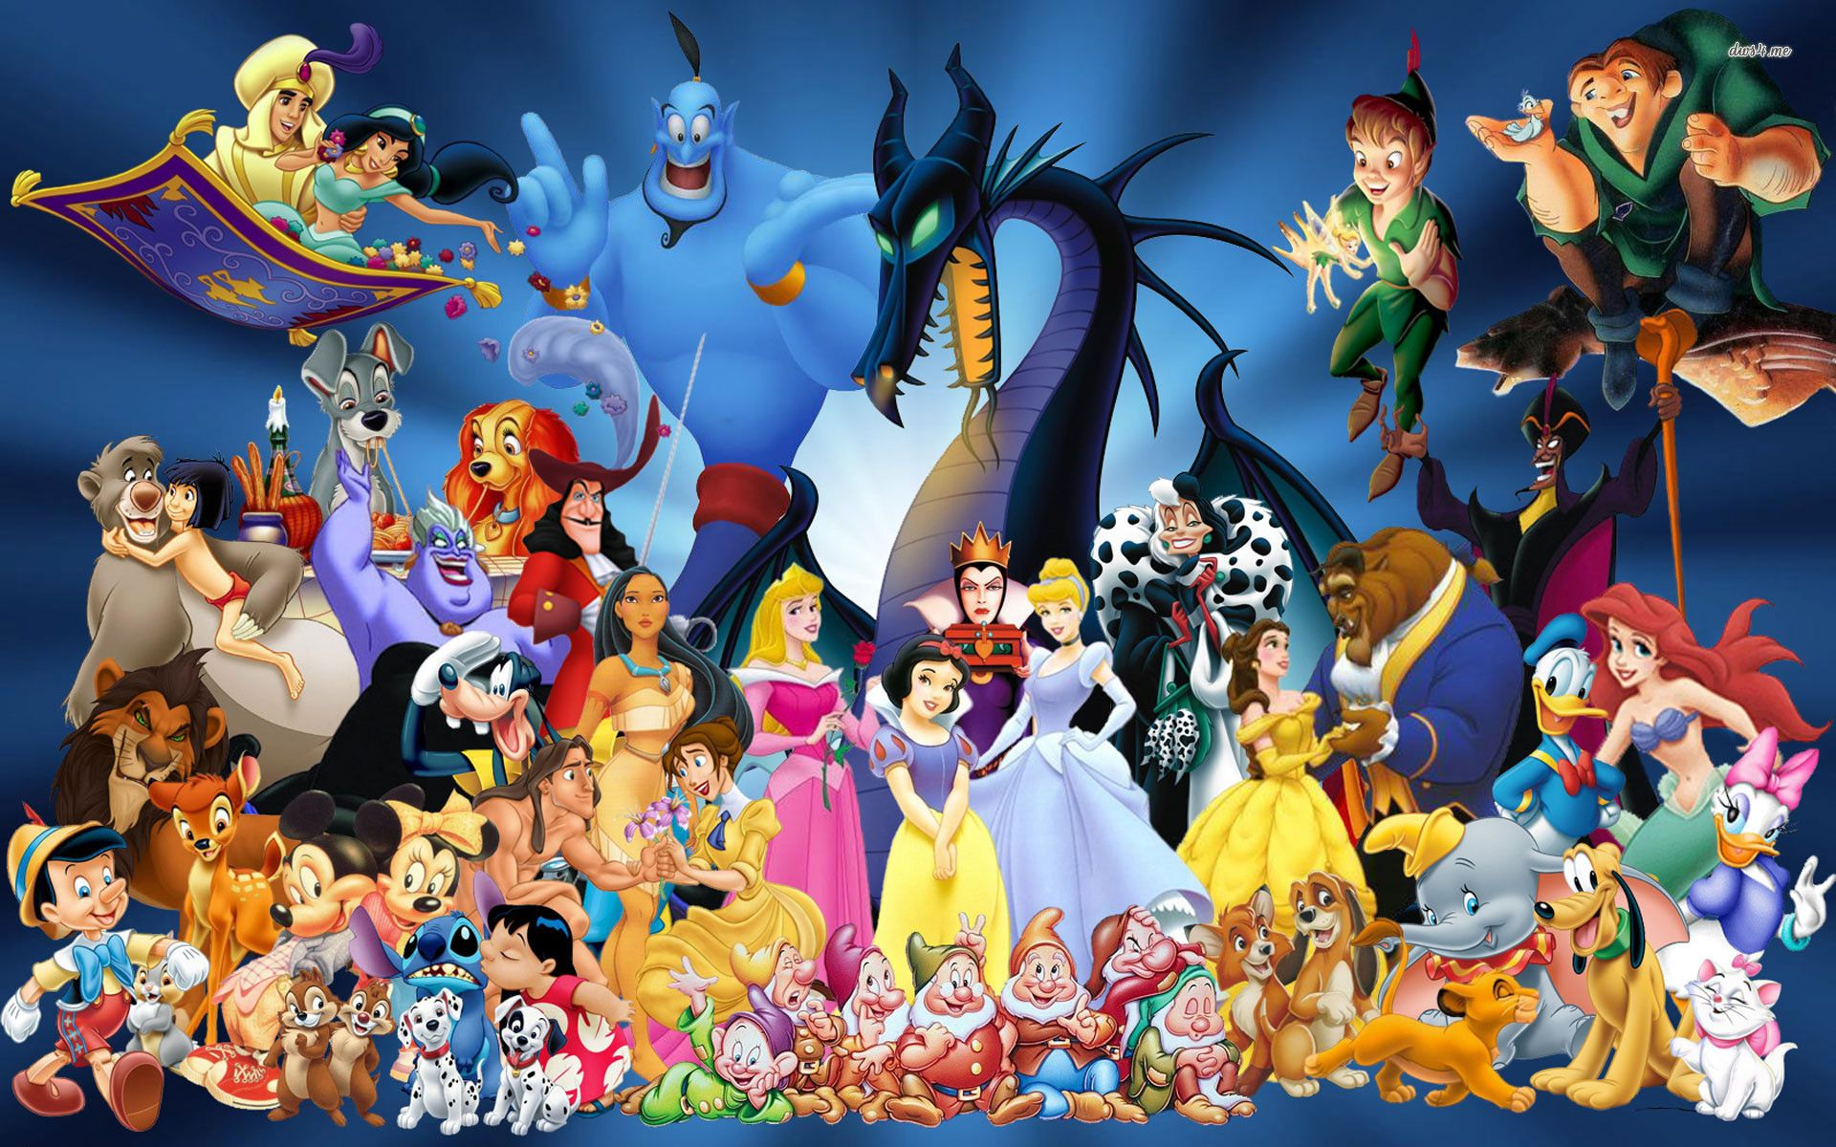
Check your passport to see how many Disney characters we met throughout the trip.
Which character was your favourite?

Slide 40
Time to jet back home, Primary 4/5!
Don’t forget your passport.

