Slide 1
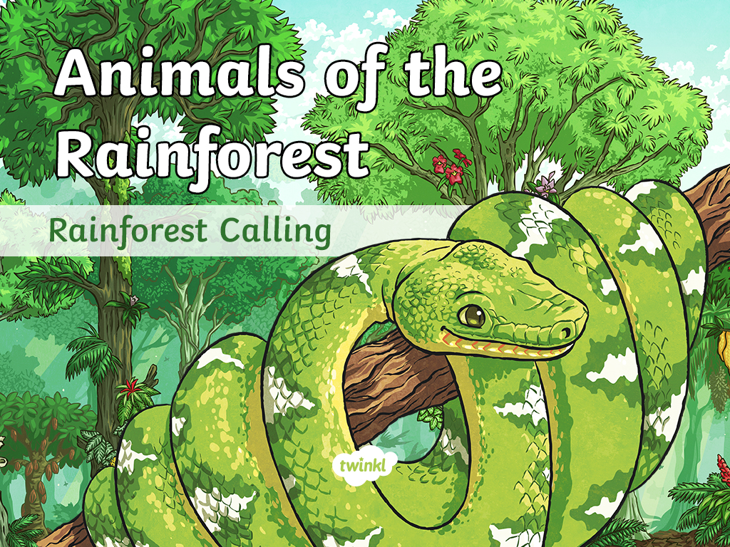

Slide 2
Contents
The animals featured here are all typically found in the rainforests of South America.
Potoo
Red-Eyed Tree Frog
Sloth
Scarlet Macaw
Emerald Tree Boa
Jaguar

Slide 3
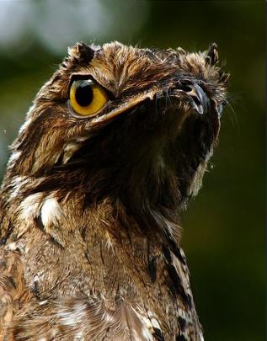
Potoo
Potoos are a noisy, strange-looking bird, which can often be found in the canopy of the Amazon rainforest.
Appearance
They have huge, gaping mouths.
Potoos have large, sometimes yellow, eyes.
Their feathers are grey, brown and black, and are perfect as camouflage against tree trunks.
"Mrs. Moon" by julian londono is licensed under CC BY 2.0
Diet
The potoo mostly eats bugs and insects, including grasshoppers, moths and beetles.
Habitat
Potoos can be found in humid forests in Central and South America.
They live in the high branches of trees, camouflaged among the tree bark.
back

Slide 4
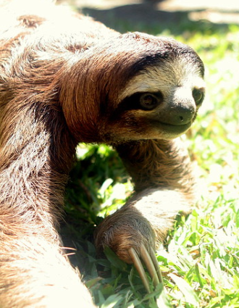
Sloth
Sloths are nocturnal mammals and are known for being particularly slow-moving creatures.
Appearance
Species of sloths are divided into two families: two-toed and three-toed sloths.
They have thick fur, rounded heads, flat snouts and stumpy tails.
They commonly have algae growing on their fur.
“Crawling” by ndanger is licensed under CC BY 2.0
Diet
Some sloth species only eat leaves.
Other types of sloth also eat fruit, insects and even small lizards.
Habitat
Sloths are mostly found in Central and South American rainforests.
They mainly live among the branches of trees.
back

Slide 5
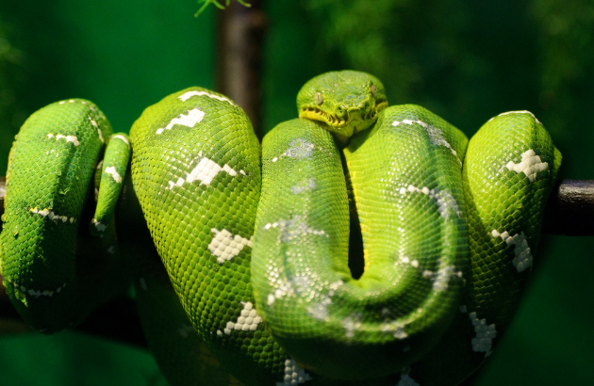
Emerald Tree Boa
The emerald tree boa is a non-venomous snake, which is often found in the Amazon rainforest.
Appearance
Emerald tree boas are bright green with a yellow underside.
They have an irregular, zigzag pattern along their back.
Adult emerald tree boas can grow to reach up to 2 metres.
They have a pair of long, sharp teeth, pointed backwards.
Their heads are relatively large and flat.
"Emerald Tree Boa" by Eric Kilby is licensed under CC BY 2.0
Habitat
Emerald tree boas live in the trees of the Amazon rainforest.
They can also often be found near rivers or swamps but are not dependent on open water.
Diet
They feed mostly on small mammals such as rats, bats and possums.
back

Slide 6
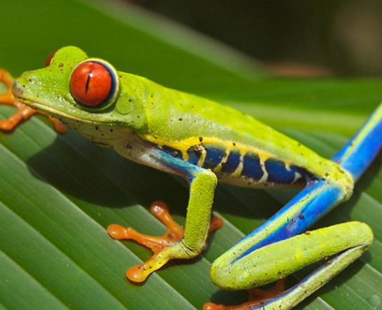
Red-Eyed Tree Frog
The red-eyed tree frog is just one of many species of frog that lives in the rainforest.
Appearance
They are known for having huge, bright red eyes.
The rest of their body is neon green with blue and yellow at the sides.
They have specially adapted suction-cup toes which help them to cling on to tree branches and leaves.
"Red Eyed Tree Frog" by Douglas Tofoli is licensed under CC BY 2.0
Diet
The red-eyed tree frogs’ prey includes moths, crickets, flies and grasshoppers.
Habitat
They are commonly found in the tropical lowland rainforests or surrounding hills.
They commonly inhabit areas close to rivers or ponds.
back

Slide 7
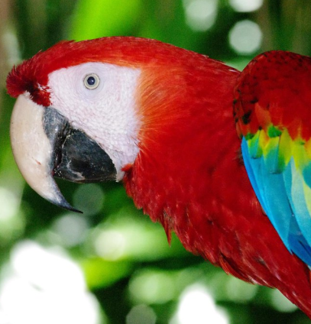
Scarlet Macaw
The scarlet macaw is one of at least 17 known species of macaws. Most are intelligent, social birds.
Appearance
Despite their name, scarlet macaws are multicoloured: red, yellow and blue.
They have large, powerful beaks.
Their bodies are between 80cm to 90cm long.
Diet
They mostly eat fruit and seeds or nuts, but can also eat insects.
"IMGP4701" by Kurayba is licensed under CC BY 2.0
Habitat
They thrive in the tropical, humid atmosphere of the rainforest.
They are usually found in the emergent or canopy layers of the forest.
back

Slide 8
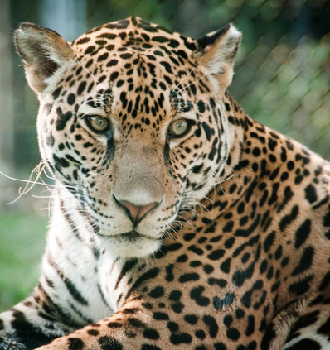
Jaguar
The jaguar is a member of the wild cat family that can be found in the rainforest regions.
Appearance
They are famous for their beautiful, spotted coats.
They can reach up to six feet in length, from their nose to the tip of their tail.
They have powerful jaws and sharp teeth.
"Jaguar, Alert" by Eric Kilby is licensed under CC BY 2.0
Diet
Jaguars are carnivores with an extensive list of possible meals including squirrels, deer and monkeys.
Habitat
Jaguars are found in rainforests as well as grasslands and woodlands.
They spend much of their time on the ground or the forest floor, using their soft padded paws to stalk quietly through the undergrowth.
back

