Slide 1
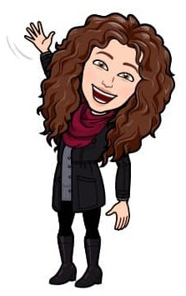

Slide 2
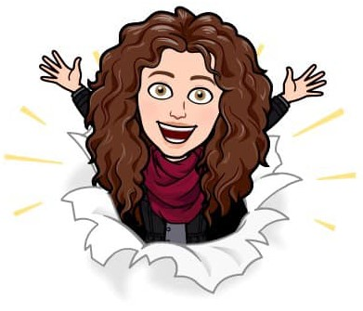
Mini Miss Jones
Hey, friends!
How have you been?
I miss you a ton,
So let’s have some fun!
I love adventures,
Wherever you’re at.
So I’ve shrunk myself down,
I’ve made myself flat!
So slip me in your pocket,
Your bag or your car,
I’ll go anywhere you go,
Whether it’s near or far!
Let’s go for a cycle,
Or paint or read.
We could eat pizza or cake,
You take the lead!
Wherever you go,
Just remember real quick,
Take out your camera,
Please take a pic!
Snap us together,
Don’t be shy to show,
Share pics on Teams,
Of the places we go!
I can’t wait to hear from you,
I miss you an awful lot.
Miss Jones is so proud of you,
In my heart, you will always have a special spot!
!!

Slide 3
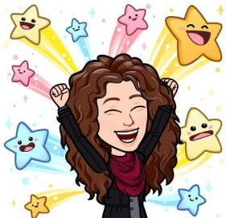
Lets do some or all of the following things together.
Remember to take pictures and you can share them on Teams.
Play outside together. | Read me a book. | Do a puzzle together. | Let’s dance to your favourite song. | Make a snack for you to enjoy.
Do a Joe Wicks Workout together | Take me for a ride on your bike or scooter. | Lets do some chores together. | Show me your favourite toy. | Movie time!
Get someone to hide me. Can you find me? | Lets draw some pictures. |  | Design me a new outfit. | Lets take a selfie with our your funniest face.
Take me to find some insects. | Lets watch your favourite TV show. | Take me for a walk. | Lets go and do some of your home learning pack. | Show me your favourite game on Topmarks.
Lets build something cool! | Go find something that is your favourite colour. | You choose! | Lets bake together. | Random act of kindness for someone.

