Slide 1

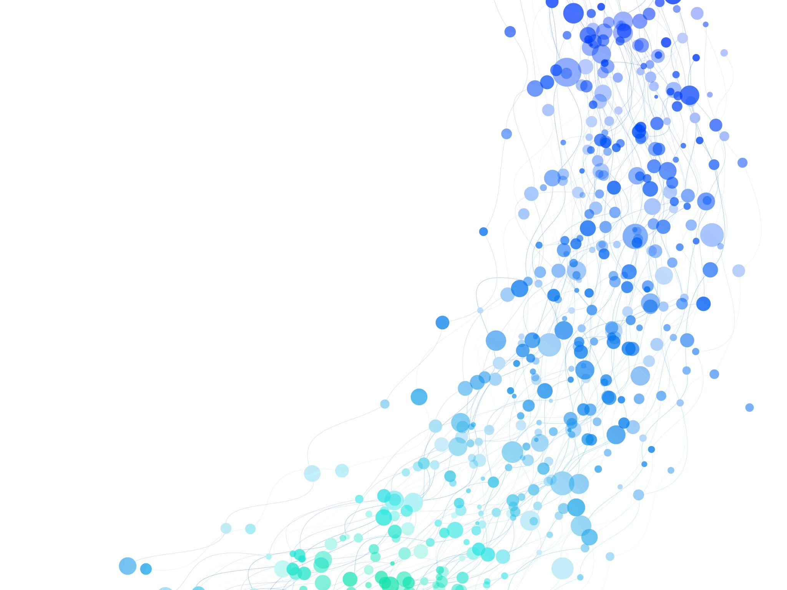

New Monkland Primary School & Nursery Class Curriculum Refresh Update & Refresh
SIP Priority 2023-2025

Slide 2
RATIONALE: Our Why…
To continue to improve attainment within Literacy and Numeracy, and to further meet the needs of learners within our establishment. A refresh of the curriculum was required to allow us to adapt current pedagogy to incorporate learning which would allow learners to become critical thinkers, providing them with opportunities to develop Meta Skills and skills for life, learning and work.
Through increasing parental engagement last session, our parent/carers now have a deeper understanding of the curriculum and how it is taught and were then able to give an informed opinion to contribute to the update of our school vision, values and aims, (previously created back in 2019), to reflect learners, parents/carers, staff, and the current educational landscape and to best meet the needs of all.

Slide 3
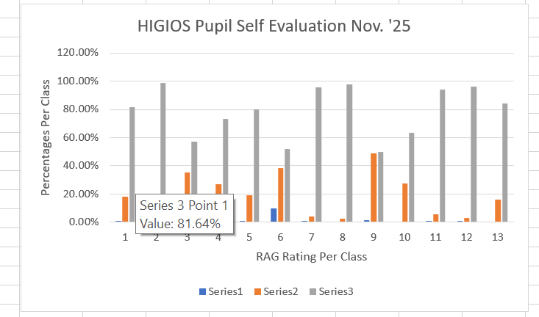
In November 2024, all classes across the school completed self-evaluation of HIGIOS indicator 2.1.
75.37% of pupils RAG rated this indictor as GREEN, on average.

Slide 4
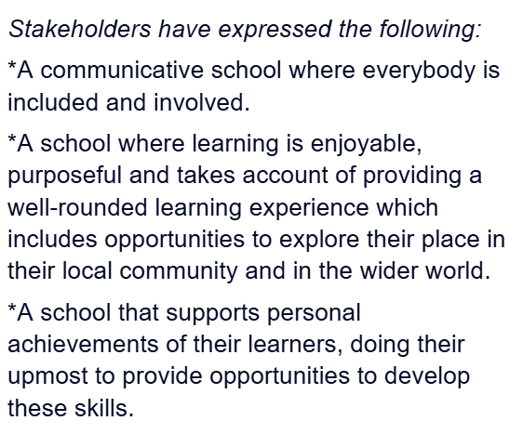
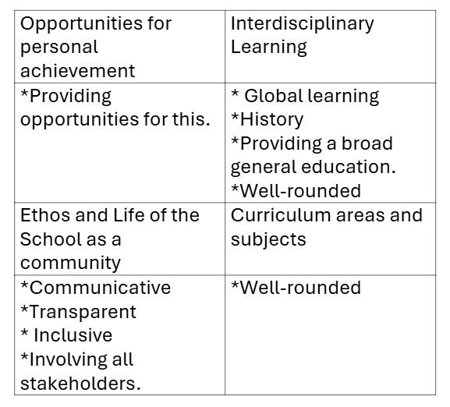
During our Term 2 ‘24 Parent’s Consultation Evening, Parents and carers were asked to complete a consultation about our 4 Capacities and to generate words to build and shape our new vision, values and aims.

Slide 5
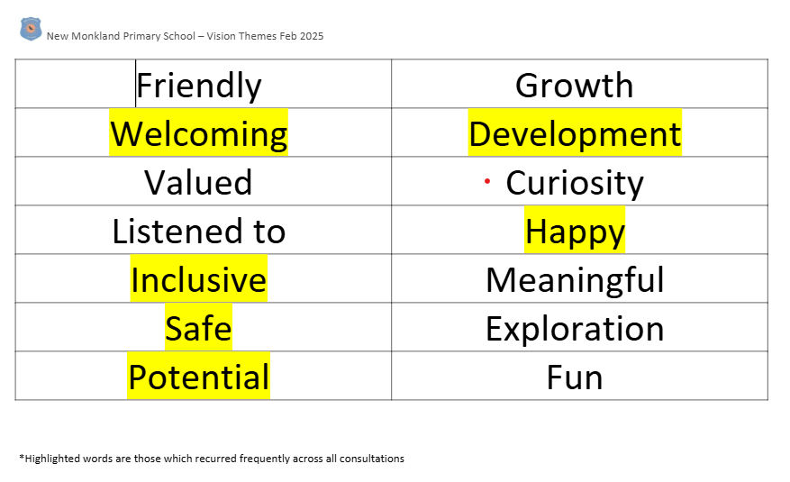
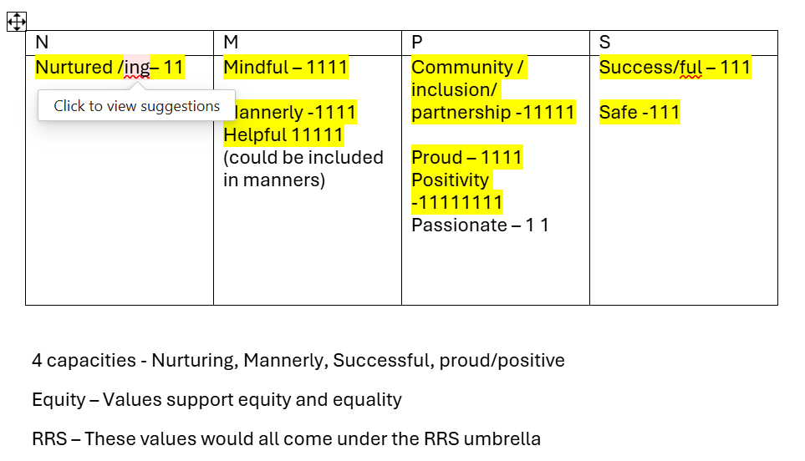
During Term 3 of 2024, all learners were asked to create a list of words which they felt best reflect our school and nursery to help build and shape our new school values, vision and aims.

Slide 6
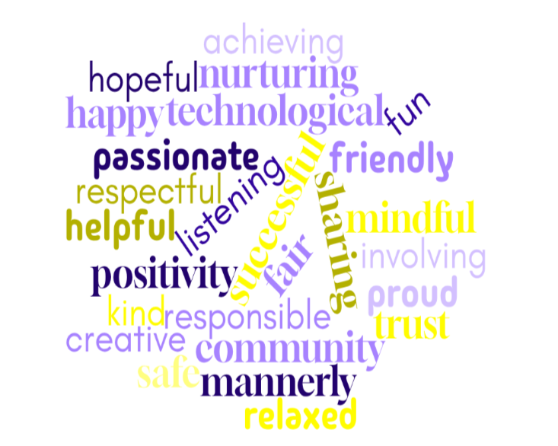
Our New School & Nursery Values
We asked the children of the school and nursery, their parents and carers and all the staff to think of words which best describe NMPS & NMNC

Slide 7
During Term 2, The Wee Leadership collated the values words generated from learners and parents and carers and used NMPS to narrow down our 4 new values:
Nurture, Mindful, Passion & Success

Slide 8
Staff came together in February ‘25 to brainstorm ideas to update our Curriculum Rationale Design.
Insert Photo Here

Slide 9
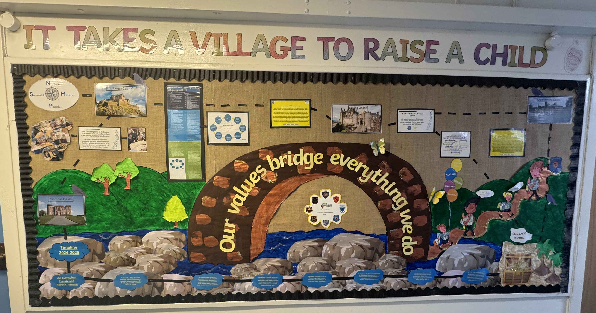
The ‘Wee Leadership Team then choose the elements from each design that they felt best represented us as a school and nursery and agreed on the final look of our Curriculum Design.

Slide 10
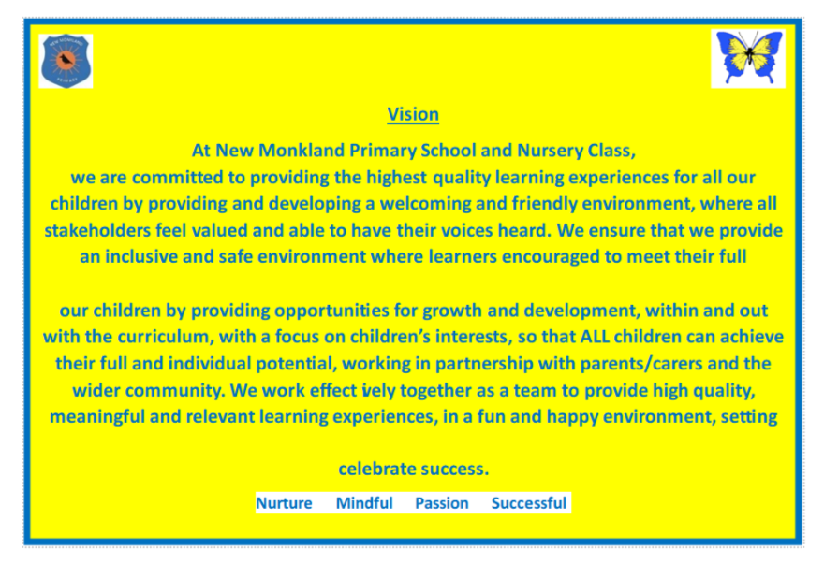
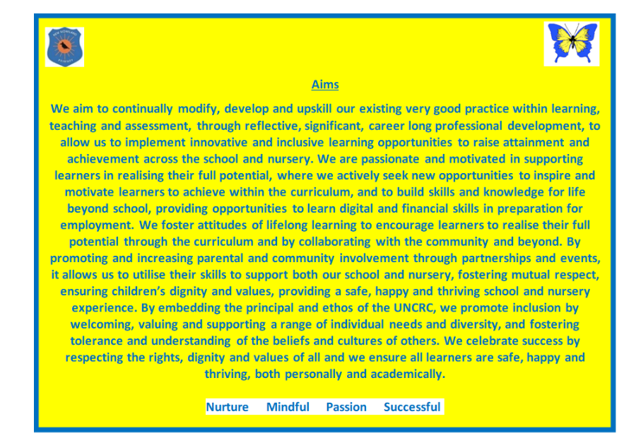
In Term 3, staff collated the words generated form parent/carer consultations to find commonality and themes which was used to generate an updated and refreshed Vision and Aims.

Slide 11
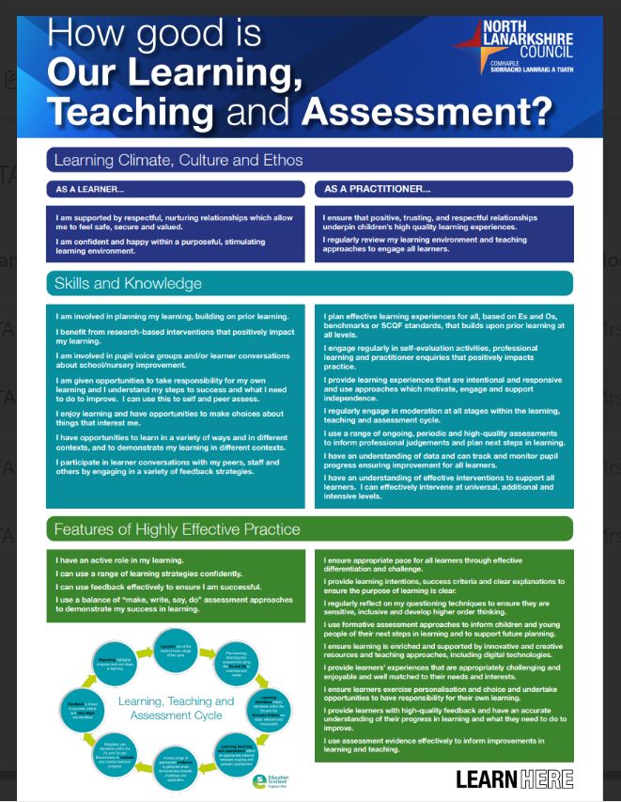
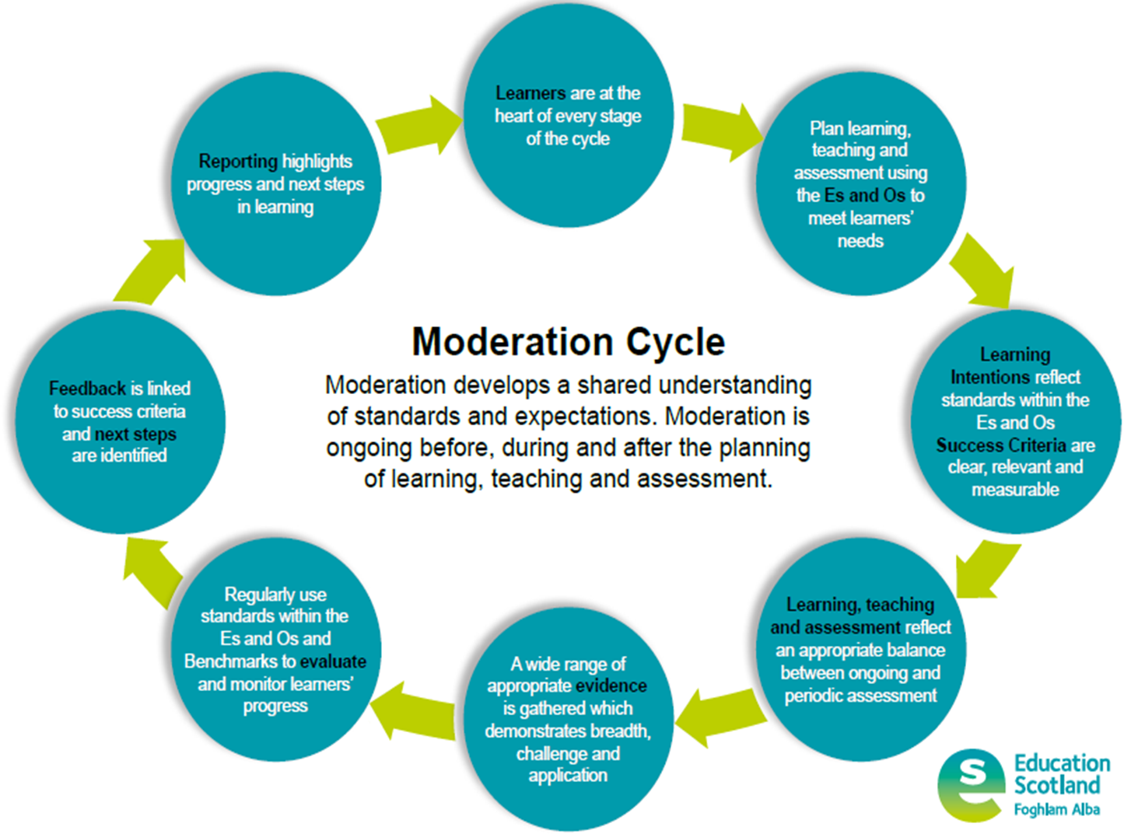
Using the new NLC LTA poster, staff worked collegiately to create a personalised poster which reflects learning, teaching and assessment within NMPS in May ‘25. This will be implemented across all classes from August ’25.

