Slide 1
Starting Muirhouse Primary School
2021

Slide 2
Happiness
Kindness
Safety
Friendship
Learning
Trust
Respect
Willow, Hazel, Ash and Oak

Slide 3
Rights Respecting School

Slide 4
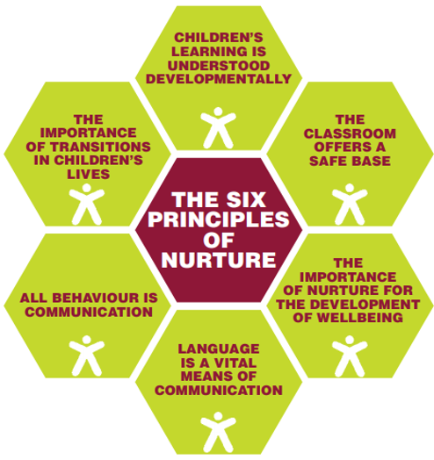
Nurture Principles

Slide 5
Starting School
Starting Primary 1 can be both an exciting and anxious time for you as a parent or carer, and maybe for your child too. This year may bring additional worries for you. Although we are not sure what the start of school will bring this year, there are still things you can do that will help to prepare you and your child for beginning their Primary 1 journey.
Remember!
These are just suggestions and should fun and easy things to do with your child. If they are too much then please don’t feel you have to do them. Children start school with a range of experiences and skills and part of the Primary 1 experience is to build on where ever the child is. If they are unable to do certain things please do not worry about it.
Have Fun!
Children learn through play and so a lot of these suggestions will be play based and designed to be fun. If they aren't fun then stop.
“You are off to great places. Today is your day. Your mountain is waiting. So be on your way”
Dr Seuss

Slide 6
Games to promote skills for learning
Your child learns through play and this will continue in to Primary 1. There are simple games you can play at home which will help to develop some important skills for learning whilst having fun. Games can help to develop attention and listening, pre-literacy skills and the ability to sort and hear rhyme.
Symbol Dance
Draw a key where shapes are associated with a particular move. Then write sequences of shapes and ask your child to look at the symbols and preform the sequence. This will encourage pre-literacy skills as they are beginning to decode symbols and learn their meaning in the same way they will the letters when they learn to read. Hop. Jump. clap
Sorting
This could be sorting coins, socks, shapes, colours or anything that helps them to start to see the similarities and differences between items.

Slide 7
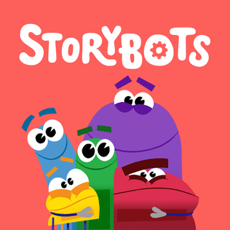
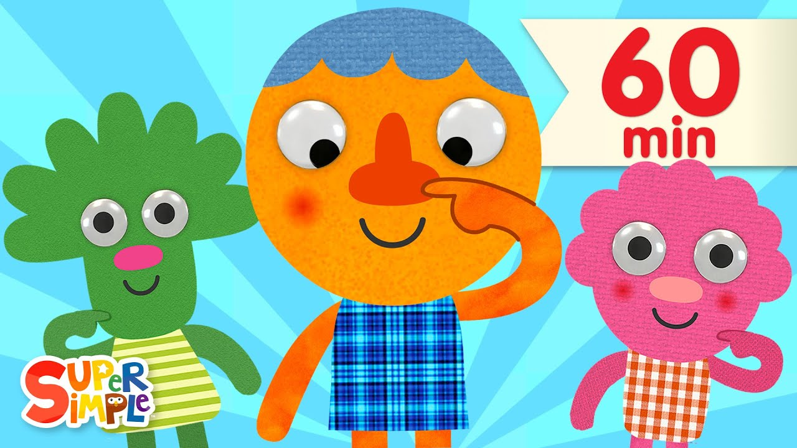
Songs and Rhymes
Lots of songs can introduce early counting such as “10 Green Bottles”.
They also introduce the concept of rhyme such as in “Humpty Dumpty”
Songs can also help attention and listening such as “Simon Says”
Baby Shark and other You-tube songs
Sites such as - :Pinkfong – Super Simple Songs – StoryBots
https://youtu.be/pZw9veQ76fo
https://youtu.be/XqZsoesa55w
https://youtu.be/pdc6EKTGwrI

Slide 8
Reading
Find your name
Hide objects around the house that have the child’s name on them to get them used to recognising their name in written form.
Read to them
Reading to children encourages a love of books and a desire to read independently.

Slide 9
Emotional Support
Normalise Feelings
Lots of children are excited about going to school but it’s okay for children (and you) to feel nervous about it too. It is a change that children sometimes feel will be difficult. It is important to normalize this and reassure your child that these feelings are natural.
Try not to talk about school as if it is a big deal. It is a normal life progression
Talk about when you went to school and what you liked
Encourage children to talk about how they feel
“I feel __________ because ________”
Use pictures to explore feelings if the words are difficult for them
Expect that there may be a change in behaviour while they process the change
Practise goodbye routines and think of ways to let them know you are keeping them in mind such as notes in lunchboxes or hearts drawn on hands as virtual hugs.
Emotionworks, Boardmaker, Colour Monster, Inside Out

Slide 10
Encourage Independence and Confidence
It is important that your child feels they can accomplish things and feel confident to try. Making mistakes and getting things wrong is one of the ways we learn. There is always help available at school but trying on your own first is a very useful skill for learning.
Spend time with them having fun and playing
Give them small jobs and responsibilities at home
Praise often and use direct praise for effort and having a go
“I liked the way you tried really hard there”
“Well done for trying that”
“I really like how you stuck at it”
“ Wow, you didn't give up and kept going”
Well Done!

Slide 11
Practical skills to practice
There are lots of new skills needed for school and children might not have done some of these before. There will of course be help on hand but it can be useful for them to be able to have some of these so they can be independent and have a sense of accomplishment.
Packing their bag
It can be helpful for children to practice packing their bag and seeing hoe best to fit things in
Tying shoe laces
You can of course buy shoes with other fastenings but if they have laces it is useful if they can tie them
Self care
Knowing how to clean themselves at the toilet and how to wash their hands are important skills to have.
Writing their name
It can be useful for children to be able to write their name. Don’t worry if they can’t and just work on helping them recognising their name
Getting changed
Being independent in getting themselves changed for different aspects of their day can be useful. For example your child could practice getting changed into and out of their uniform and PE clothes. Buttons can some-times be stiff on new shirts and this can help to relax them a bit
.
Attention and Listening
This is a very important skills to develop for learning. You can sit with your child and read, or play games that develop this skill

Slide 12
Help them to visualise school
Helping to imagine what school might be like might make it seem less strange. Try to find ways to make school feel familiar.
Look at pictures of the school Starting School tile on Teams
Practise the walk to school if you can
Role play school days with teddies or toys
Practise packing their bag
Read books (see list opposite)
https://youtu.be/GNCzejOfjME
Copy and paste into browser
https://youtu.be/_VoHpv1XIic
https://youtu.be/qHjRzSFyn50

Slide 13
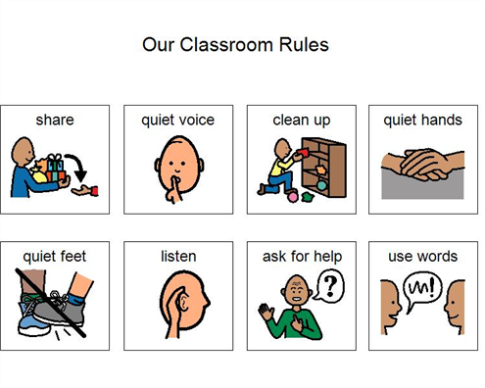
Practise Social Skills
Social skills are important in a new environment. They help young children ask for things they need and make connections with others which can help to make them feel safe and secure. Some of these skills can be practised at home.

Slide 14
Learning through Play

Slide 15
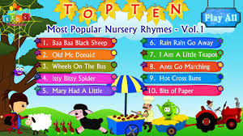
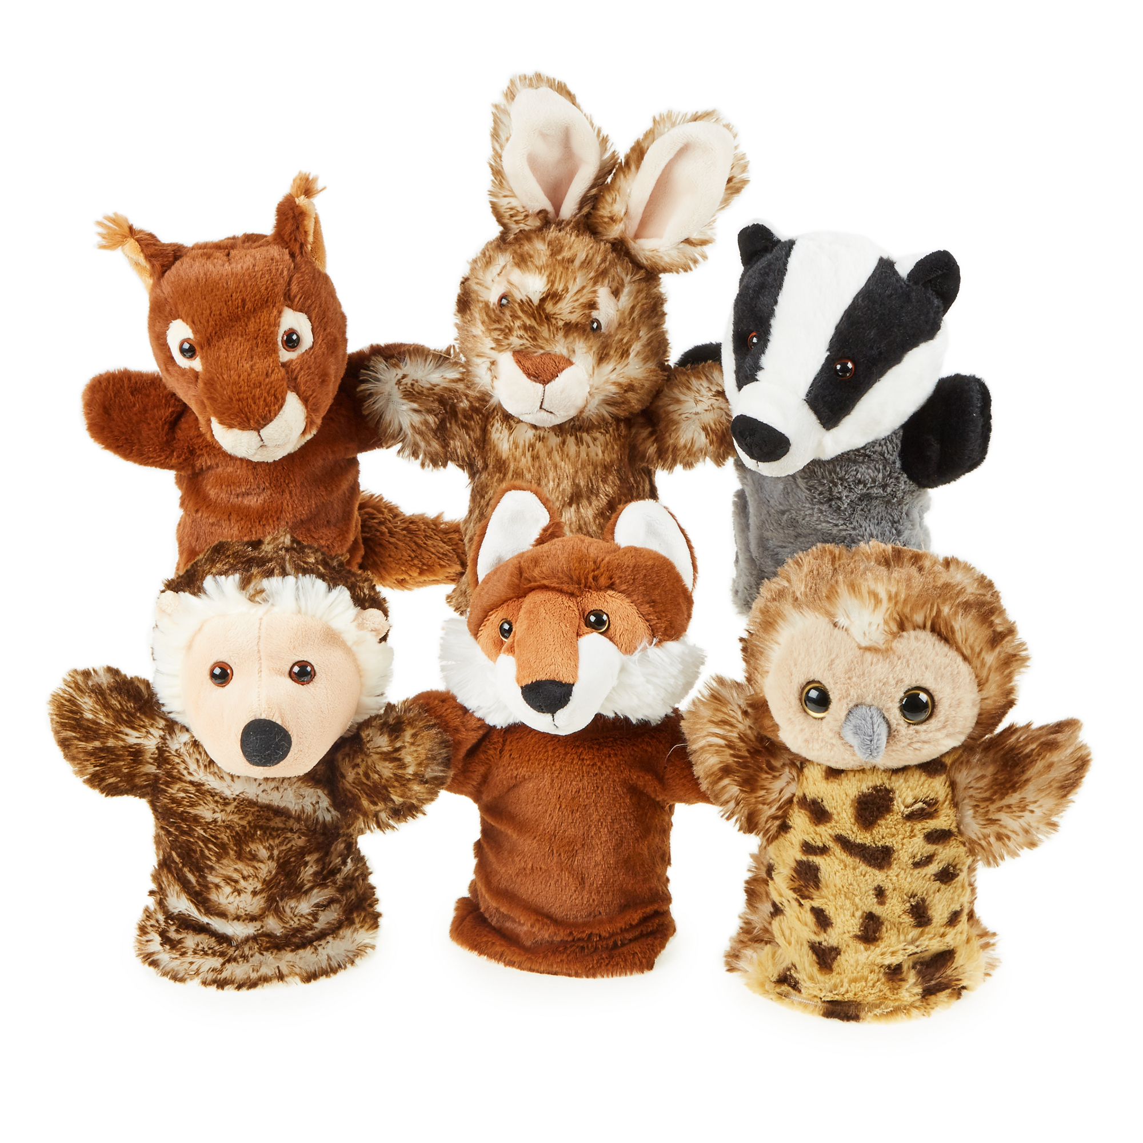
Literacy
First four weeks
Phonological awareness
Fine motor skills
Rhyme and syllables
NLC Active Literacy
One sound per week
Three common words
Reading Books
Role play/ story telling/ puppets
Taught writing
Lending Library
What can I do at home?
Read reading books every night.
Practice reading and writing common words.
Flashcard practice
The children will be given two reading books each week. Please make sure these are returned to school EVERY day as we use them in class and may need to quarantine them before other children can use them.

Slide 16
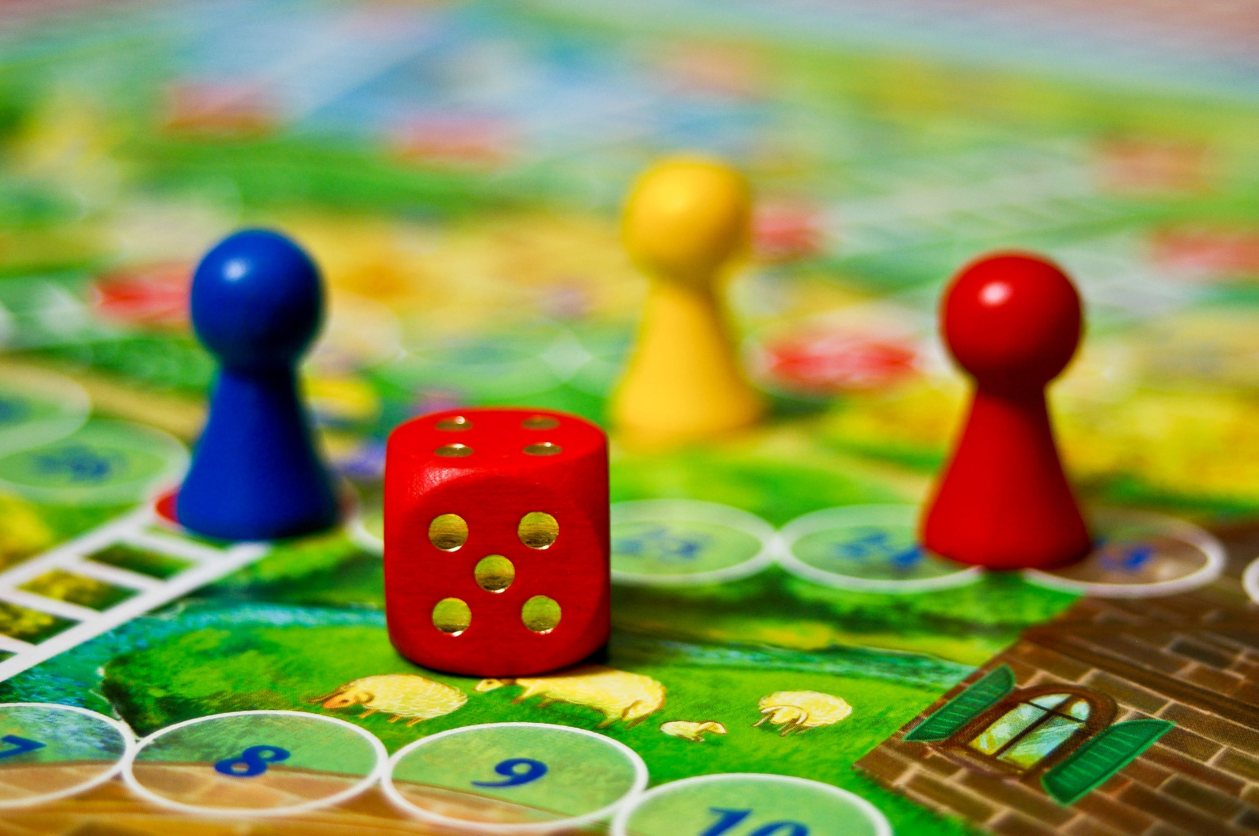
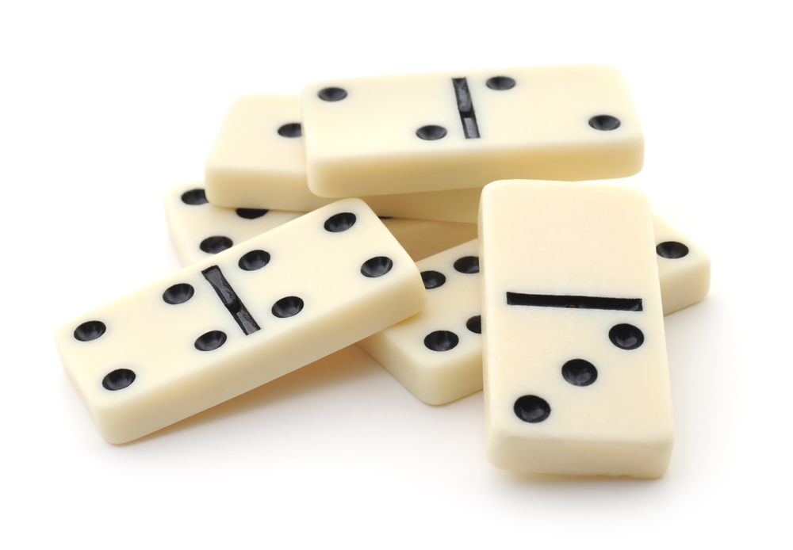
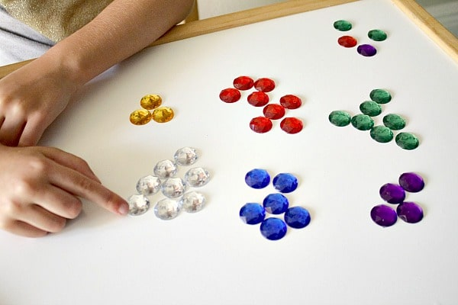
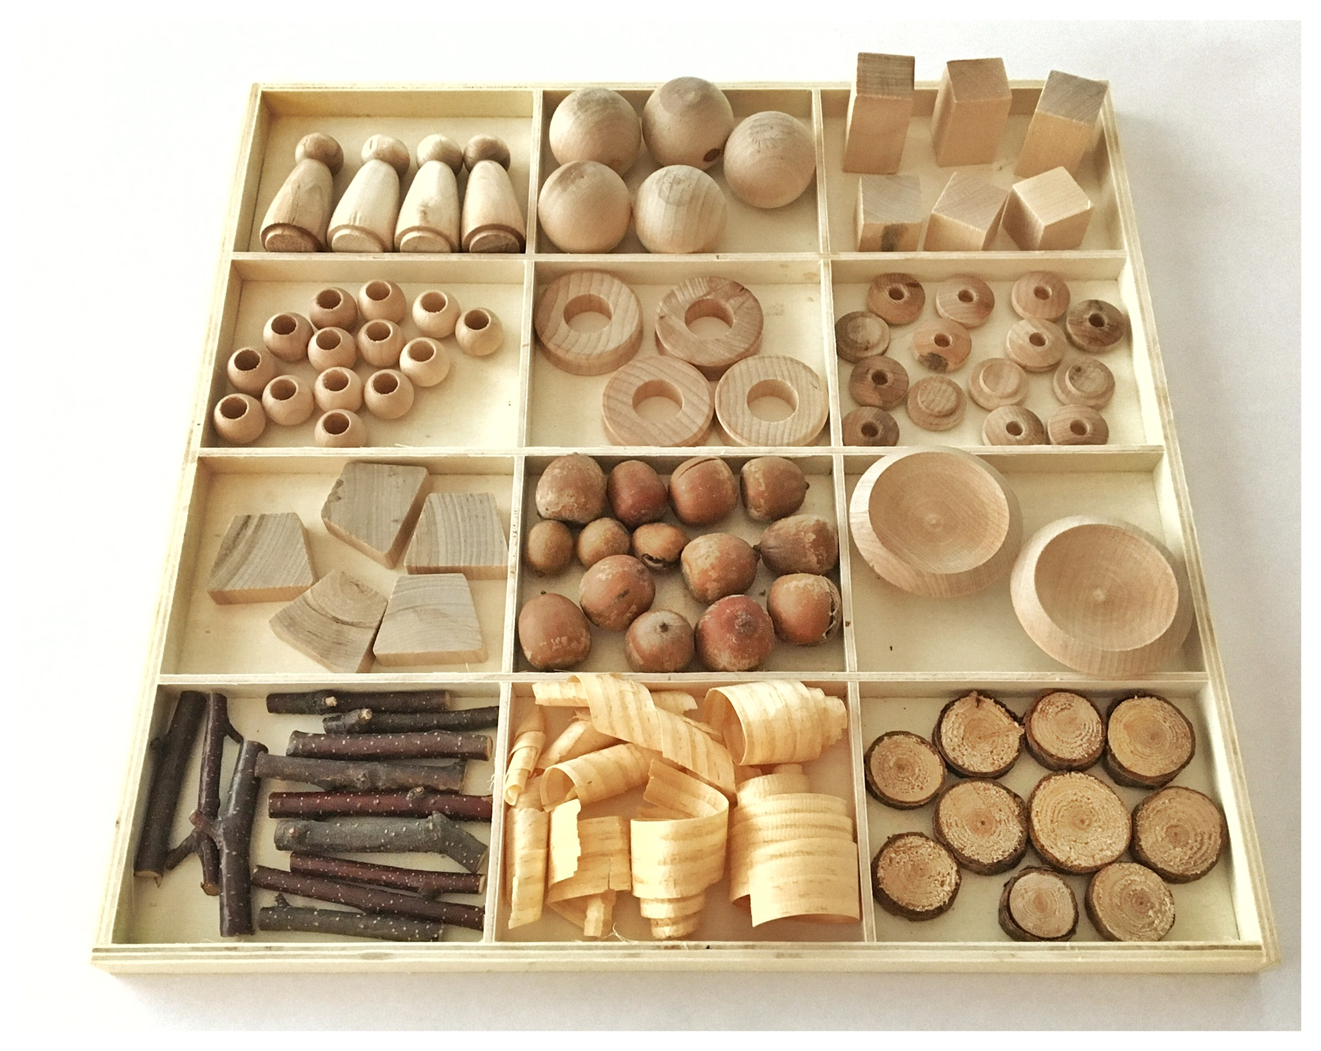
Numeracy
SEAL Planners
Counting songs
Mainly numeracy based
Active tasks and play
Loose materials
Counting games
blocks
What can I do at home?
Play board games
Dice games
Dominos
Counting objects 1:1
Keep an eye on Microsoft Teams for Home Learning activities relating to what the children are learning in school.

Slide 17
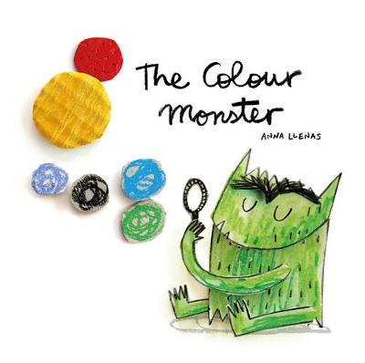
Health and Wellbeing
Colour Monster
Emotion Works
Mr. Men
Confident Individuals
Successful Learners
Effective contributors
Responsible Citizens
Targets
Every two weeks, the children will choose achievable targets related to the four capacities.

Slide 18
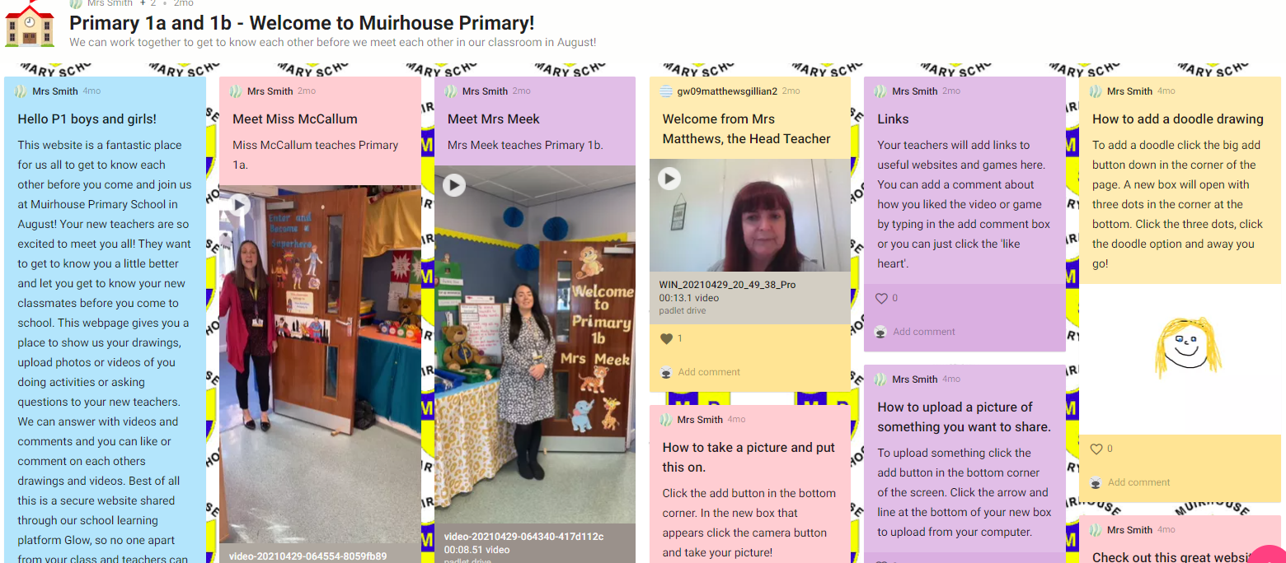
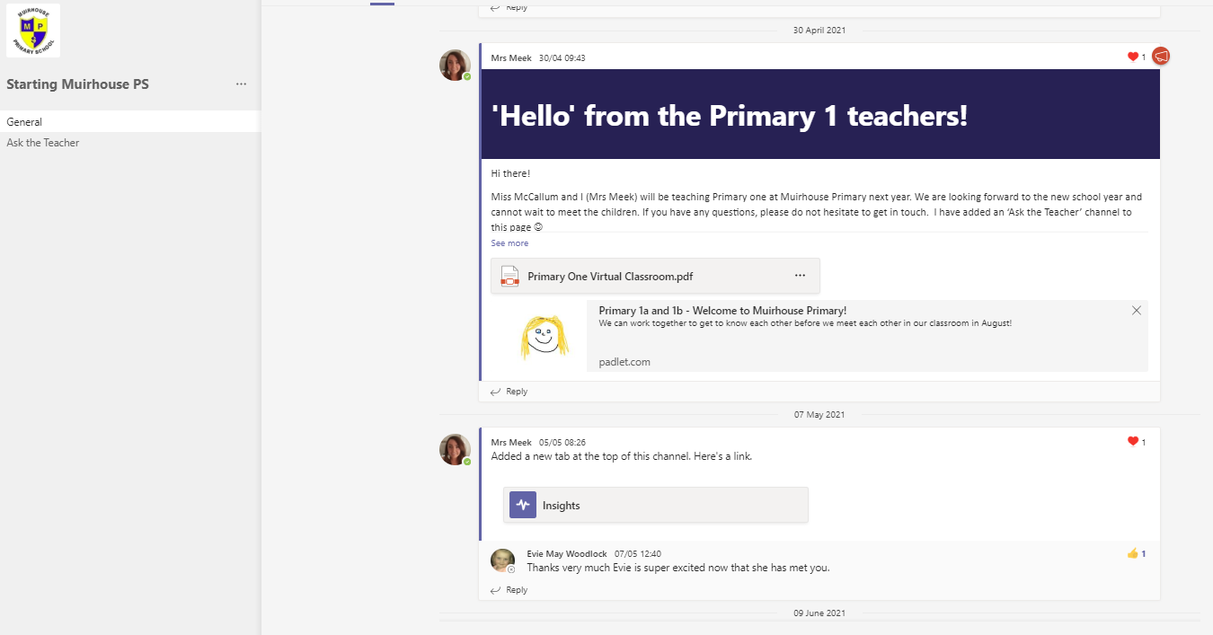
Primary One Information
P1a- Miss McCallum
P1b- Mrs Meek
Mrs Meek (Classroom Assistant)
Starting MHP Microsoft Team and Padlet website

Slide 19
First Day
Primary 1a arrive at main entrance on Monday 16 August 2021, at 9.15 am.
Children and parents line up at main door where they will be met by the class teacher and taken inside.
Primary 1b will arrive at 9.30 am.
We are not yet in a position to say whether parents will be able to enter the building or not come August. If COVID rules change over the summer we will let you know.
Primary 1a will be dismissed at the infant gate at 2.40pm. Parents must stay behind the fence.
Primary 1b will be dismissed a the infant gate at 2.55pm.
Children are taught to line up and stay with the teacher until they see the adult who is picking them up the give the THUMBS UP SIGN.
Please make sure that your child knows who is collecting them each day.
Day 2- ALL PRIMARY 1 classes will line up at the yellow markers, in the infant playground at 8.55am.
Parents MUST stay at the gates.
Pupils will exit by the infant door and be escorted to the gate at 2.55pm.

Slide 20
After School Care
Get In Touch Aquatec, 1 Menteith Road, Motherwell, Wishaw Sports Centre, Alexander Street, Wishaw Tel: 01698 352 270 Mob: 07980 686 705
E-Mail: clydesdaleafterschoolcare@gmail.com

Slide 21
Lunch
All Primary 1-3 children receive a free lunch in school.
Nursery children are already familiar with having a lunch and our children are familiar with the lunch hall etiquette.
Children will order their lunch first thing in the morning with their teacher. It is useful to check the NLC website for lunch choices and discuss this with your child each day, so they are prepared.
Children are welcome to bring a packed lunch.
Please supply your child with a bottle of drinking water and a healthy snack for playtime.
Please store the snack somewhere separate from their packed lunch, e.g., school bag. All being in the same bag as the packed lunch causes confusion.

Slide 23
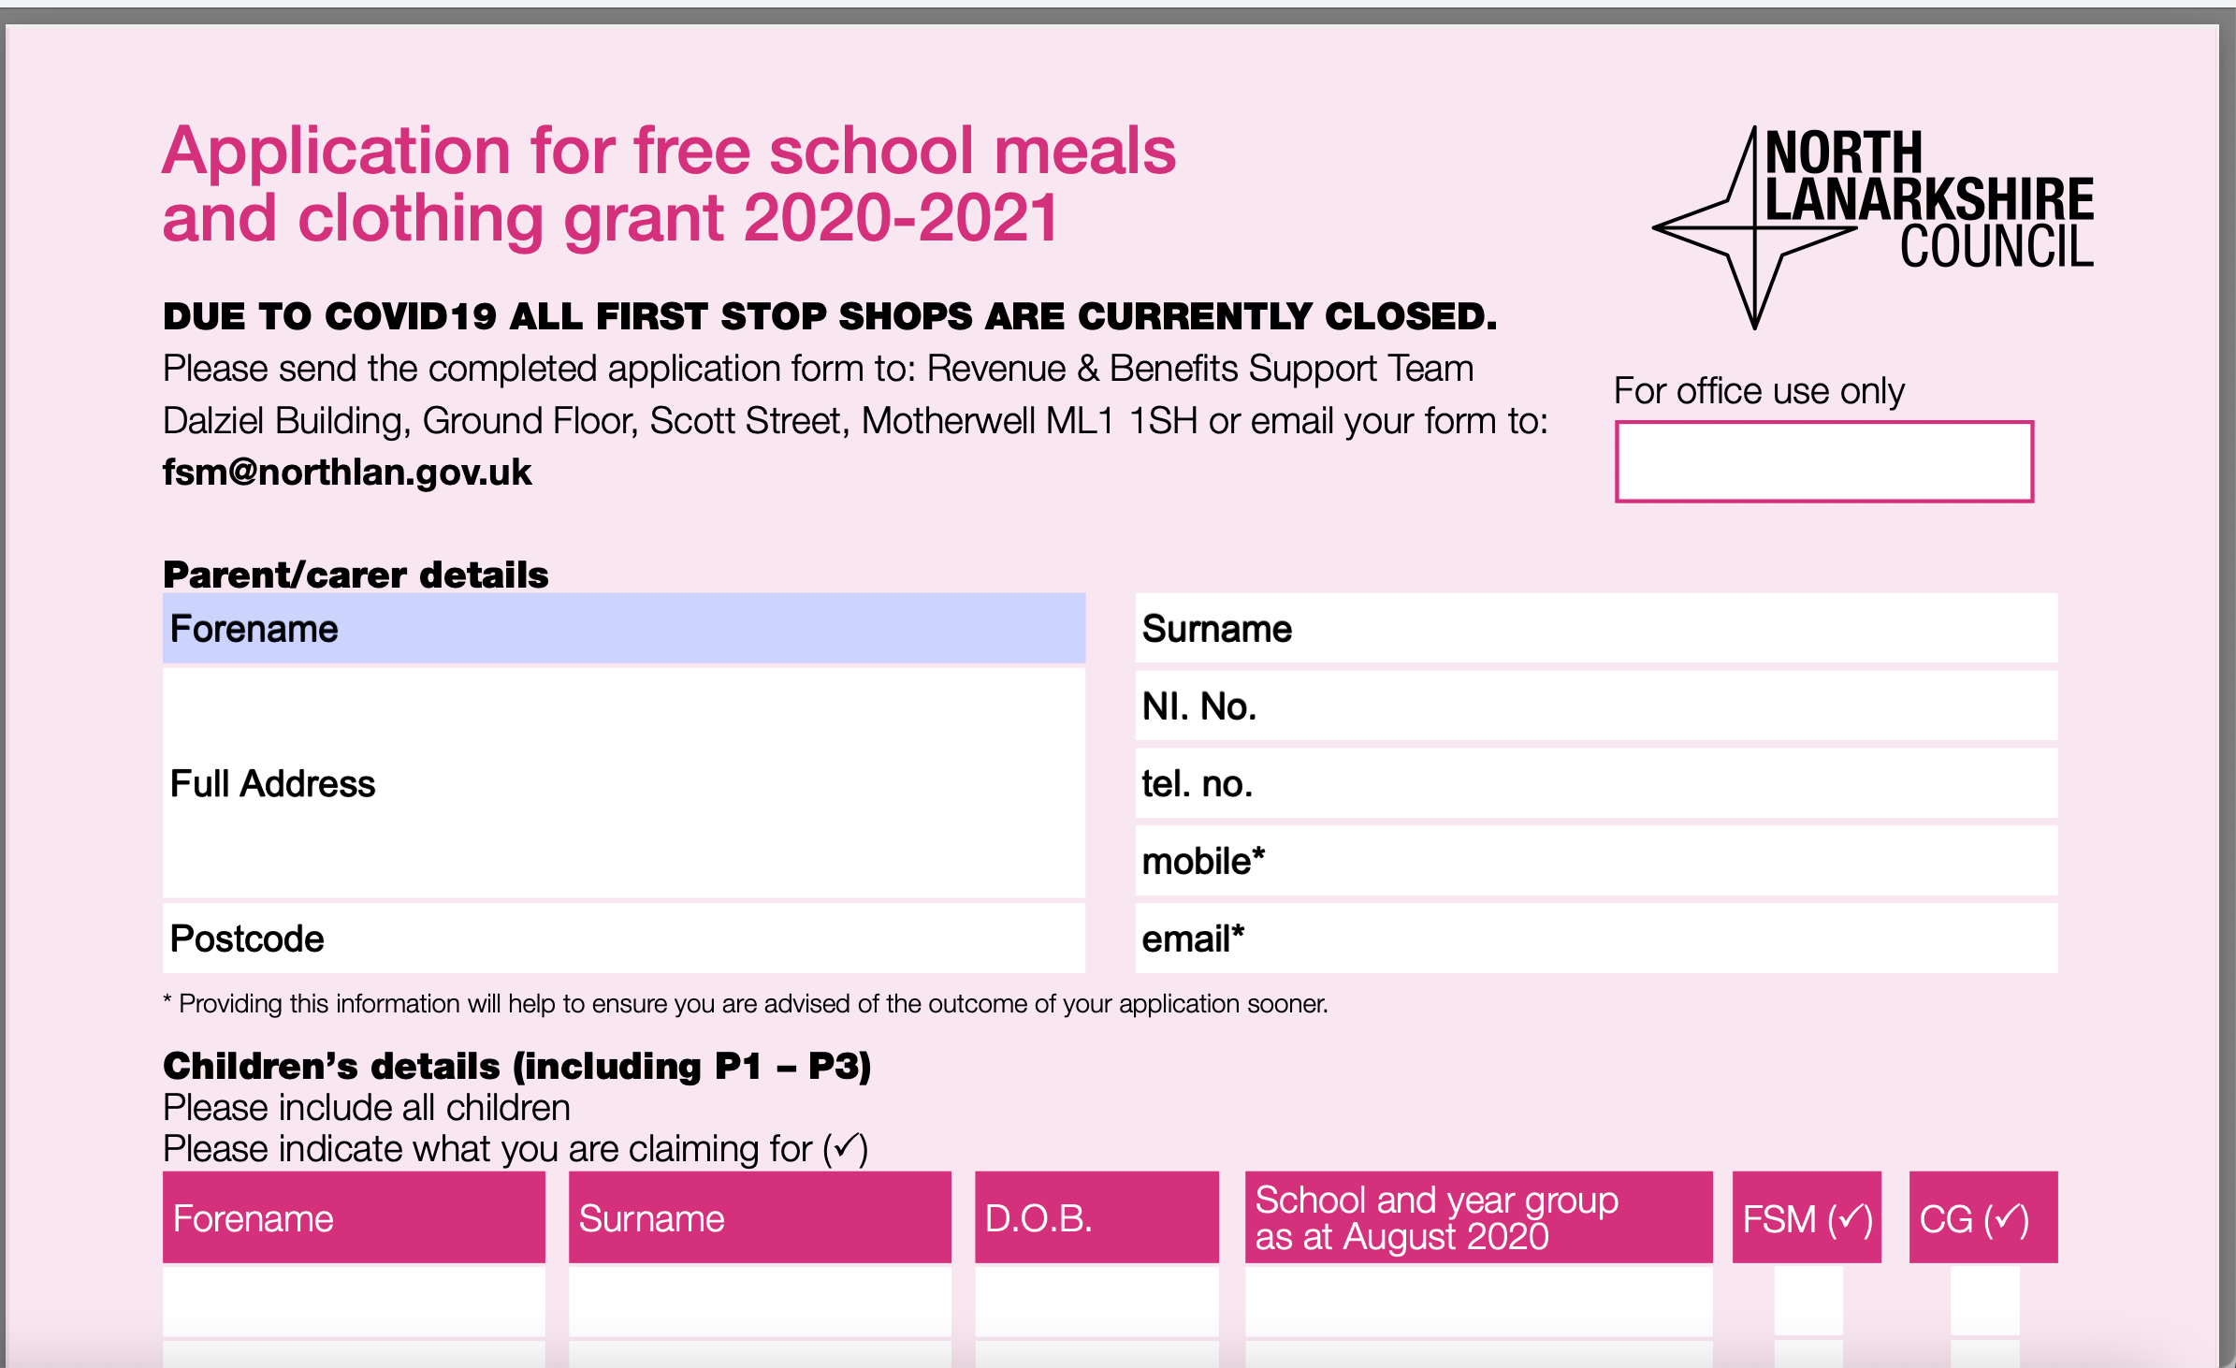
Best Start Grant

Slide 24
See-Saw app and Teams
See-saw app is being considered for use by NLC. We are awaiting more information regarding this and will let you know in due course.
Children will be able to access a Primary 1 online Teams page, the children will be introduced to this in class and gradually incorporate it into the school day.
The Starting School page will be renamed as the Primary One Team tile.

Slide 25
Any questions??
We are hoping that current COVID restrictions will begin to eased and that school life will begin to become more normalised again.
We will keep you updated on the latest NLC guidelines for schools and how it effects you and your child.
Enjoy your summer and stay safe!

