Slide 1
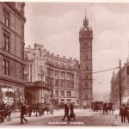
Glasgow Landmarks – the Tolbooth Steeple
The Tolbooth is located on the High Street in Glasgow
The Tolbooth Steeple was part of a much larger building called the Tolbooth
It was built in 1626 and is still standing strong today
1626

Slide 2
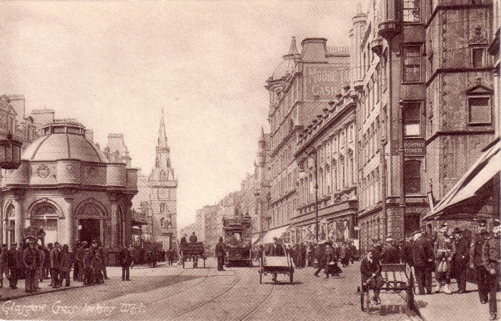
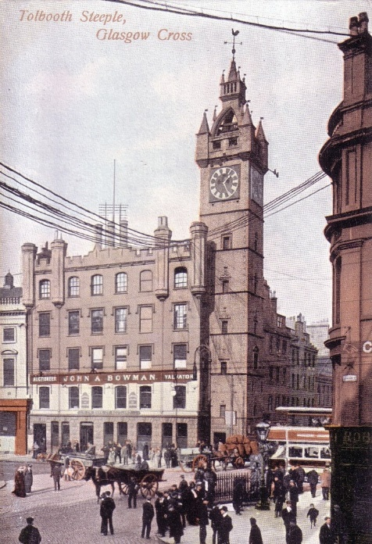
How big was it?
1900’s
1814
The Tolbooth Steeple stands 7 stories high
It is Exactly 126 feet high

Slide 3
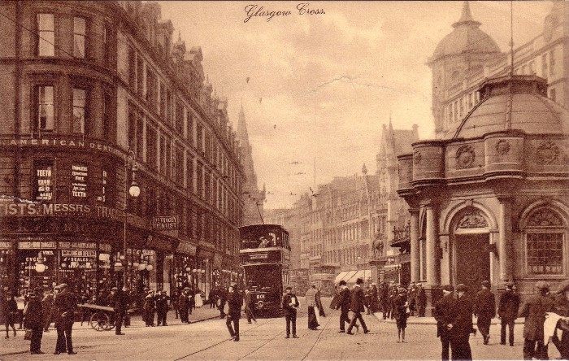
What was it used for?
It was a multipurpose building which at one point contained the Town Clerks OfficeTown hall, the Court and the Jail.
1910
The Tolbooth housed the Glasgow Council Chambers until 1814

Slide 4
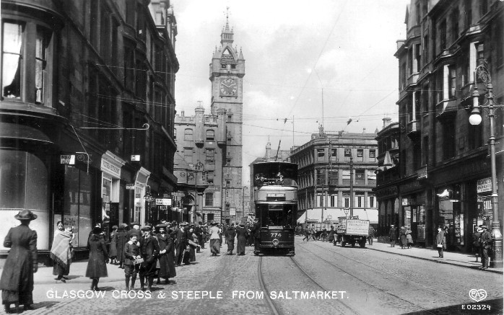
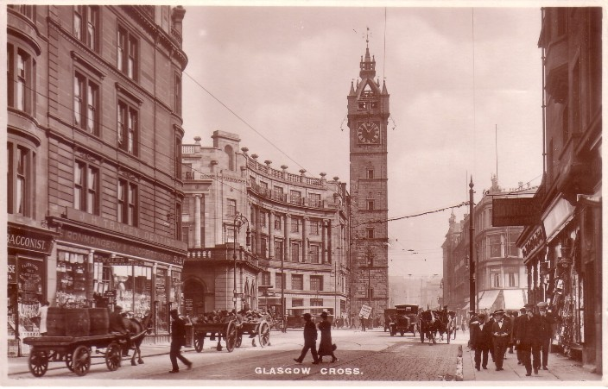
The Tolbooth building it’s self was demolished in 1921
This left the Tolbooth Tower standing alone
1920’s
1912
There used to be a passageway for pedestrians through the base of the steeple but this was closed off once the steeple stood alone

Slide 5
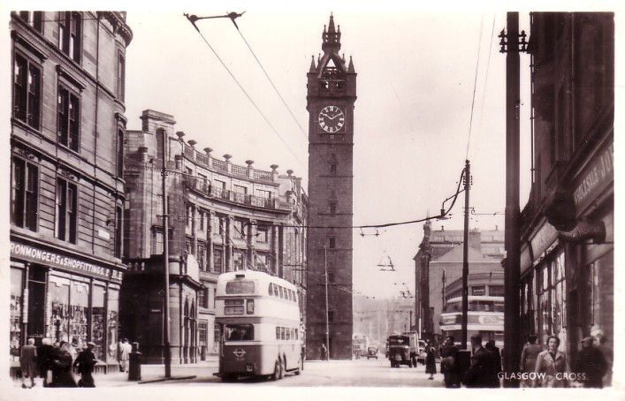
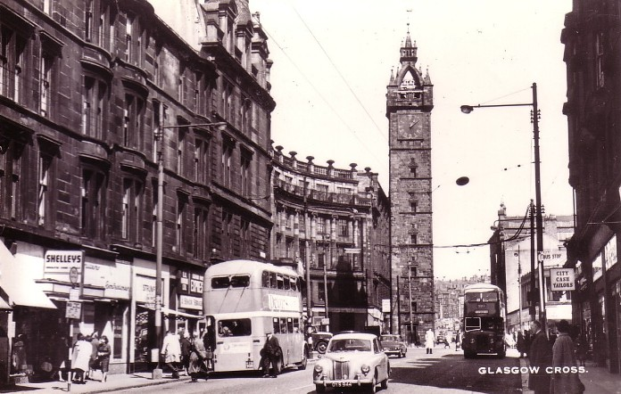
How has it changed?
You can see the changes in the pictures as time goes by
It looks more and more Modern
1960’s
1949

Slide 6
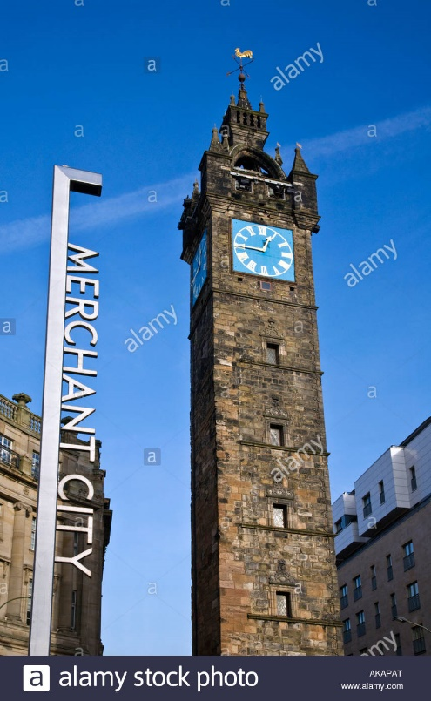
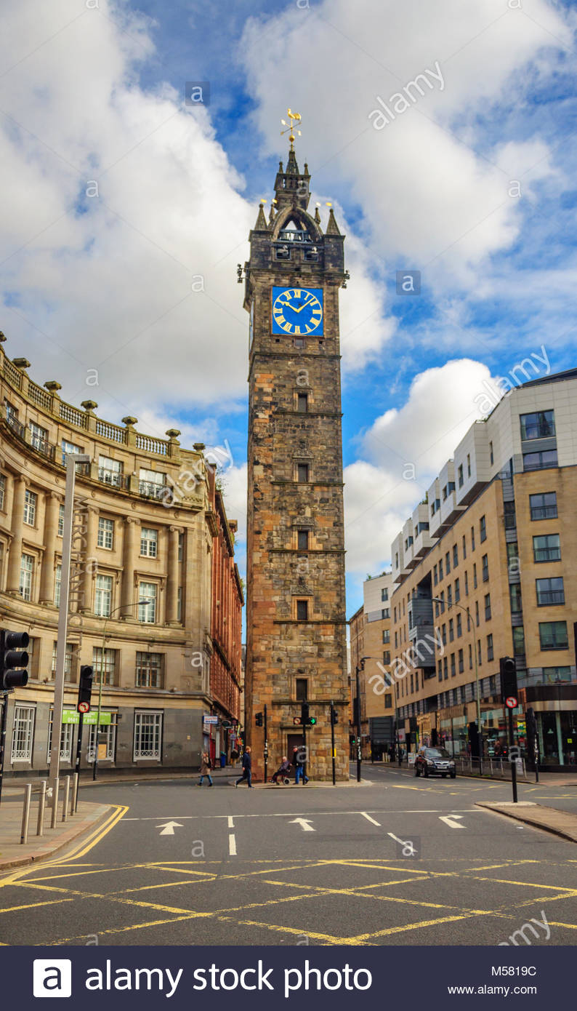
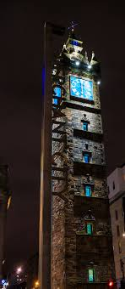
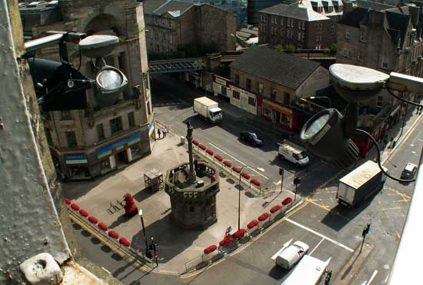
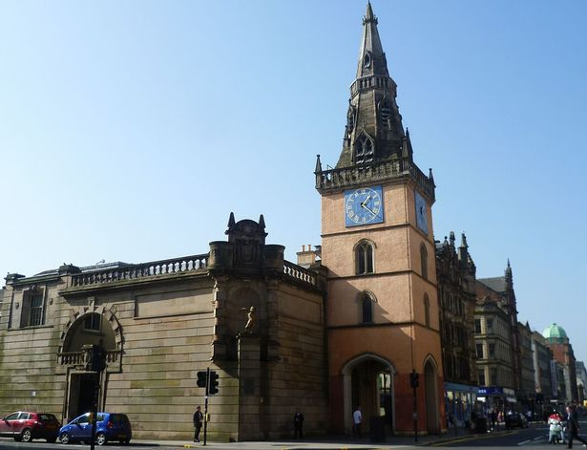
What does it look like today?
If you wander through the Trongate area of the city, you'll find an amazing variety of new upmarket pubs, restaurants and apartments blocks
View from the tower

