Slide 1
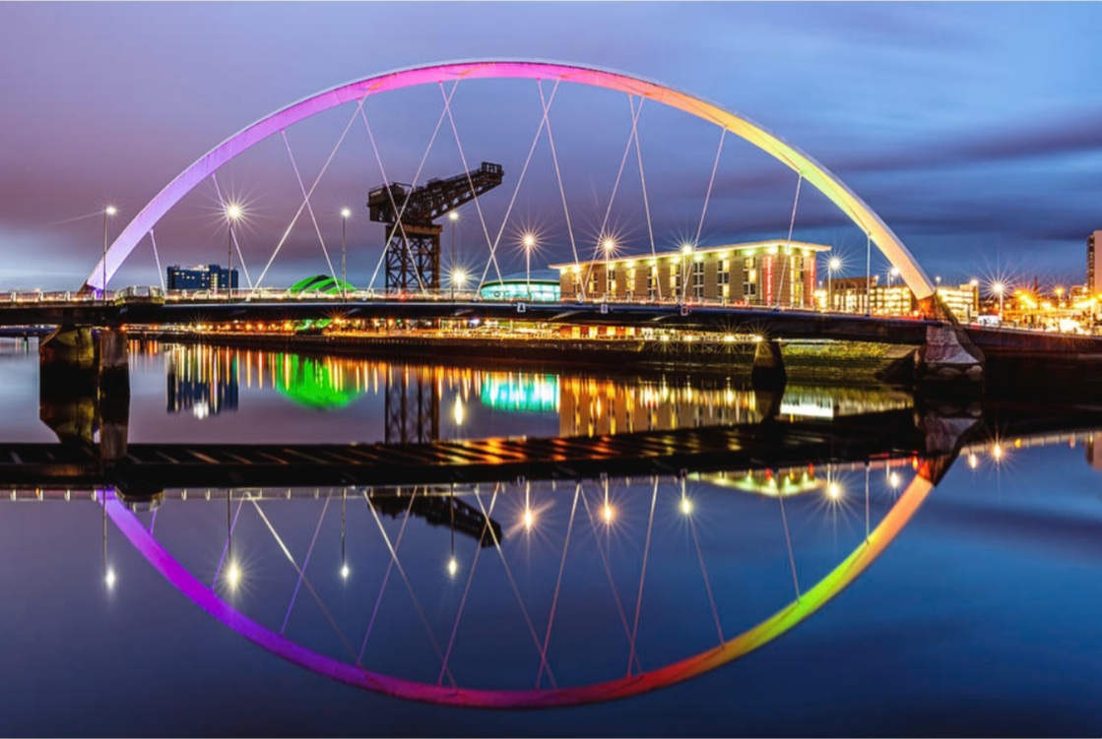
The Clyde arc
By Maryam Bajwa

Slide 2
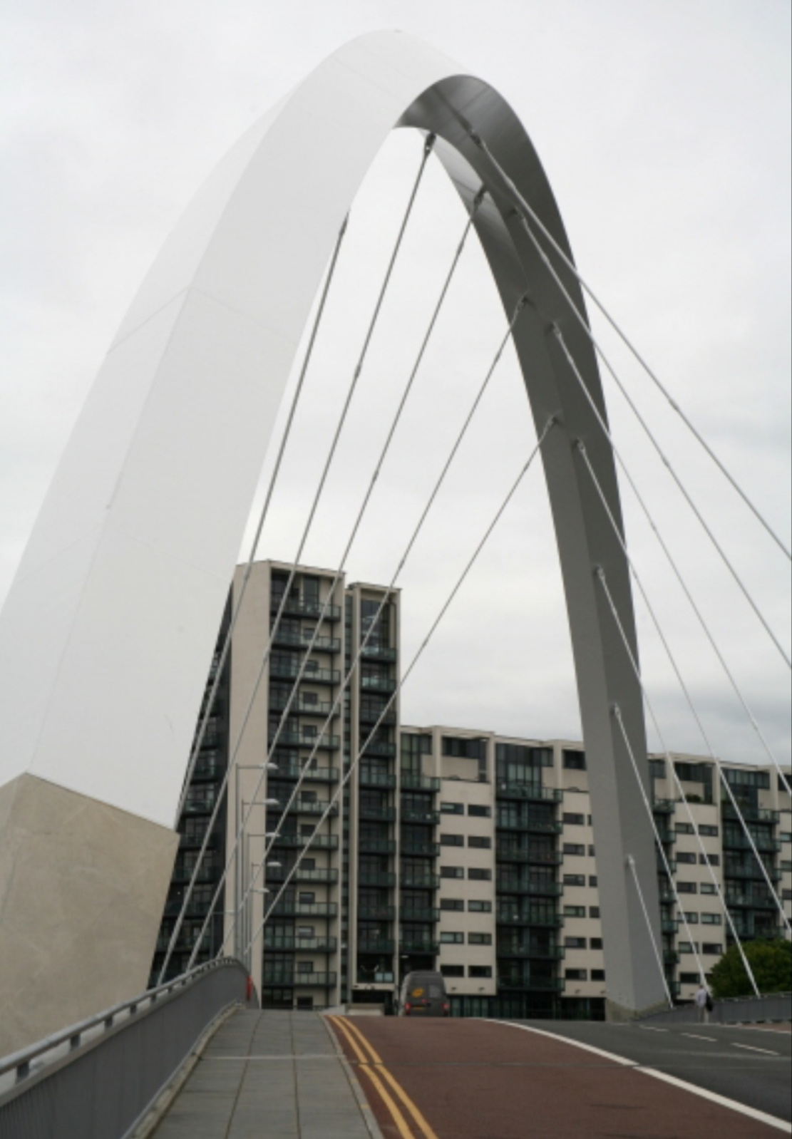
The Clyde Arc is a road bridge spanning the River Clyde in Glasgow, Scotland.
The bridge was officaly opened on 18th September 2006.
It is also known as the “Squinty Bridge” and the “ Finnieston Bridge”.

Slide 3
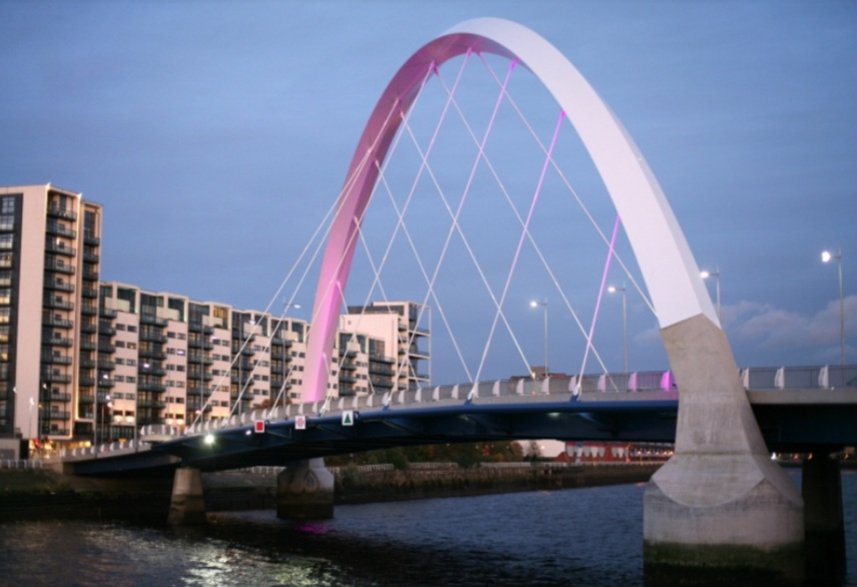
It is a tied arch bridge with a suspended deck.
A prominent feature of the bridge is its innovative curved design and the way that it crosses the river at an angle.

Slide 4
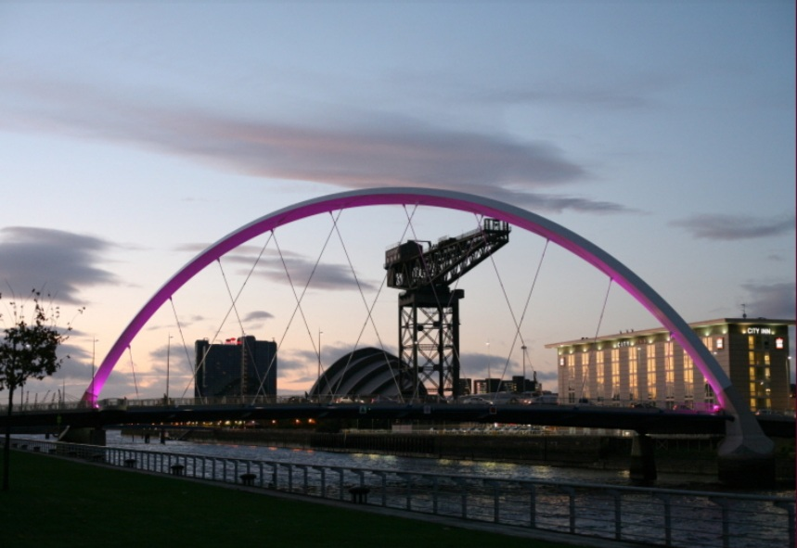
The bridge carries motor vehicles, cyclists and pedestrians.
It has a width of 22 metres.
It has a span of just under 100 metres.
It cost £20.3 million to construct.

Slide 5
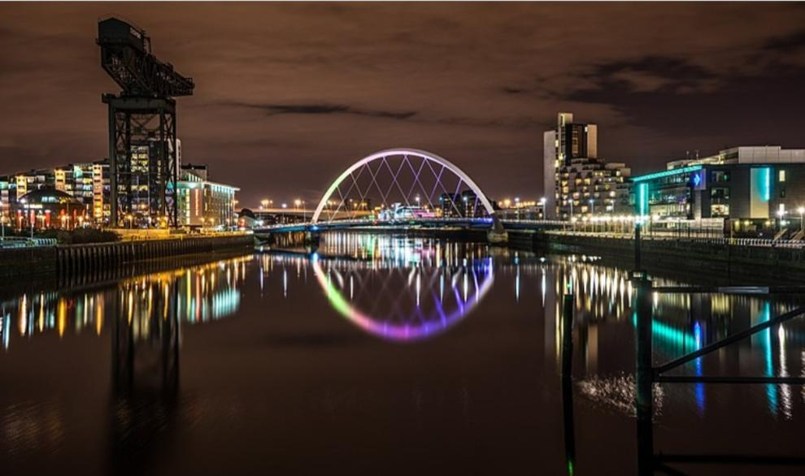
The Clyde Arc is a beautiful Glasgow landmark.
It is nice to take pictures of it during the day, but its better at night because it lights up with all different colours.
It is near other Glasgow landmarks such as the Titan Crane, the Clyde Audoutorim and of course the River Clyde.

