Slide 1
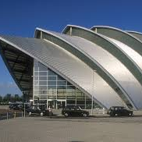
THE CLYDE AUDITORIUM
Also known as The Armadillo
A presentation by: Joseph Murphy

Slide 2
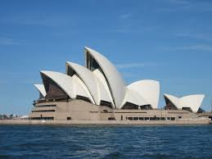
Built in the year 2000 by Sir Norman Foster it is said to look like
Sydney Opera House

Slide 3
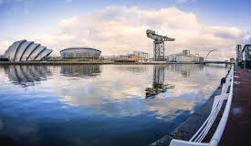
It stands on the North Bank of the River Clyde

Slide 4
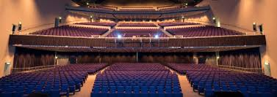
It is one of the principal concert venues in the country with a capacity of 3000

Slide 5
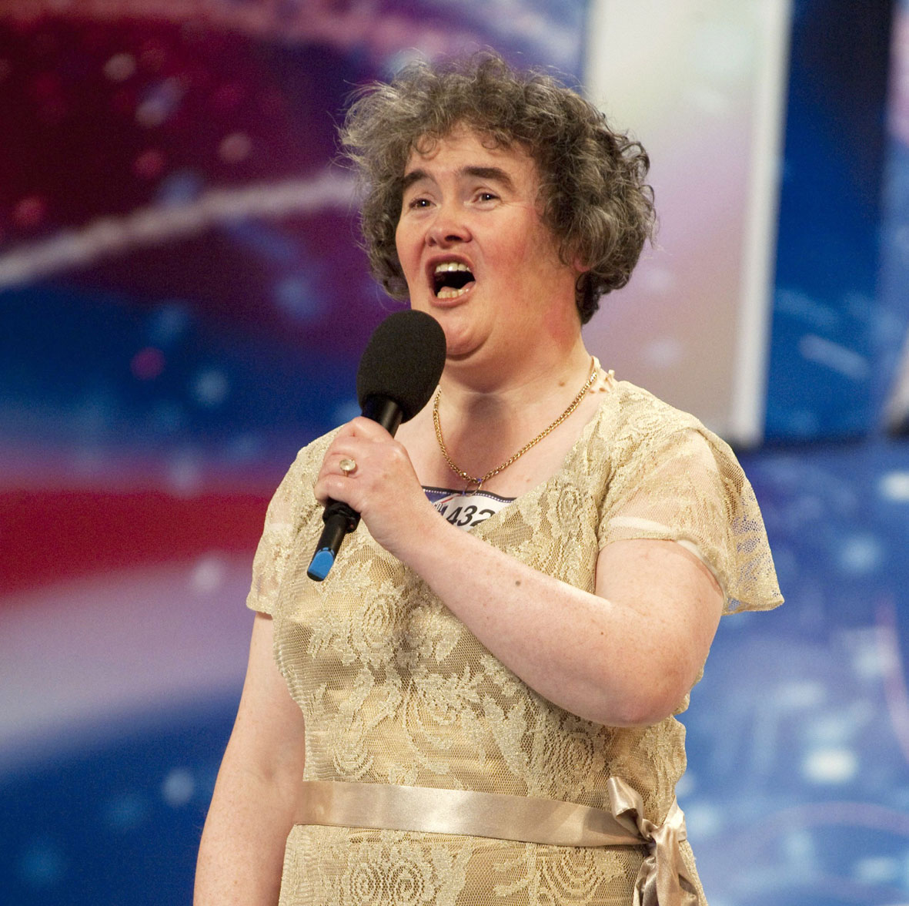
Britains Got Talent (BGT) have held auditions there and Susan Boyle was discovered at 1 of these auditions.

Slide 6
the 63rd World Science Fiction Convention was held here

Slide 7
The building served as the venue for the weightlifting competitions of the 2014 Commonwealth Games held in Glasgow.

Slide 8
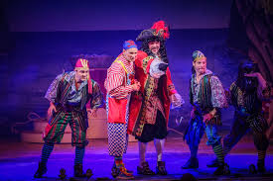
In the season of Christmas, the Armadillo is used for Pantomimes

Slide 9
CBBC have held shows here and I went to see a cbeebies show when I was 2

Slide 10
The end!
:D

