Slide 2
What Is Scots?
Scots is one of three native languages spoken in Scotland, alongside English and Scottish Gaelic.
Scots has many different dialects.
Dialects
Dialects are a form of a language that is specific to a particular region or social group.
Some of the different dialects are known as:
Doric
Scotch
Glesga
Lallans
Buchan
Dundonian
Shetland

Slide 3
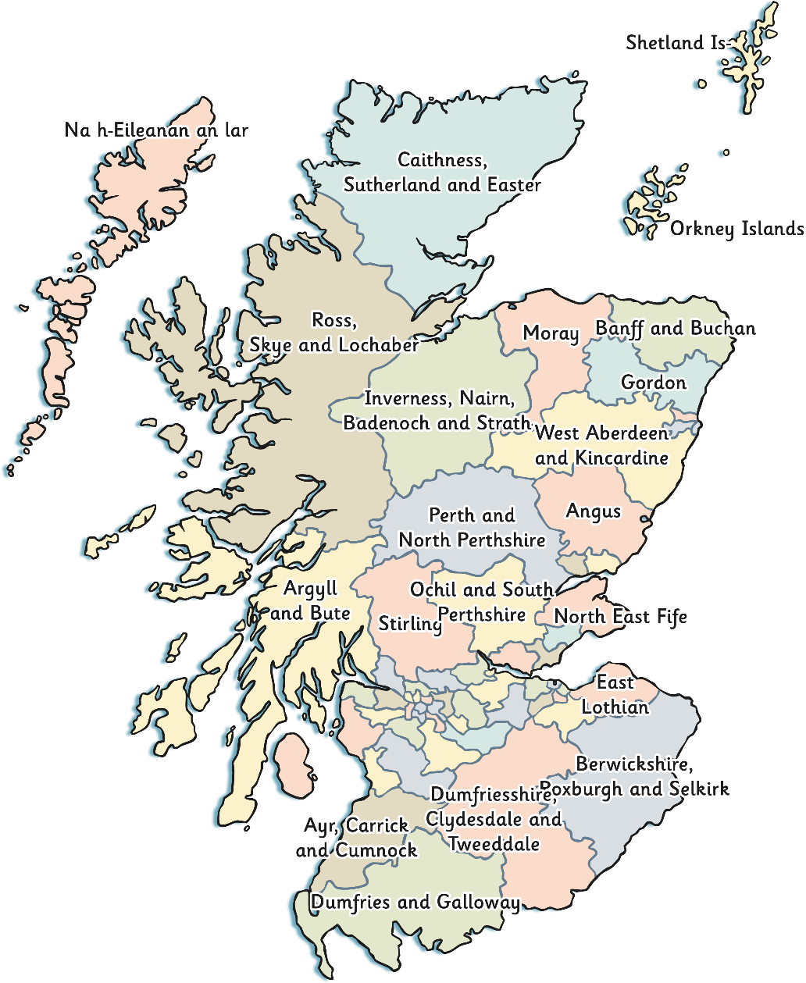
The History of the Scots Language
Some Scots sayings are still popular and used today, even in parts of the country that do not commonly speak Scots, like the central belt.
Scots has been spoken in Scotland for many centuries and was once the dominant language of Scotland, spoken by Scottish kings and queens.
It is still spoken today in parts of the east and south of Scotland and the Orkney and Shetland islands.

Slide 4
Robert Burns
Robert Burns was a Scottish poet from Ayrshire, who lived over 250 years ago. Much of his work is written in Scots language and is famous all over the world.
Many people would say he is the most popular and well-known Scots poet. ‘Auld Lang Syne’ is one of his most famous poems and sung all over the world on Hogmanay.

Slide 5
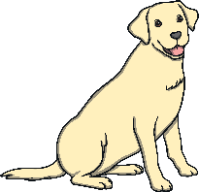
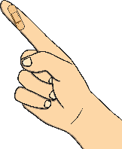
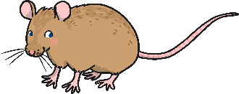
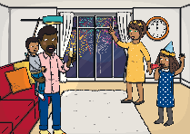
Scots Poetry, Rhymes and Songs
Many people have written poems, songs and rhymes in Scots throughout history. Many of these poems, songs and rhymes have been passed down generations of families.
Can you guess what some of these famous Scots poems, songs and rhymes are?
A Dug, a Dug by Bill Keys
The Sair Finger by Walter Wingate
Skinny Malinky Long Legs
Coulter’s Candy by Robert Coltart
To a Mouse by Robert Burns
Auld Lang Syne by Robert Burns

Slide 6
Dae ye ken Scots?
Awa’ an gie it a guid try!

Slide 7
Scots Dictionary
Click on the words below to learn their meaning.
aboot -
about
greet -
cry
auld -
old
hame -
home
bairn -
child
hauld -
hold
bonnie -
pretty
ken -
know
braw -
good
sleekit -
sneaky
crabbit -
bad tempered
dug -
dog

Slide 8
A Dug, a Dug
A Dug, A Dug is a poem by Bill Keys.
What do you think it might be about?
It is a poem about a child trying to persuade their dad to get a dog.
Here is a line from the poem. What do you think it says?
Dae
ye
hink
ah’ve
goat
nothing else
tae
dae
Do
you
think
I’ve
got
to
do
Do you think I’ve got nothing else to do?

Slide 9
The Sair Finger
The Sair Finger is a poem by Walter Wingate.
What do you think it might be about?
It is a poem about a child who has got a splinter in their finger.
Here is a line from the poem. What do you think it says?
Noo,
there
na
-
rin
awa’!
Now,
now
run
away
Now, there now – run away!

Slide 10
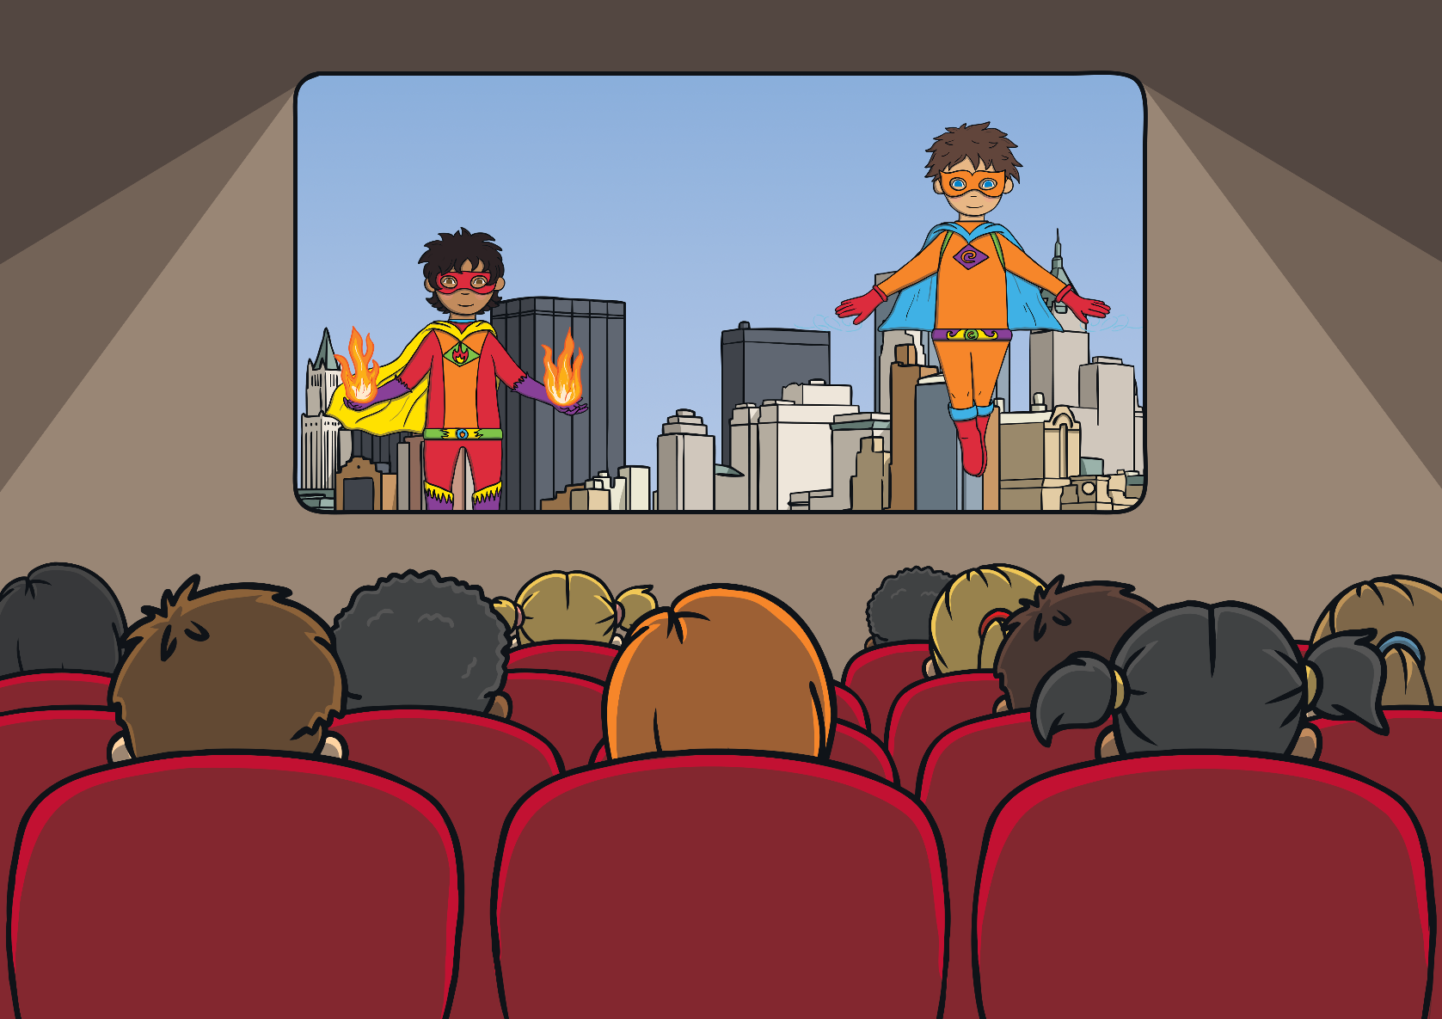
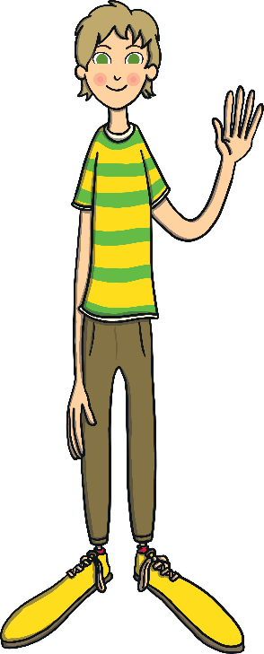
Skinny Malinky Long Legs
Skinny Malinky Long Legs is a Scottish children’s nursery rhyme.
Skinny Malinky Long Legs,
Big banana feet.
Went to the pictures,
And couldnae find a seat.
When the picture started, Skinny Malinky farted!
Skinny Malinky Long Legs,
Big banana feet.
What do you think Skinny Malinky looks like?
Skinny Malinky describes a tall, thin person.
Skinny Malinky Long Legs went to the pictures. What is the pictures?

Slide 11
Coulter’s Candy
Coulter’s Candy or Ally Bally Bee is an old Scottish folk song written by Robert Coltart
Coulter’s candy is a hard sweet.
Here is a line from the poem. What do you think it says?
Greetin
for a
wee
bawbee.
crying
small
half pence
Crying for a small half pence.

Slide 12
To a Mouse
To a Mouse is a famous poem by Robert Burns.
What do you think it might be about?
It is a poem apologising to a mouse as its home is ruined as the farmer ploughs the field.
Here is a line from the poem. What do you think it says?
Wee,
sleekit,
cowran,
tim'rous
beastie.
Small
sneaky
cowering
fearful
animal
Small, sneaky, cowering, fearful animal.

Slide 13
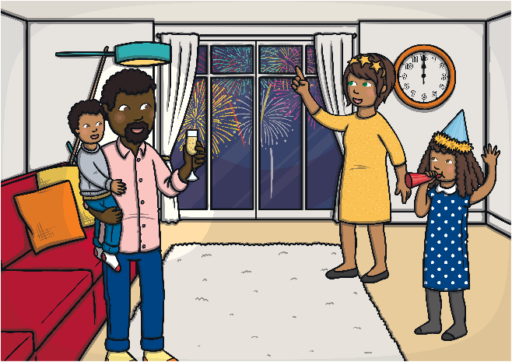
Auld Lang Syne
Auld Lang Syne is a poem written by Robert Burns that has become a popular Scottish song, often sang on New Year’s Eve.
Auld Lang Syne translates as ‘old long since’ and is about remembering old times.
Here is a line from the poem. What do you think it says?
And we'll
tak
a right
gude-willy
waught
take
goodwill
drink
And we will take a goodwill drink.

Slide 14
Popular Scots Sayings
There are many Scots sayings that people often use, even when Scots is not their native language. Do you recognise any of them?
Whit’s fur ye’ll no go by ye!
-
Whatever is meant to happen, will happen.
Lang may yer lum reek!
-
May you live long and stay well.
Keep the heid!
-
Stay calm.
-
Haud yer wheesht!
Be quiet.
Gie it laldy.
-
Give it all you have got.
Haste ye back!
-
Return soon.
It’s a dreich day!
-
It’s a miserable, wet day.
Ma heid’s loupin’.
-
My head is sore.

