Slide 2
Aim
To learn about what you might see and experience at a mosque.
To learn about why it is an important place to many people.
Success Criteria
I can list the things that are the same and different about mosques around the world.
I can name and describe special objects that can be found inside.
I understand why a mosque is an important place by describing what happens there.
I can talk about other places where Muslims can worship.
I can list rules for how to behave in a mosque.

Slide 3
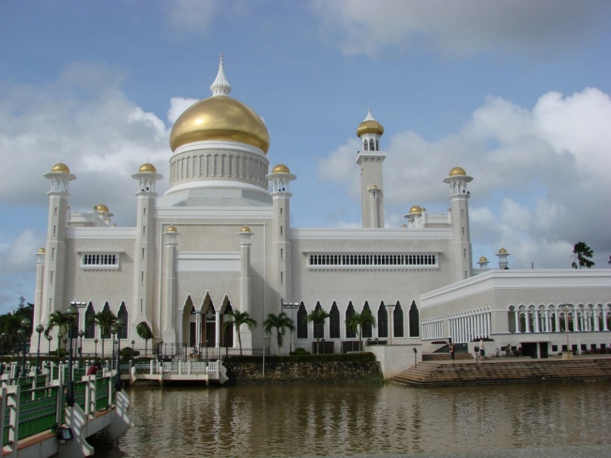
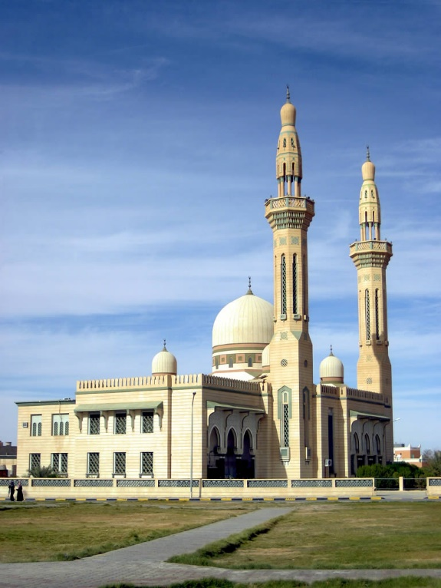
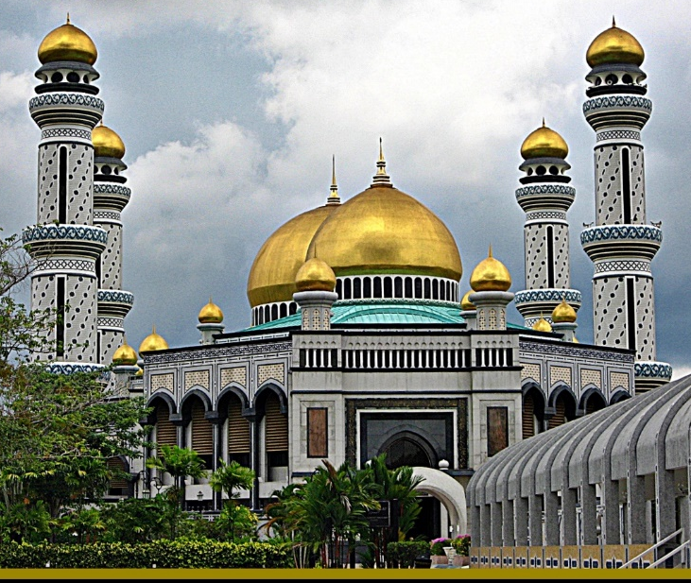
Starter Activity
What do all of these buildings have in common?
Photos courtesy of suzlil, watchsmart and D-Stanley (@flickr.com) - granted under creative commons licence - attribution

Slide 4
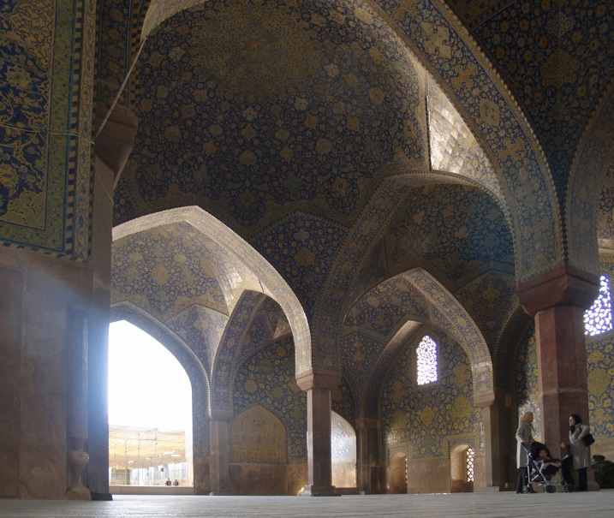
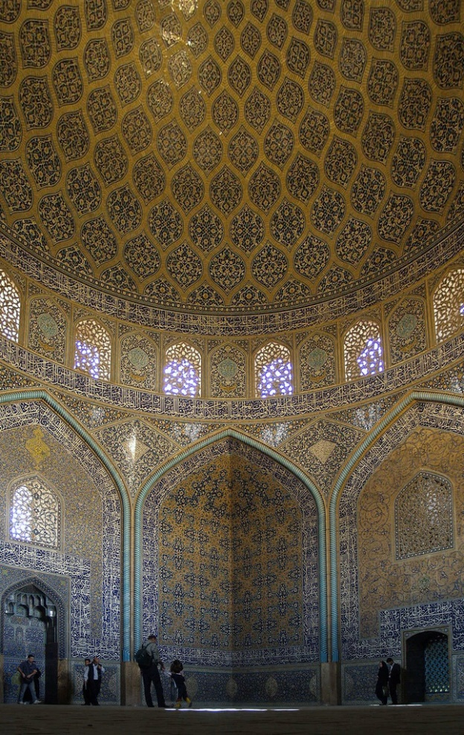
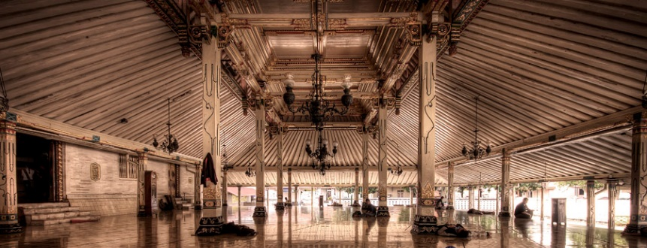
What Is It like inside a Muslim Mosque?
Photos courtesy of seier+seier, Jimmy McIntyre - Editor HDR One Magazine (@flickr.com) - granted under creative commons licence - attribution

Slide 5
Important Features of a Mosque
Shoe Rack
Prayer Mats
A place to leave your shoes before entering.
Mosques either have carpet with individual prayer mats or Muslims take their own prayer mat to worship upon.
Qur’an
Wash Room
The Muslim holy book which is the word of God. It is treated with great respect and placed on a special wooden stand to be read.
Muslims must wash before entering the main hall.

Slide 6
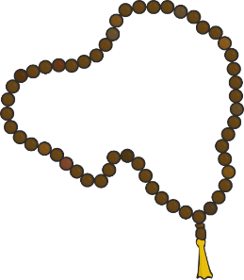
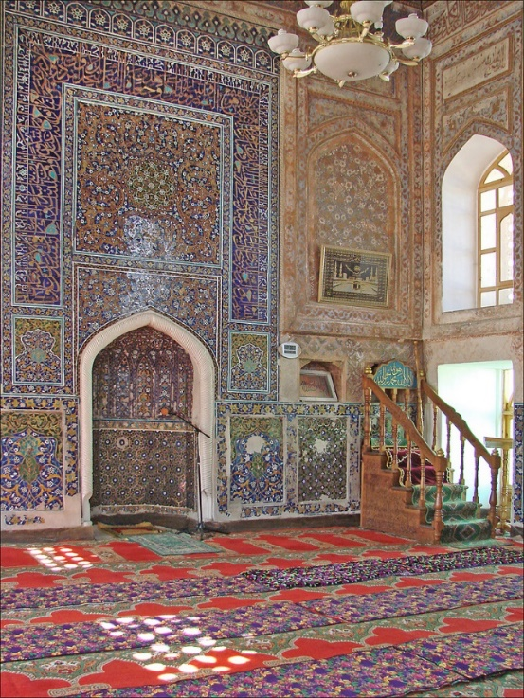
Important Features of a Mosque
Tasbih Beads
Mihrab
Beads hanging around the mosque to help worshippers think about Allah.
An alcove in the wall shows the direction the worshippers need to face. This is the direction of Mecca in Saudi Arabia, the most sacred Muslim place in the world.
Minaret
Most mosques have at least one minaret which is a tall thin tower. A man stands at the top and calls Muslims to prayer.

Slide 7
Why Do People Go to a Mosque?
Muslims go to mosque to pray and services are held every day. The most important weekly service is held on a Friday.
Many Muslims believe that praying with other Muslims can make you feel part of a family.
Inside a mosque, there is often a school where people can learn the Arabic language. This is the language that the Muslim holy book, the Qur'an, is written in.
Festivals, weddings and funerals can take place in mosques too.

Slide 8
Worship at Home
Find out more about how Muslims don't just worship at mosque by watching the videos available on BBC Bitesize.
Source - bbc.co.uk/learningzone - © 2014 BBC

Slide 9
Showing Respect
Wash feet, hands, nose, mouth, throat, ears, arms (up to elbow) before entering.
Take off your shoes before entering.
Women and men worship separately.

Slide 10
Plenary
Why do you think Muslims believe it is important to attend mosque?
Do you have any other questions about this place of worship?

