Slide 2
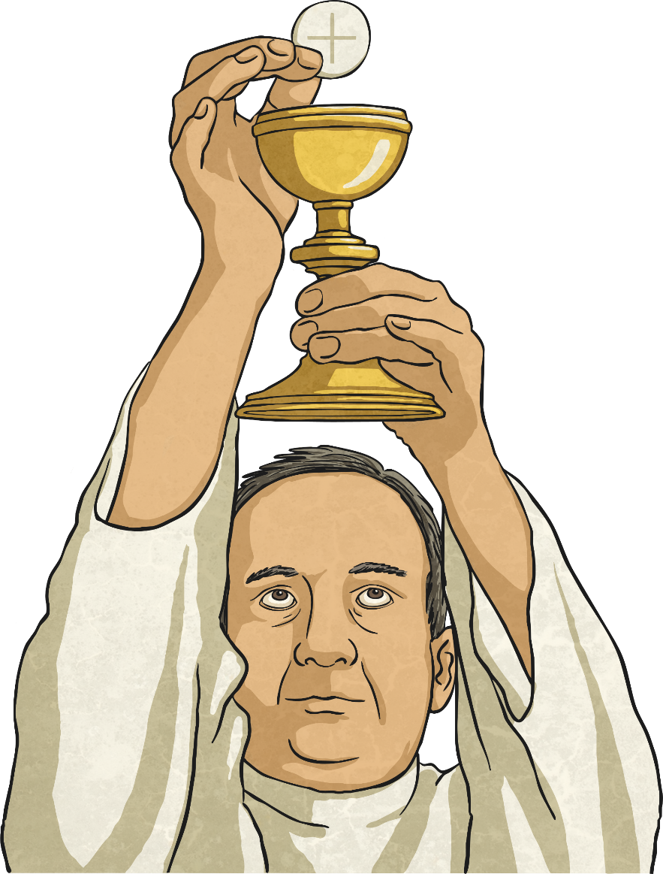
Mass Responses
The Lord be with you.
And with your spirit.
A reading from the Holy Gospel according to ____
Glory to you, O Lord.
The Gospel of the Lord.
Praise to you, Lord Jesus Christ.
The mystery of faith.
We proclaim your death, O Lord
And profess your resurrection until you come again.
The Body of Christ.
Amen.

Slide 3
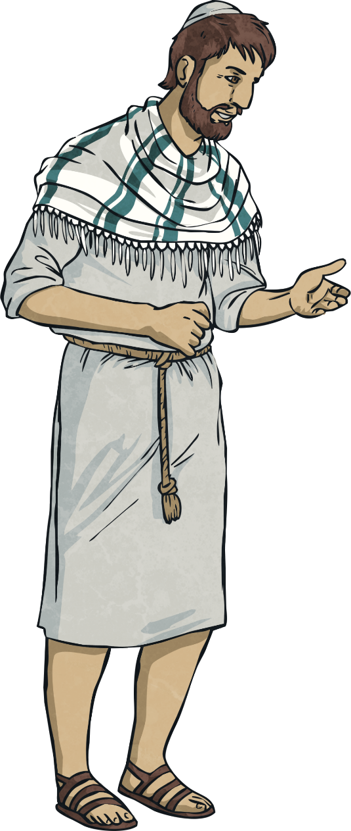
Apostles’ Creed
I believe in God, the Father almighty, creator of heaven and earth.
I believe in Jesus Christ, his only Son, our Lord, who was conceived by the Holy Spirit and born of the virgin Mary.
He suffered under Pontius Pilate, was crucified, died, and was buried;
he descended to hell.
The third day he rose again from the dead.
He ascended to heaven and is seated at the right hand of God the Father almighty.
From there he will come to judge the living and the dead.
I believe in the Holy Spirit, the holy catholic church, the communion of saints, the forgiveness of sins, the resurrection of the body,
and the life everlasting. Amen.

Slide 4
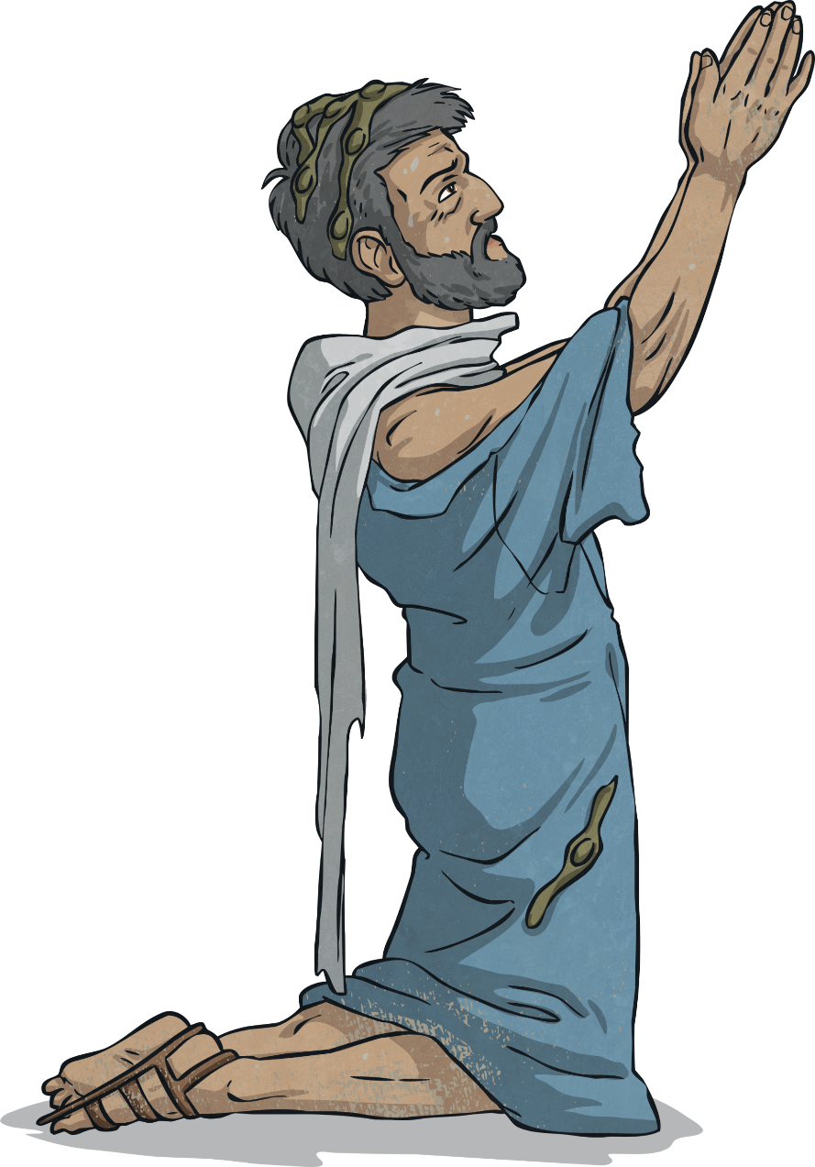
Agnus Dei
Lamb of God, you take away the sins of the world,
have mercy on us.
Lamb of God you take away the sins of the world, have mercy on us.
Lamb of God you take away the sins of the world,
grant us peace.
Go now in peace to love and to serve the Lord.
Thanks be to God.

Slide 5
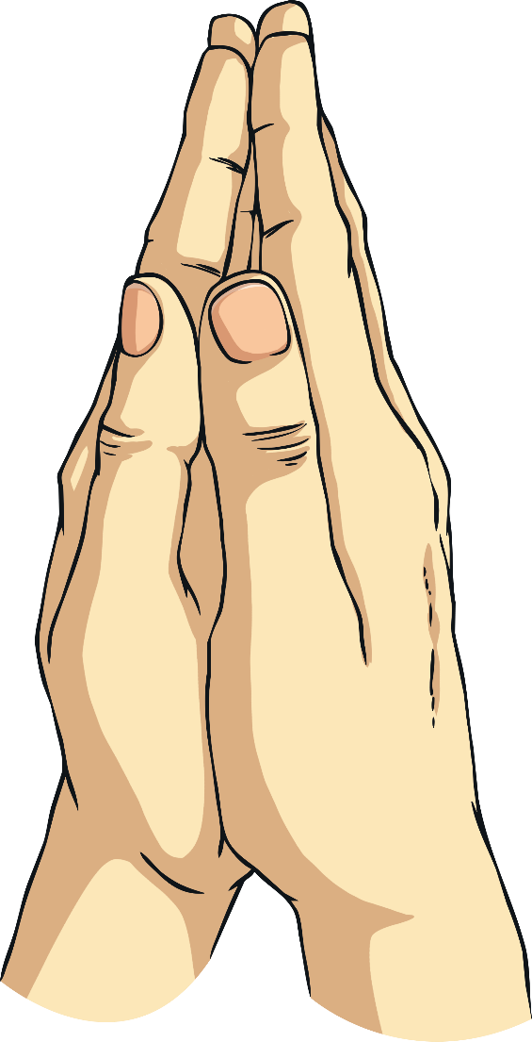
Confiteor
I confess to almighty God
and to you, my brothers and sisters,
that I have greatly sinned,
in my thoughts and in my words,
in what I have done and in what I have failed to do,
through my fault, through my fault,
through my most grievous fault;
therefore I ask blessed Mary ever-Virgin,
all the Angels and Saints,
and you, my brothers and sisters,
to pray for me to the Lord our God.
Amen.

Slide 6
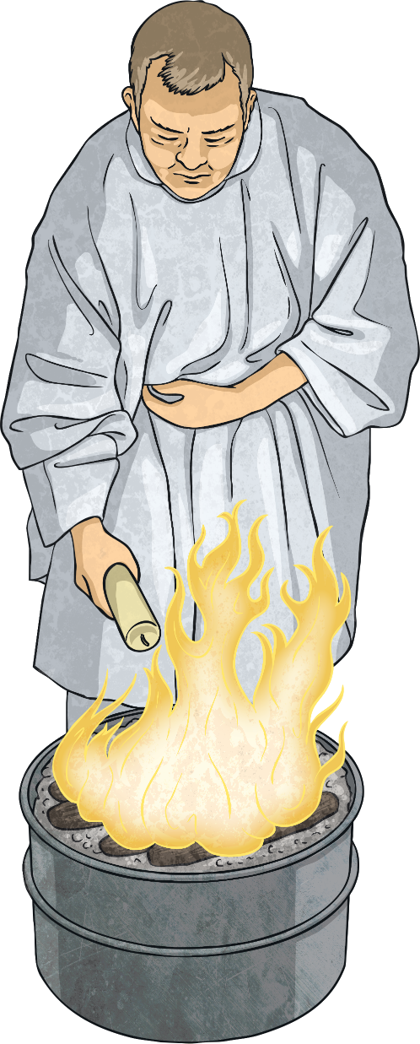
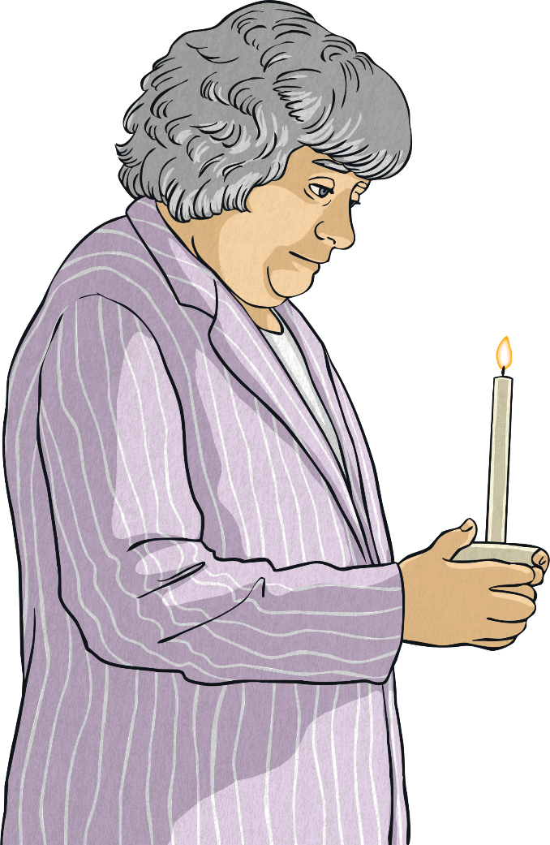
Kyrie
Lord have mercy.
Lord have mercy.
Christ have mercy.
Christ have mercy.
Lord have mercy.
Lord have mercy.

Slide 7
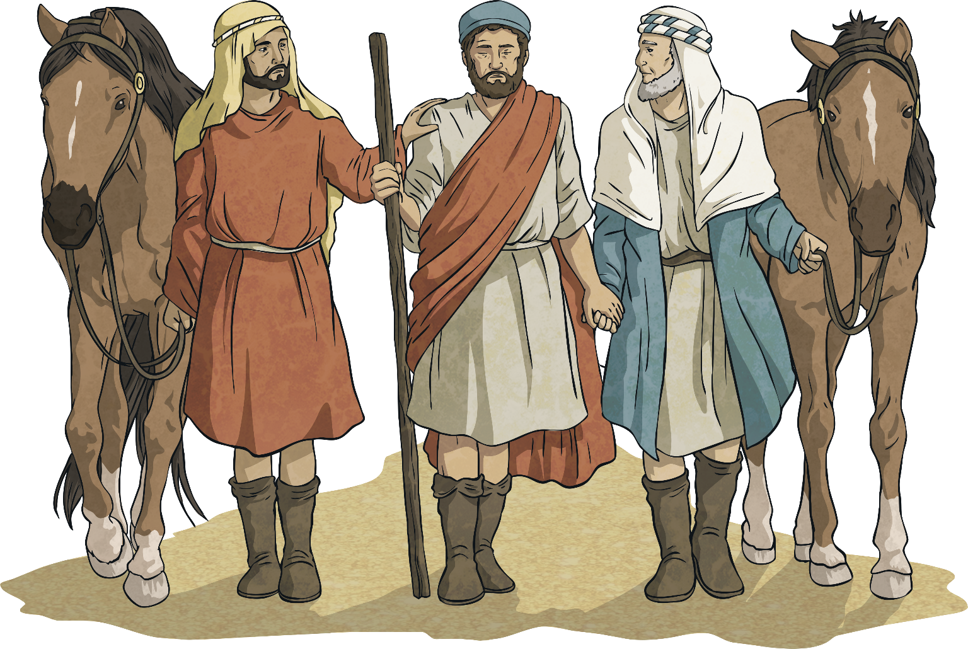
Gloria
Glory to God in the highest,
and on earth peace to people of good will.

Slide 8
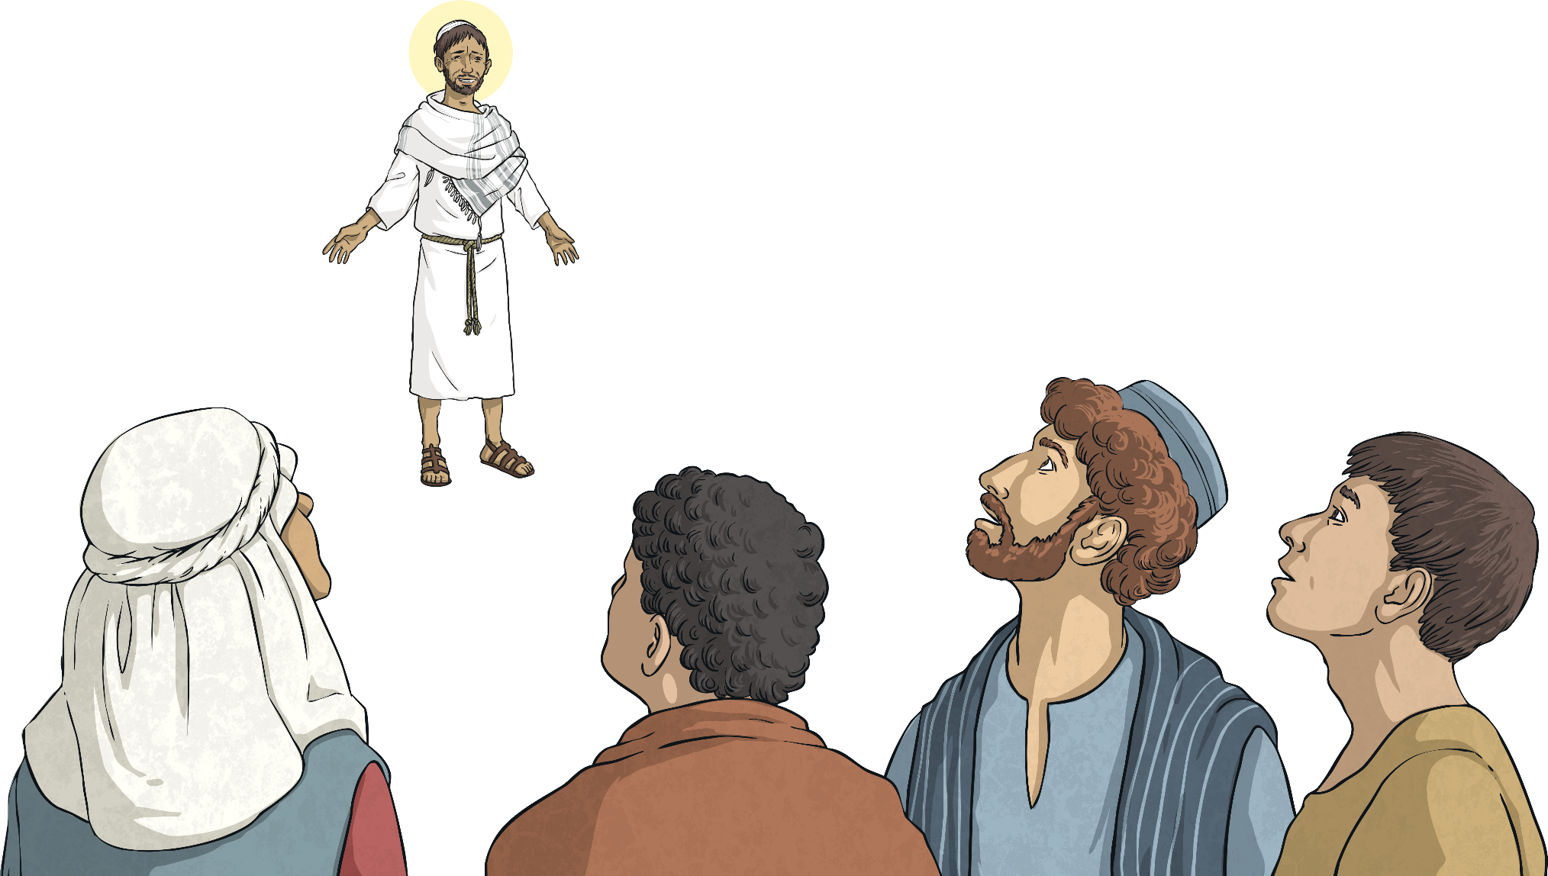
Sanctus
Holy, Holy, Holy Lord God of hosts.
Heaven and earth are full of your glory.
Hosanna in the highest.
Blessed is he who comes in the name of the Lord.
Hosanna in the highest.

