Slide 1
Building Vocabulary - Affixes
Wednesday 3rd March 2021

Slide 2
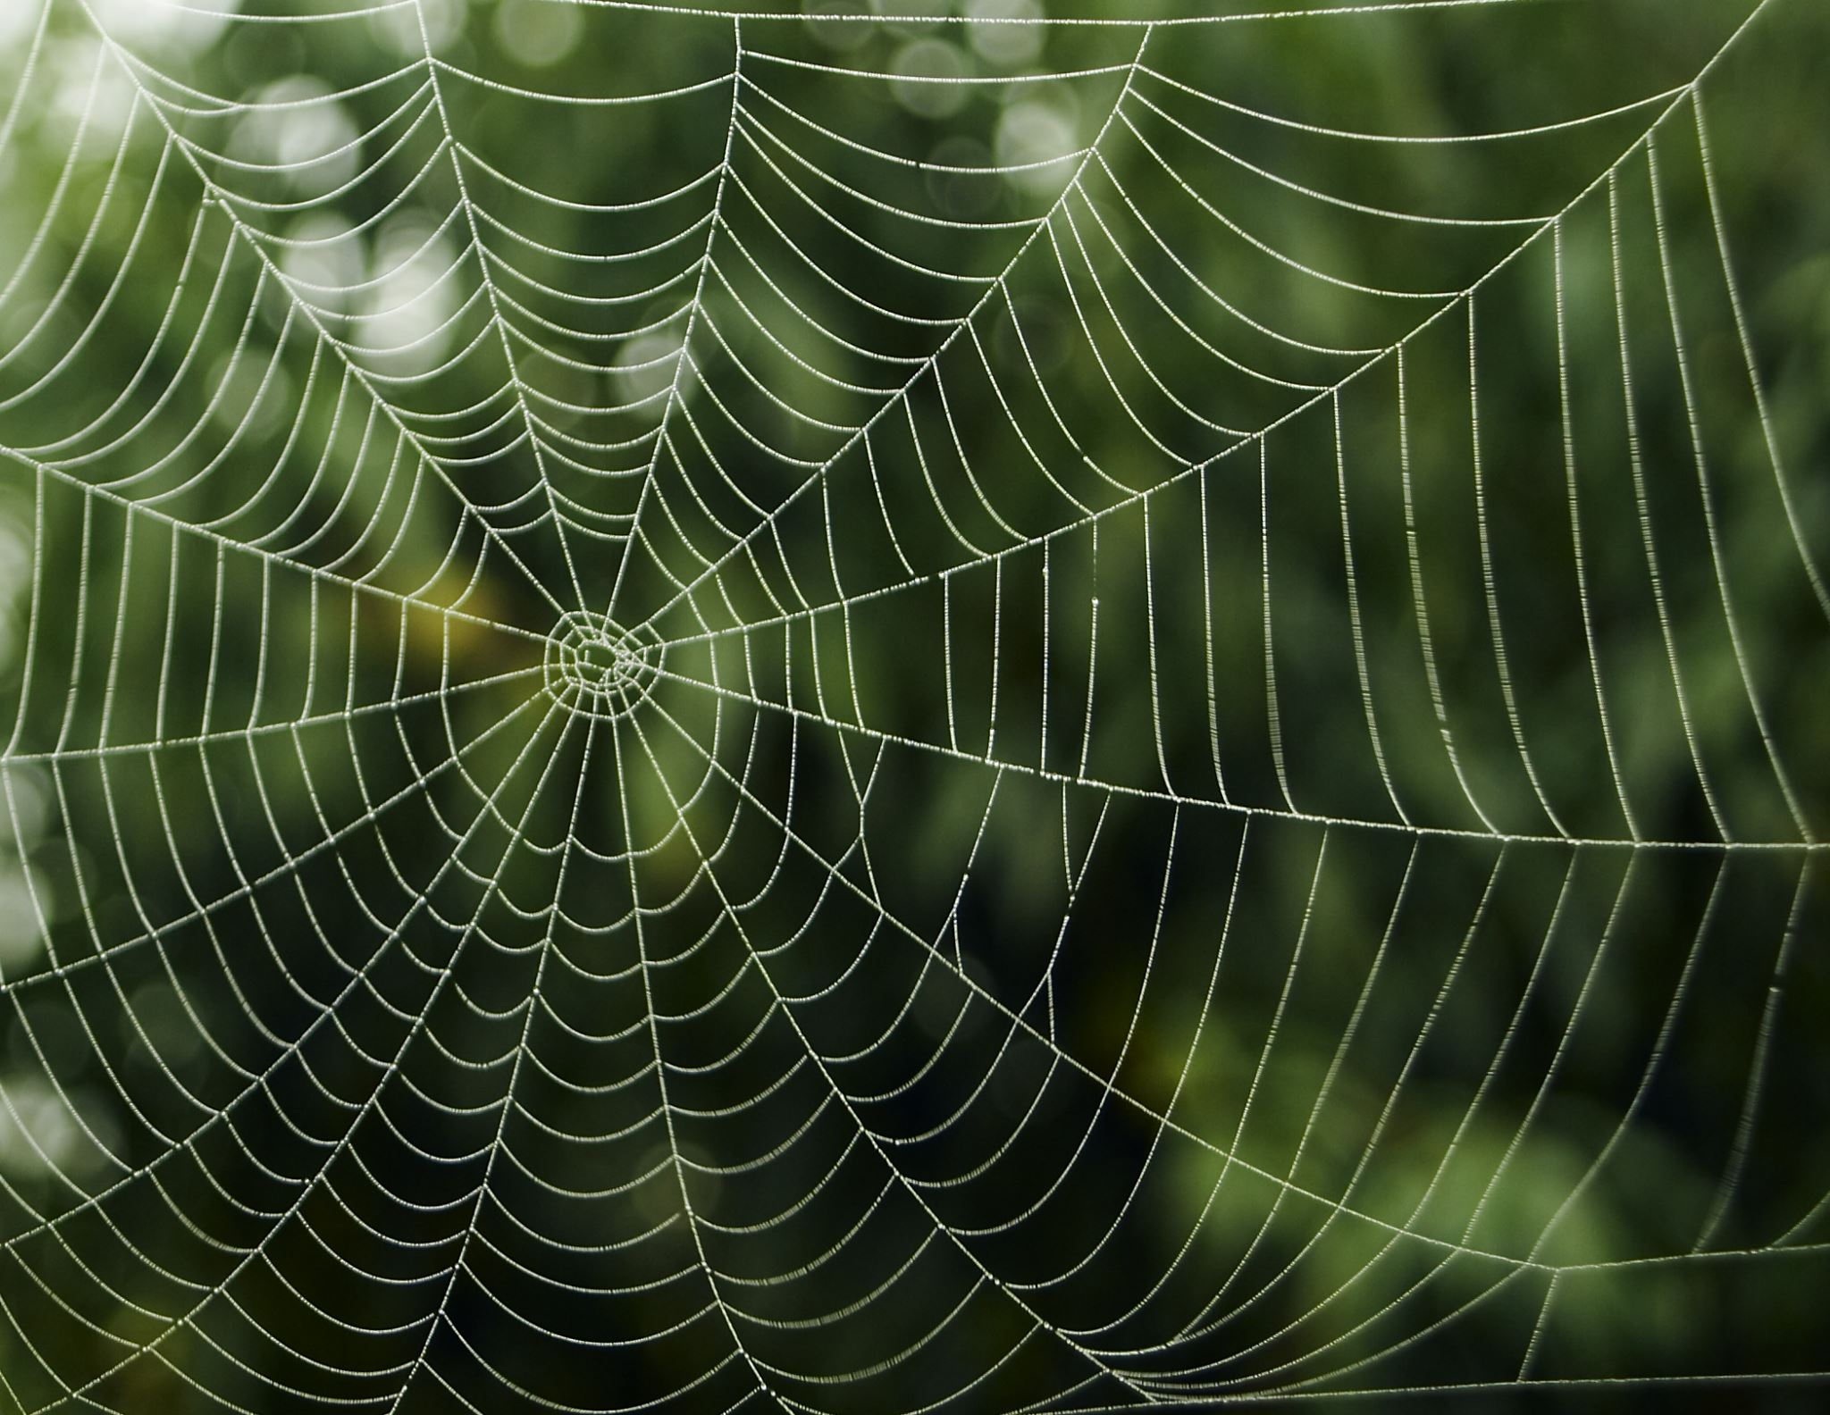
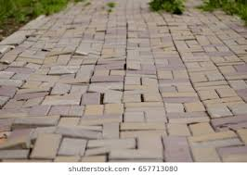
L.I.– I can focus on the affix meaning. S.C.– I will create examples & use in the correct context.
Look back at the webs you created yesterday.
Select three words from each to draw a small illustration of. Write the word below.
uneven
delicious

Slide 3
L.I.– I can focus on the affix meaning. S.C.– I will create examples & use in the correct context.
Review all the words that you’ve recorded so far this week. Pick two words from each affix and use them in super sentences of their own. Four sentences in total.
I’m pleased with my work because…
Look back to our learning intention & success criteria.
Next time, I could try…

