Slide 2
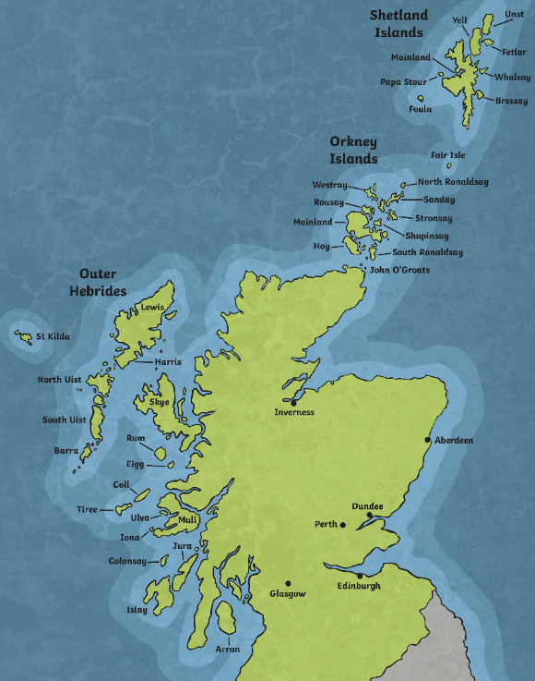
Paisley, Scotland
Paisley is one of the biggest towns in Scotland and it a short 10-minute drive from Glasgow.
Paisley is famous for making and weaving textiles.
Paisley

Slide 3
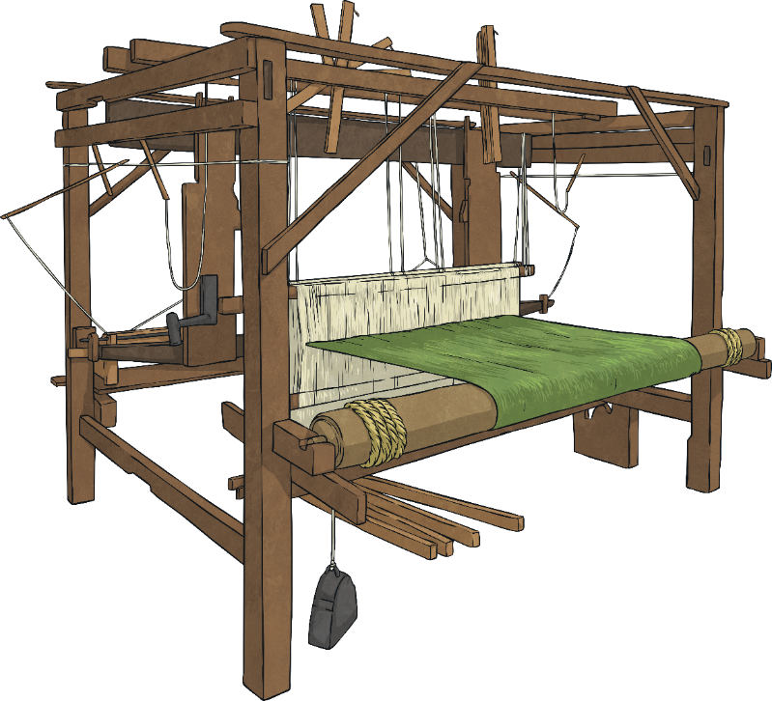
Cottage History
Weaving began in Paisley as a cottage industry during the 17th century. This meant that weavers would work from their homes on hand looms.
Weavers could make muslin, lawn and silk materials on their hand looms.

Slide 4
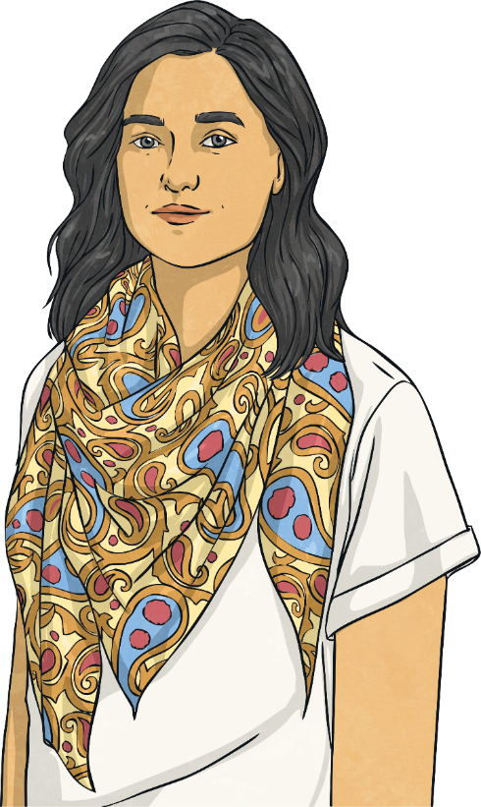
Patterned Shawls
In the 1800s, patterned shawls were brought into Europe by the East India Company.
These patterned shawls were very fashionable but very expensive.
Weavers in Paisley could create copies of these shawls and sell them more cheaply.
The Paisley shawls were very popular and demand for the imitations grew.

Slide 5
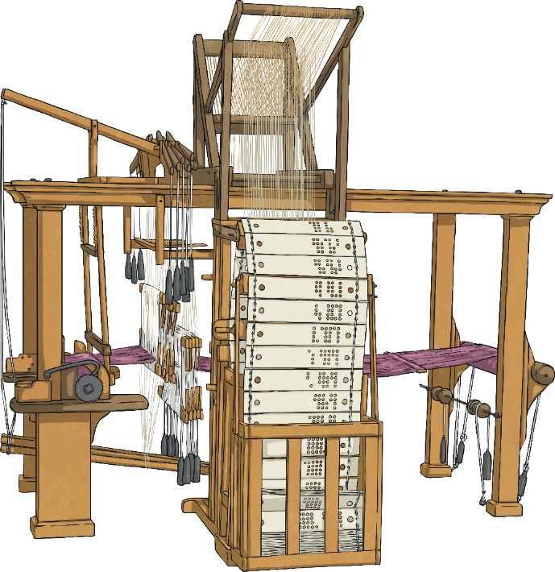
Increasing Demand
Weavers in Paisley came up with new ideas to cope with increasing demand.
The jacquard loom was introduced.
The hand loom was improved to use five colours rather than two.
Weaving jobs were divided to speed up production
These changes helped shawl manufacturing move from a cottages into factories.

Slide 6
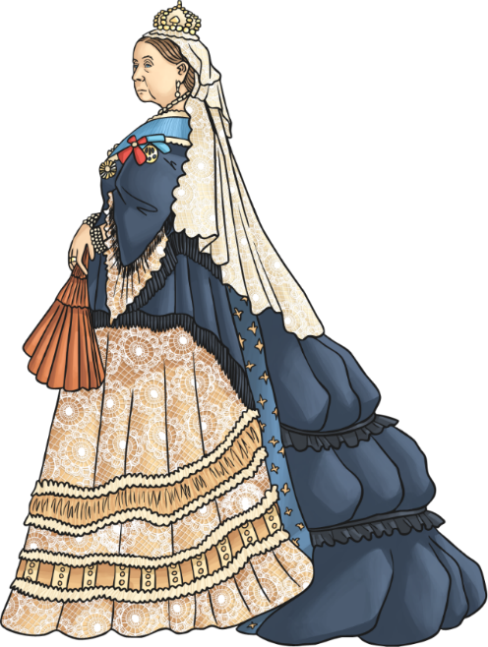
Weaving in Paisley
For 75 years, from 1800, Paisley was the largest producer of shawls in the world.
By 1834, Paisley was producing shawls with a value of over £1,000,000.
Queen Victoria is said to have bought 17 shawls.
By 1860, there were over 71 shawl manufacturers in the town.

Slide 7
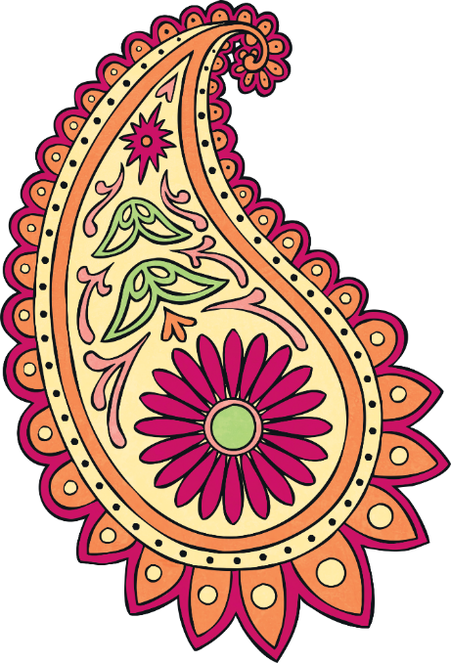
Origins
The original imported shawls came from Persia (Iran) or Kashmir.
These shawls were decorated with a tear-drop shaped pattern.
It is thought to be a symbol the Zoroastrian religion and represented a cypress tree, a sign of life and eternity.
This tear-drop pattern can be traced back to around AD 221 in Persia.

Slide 8
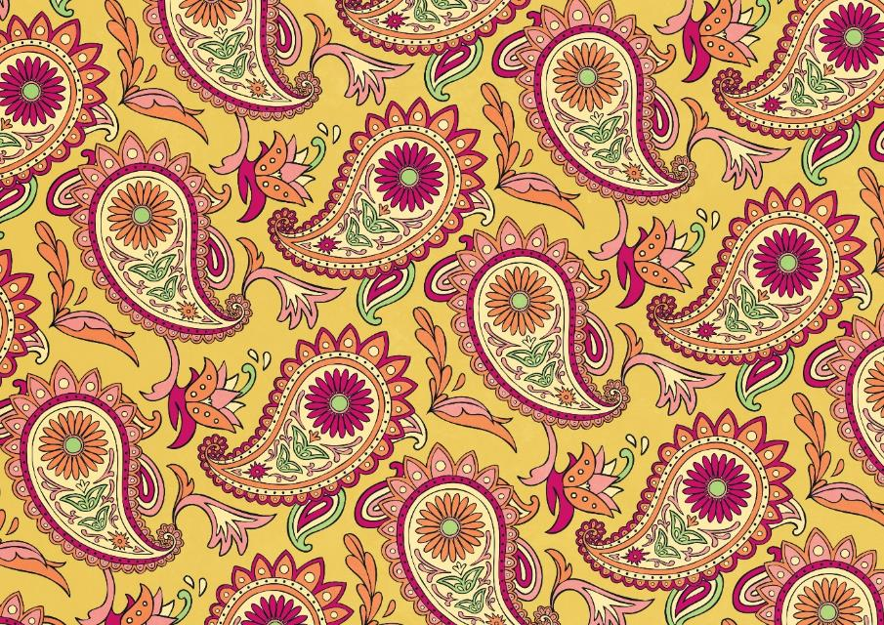
Pattern
Due to the size of shawl production in Paisley, the pattern began to be known as paisley.
However, the pattern is known by different names in different countries.
It is called Persian pickles in America, peizuli in Japan, palme in France, and bota in the Netherlands.

Slide 9
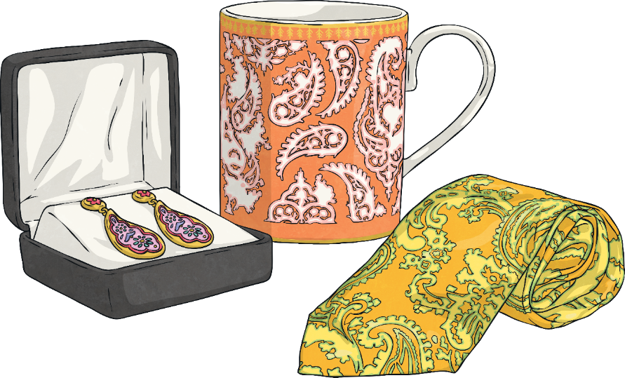
Paisley Pattern Fashion
Although the shawls went out of fashion in Europe in the 1870s, the paisley pattern is still popular today.
The design has been used in fashion across the world for hundreds of years. It is seen in clothing, jewellery, wallpaper, vases, carpets and rugs.

Slide 10
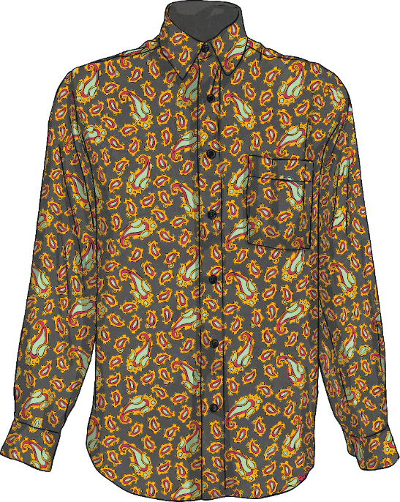
Fashion
William Morris adapted the pattern and used it in his wallpaper designs in the Victorian era.
Paisley became popular again in the 1960s, when Mick Jagger and the Beatles were seen wearing it. It also became popular again in the 1990s.
Paisley pattern shirts, T-shirts and bandanas are sold online and in high street shops today.

