Slide 1
Building Vocabulary - Affixes
Wednesday 3rd February 2021

Slide 2
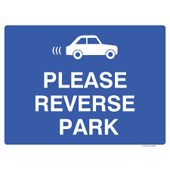
L.I.– I can focus on the affix meaning. S.C.– I will create examples & use in the correct context.
Look back at the webs you created yesterday.
Select three words from each to draw a small illustration of. Write the word below.
reverse
transmit

Slide 3
L.I.– I can focus on the affix meaning. S.C.– I will create examples & use in the correct context.
Review the words that you’ve not yet used. Pick one word from each affix and use them in super sentences of their own. Two sentences in total.
Look back to our learning intention & success criteria.
I’m pleased with my work because…
Next time, I could try…

