Slide 2
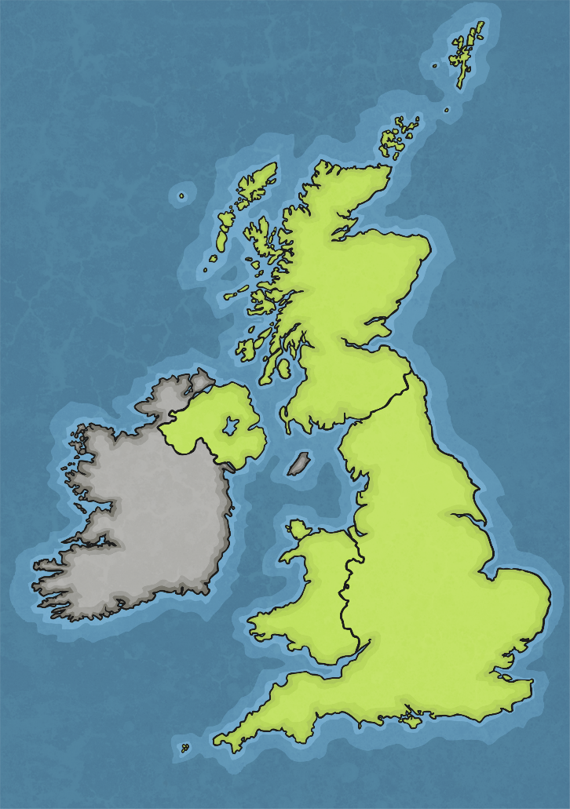
A Northern Artist
Laurence Stephen Lowry was a northern artist famous for his oil paintings of industrial cityscapes. He was born on 1st November 1887 in Stretford, Lancashire.
His mother was very disappointed that she didn’t have a daughter and Lowry often referred to having had an unhappy childhood.
When Lowry was a boy, his family moved from the green, leafy area of Rusholme to the more industrial area of Pendlebury in the suburb of Salford, Greater Manchester. Lowry did not like the area at first but soon grew more interested in his surroundings, spending time sketching the factory chimneys and mills.
Manchester

Slide 3
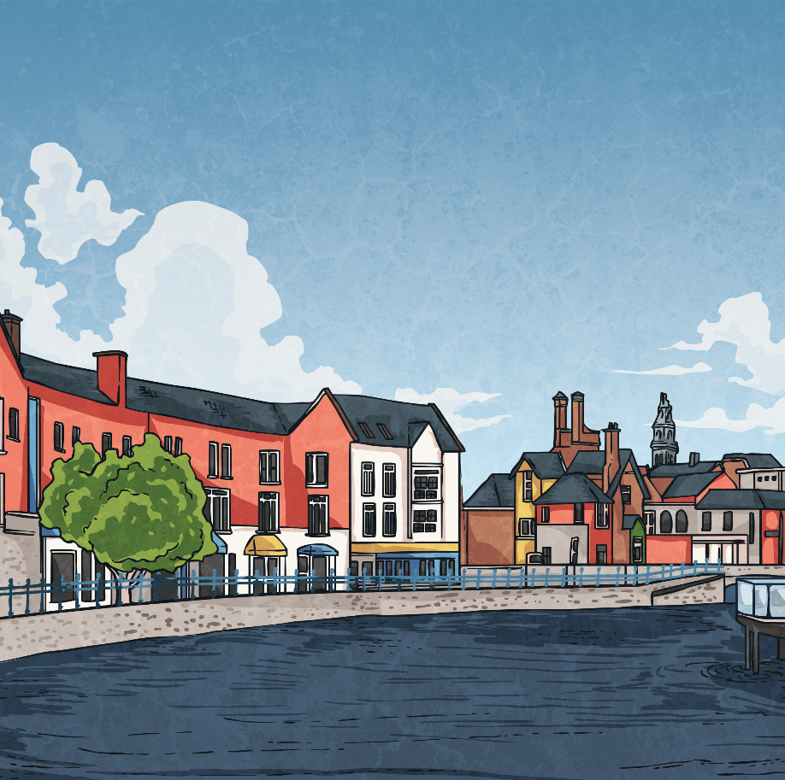
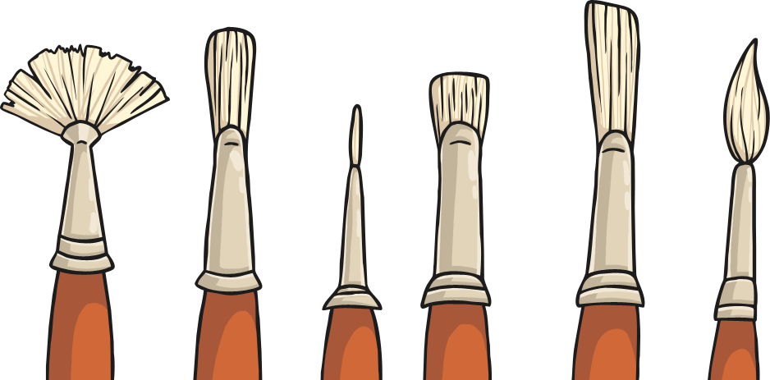
The Young Artist
When Lowry left school, he began working, first as a clerk for an accountant and later as a rent collector at the Pall Mall Company. This meant he could afford to have private art lessons in the evening. In 1905, he was offered a place at the Manchester School of Art where he was tutored by a French Impressionist teacher, Pierre Adolphe Valette. Lowry was very influenced by Valette and began to develop his own distinctive style of painting.

Slide 4
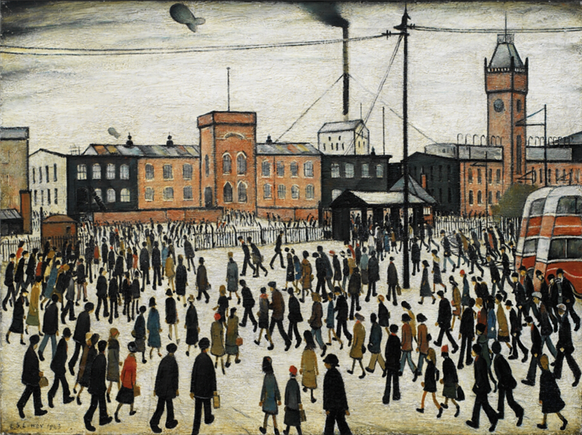
Matchstick Men
Lowry began to paint urban landscapes of factories, mills, chimneys and the workers who clocked in and clocked out day after day.
Lowry’s human figures were nicknamed ‘matchstick men’ due to their spindly appearance.
In 1978, a song called Matchstalk Men and Matchstalk Cats and Dogs was written about Lowry and his paintings which became a number one hit in the pop charts.
Did you know?...

Slide 5
Going To Work – 1943
What are your thoughts about this painting?
How has Lowry captured the mood of the time or place?
CC BY-LL 2.0,

Slide 6
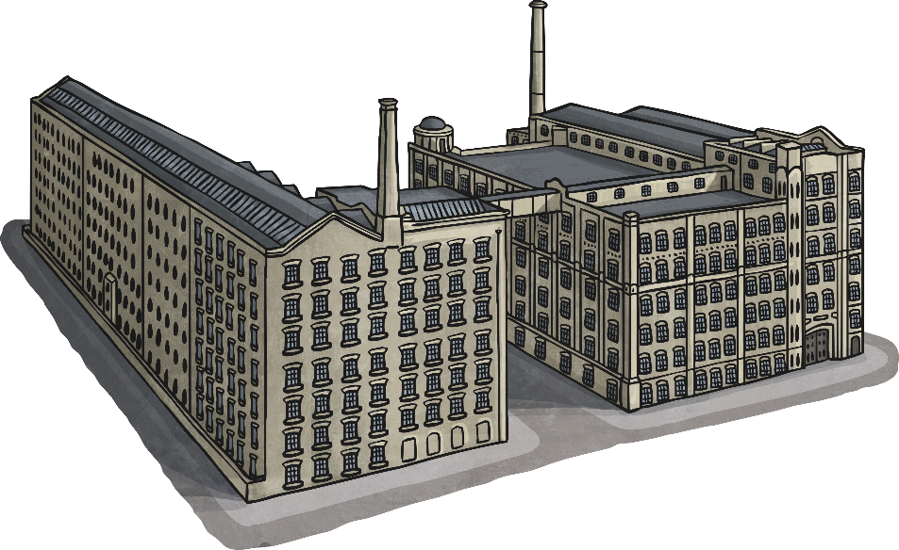
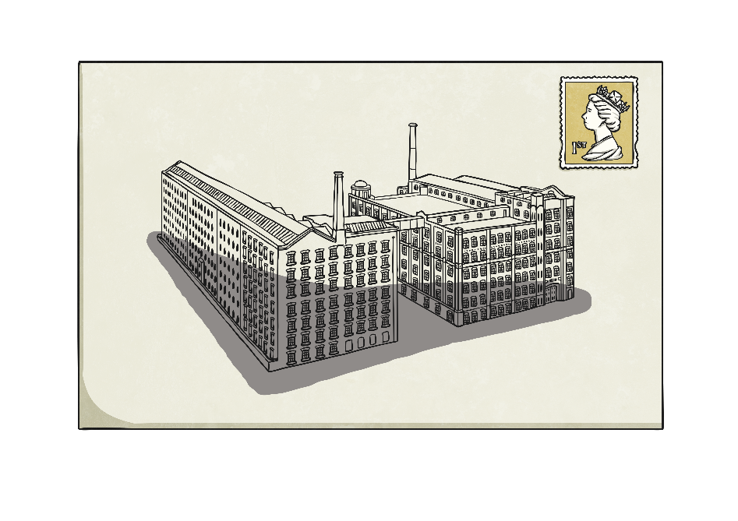
The Envelope Artist
When Lowry was outside without a sketchbook, he would sketch on the back of envelopes, napkins and cloakroom tickets. He would then give them to young people who were out and about with their families.
These sketches would now be worth thousands of pounds.

Slide 7
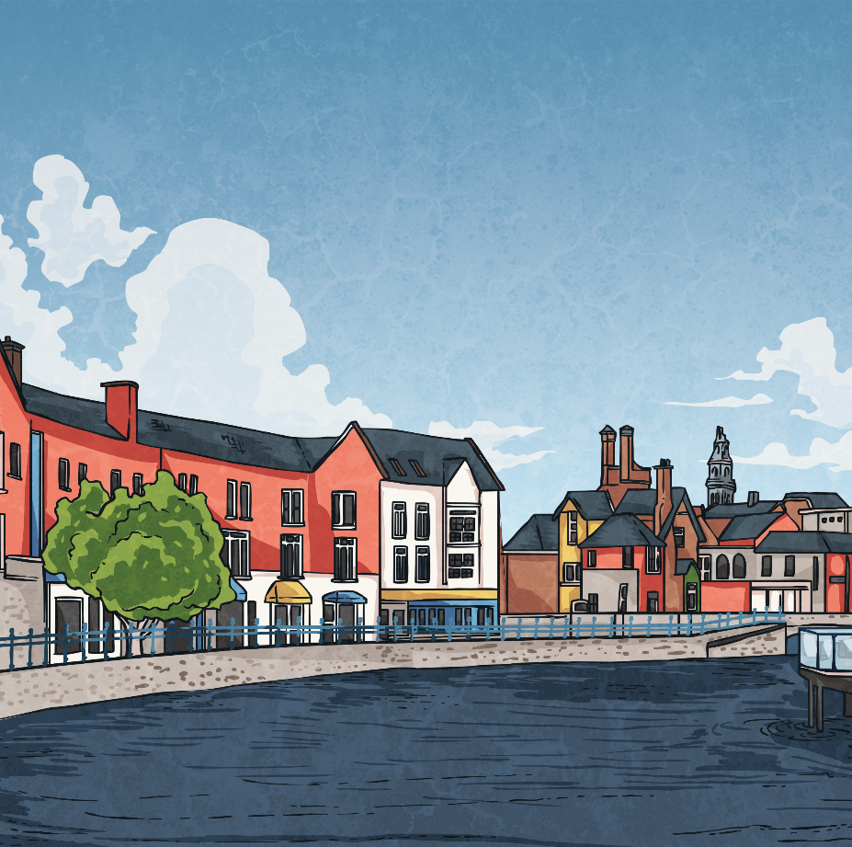
An Ordinary Man
The artist, renowned for showing the life of the working man, the streets of Salford and industrial England in the early 1900s, died at the age of 88 from pneumonia in a hospital in Glossop, Derbyshire.
LS Lowry’s legacy lives on and he has become one of the most famous British artists of all time.
Lowry was quite the ordinary man. He rejected being honoured by The Queen five times, the most recent honour he turned down being a knighthood. He was a keen football fan, supporting Manchester City his whole life. He inherited his mother’s collection of clocks, which he set at different times. A storyteller who elaborated the truth at times, he never married but made good friends throughout his life. Lowry retired from the Pall Mall Company at the age of 65, having worked there for the majority of his working life.

Slide 8
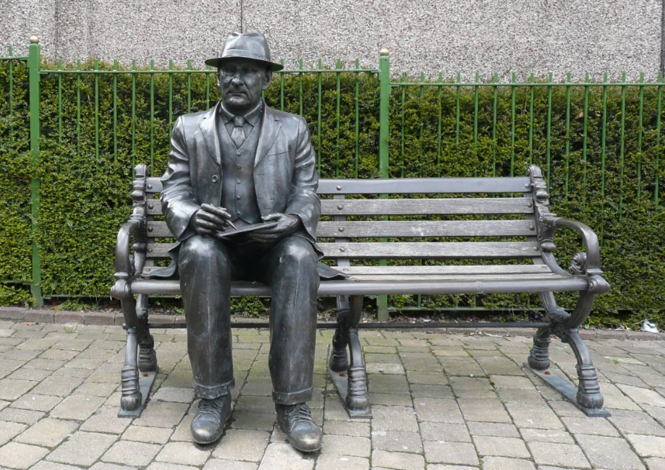
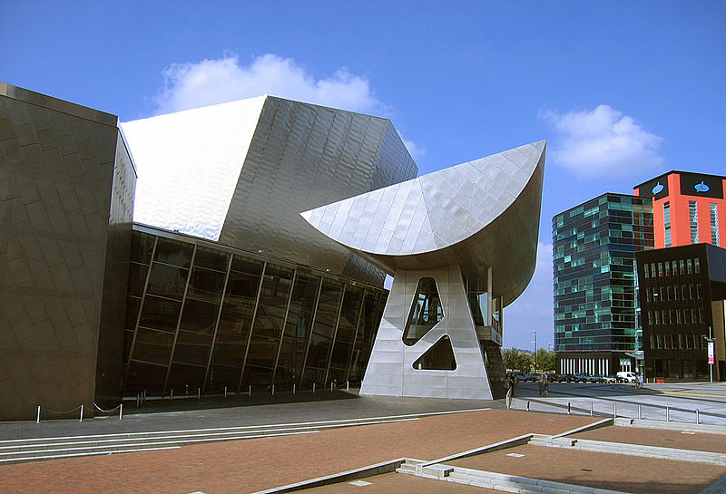
The Lowry Gallery
The Lowry Gallery on the Salford Quays, was opened by Queen Elizabeth II in October 2000. The gallery houses a collection of Lowry’s lesser known seascape paintings.
There is also a memorial statue of Lowry sketching in a park in Mottram, where he lived for 25 years.
The Lowry Gallery, Salford Quays
CC BY-SA 2.0,

