Slide 1
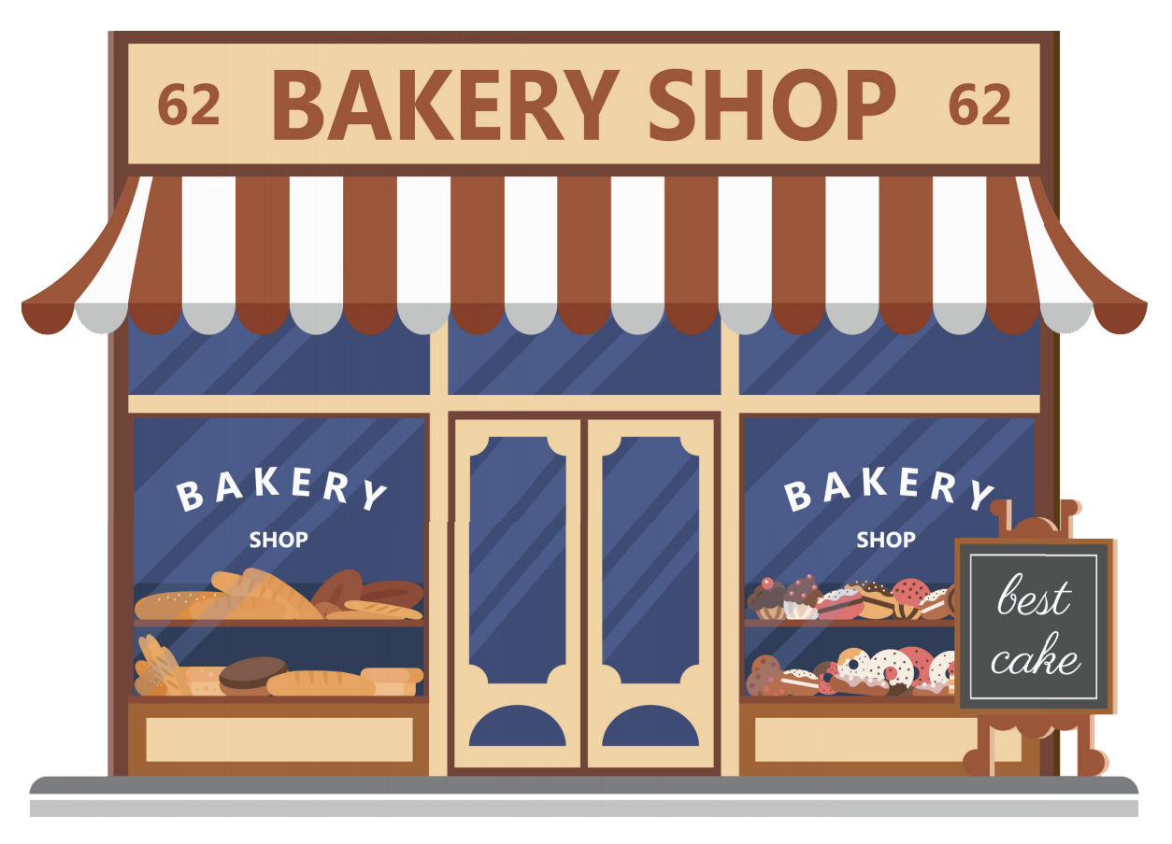
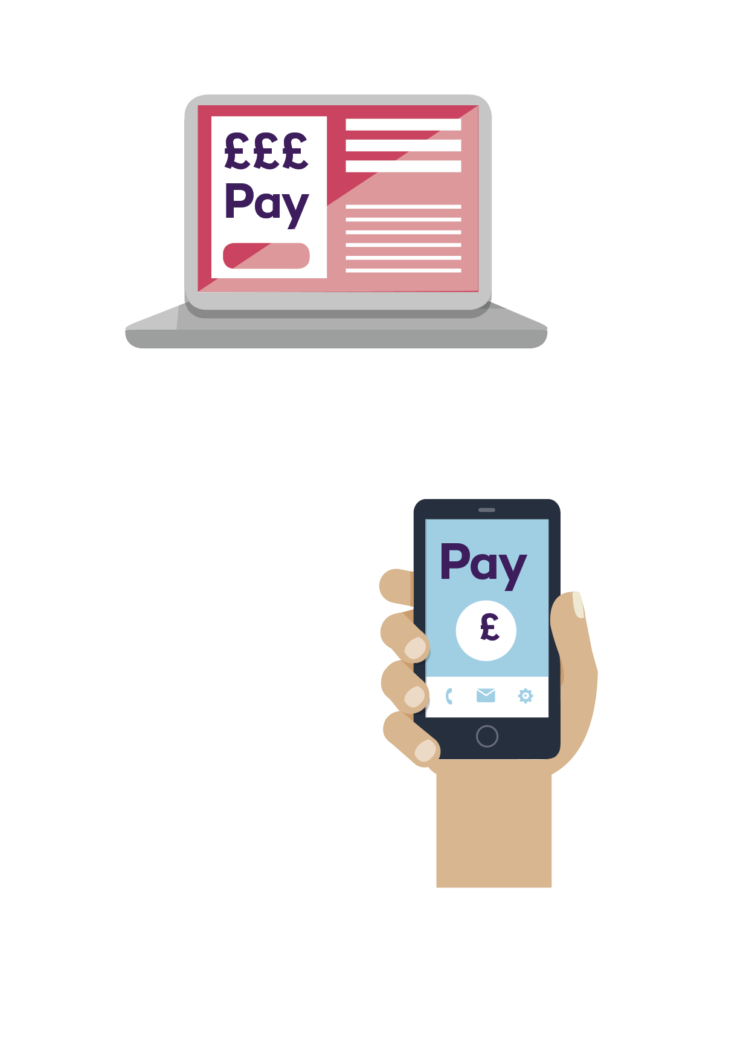
How are payments changing?
£

Slide 2
Learning objectives/
intentions:
• Recall the reasons why people shop.
• Explain the positives and negatives of shopping
in different ways.
• Compare different ways to pay for goods.
• Suggest the best ways to use technology safely.

Slide 3
Spending money
To buy new things in a shop, supermarket or online, we need to use money. People spend money on needs and wants.
A need is something we must have in order to stay alive.
A want is something we would like to have, but we don’t
need it in order to stay alive.

Slide 4


Spending money
• Why do people spend money?
• What do young people spend money on?
• What do adults spend money on?
• What is the difference between a need and a want?
Extension: Choose one of the following topics to evaluate through discussion or writing: Does shopping make everyone happy? What is more important to spend money on, a need or a want? Does everyone need to shop? Is shopping easier for young people?

Slide 5
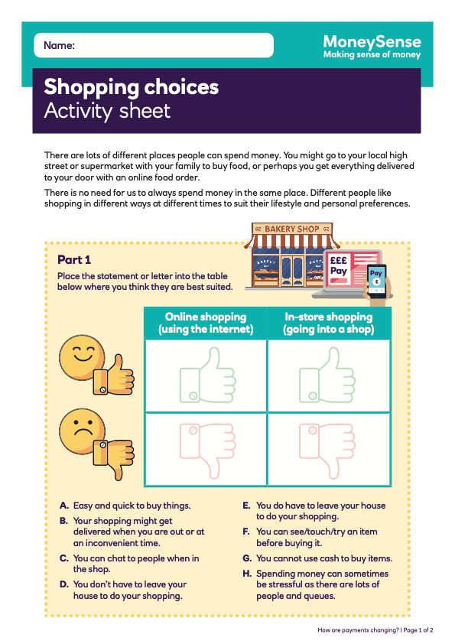
Activity 1: Where to shop?
Complete the Shopping choices activity sheet then answer the
question below.
Where do you think people prefer to spend money …in-store or online?
Explain your answer
Extension: Create a poster to highlight the positives of shopping in-store or online.

Slide 6
Activity 2: Money on the move
In recent years, more people are spending money online, which is changing the way we pay for our shopping and the items we buy.
CAN BE USED ONLINE | CANNOT BE USED ONLINE
Payment Cards | Cash
Online Banking | Cheques
Payment Apps | Contactless Payment

Slide 7
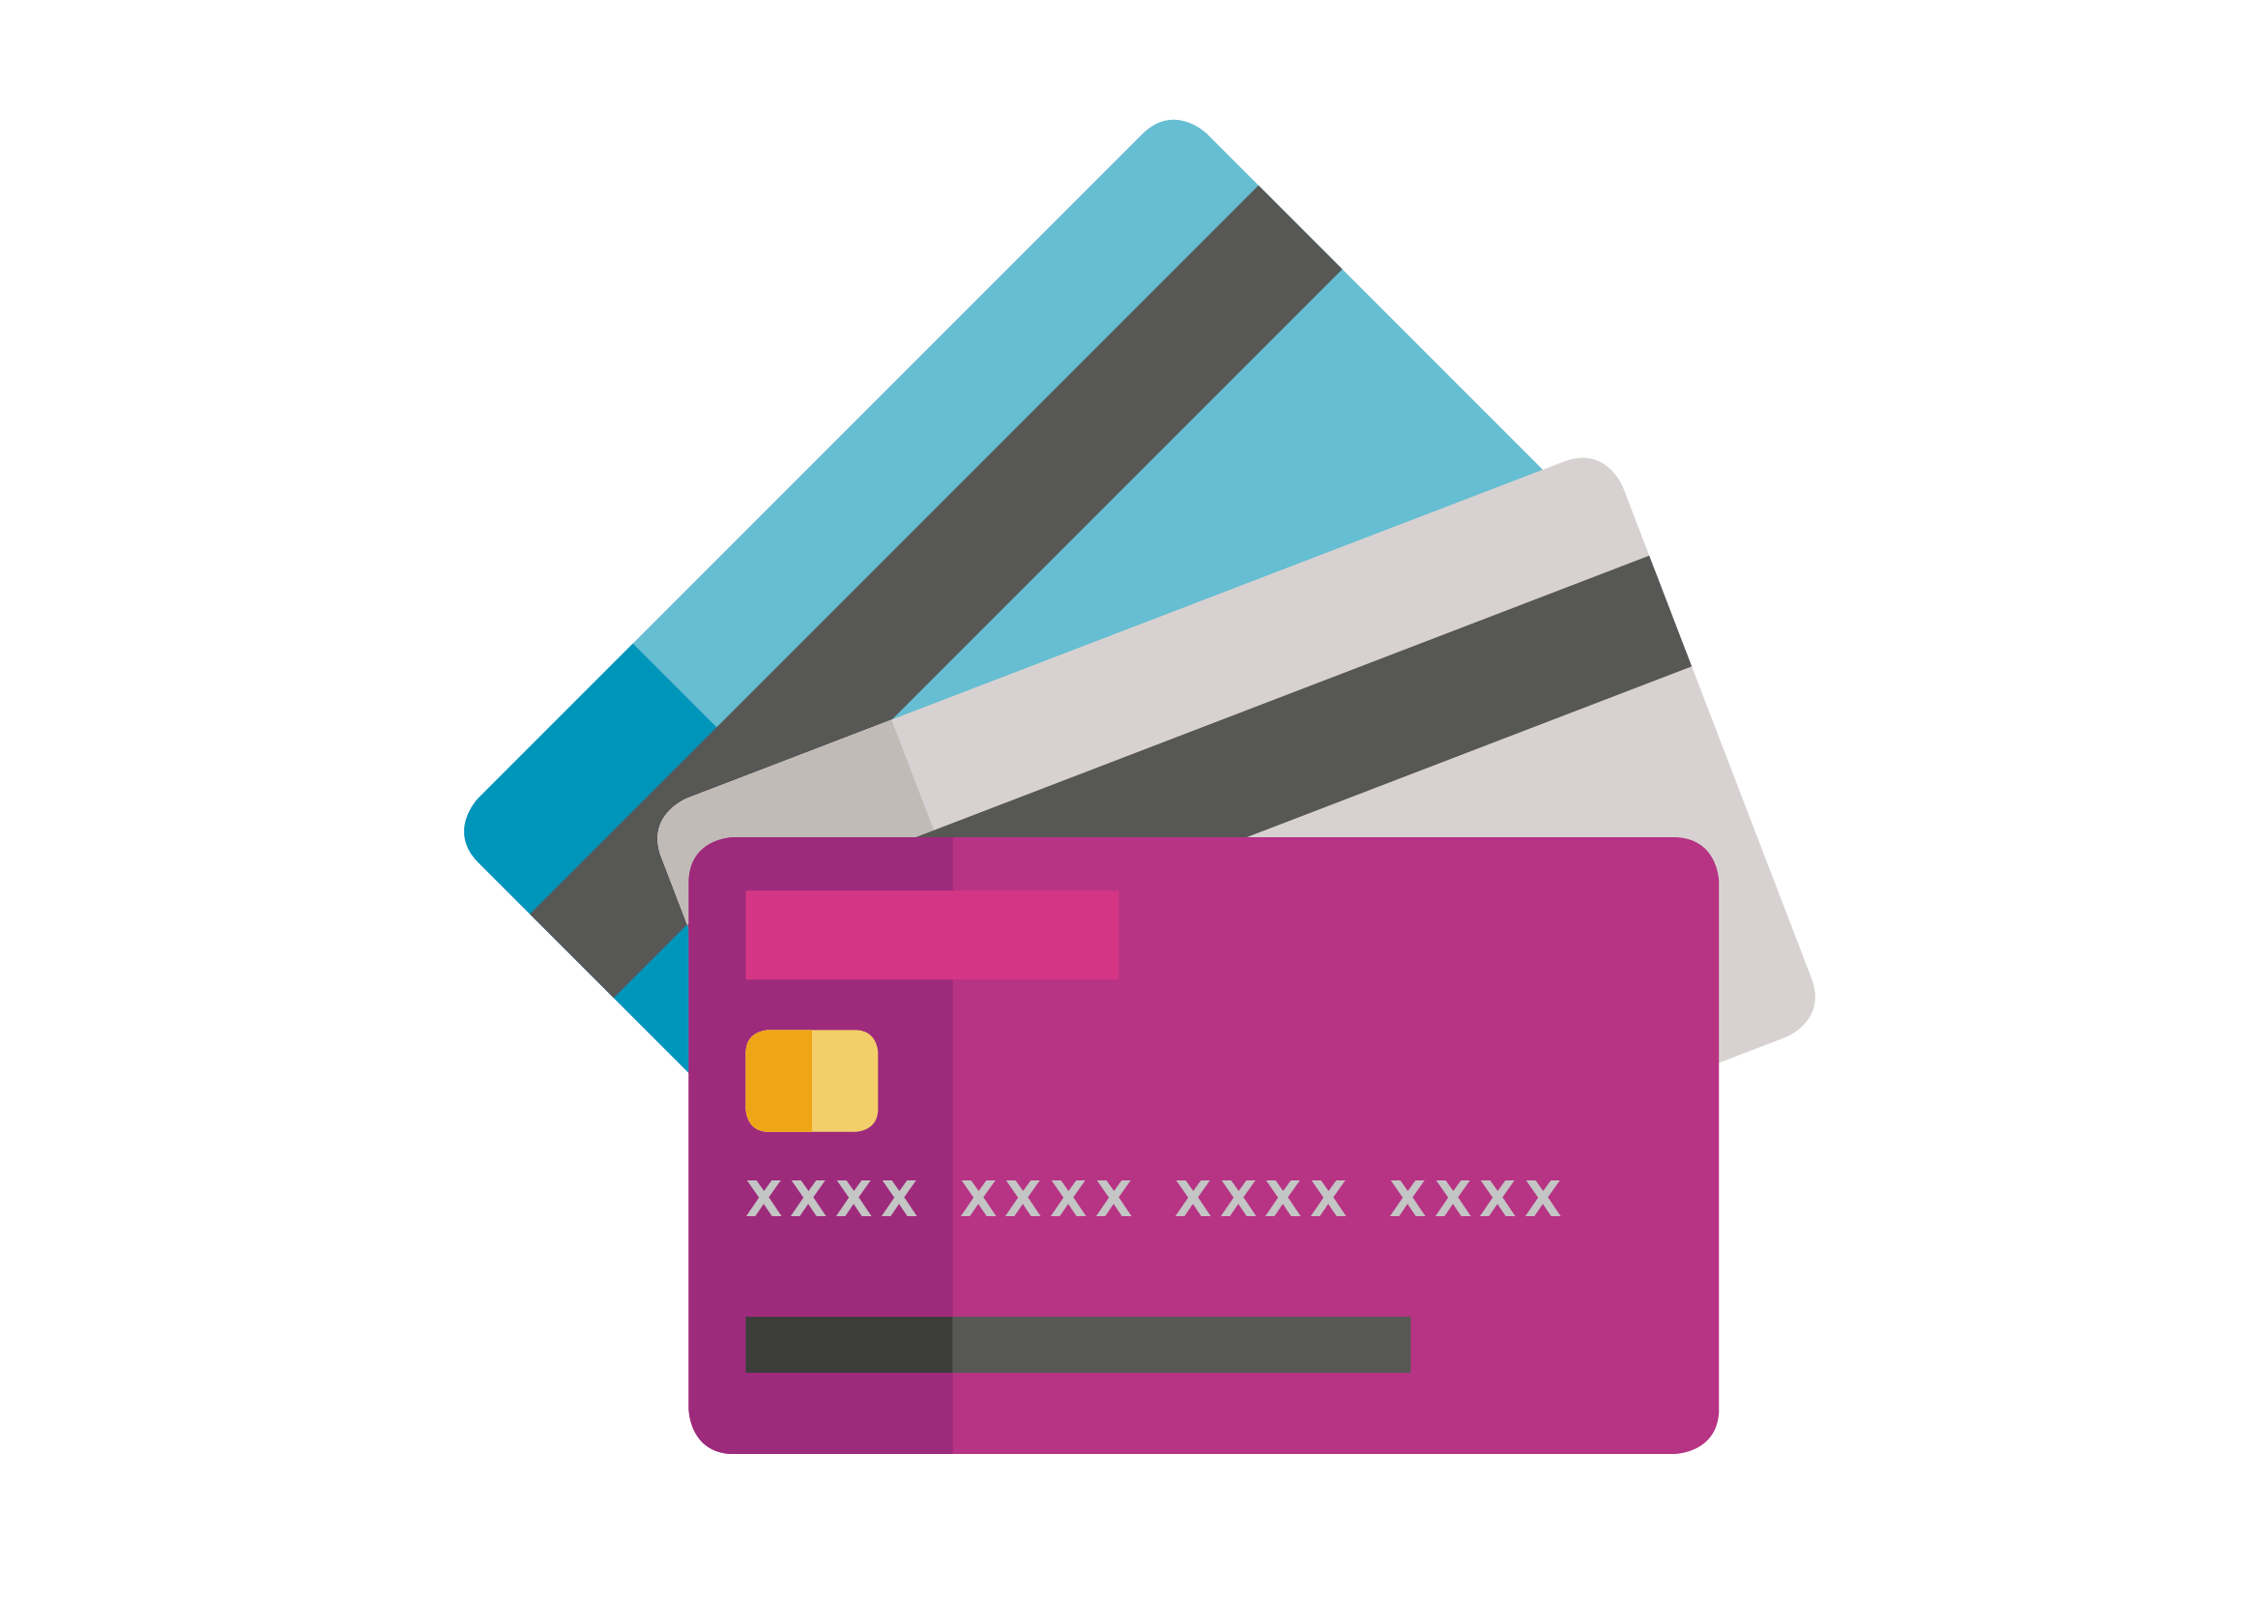
Money on the move
Payment methods that can be used online
CREDIT OR DEBIT CARDS
Easy to use
Can use them to withdraw cash from a cash machine
Shops are set up for their use
Protection if lost or stolen
You are borrowing money, so if you pay money back late you pay more (interest or fine)
Need to be over 11 for a debit card and over 18 for a credit card
Can be easy to overspend (get into debt)

Slide 8
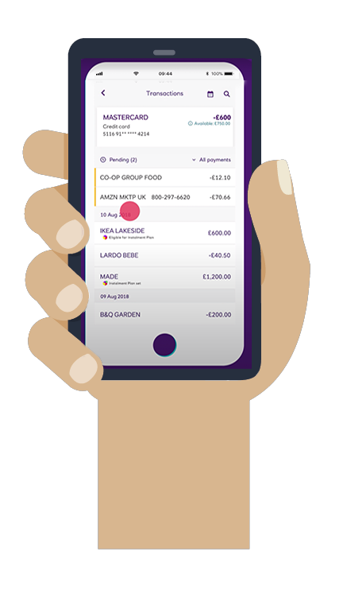
Money on the move
Payment methods that can be used online
ONLINE BANKING (VIA DESKTOP OR APP)
Easy to use
Can make payments whenever and, if using an app, wherever you want
Protection if lost or stolen
Sometimes payments are shown a few days after spending money
Need access to the internet
Need to be over 16 to use
Can be easy to overspend (get into debt)
Need to remember your password
How are payments changing? | 8

Slide 9
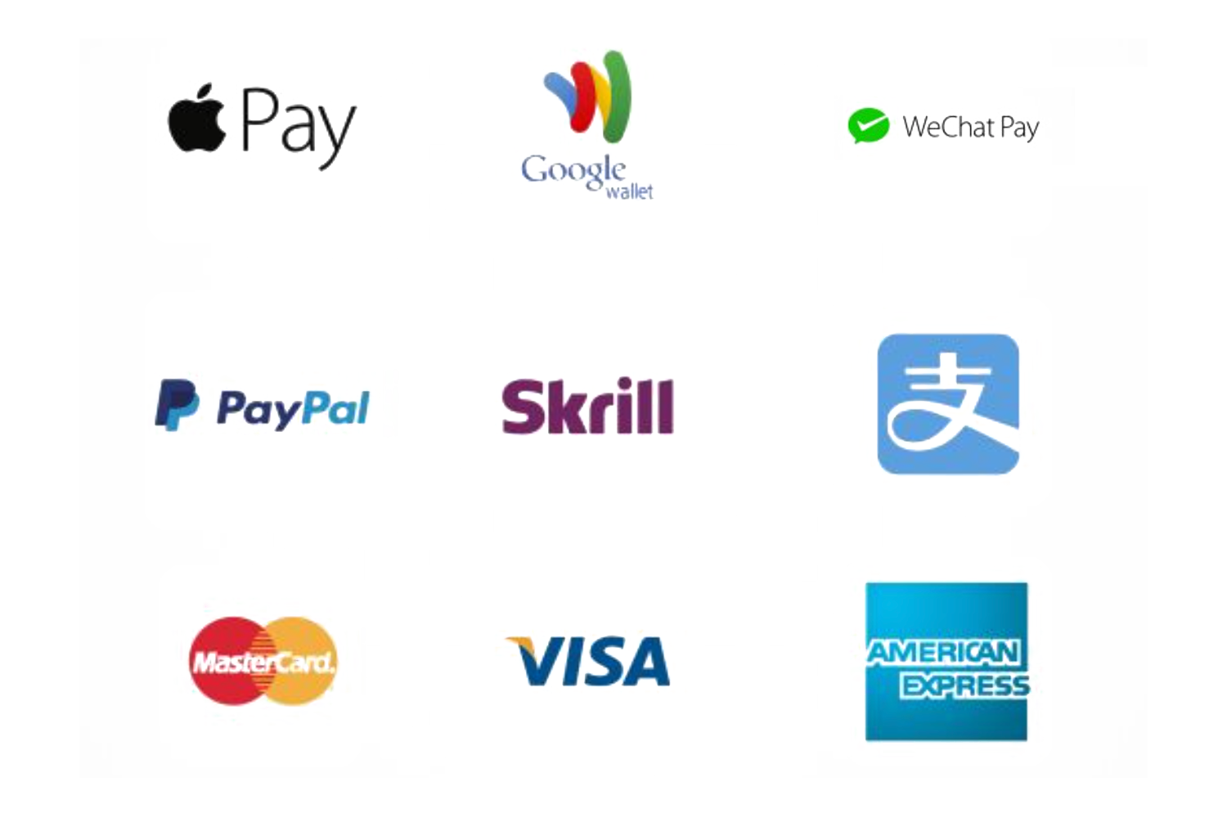
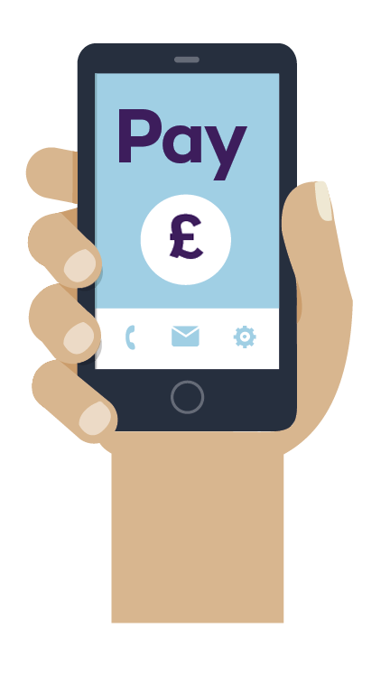
Money on the move
Payment methods that can be used online
PAYMENT APPS*
Easy to use
Payment shown on app straight away
Can make payments whenever and wherever you want
Apps such as Apple Pay can be used if you are over 13*
Can freeze or lock if needed
Need access to the internet
Some require you to be over 18 to use
Can be easy to overspend (get into debt)
*These link to your credit or debit card.

Slide 10
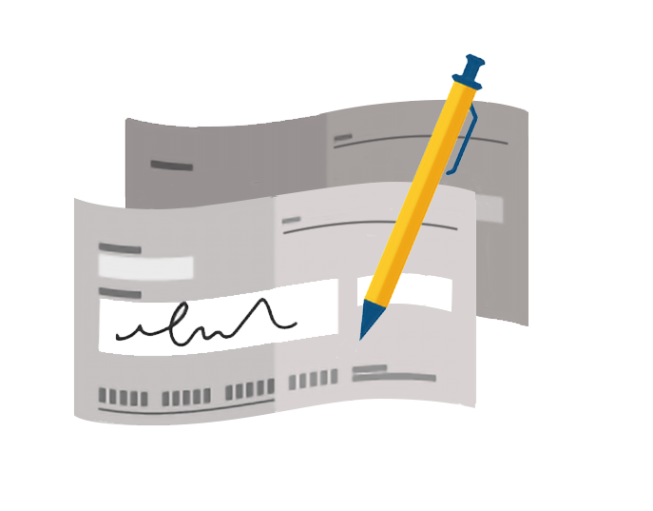
Money on the move
Payment methods that cannot be used online
CHEQUES
Safe way to spend money
Not many shops or services accept them anymore

Slide 11

Money on the move
Payment methods that cannot be used online
CASH
Easy to use
More likely to avoid overspending (debt)
Can easily track spending
Can use at any age
Change is heavy to carry around
Do not always have the right amount to pay for something
Little protection if lost or stolen
£

Slide 12
Money on the move
Payment methods that cannot be used online
CONTACTLESS PAYMENT
Safe way to spend money
Quick to tap your card/phone, no need to enter your PIN
Limit to how much you can pay for via contactless
Easy to lose track of spending

Slide 13
Money on the move
Complete the How should they pay? activity sheet.
Extension: Give advice to Steve and Isra on how they could pay for items during the day:
Steve needs to pick up some medicine from his high street pharmacy and then some food from the local fruit and veg shop. When he leaves the house, he takes his wallet, and a mobile phone that he only uses in emergencies.
Isra needs to do some shopping for a holiday but the only time available to do this is on her bus journey to work. She also needs to buy some dinner from the supermarket on her way home. She has a work mobile phone and a personal mobile phone.

Slide 14

Activity 3: Safe spending
However you choose to spend money, it is important to spend safely.
Here are some top tips:
Keep any method of payment somewhere safe, that cannot be seen
by others
All payment/banking apps, and your devices, should have unique and memorable passwords or codes to open and use them
Never tell other people personal information about money or passwords, e.g. your PIN
Always ask an adult if you want to spend money online
Always read terms and conditions of anything you sign up to or use online
Only use websites that have a padlock in the search bar.

Slide 15


Safe spending
Draw a padlock.
From memory, fill the padlock with five different ways
to stay safe when spending money in a digital world.
Extension: Create a poem, short story or song about going shopping with your family. Include who you are with, what you are going to buy and where you are going to buy it from.

Slide 16
Checking the learning
Answer True or False to the following questions...
1. A want is something we would like to have, but we don’t need it in order to stay alive
2. Online shopping means you can see and touch what you want to buy
3. It is easy to tell when someone overspends if they use cash
4. You need to be 16 or over to have a payment card
5. Payment apps can be used by anyone at any age
6. Online payments have more security measures than using cash
Extension: Write down three key things you have learnt in this session.

