Slide 2
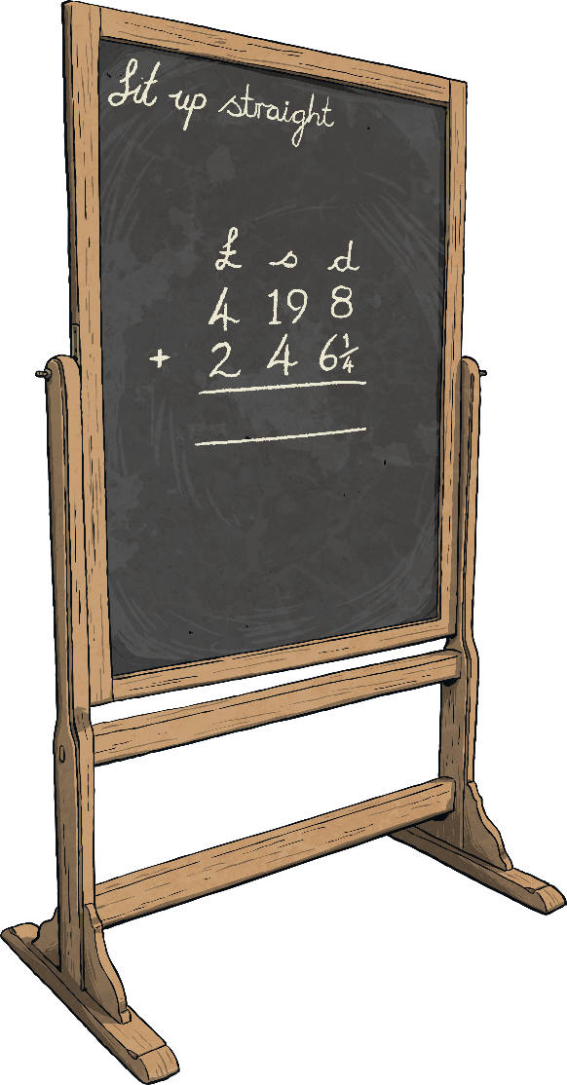
During and After Reading Each Chapter
Three active listening tasks are provided for display while a chapter is being read. These give focus to what children are looking out for while listening to the story.
Five questions are provided for after each chapter has been read. These may be just for discussion or answered on whiteboards, verbally or as a short assessment of understanding.

Slide 3
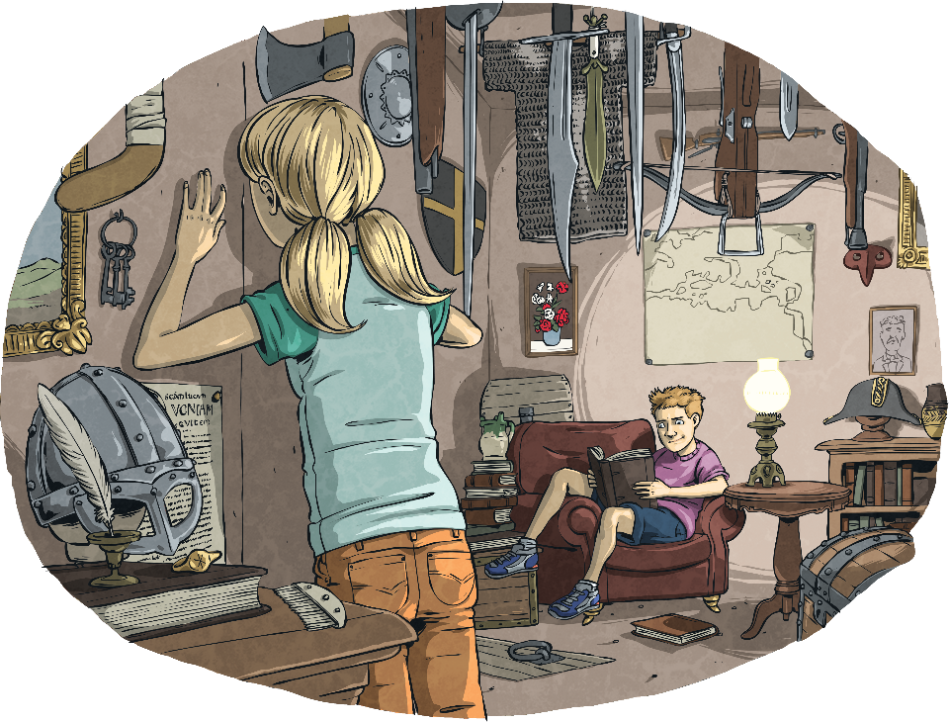
Chapter 1: Charlie’s Dare
To think about while reading:
Where does the opening scene take place?
Who did all the items belong to?
What do the ‘gates’ or ‘doorways’ enable the children to do?

Slide 4
Chapter 1: Charlie’s Dare
After reading the chapter:
What are the names and relationship of the two main characters?
Which period of history have the characters visited previously?
How do the characters feel about the suggestion of going back in time?
What do the small fabric bags on the cork board contain?
In which city is the story set?

Slide 5
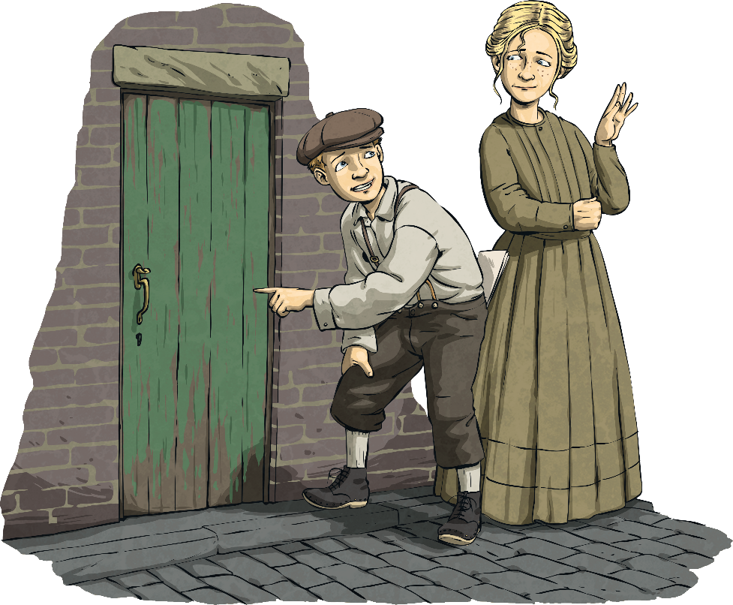
Chapter 2: The Oldest Door
To think about while reading:
How are Charlie and Tilda’s costumes described?
Where is the ‘gate’ located?
What ‘key’ do the siblings need to pass through the gate?

Slide 6
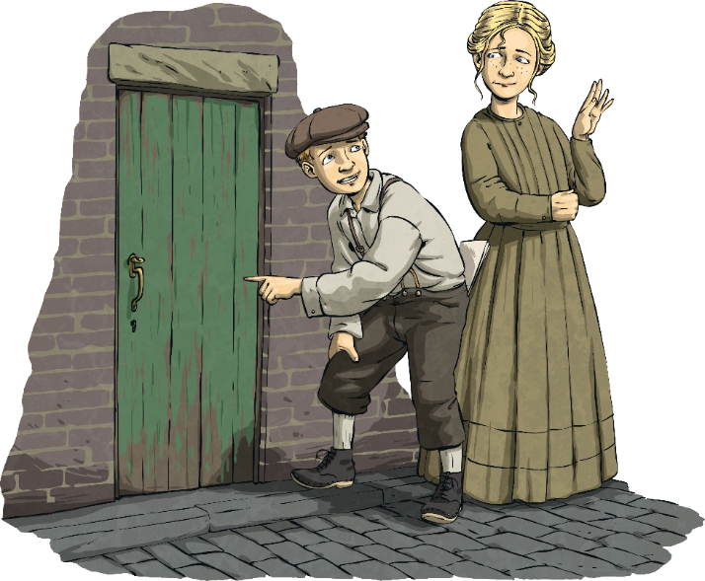
Chapter 2: The Oldest Door
After reading the chapter:
How did Tilda feel about her costume?
Why do you think the word ‘borrowed’ was in inverted commas?
What materials was the door made from?
Who went through the doorway first and why?
What do you think will be different after they pass through the gate?

Slide 7
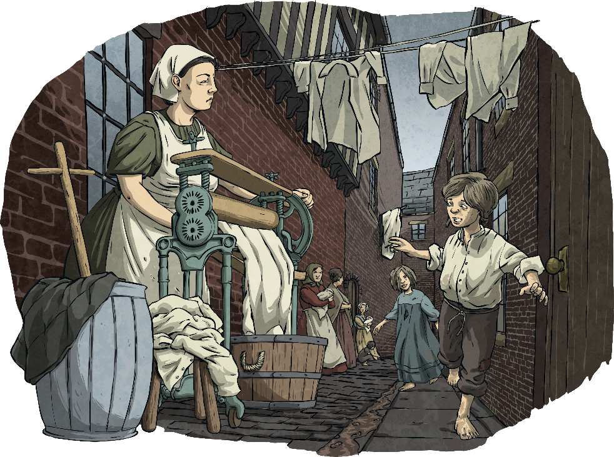
Chapter 3: Blaggers, Toffs and Overgrown Bantlings
To think about while reading:
Look for descriptions of the Victorian setting, including those appealing to different senses.
Who do Charlie and Tilda first meet when back in Victorian York?
What year did the siblings go back to?

Slide 8
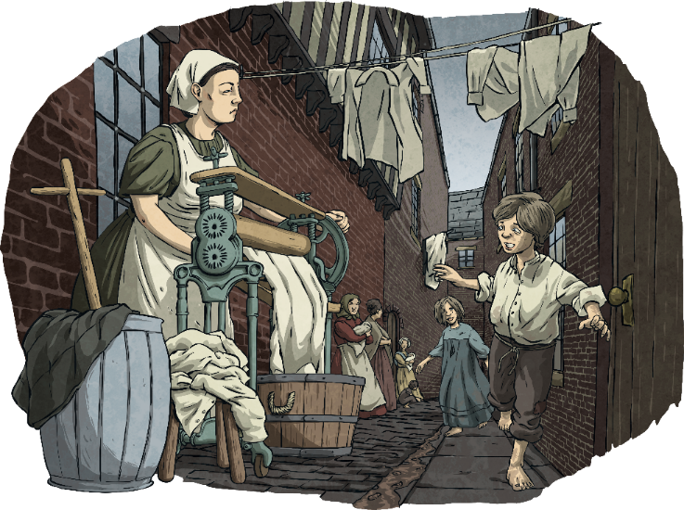
Chapter 3: Blaggers, Toffs and Overgrown Bantlings
After reading the chapter:
What is a ‘mangle’ used for?
What is the meaning of the words ‘blagger’ and ‘toff’?
Why did Charlie tell the woman that they were thieves?
Why did Charlie dirty his sister’s dress?
What do you think would be the worst part about living in the Victorian slum and why?

Slide 9
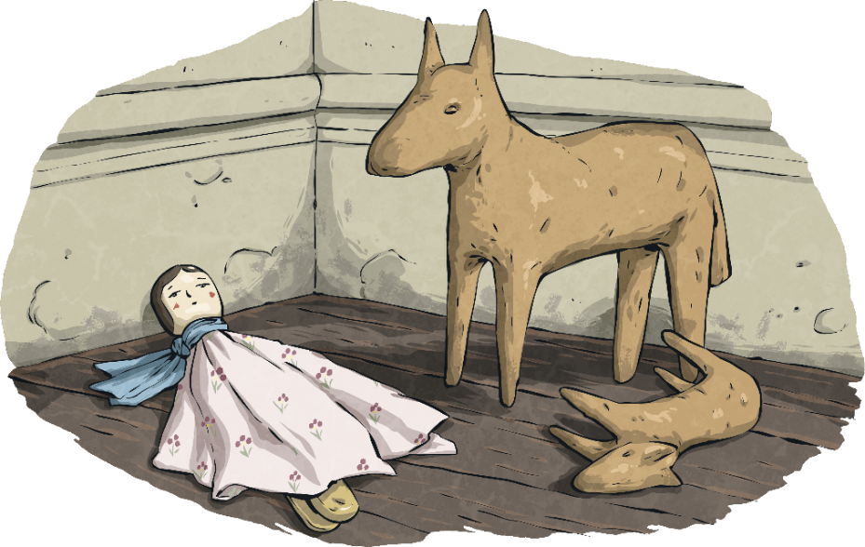
Chapter 4: Filthy Lurkers
To think about while reading:
What are the women doing gathered in the middle of the street?
What do we learn about toilets in the Victorian houses?
Who are the two men that Charlie and Tilda meet? What are their jobs?

Slide 10
Chapter 4: Filthy Lurkers
After reading the chapter:
Who does Charlie mean by ‘artisans’?
Look at the quotes: ‘…the stern face of a very large man…’ and ‘…the burly constable growled…’. What impression do you get of the police constable?
What has Mrs Baxter done wrong?
“D’you hear that, Constable?” sneered the little man. “They haven’t done anything wrong!”
What does the word ‘sneered’ suggest?
5. Where does the constable threaten to take the children?

Slide 11
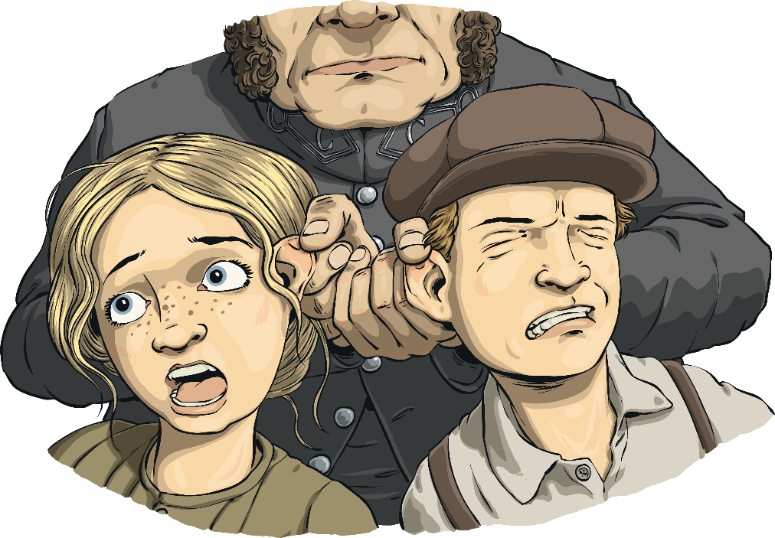
Chapter 5: You Snooze, You Lose
To think about while reading:
Who is discovered in the house?
Where was Mrs Baxter reported to be?
Look for any similes or metaphors that you can find in the chapter.

Slide 12
Chapter 5: You Snooze, You Lose
After reading the chapter:
What happened to the Baxters’ father?
Who is captured and who gets away in this chapter?
Joseph is described as ‘wearing clothes that hung from his thin frame like rags on a scarecrow’. What impression does this give of him?
What other synonym for ‘idiots’ is used?
How do the Baxter children feel? Find evidence in the text to support your answer.

Slide 13
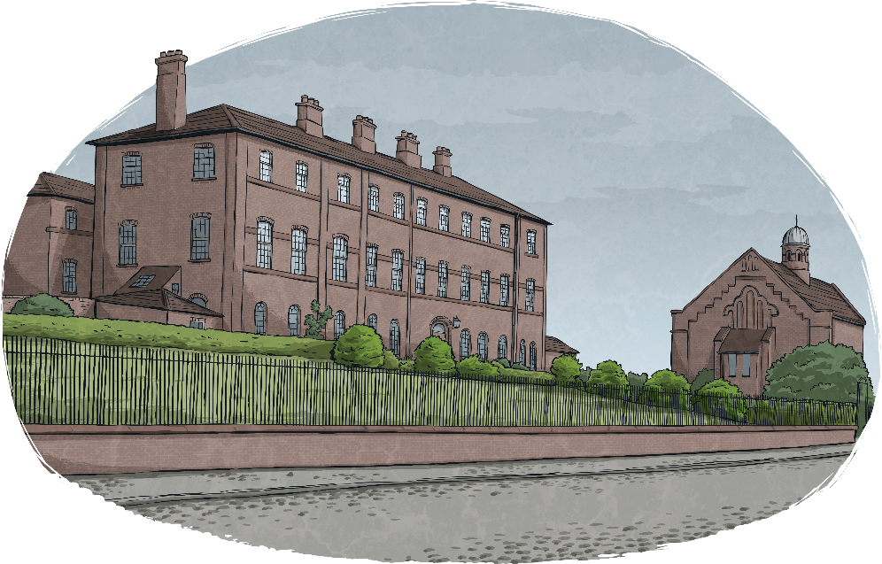
Chapter 6: Home, Sweet Home
To think about while reading:
Where do Charlie and Joseph go after getting away from the landlord?
What more do we find out about Mr Baxter’s death?
Who is Master Thompson?

Slide 14
Chapter 6: Home, Sweet Home
After reading the chapter:
How is the outside of the workhouse described?
What noises are made by the workhouse door? Find two.
What is the meaning of the word ‘petty’ in Victorian slang?
How old is Joseph?
‘He instantly regretted asking the question.’
What is the meaning of the word ‘regretted’?

Slide 15
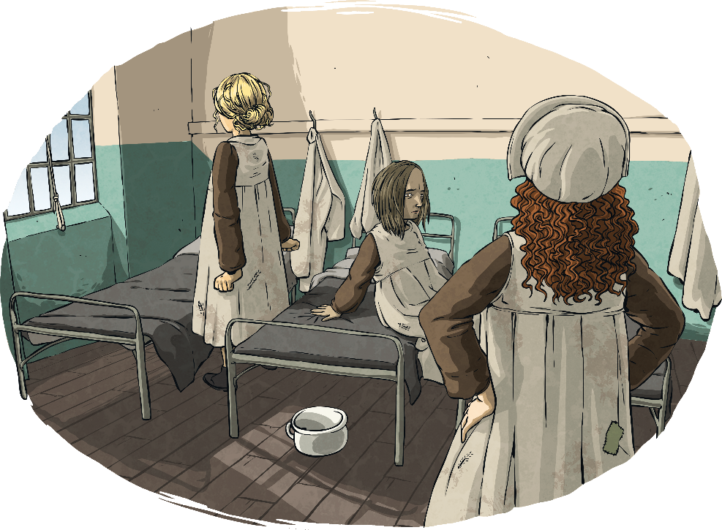
Chapter 7: Cockroaches on the Ceiling
To think about while reading:
How many workhouse staff are we introduced to in this chapter and who are they?
What impression do you get of the inside of the workhouse?
What do we find out about the clothes given to the children in the workhouse?

Slide 16
Chapter 7: Cockroaches on the Ceiling
After reading the chapter:
What is meant by the word ‘wings’ in this chapter?
What impression do you get of Agatha Crowle? Find evidence to support your answer.
What is a ‘dormitory’?
What were the ‘small, dark dots scurrying across the unpainted brickwork’?
Agatha’s laughter is described like ‘the rattle of machine-gun fire’. Why is this an effective simile?

Slide 17
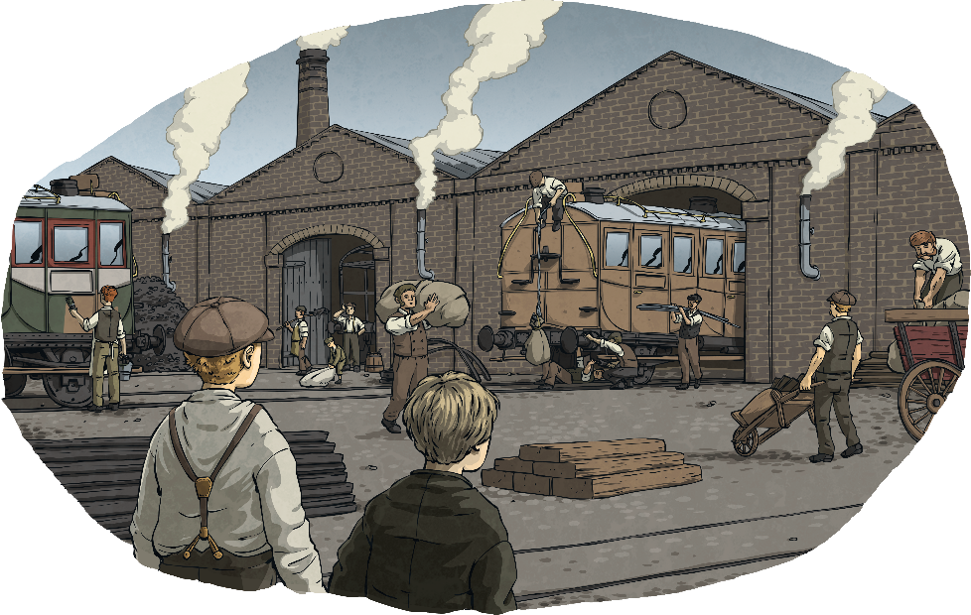
Chapter 8: The Railway City
To think about while reading:
How old does Joseph say you have to be to work in a factory?
What is being built at the factory that the boys visit?
What could the boys see going on inside?

Slide 18
Chapter 8: The Railway City
After reading the chapter:
List three other cities mentioned in the chapter.
‘The trepidation painted on his face told Charlie that children rarely spoke in this way to adults.’
What is meant by the word ‘trepidation’?
3.
4.
5.
Why do the boys end up at the big house?
Why does Charlie think that Master Thompson should help pay for Mrs Baxter’s debts?
What is Charlie’s plan at the end of the chapter?

Slide 19
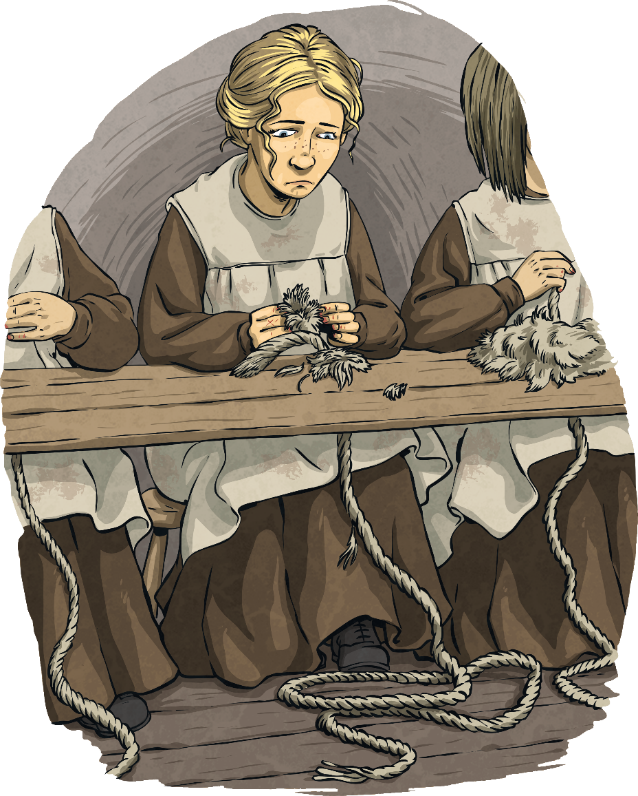
Chapter 9: Gormless Sauceboxes
To think about while reading:
What do you think is meant by the phrase ‘gormless sauceboxes’?
What type of work is given to Alice and Tilda?
How do you think they felt about doing the work?

Slide 20
Chapter 9: Gormless Sauceboxes
After reading the chapter:
Find a word in the first paragraph that is a synonym for ‘looked’.
Describe the level of noise in the room while children were working.
What further impression do you get of Agatha Crowle in this chapter?
What is Matron Watts’ rule about ‘if they don’t work…’?
How would you describe Tilda’s actions in saying that she stole Alice’s rope?

Slide 21
Chapter 10: Plum Duff and Old Prunes
To think about while reading:
What have the boys just done at the beginning of the chapter in order to get into the house?
What description can you find of the inside of the house?
Who are the boys mistaken for later in the chapter?

Slide 22
Chapter 10: Plum Duff and Old Prunes
After reading the chapter:
What was the smell coming from the house before the boys entered?
What is the meaning of the word ‘taxidermy’?
Why do you think Charlie is worried about his sister?
What lessons are taught to Alice and Tilda by the schoolmistress?
Why was Tilda unhappy about the lessons being taught to girls?

Slide 23
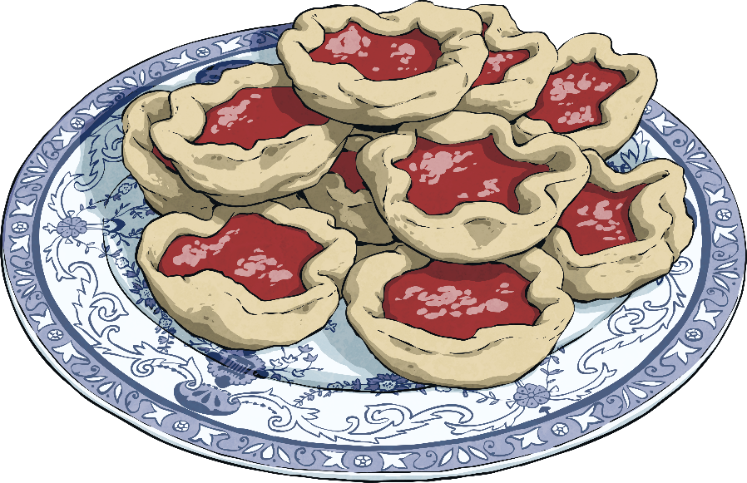
Chapter 11: Parlour Tricks and Gigglemugs
To think about while reading:
What impression do you get of Governor Watts in the opening paragraph?
What does the kitchen worker think of the boys’ tarts?
Who do Charlie and Joseph meet on the stairs?

Slide 24
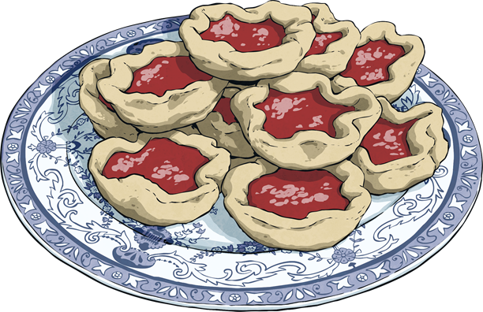
Chapter 11: Parlour Tricks and Gigglemugs
After reading the chapter:
What punishment does Tilda receive for her actions?
How do you think the schoolmistress feels about the punishment given to Tilda?
Which subjects does Nathaniel mention to Charlie and Joseph?
What questions does Master Thompson test Charlie with?
What do you think Charlie will encounter in a Victorian school?

Slide 25
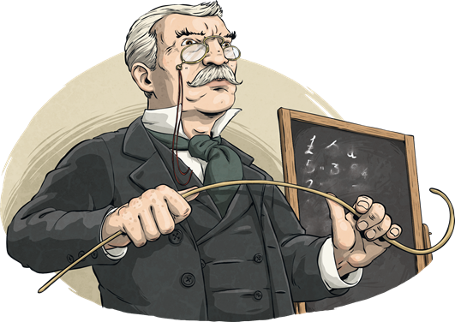
Chapter 12: The Wrong Queen
To think about while reading:
What do you think is meant by ‘the wrong queen’ as the chapter title?
What Victorian items are mentioned inside the schoolhouse?
How does Nathaniel feel after Charlie has joined him for the session at school?

Slide 26
Chapter 12: The Wrong Queen
After reading the chapter:
How do the boys get to the schoolhouse?
How many boys and how many girls are in the class?
What modern subject is mentioned as similar to ‘drill’?
What was Charlie’s punishment for getting the answer wrong?
Who do you think had the worst punishment: Charlie in this chapter or Tilda in the last one? Why?

Slide 27
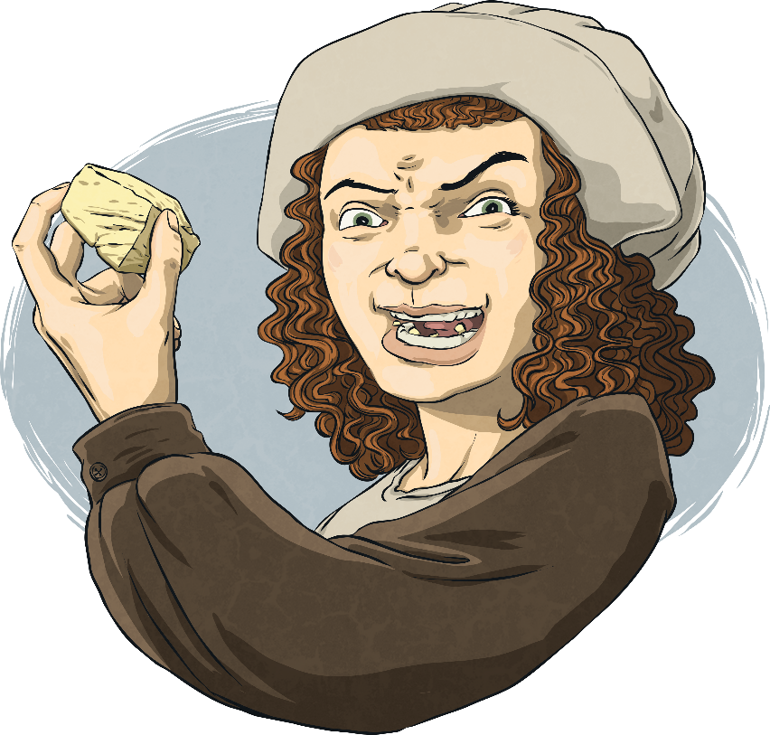
Chapter 13: Trouble for Tilda
To think about while reading:
How does Tilda feel about her own actions in the workhouse now?
What is meant by the word ‘privies’?
What does Agatha do to try to get Tilda into more trouble?

Slide 28
Chapter 13: Trouble for Tilda
After reading the chapter:
Does Tilda like cheese? How do you know?
Why do you think the children are giving the bread and cheese to Agatha?
Do you think it is the first time they have done this? Find evidence from the text to support your answer.
What is meant by the word ‘reluctantly’?
In the final paragraph, find a synonym for ‘breathed’.

Slide 29
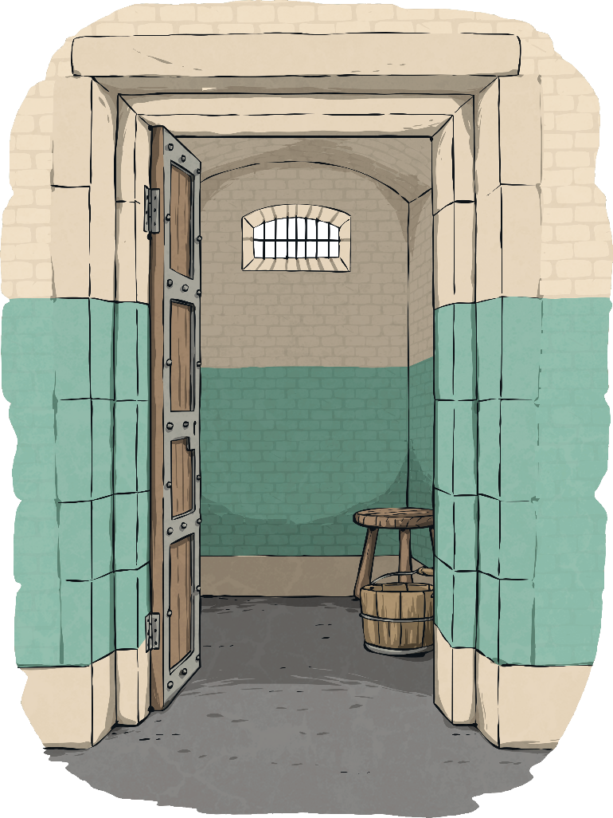
Chapter 14: Bed and Breakfast
To think about while reading:
What is Tilda’s new punishment?
What impression do you get of Nurse Atkins and why?
What happened to the previous person who had been in the room that Tilda was led to?

Slide 30
Chapter 14: Bed and Breakfast
After reading the chapter:
Look at the line beginning: ‘Tilda sighed wearily…’. What does this suggest about the way Tilda is feeling?
‘…the matron’s fists were clenched so tightly…’
What does this show about the matron’s feelings?
3. Where in the building was the refractory cell?
4. Describe the contents of the cell.
5. If Tilda had been guilty, do you think this was a fair punishment?

Slide 31
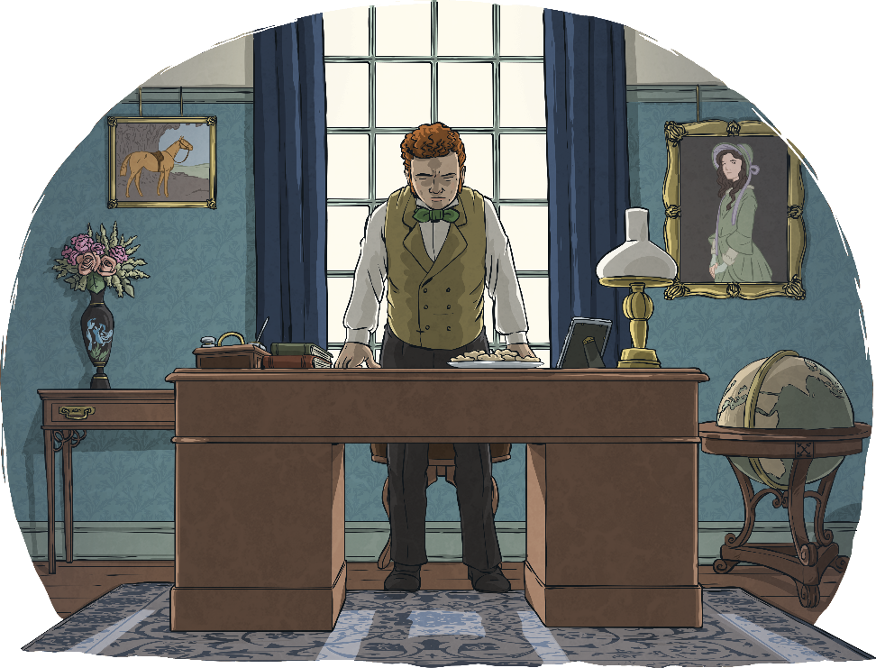
Chapter 15: A Favour for a Favour
To think about while reading:
What does Charlie request of Master Thompson?
Describe Master Thompson’s reaction.
How much is Joseph paid for the tarts?

Slide 32
Chapter 15: A Favour for a Favour
After reading the chapter:
What furniture does Charlie see in Master Thompson’s office?
What does Master Thompson offer to do in addition to paying for the tarts?
How do you think Joseph felt about Master Thompson’s offer? Use evidence from the text to support your answer.
Who did Master Thompson say he would send to the debtor's prison and why?
‘But I still don’t see what that’s got to –’ What is the purpose of the dash at the end?

Slide 33
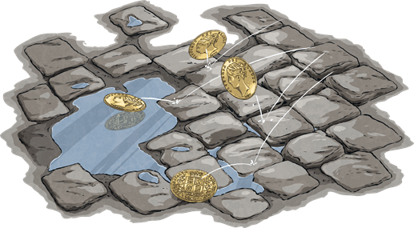
Chapter 16: Sovereigns for the Slums
To think about while reading:
Who is the first person to visit Tilda in the cell in the morning?
Who is next to visit her and why?
Who do Charlie and Tilda meet on the cobbles?

Slide 34
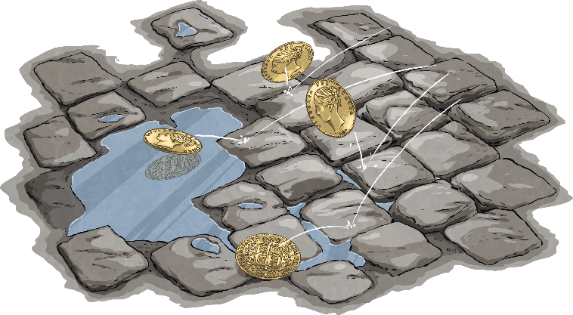
Chapter 16: Sovereigns for the Slums
After reading the chapter:
How did Agatha’s stealing get found out?
How was Tilda freed from the workhouse?
What happened to the Baxter family?
What did Charlie do with the money he was paid?
If you had the chance, would you go back to visit the Victorian period like the Hackers? Give reasons for your answer.

