Slide 1
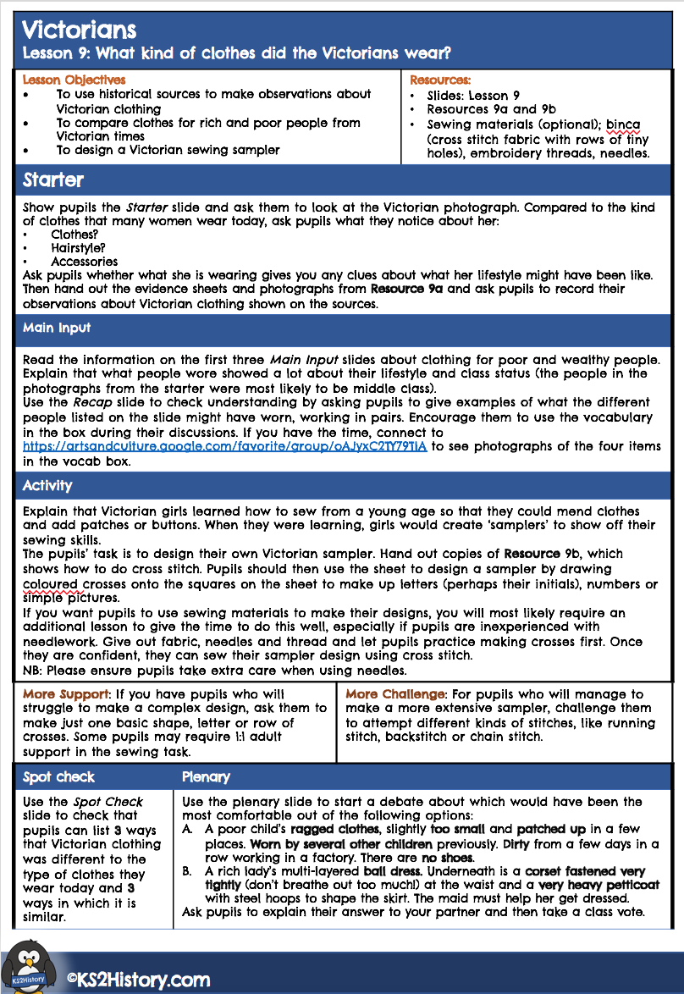
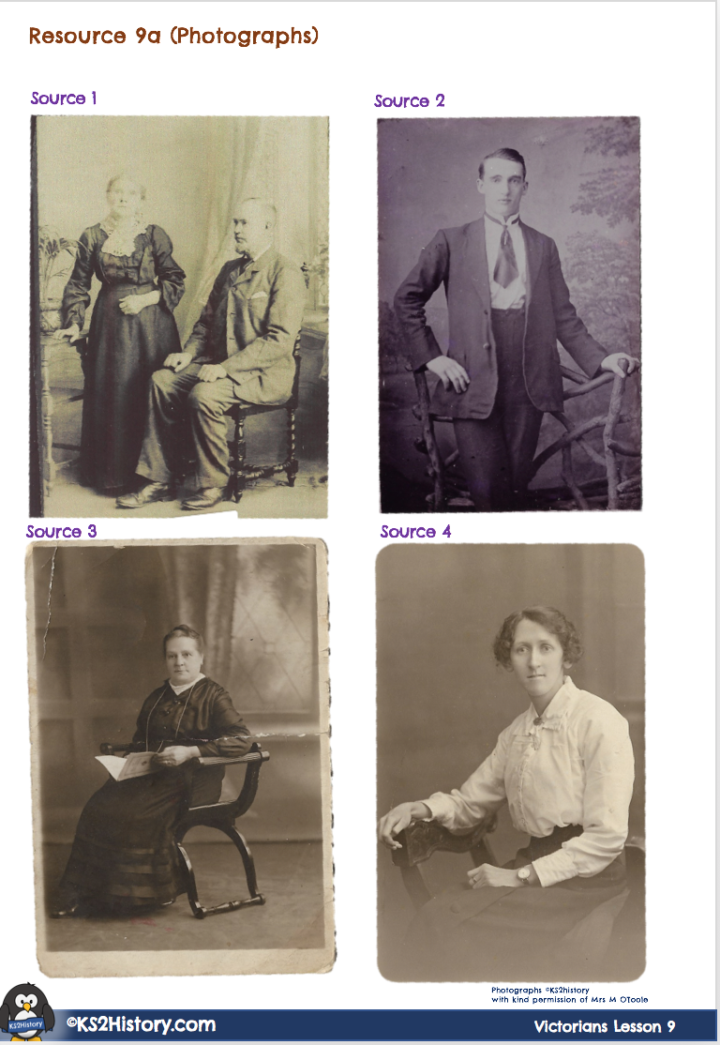
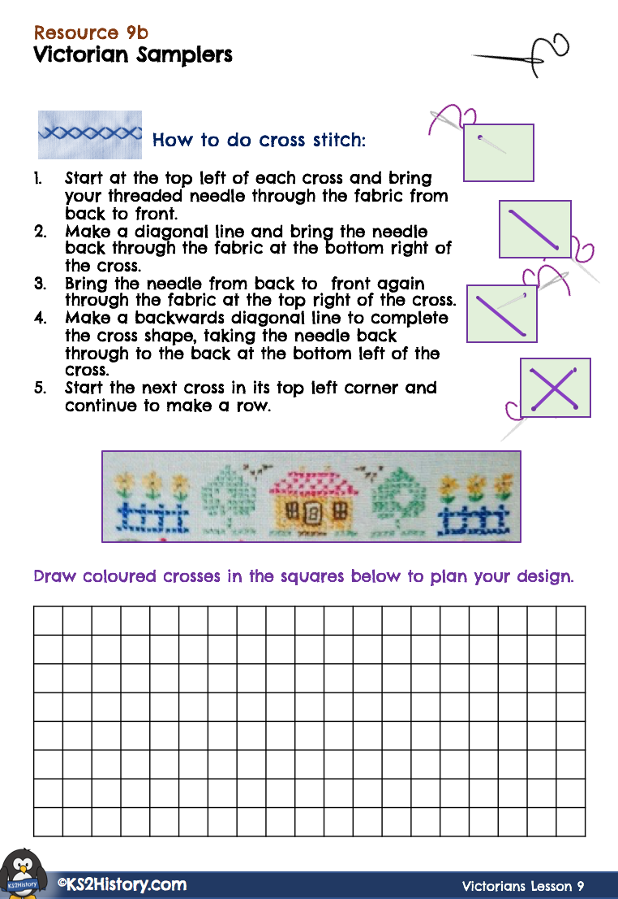
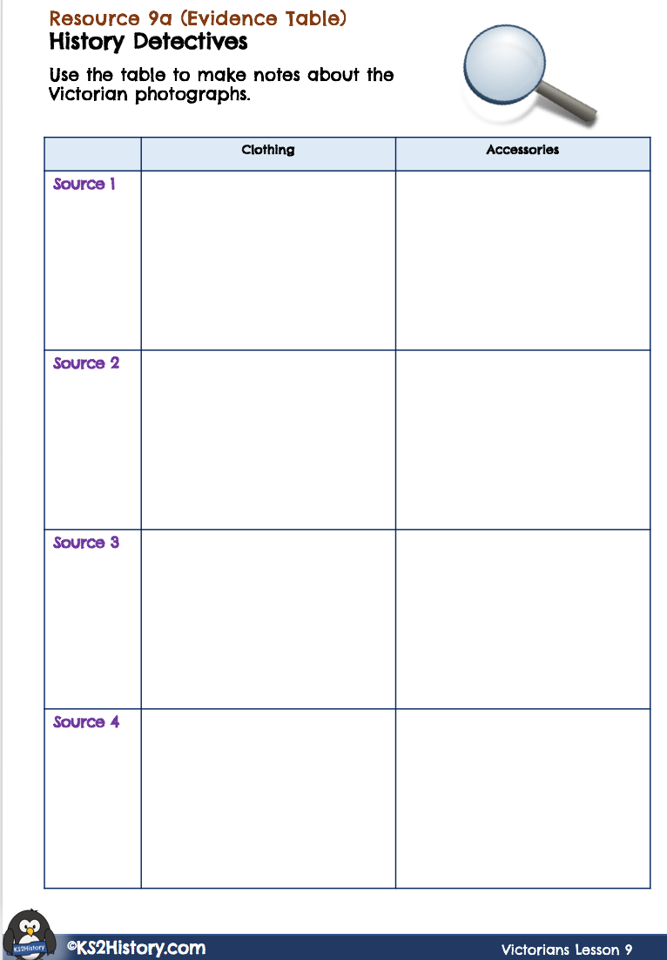
Lesson 9: Victorians
What kind of clothes did the Victorians wear?
©KS2History.com

Slide 2
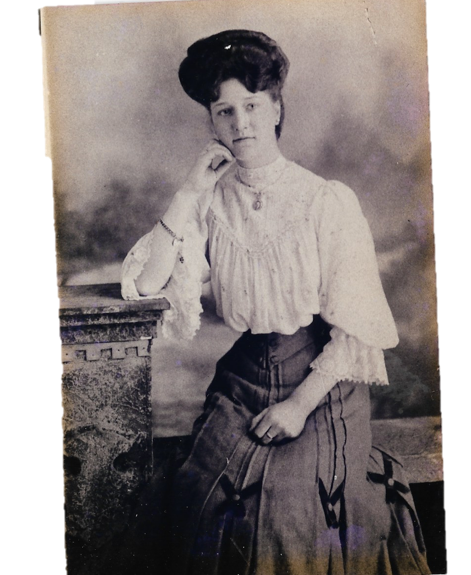
Starter Activity
History Detectives
Have a look at the lady in the photograph.
Compared to the kind of clothes that many women wear today, what do you notice about her:
Clothes?
Accessories?
Does what she is wearing give you any clues about what her lifestyle might have been like?
Photograph ©KS2history
Victorians Lesson 9
Victorian Clothing

Slide 3
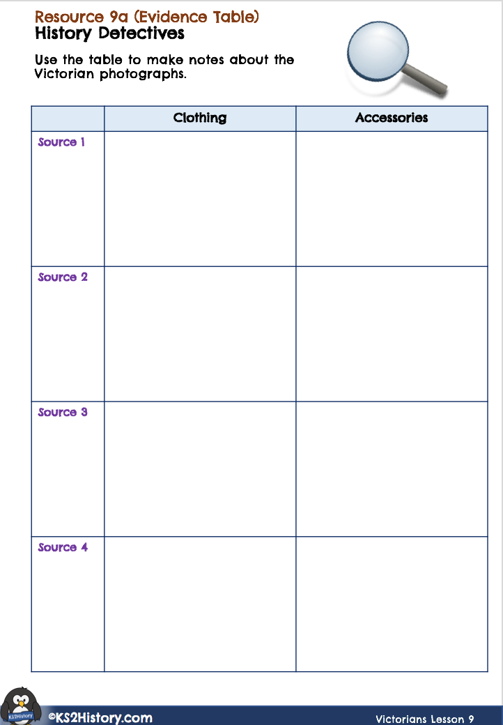
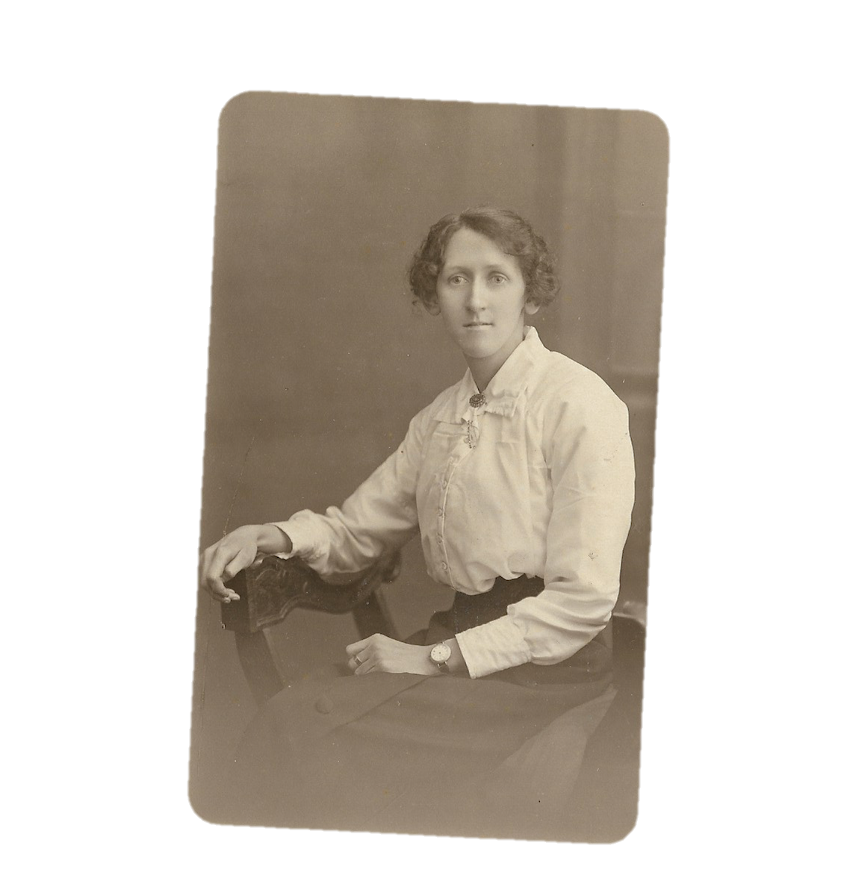
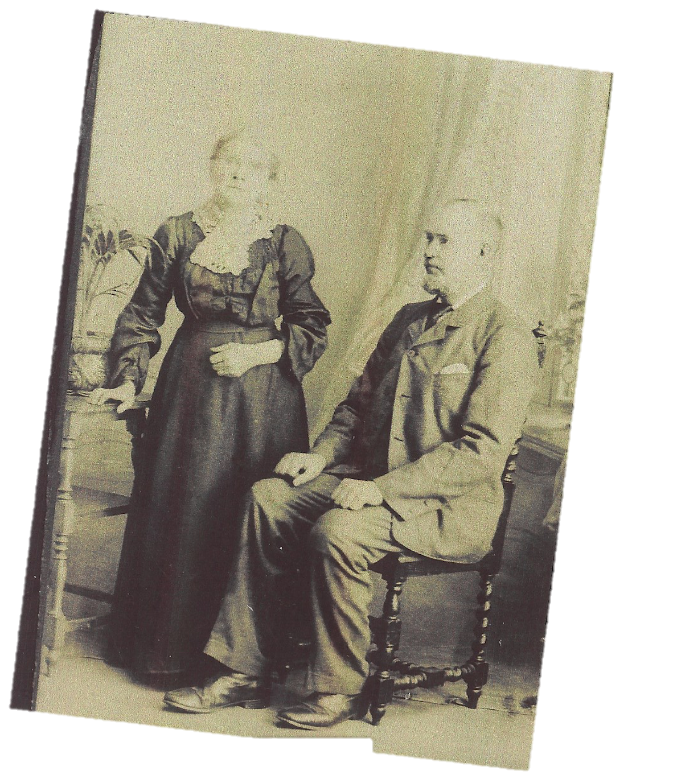
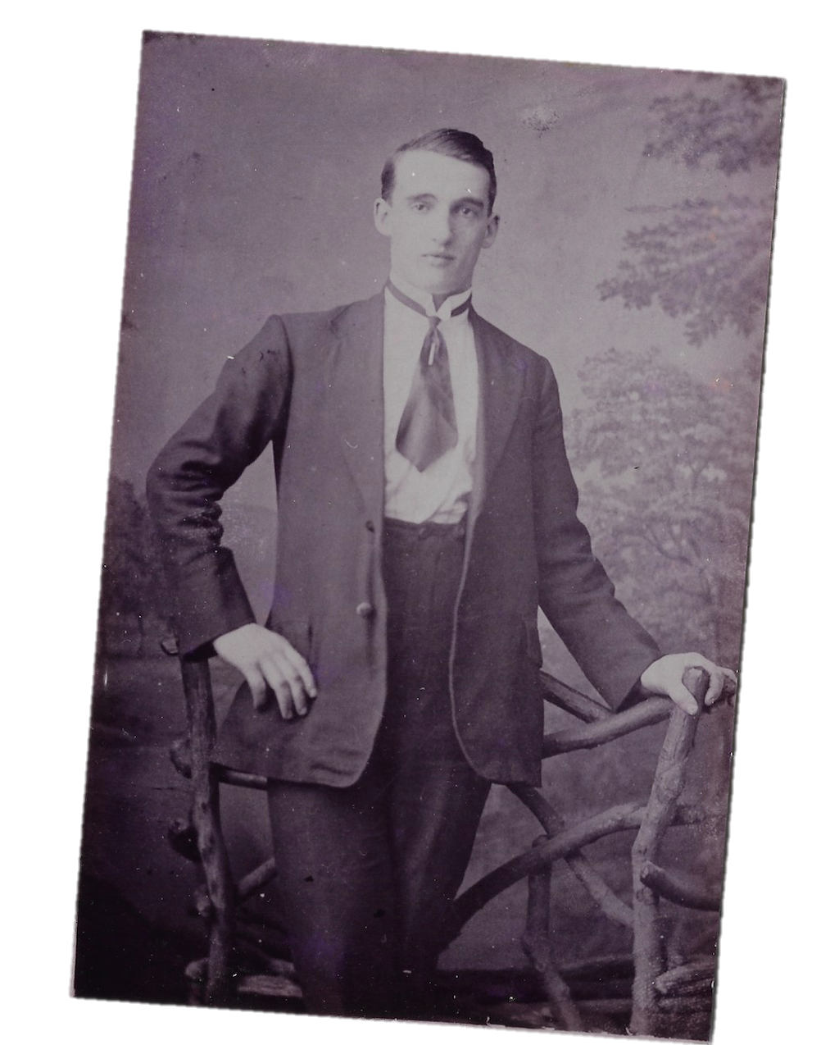
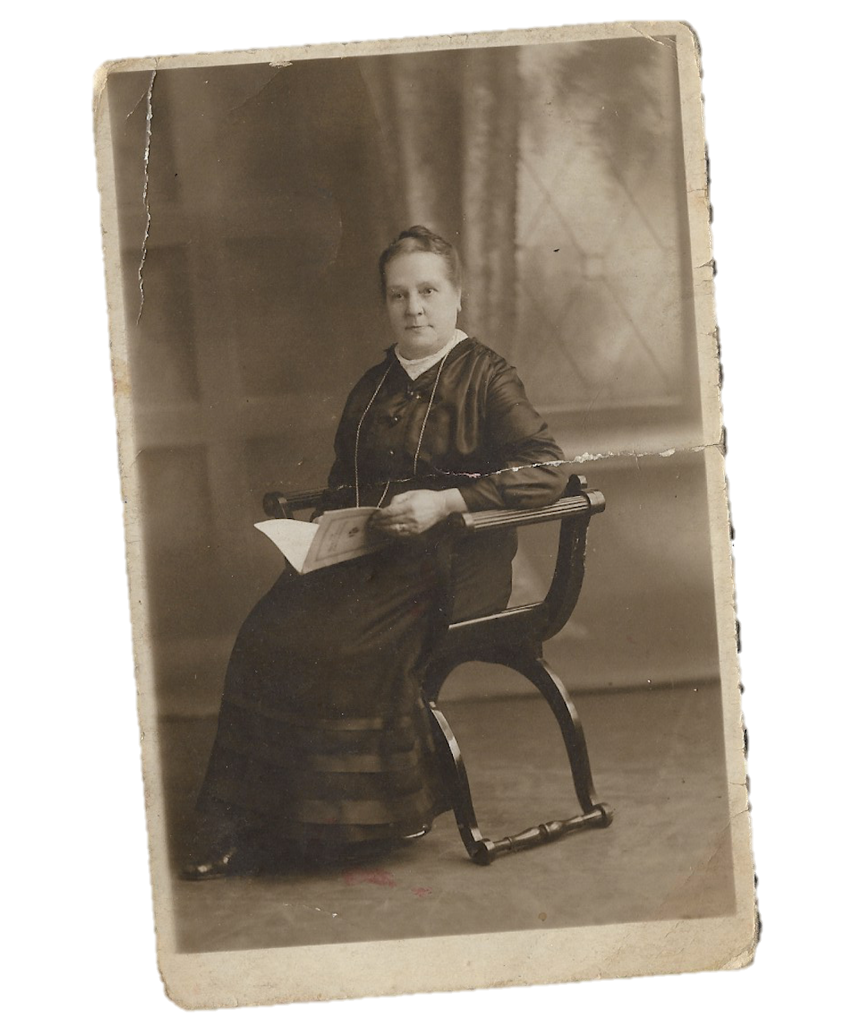
Starter Activity
Matching Resource: 9a
History Detectives
Look at the photographs provided by your teacher. They are all historical sources showing people from the Victorian period.
Use your observational skills to notice what the people are wearing. On your sheet, record notes about each photograph.
Victorians Lesson 8
Victorian Schools
Photographs ©KS2history
Victorians Lesson 9
Victorian Clothing

Slide 4
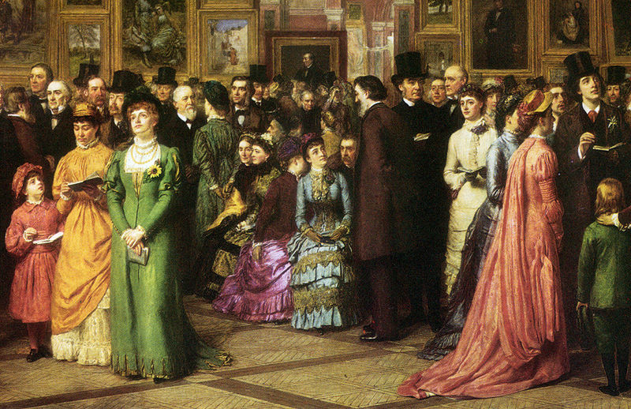
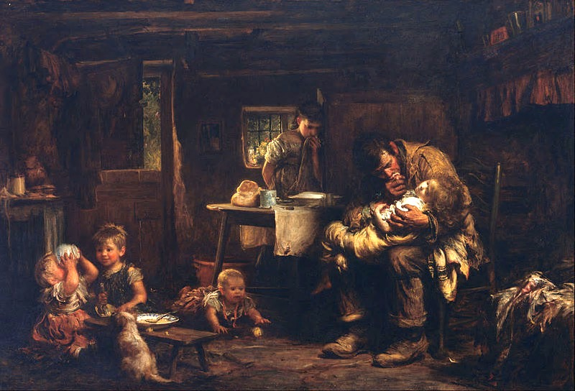
Main Input
Clothes: Rich or Poor
In Victorian times people’s attitudes towards clothing were quite different from today. What people wore showed quite a lot about their lifestyle. The photographs you have seen mostly show middle class people, but there were many other people in Victorian times who were much richer or poorer.
As a general rule, you could tell how rich or poor somebody was from their clothing. Look at these two paintings and try to summarise the differences between the clothing you can see.
A Private View at the Royal Academy, 1881 (William Powell Frith)
The Widower (Sir Luke Fildes)
Image source: Wikimedia Commons / Public Domain
Image source: Wikimedia Commons / Public Domain
©KS2History.com
Victorians Lesson 9
Victorian Clothing

Slide 5
Main Input
Clothes: Poorer People
People who were poor did not own many clothes. Their everyday outfits would have to last as long as possible and if they became torn or ripped, the clothes would be patched up and mended. For this reason girls were taught how to sew from being a young age. There were no washing machines but women washed the family clothes by hand using a wash tub, washboards and a wooden tool called a dolly.
Many people wore clothes in dark colours, made from cotton or wool. Children’s clothes were often passed down different family members. Most children had one smarter outfit called their ‘Sunday best’, which would be saved for wearing to church.
Clothes for the poor had to be functional so that the wearers could do their work easily. Poorer women often wore long-sleeved dresses, a shoulder shawl made of wool and bonnets or caps. Men often wore clothes that suited the kind of work they did, or they bought clothes from second hand shops. People only wore shoes if they could afford them, and many poor people (especially children) walked around with bare feet, even outside.
©KS2History.com
Victorians Lesson 9
Victorian Clothing

Slide 6
Main Input
Clothes: Richer People
For richer people, clothes were more about fashion and demonstrating status than being functional or needing to last a long time.
Middle class women wore dark coloured dresses or blouses and skirts and many middle class men wore suits and hats.
The wealthiest women had elaborate outfits consisting of many layers and they sometimes needed a maid to help them dress. Underneath, they would wear a corset (a very tight under garment designed to shape the woman’s figure at the waist). The skirts on the dresses were made to be very wide and were shaped underneath by metal hooped petticoats or linen ‘crinolines’. To finish the outfit, they would sometimes add bustles or ruffles to the top of the dress.
Many rich men wore smart suits, waistcoats and top hats (even indoors).
Wealthy children very often wore simplified miniature versions of adult outfits.
©KS2History.com
Victorians Lesson 9
Victorian Clothing

Slide 7
Plenary
Is it Comfortable?
Which of these Victorian outfits do you think would be least comfortable for the wearer?
A poor child’s ragged clothes, slightly too small and patched up in a few places. Worn by several other children previously and dirty from a few days in a row working in a factory. There are no shoes.
A rich lady’s multi-layered ball dress. Underneath is a corset fastened very tightly at the waist (don’t breathe out too much!) and a very heavy petticoat with steel hoops to shape the skirt. The maid must help her get dressed.
or
Explain your answer to a family member.
Victorians Lesson 9
Victorian Clothing

