Slide 2
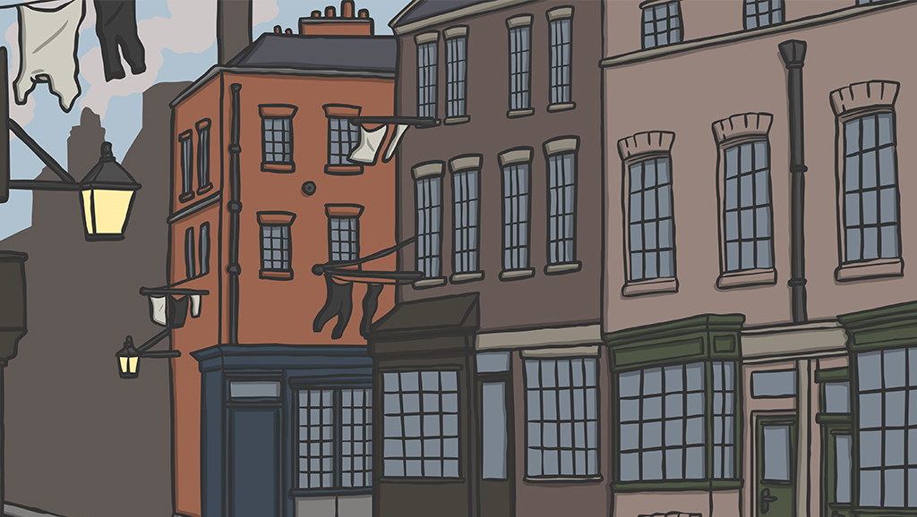
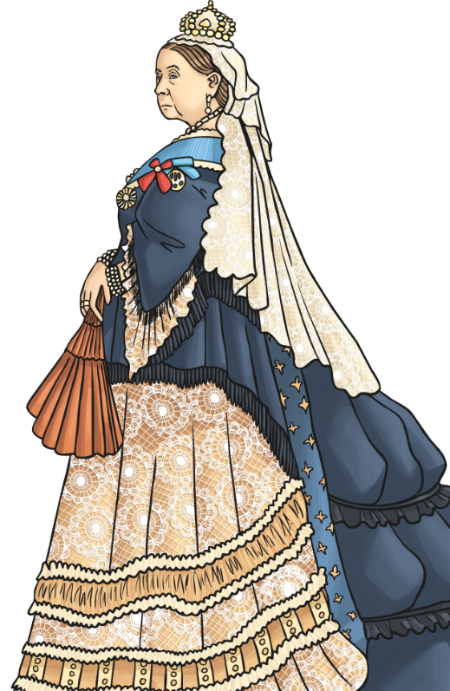
Victorian Engineers, Scientists and Inventors
The Victorian era is the time when Queen Victoria was on the throne of the United Kingdom. She came to the throne in 1837 and died in 1901.
People who lived during this period are known as Victorians.
The Victorian age was a time of great innovation and change and produced many innovators, inventors and scientists.
Innovator
A person who introduces new methods, ideas or products.

Slide 3
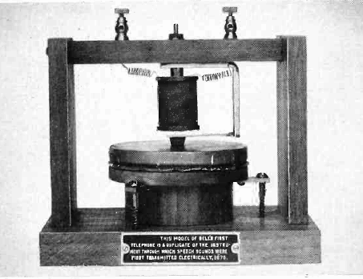
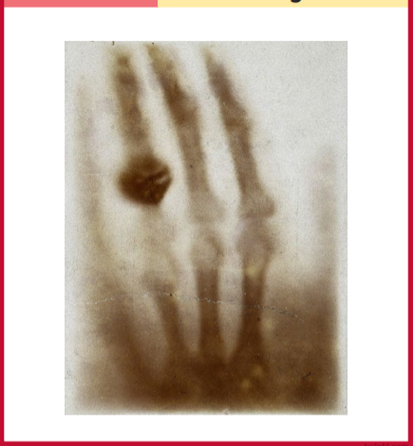
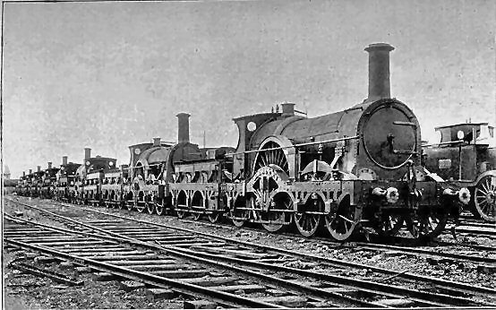
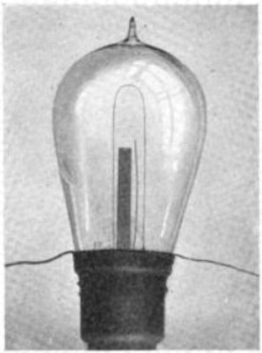
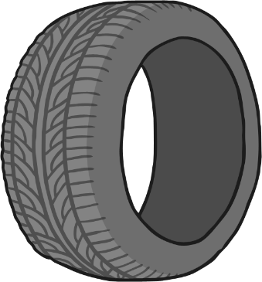
Do You Recognise Any of These Victorian Inventions?

Slide 4
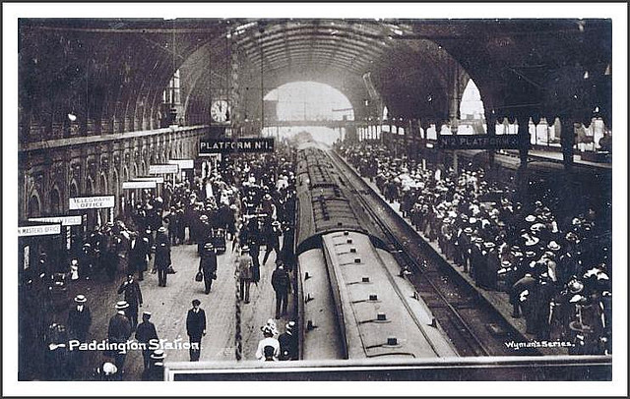
Isambard Kingdom Brunel
In 1822, Isambard took on his first job with his father, digging a tunnel under the River Thames. It took many years to make and was a dangerous mission, as it would sometimes collapse on them. However, it is still used by trains today.
Born in Portsmouth, England in 1806
Brunel also made the world’s biggest ship, called the Great Eastern. It was designed to take people from Britain to Australia. The ship was launched in 1839 but sadly never made it to Australia.
Isambard Kingdom Brunel was a famous engineer. He made many things, including ships, bridges, railways and tunnels.
Other things Isambard Kingdom Brunel created include:
The Maidenhead Bridge across the River Thames
The Wye Bridge at Chepstow
Paddington Train Station
Famous for making many things, including ships, bridges and railways

Slide 5
Alexander Graham Bell
Born in Edinburgh, Scotland in 1847
In October 1876, Alexander and Thomas talked to each other on the telephone for the first time. They were over two miles away from each other at the time.
Alexander was particularly interested in the different ways that sound could travel. In 1874, Bell and a skilled electrician called Thomas Watson started working together to invent what is now known as the telephone.
As a child, Alexander always wanted to know more about the world around him and tried to solve problems by inventing new things. When he was 12 years old, he invented a machine to help the local mill owner. As a thank you, the owner of the mill allowed Bell to use a small workshop to create more inventions.
In 1877, Alexander started his own telephone company and his invention became famous around the world. He received many awards, medals and honours for his invention.
Famous for inventing the telephone

Slide 6
John Boyd Dunlop
Born in Dreghorn, Scotland in 1840
A racing cyclist asked if he could borrow John Dunlop’s idea and then he started to win races. The cyclist was so successful, that the tyres started being made and sold all over the world.
Sadly, there was a problem with the patent so Dunlop never became rich from the invention, and continued to earn his living as a vet.
John Boyd Dunlop initially had a career as a veterinary surgeon.
In 1887, he used rubber to make a tyre for his son’s tricycle.
Dunlop tyres is a name that many people recognise and associate with tyres, which are made in a variety of sizes for lots of different vehicles all over the world.
Famous for inventing the pneumatic tyre
Pneumatic
means ‘filled with air’.

Slide 7
Margaret E. Knight
Born in Maine, USA in 1838
In 1867, Margaret was employed by the Columbia Paper Bag Company and in 1868, she invented a machine that folded and glued paper to form flat-bottomed paper bags.
Someone called Charles Annan tried to steal her design but Margaret took him to court and won the right to call the design her own.
Margaret only received a basic education and had to work in a cotton mill as a child because her father sadly passed away when she was young.
She continued inventing useful objects, including a number of engines, for the rest of her life.
At 12, Margaret witnessed an accident at the mill so decided to invent a safety device for the mill machine, which is thought to have stopped it if something got caught in it.
Famous for inventing the flat bottomed paper bag

Slide 8
Charles Darwin
Born in in Shrewsbury, England in 1809
At 16, Darwin’s father sent him to Edinburgh to train to become a doctor but he did not enjoy it and hated the sight of blood! So his father sent him to Cambridge to become a vicar but he was more interested in learning about nature and animals.
Around 1831, Charles got the opportunity to become a naturalist onboard HMS Beagle. He had to explore, collect and record information about the rocks, plants and animals that they found on their trip. It was his dream job!
Charles Darwin is a famous scientist known for his studies of plants and animals.
He loved science at school and was always asking questions. When he was 13 years old, he set up a science lab in his garden shed.
Evolution
The process by which different kinds of living organisms are believed to have developed from earlier forms over time.
Famous for his contributions to the science of evolution

Slide 9
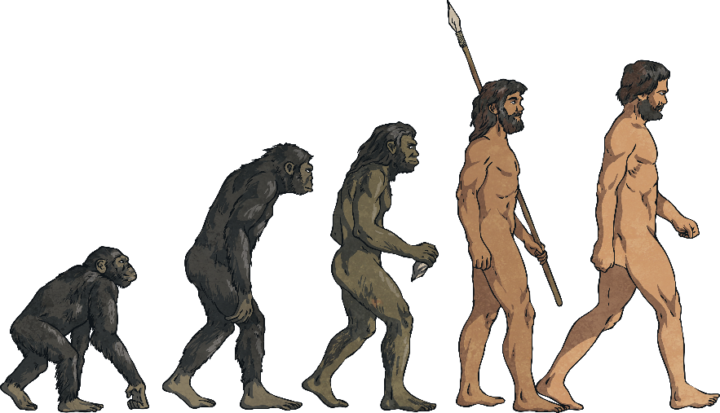
Charles Darwin
The Beagle’s voyage lasted for five years. They travelled to the Galapagos islands in South America. When he went ashore, Darwin found plants and animals that nobody had ever seen before! He took seeds from the plants to take home with him and wrote down all of his findings.
In 1859, Charles Darwin wrote a famous book all about the things he had found on his travels. After 20 years of studying, he had an idea that the plants and creatures he had collected hadn’t always been like that. He believed that, millions of years ago, living things had all started off in the same way and had gradually, very, very slowly, changed.
When he returned home to England, he planted the seeds he had bought back and continued studying plants and animals.
In this way lots of different animals and plants had developed. This idea is called ‘evolution’.

Slide 10
Thomas Edison
Born in Ohio, America in 1847
Thomas wanted to invent a light that did not need oils or gas to be lit. After some tests and changes, Edison created a lightbulb that would stay lit using electricity for 13 ½ hours!
Edison’s lightbulb was patented in 1879, however, there has been some debate over whether Thomas Edison really was the first person to invent the electric lightbulb as other inventors had made early versions of electric lamps.
As a teenager, Thomas Edison sold candy and newspapers on trains. He quickly became a good businessman and started selling newspapers on the streets with four assistants.
Famous for inventing the electric lightbulb
Edison’s first invention was completed in 1877 – the phonograph. It was a machine that could record and replay sound. The sound was played through a large horn.

Slide 11
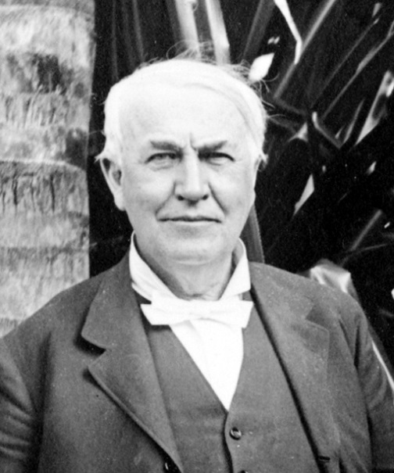
Thomas Edison
Soon after, the car maker Henry Ford asked Thomas Edison to design a battery for a car to start itself.
Edison invented a machine called a kinetograph that could crush rocks that had been brought up from the mines.
He also developed the carbon transmitter that improved the sound heard down a telephone line.
Thomas Edison was a very careful worker, who is now known as one of the most important inventors in history.

Slide 12
Lewis Howard Latimer
Although Thomas Edison is generally credited with inventing the light bulb, his design used a paper filament which would burn out quickly. Latimer improved the newly-invented incandescent light bulb by inventing a carbon filament (which he patented in 1881), which made possible the widespread use of electric light in public and at home.
Latimer also invented a threaded wooden socket for light bulbs, the first toilet that could be used in trains and a forerunner of the air conditioner.
Born in Massachusetts, America in 1848
Lewis Howard Latimer was a Black American engineer and inventor and a member of Thomas Edison’s research team, which was called "Edison's Pioneers."
Invented the carbon filament to improve the electric lightbulb

Slide 13
Sarah Guppy
She is most famous for patenting a bridge design, which was used in Telford’s magnificent Menai Bridge. Sarah also mentored a young Isambard Kingdom Brunel with his winning entry for the Clifton Suspension Bridge Competition.
Born in Birmingham, England in 1770
She also invented a bed with a reclining feature that doubled as an exercise machine, a method of caulking wooden ships and an attachment to tea and coffee urns that could poach eggs and warm toast.
Sarah Guppy was an engineer, inventor, campaigner, designer, reformer, writer, environmentalist and business woman!
Famous for patenting a type of bridge, reclining bed (among other things), as well as improving many designs, such as candlesticks and stoves
caulking
To make (a boat) watertight by sealing up any gaps in its hull.

Slide 14
Sarah Guppy
She developed a scheme for recycling roadside manures for use as farm fertilizer and suggested safety procedures for railways.
Guppy also copyrighted numerous designs for improved candlesticks, stoves and other appliances.
She truly was an innovative woman of her time!

Slide 15
George Jennings
Born in Hampshire, England in 1810
At the Great Exhibition of 1851, Jennings revealed his ‘Monkey Closets’. They were the first public toilets that anyone had ever seen and, during the exhibition, 827,280 visitors paid one penny each to use them. This is where the phrase ‘spending a penny’ comes from!
For ‘spending a penny’, visitors would have a clean seat, a towel, a comb and a shoe shine. Sounds like it was pretty good value for money!
George Jennings was an engineer and plumber, who invented the first public flushing toilets.
Famous for inventing the flushing toilet

Slide 16
Wilhelm Conrad Röntgen
Born in Lennep, Germany in 1845
Before x-ray machines were invented, broken bones and other things had to be diagnosed by a doctor’s best guess when looking at a patient. Thanks to x-rays, doctors were able to ‘see’ inside the body!
X-rays are a type of radiation that can’t be seen or felt but that can pass through the body.
Have you ever broken a bone? If so, you probably had an x-ray at the hospital.
Wilhelm Conrad Röntgen was a German mechanical engineer and physicist, who in 1895, produced and detected electromagnetic radiation in a wavelength range known as x-rays.
Röntgen received the first Nobel Prize for physics in 1901 for his work.
Famous for inventing x-rays

Slide 17
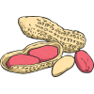
George Washington Carver
George’s parents were slaves, owned by the farmers Susan and Moses Carver. His father had died in an accident before he was born and when George was just a week old, kidnappers took him, his sister and mother in the night, to sell them. His brother James was saved by the Carvers, who then also went out to find the rest of the family. They only managed to find baby George.
Born in America in the early 1860s (we’re not sure exactly when)
George Washington Carver was a Black American teacher, scientist and inventor.
He became known as ‘the peanut man’, due to inventing more than 100 uses for peanuts.
Famous for inventing more than 100 uses for peanuts

Slide 18
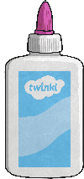
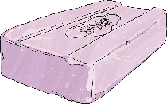
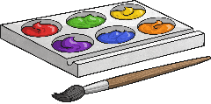
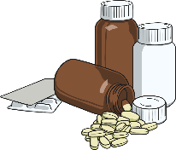
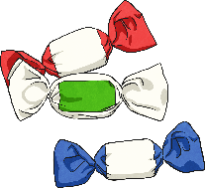
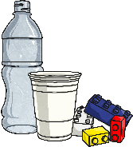
George Washington Carver
He invented more than 300 products from peanuts, including plastics, paints, soap and wood stains. He even invented a plant-based petrol.
In 1865, slavery was abolished but Moses and his wife, Susan, decided to continue to look after and educate George and his brother in their home.
George was interested in science and the arts. In 1896, George became a teacher at Tuskegee University, where he taught for 47 years. During this time, he also worked on his inventions.
soap
paint
glue
coffee
ink
face cream
wood stains
medicine
sweets
plastics

