Slide 1
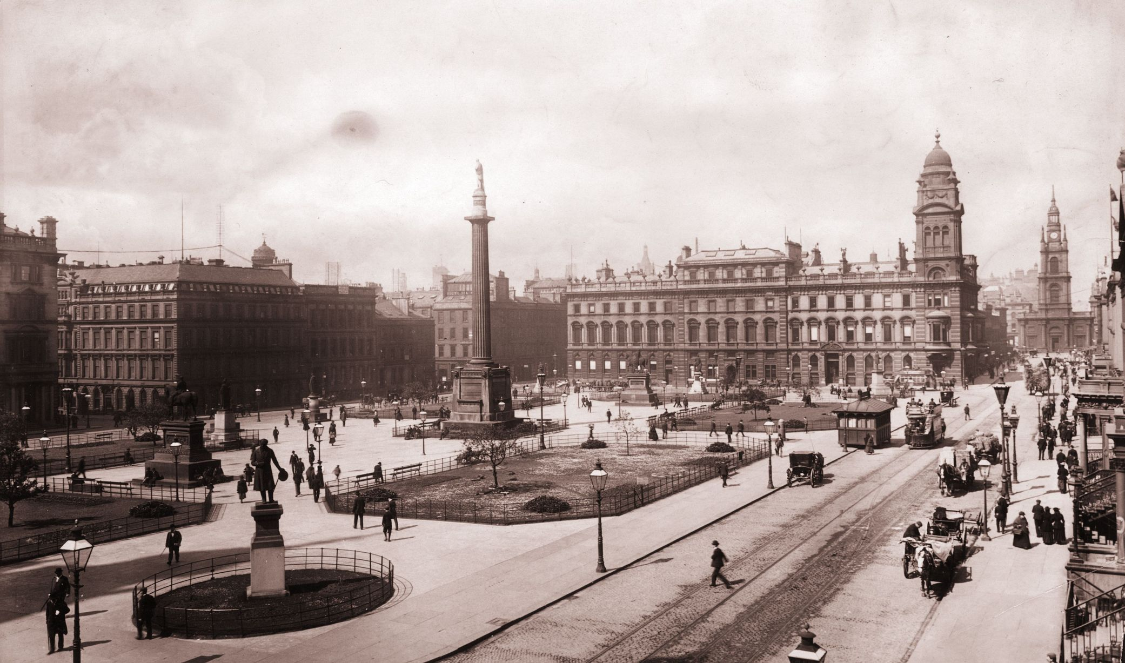
The Victorians

Slide 2
Learning Intention:
To carry out research
Success Criteria:
I can use search engines to find and select accurate information
I can take notes under given headings, on the key facts and information
I can write notes in my own words
I can include bullet points

Slide 3
Think about the following questions:
What does the term ‘Victorian era’ mean?
Why were the Victorians so famous?
What significant events happened during the Victorian era?
Using the information contained within this PowerPoint as well as your own Internet research, answer these three questions.

Slide 4
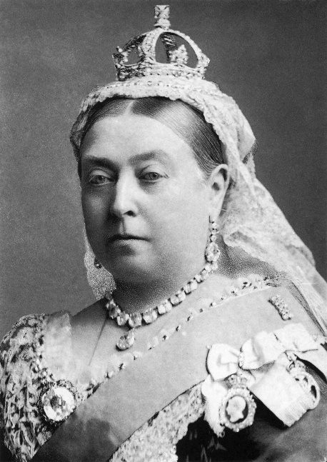
Who were the Victorians?
The Victorians lived over one hundred and eighty years ago during the reign of Queen Victoria (1837 to 1901).
What does the Victorian Era mean?
The Victorian Era means during the time that Queen Victoria ruled Britain. This is also known as the time Queen Victoria was on the throne. She ruled for 64 years.
Reign
The period of time during which a king,
queen, emperor, etc. is a ruler of a country.
Did you know?
Queen Victoria has the second longest reign within Britain. Our current Queen, Queen Elizabeth II has been on the throne for over 68 years.

Slide 5
Why is the Victorian Era a famous time in history?
The Victorian era is known as one the most important times in British history. This is because of all the changes that happened during Queen Victoria’s reign.
Britain managed to build a huge empire during the Victorian period.
What is an empire?
An empire is a group of states or countries ruled over by a single monarch.
There were tremendous changes for the lives of British people during the Victorian era. In 1837 most people lived in villages and worked on the land; by 1901, most lived in towns and worked in offices, shops and factories.

Slide 6
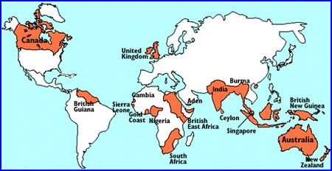
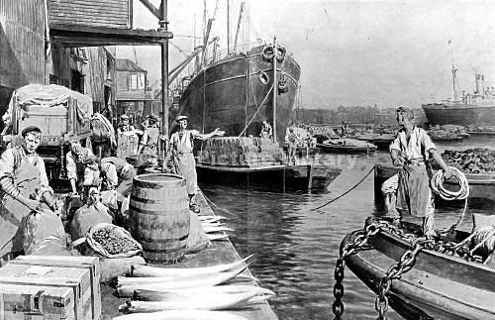
What changed during the Victorian era?
Britain became very powerful.
The countries ruled by Britain during the Victorian era.
Britain became the richest and most powerful country in the world. It had the largest empire that had ever existed, ruling a quarter of the world’s population.
During the reign of Queen Victoria, British ports were full with ships arriving from other countries with goods ready to be sold. This helped make Britain a very wealthy nation.
Workers unloading boats at the docks.

Slide 7
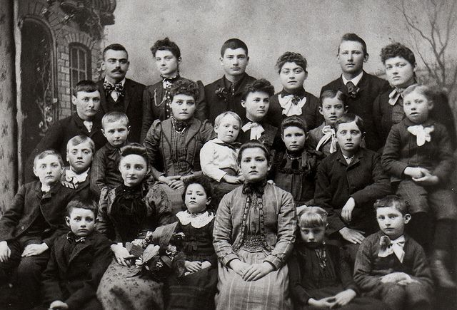
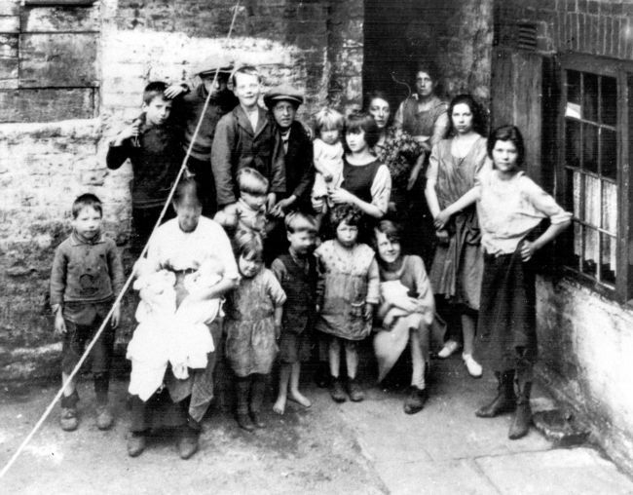
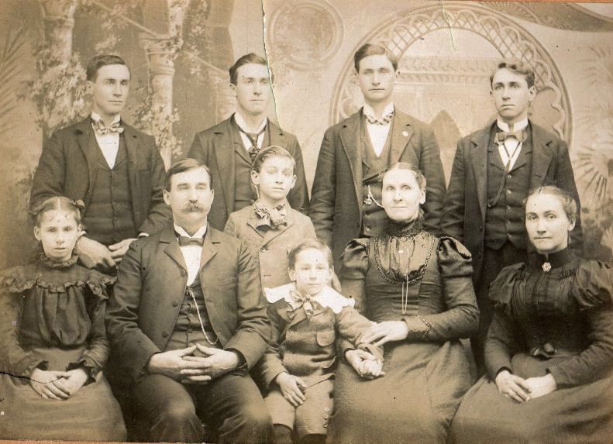
What changed during the Victorian era?
Population increased
The number of people living in Britain more than doubled. The population went from 16 million to 37 million, causing a huge demand for food, clothes and housing.
Victorian family photos

Slide 8
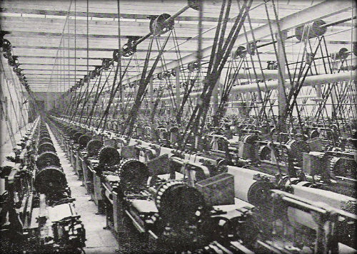
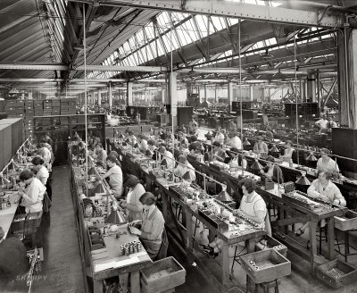
What changed during the Victorian era?
Factories
Factories and machines were built to meet the huge demand for food, clothes and housing. New towns were created and the landscape of Britain changed. People were not only working out on the land but they were now working indoors.
Inside a typical Victorian factory.

Slide 9
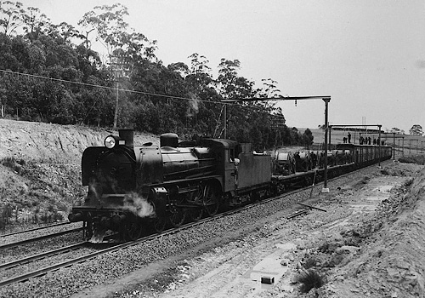
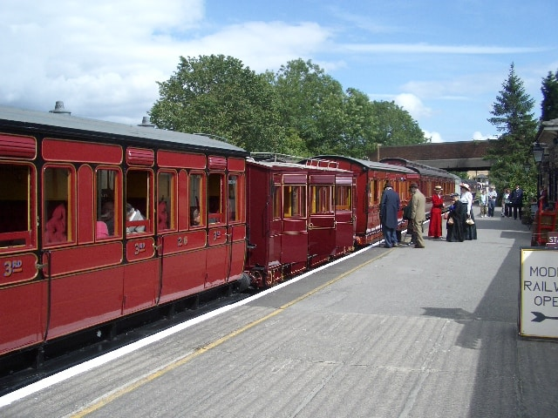
What changed during the Victorian era?
Railways
Rail was the most popular means of transport for goods and people throughout the Victorian era. With the high demand for food, goods and clothing, railways were needed to transport all of these goods.
The seaside holiday was created during the Victorian era. For the first time people who could afford to travel could leave their homes and spend some time by the sea.
A modern day replica of a Victorian passenger train.

Slide 10
Task
Using the worksheet template, or your own paper at home, answer the following questions.
What does the term ‘Victorian era’ mean?
Why were the Victorians so famous?
What significant events happened during the Victorian era?
You can display the information in whichever way you would like. For example:
Paragraphs
Posters
Information leaflet

