Slide 1
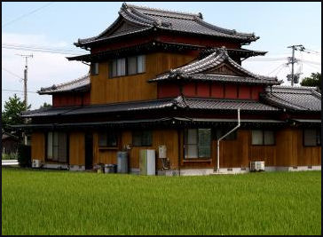
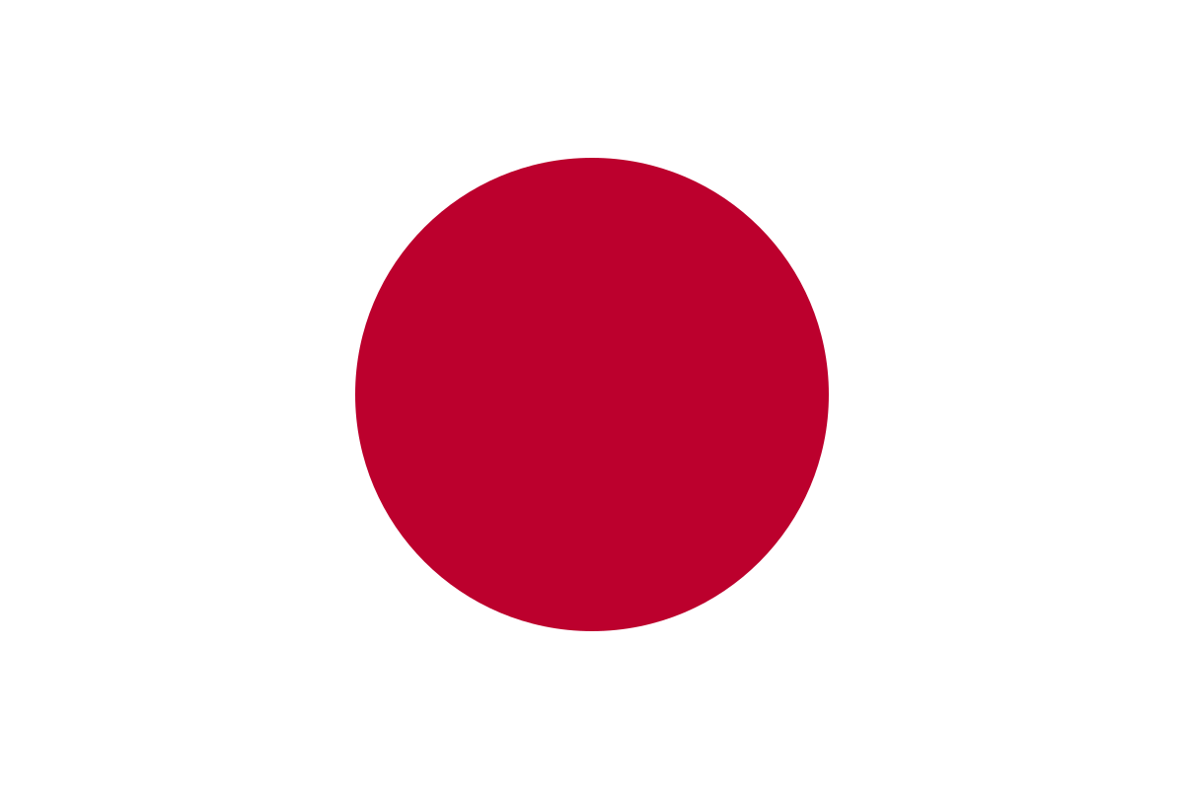
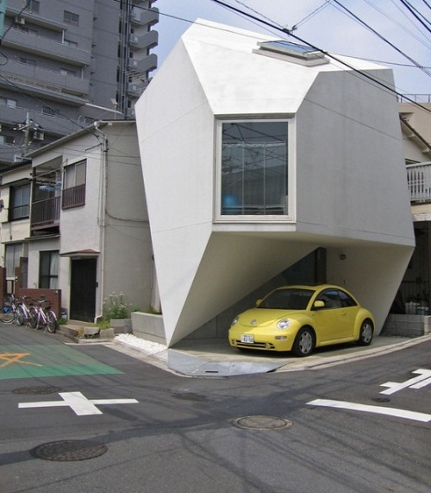
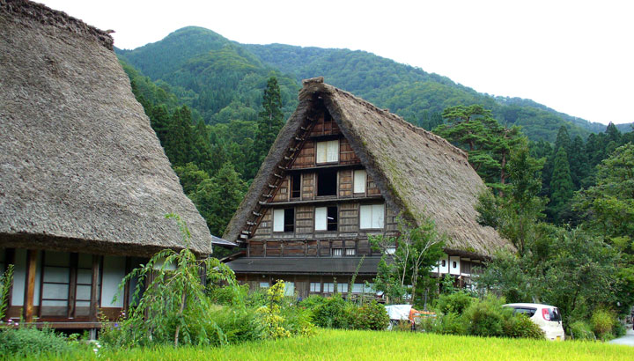
Japanese Model Homework Design Challenge
This design challenge is intended to spark your curiosity about Japan, to give you the opportunity for personal research and it’s a chance to show your creativity.
You can craft your model building from a cardboard box and model it either on a modern earthquake proof structure or a more traditional style Japanese home.
It’ll be great if you can keep a record of the websites & books you research. Throughout the coming weeks you’ll have a chance to talk about how your project is coming along and we’ll look forward to seeing your completed structures on the 23rd of September. Good luck!
Primary Seven
Term One – Due Wednesday 23rd September
This Photo by Unknown Author is licensed under CC BY-SA

