Slide 1
Meet the Teachers
Information for the Class of 2021

Slide 2
Welcome
The start to this school year may different from the years before but we are excited to welcome your child to Primary Seven, their final year at primary. Hopefully, this presentation will answer any questions that you may have and let you know what we have planned?
Mrs Baxter & Mrs Gribben

Slide 3
Useful Information
P.E. – Could we ask that on gym days, your child comes to school wearing footwear that is suitable for the pitch? Our gym days will be a Monday and a Friday. Long hair should be tied back or your child should come with a bobble.
Pitch Days – Pupils will be given access to the pitch on Thursdays & Fridays.
Heart Start – As part of our Health & Well Being learning, we are hoping that Heart Start will take place later in the term, if so, girls will be asked to wear shorts under their school skirt, this will enable the more practical exercises to take place. Notice of this will be given to pupils and posted on the class Glow page.

Slide 4
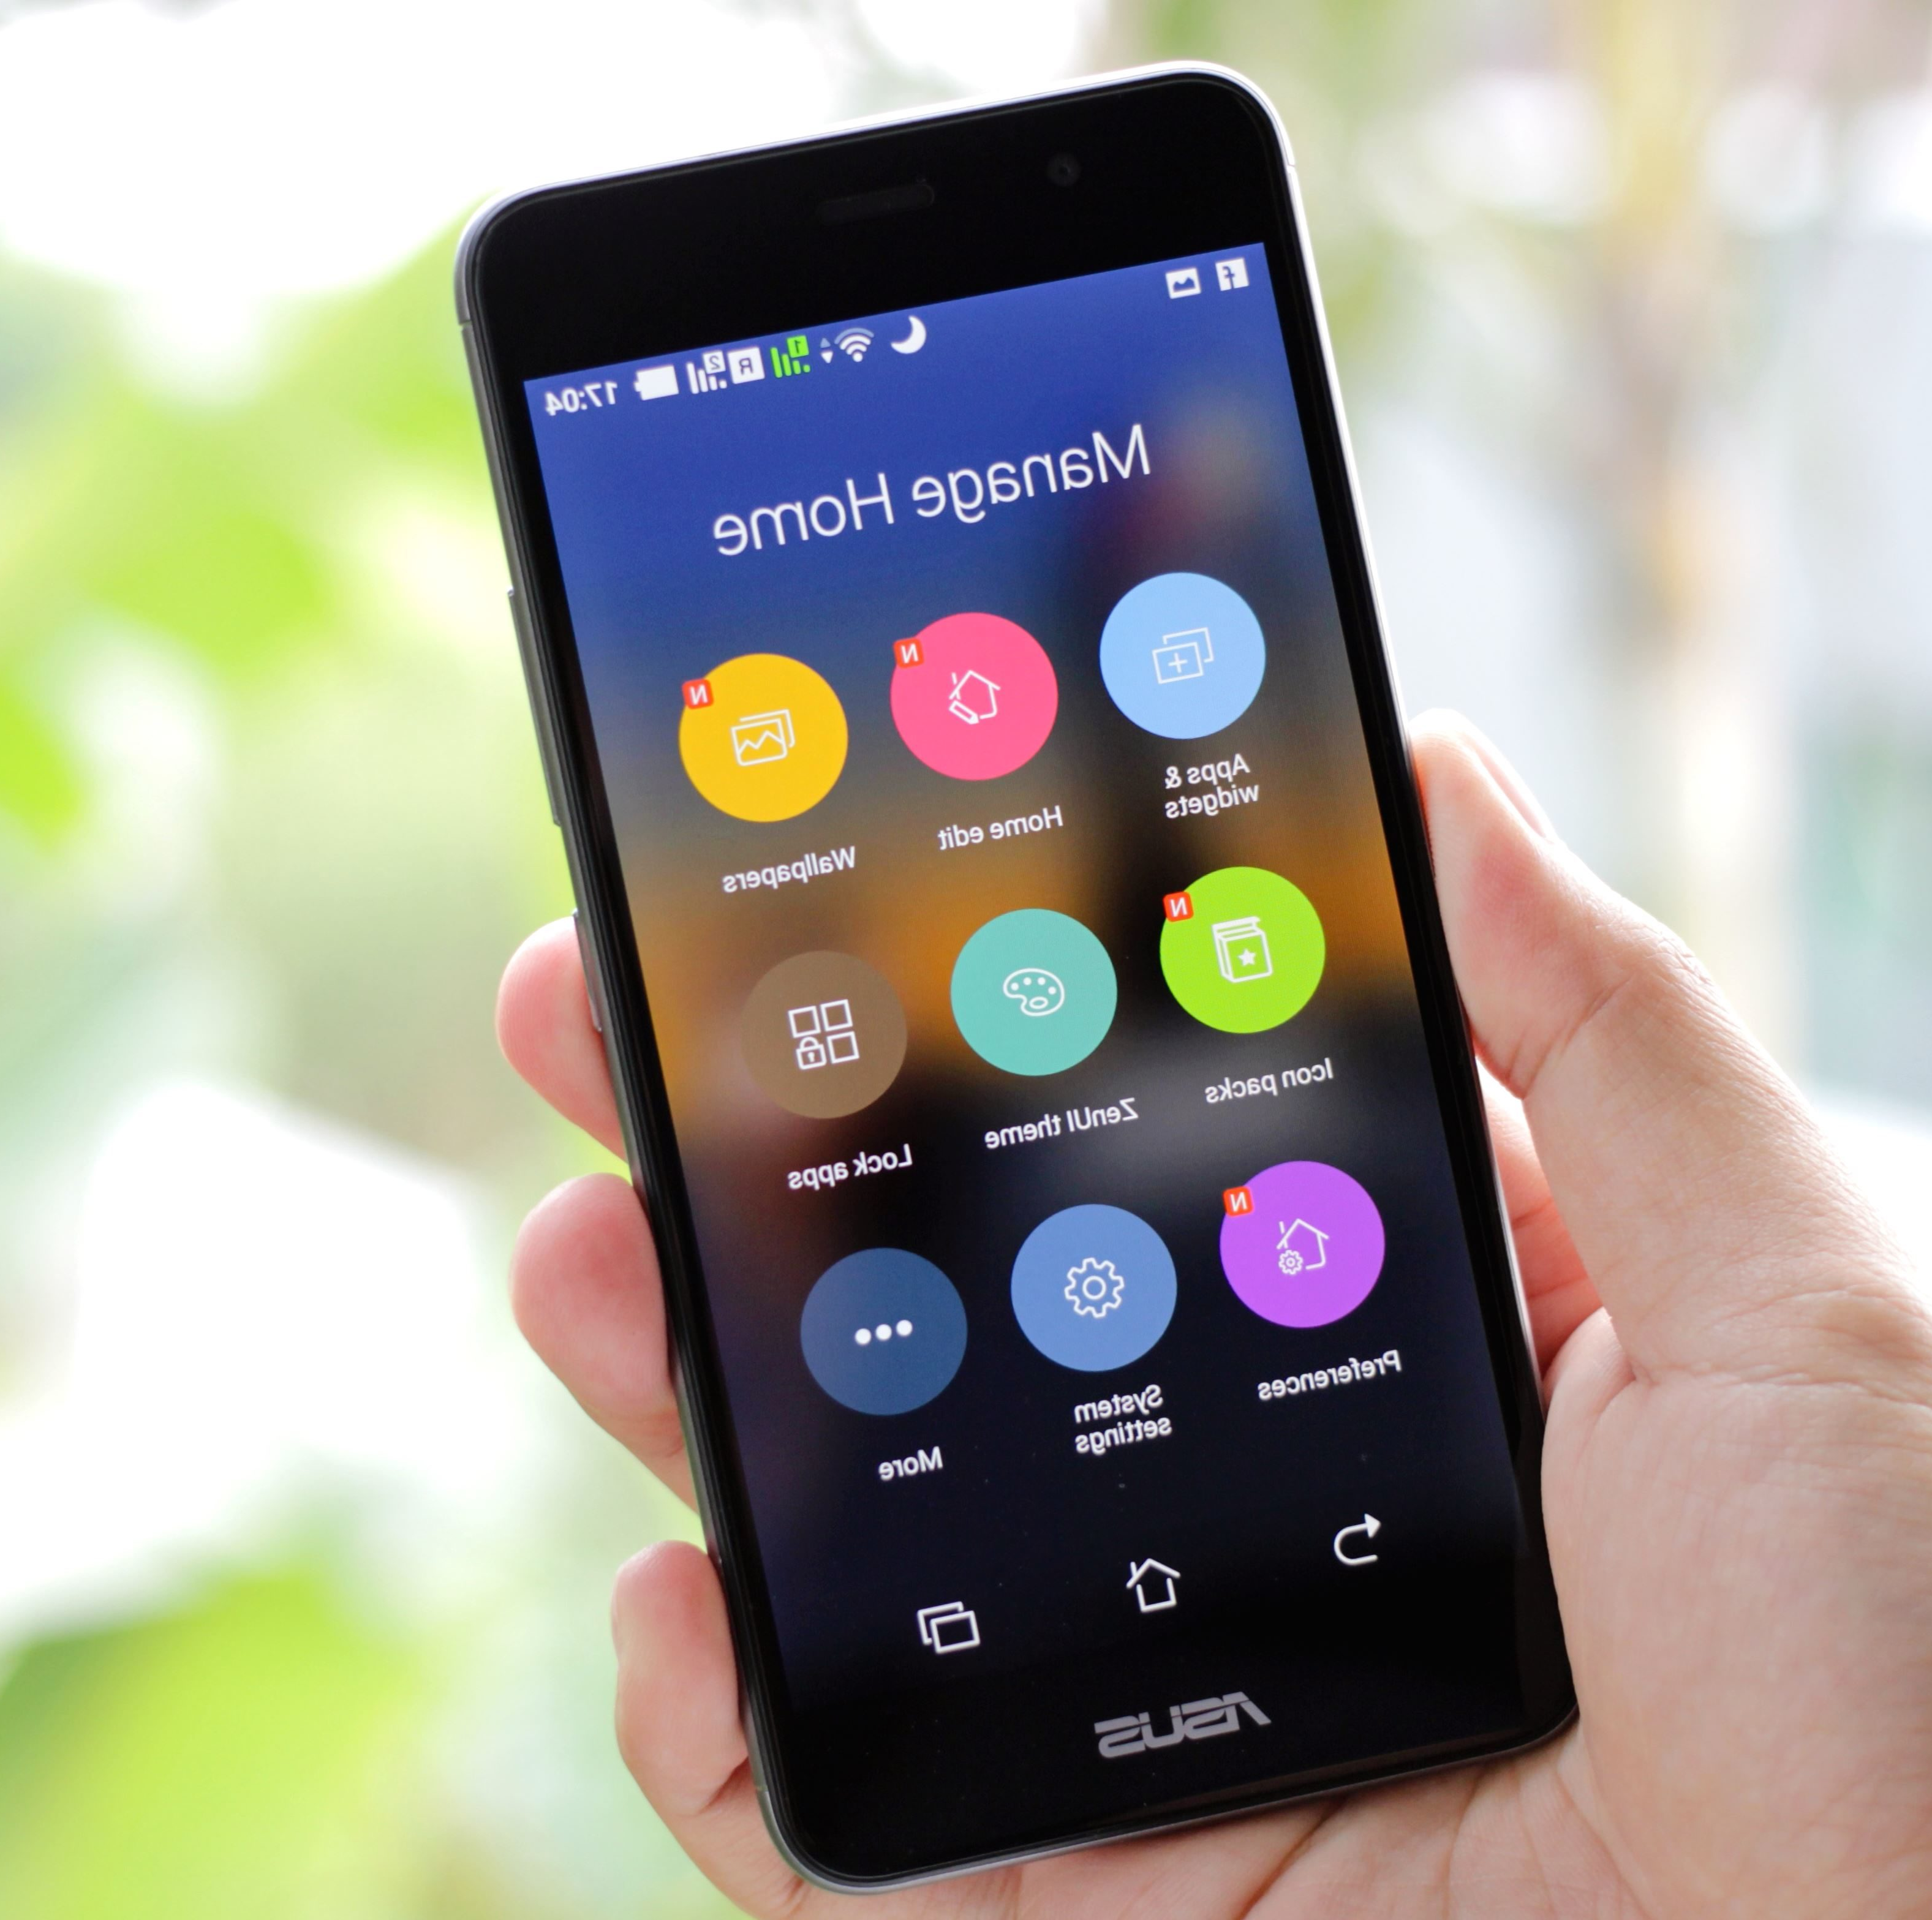
Useful Information
Pupils are discouraged from bringing mobile phones to school. On the very odd occasion where your child needs to bring their phone they are aware that it should be switched to silent and kept in their bag for the duration of the school day and not come out until they are out with the school grounds. Any phone brought to school is at the child’s own risk & school will take no responsibility for damage or loss.

Slide 5
Class Glow Page & Homework
Class Glow page. This is the means of communication from us to you. Homework for the class will be posted here. The pupils have been shown how to find our class page. Please let us know if there are any issues with accessing the site.
Homework will begin on the week of Monday 31st of August. Prior to this, we felt the children would benefit from a soft start to their return to the school routine.
Twitter. Class teachers will aim to post photos of activities & experiences taking place within our class so keep an eye out.

Slide 6
Literacy
Reading – Wonder by R.J. Palacio. Each pupil will be asked to care of their own copy of the text and we’ll also make use of the audio book while in school. In the case that the novel is sent home for personal reading, your child should ensure it’s packed for school the following day.
- North Lanarkshire Reading Strategies & Blooms activities will be
utilised as we explore the text.
Spelling – Rotation between a focus on common words,
building vocabulary and subject specific vocabulary.
Creative Writing

Slide 7
Numeracy
North Lanarkshire Maths Pathway
Mental Agility & Number Talks
Problem Solving
Useful maths websites -
www.doorwayonline.org.uk
www.topmarks.co.uk
www.primaryhomeworkhelp.co.uk/
www.bbc.co.uk/bitesize
www.mathszone.co.uk
www.coolmath4kids.com

Slide 8
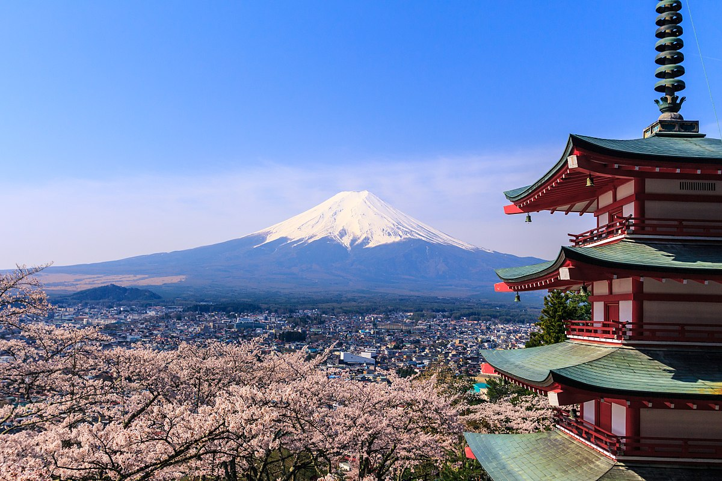
Inter Disciplinary Learning
Japan
This Photo by Unknown Author is licensed under CC BY-SA

Slide 9
Health & Well Being
We are planning to cover content relating to healthy lifestyles and the impact that alcohol and drugs can have. Discussion of scenarios relating to peer pressure will take place.
In previous years, the primary seven children have shown great interest in the Heart Start first aid program, it really can be a skill for life.

Slide 10
Pope Francis Faith Award
We will continue on from where the children left prior to the closure. Please encourage your child to share their thoughts as they progress through their journal.
“How beautiful it would be if each of you, every evening, could say: “Today at school, at home, at work, guided by God, I showed a sign of love towards one of my friends, my parents, an older person!”
(Pope Francis, addressing young people, April 2013)

