Slide 1

Digital Footprint
what is it and why should you care?

Slide 2
What is your Digital Footprint?
With every new profile, photo or comment we post, we add to a trail of information about ourselves which stays online. This is called a ‘digital footprint’.
People who know us, and people who don’t, can see our digital footprints and learn more about us.
Our digital footprints can show us in our most positive moments – but sometimes they might reflect thoughts or experiences that we later wish had been kept private.

Slide 3

How could your Digital Footprint have an impact on your future?
Watch this clip to find out more… Digital Footprint - BBC Teach

Slide 4


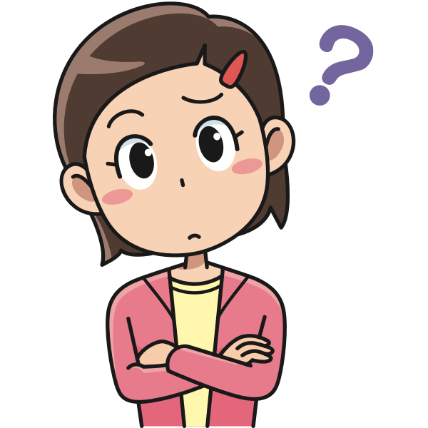
Challenge
Try and find out what you can about yourself online.
What information did you find?
Think about if this is information that you would want a potential future employee or partner to see.
Have a go at the following quiz after today’s session and
see how you score.
How big is your digital footprint? - Own It - BBC
Notes:
I’ve googled myself and because my name is pretty common, their isn’t much. But the more people know about me, the more they can find out e.g if people know what town I live in, they might include that in their search. However my maiden name was much more unique, therefore it was much easier to find out information from then.

Slide 5

How can we ensure that we have the best possible Digital Footprint?
Thinkuknow is the education programme of the Child Exploitation and Online Protection (CEOP) Centre aimed at young people, and encourages Internet safety. It is based around three key themes:
How to have fun
How to stay in control (or how to take control)
How to report a problem
Notes:
Educating yourself is the best way to keep yourself safe. There are lots of good websites and organisations out there to help you access what you need to know and taking part today is a great start. They have guidelines that encourage you to think about what you share online.

Slide 6

What to consider before posting online…
Who can see my tracks?
Am I giving away too much?
Does it hurt, embarrass or offend others?
This Photo by Unknown Author is licensed under CC BY-NC
Notes:
Who can see my tracks?
When you share something online, who can see it? Think about who you’re sharing with and whether they’ll take care of what you share. Don’t forget it’s easy for other people to copy what you share, change it and pass it on without you knowing.
Am I giving away too much?
The more you share publicly, the more people can learn about you. Sadly, mean people sometimes use things they’ve found out about someone online to bully them, or to pretend they know them better than they really do.
Am I giving away too much?
The more you share, the more people can learn about you. Could they use your posts to bully you?
Does it hurt, embarrass or offend others?
It’s important to think about whether what you post online could hurt others. Do you have your friend’s permission to share that funny picture of them? Could that jokey comment you posted hurt someone’s feelings? You can’t sense the tone.

Slide 7


Online Safety Tips
Safer sharing
Mind your privacy.
Choose your friends wisely.
Check your tracks.
Shut down or delete.
This Photo by Unknown Author is licensed under CC BY-NC
Notes:
Safer sharing
Sharing what you’re up to and things you’ve done with your friends is part of the fun of being online, so make sure you know how to do it safely.
Mind your privacy.
Most websites, apps and social networks you can share information on have ‘privacy settings’. These help you control what you share and who you share it with. So, if you decide your friends, friends of friends or everyone can see what you post.
Choose your friends wisely.
It’s always best to only share with friends you know and trust. Remember too that what your friends share about you and their privacy settings online will also affect you and your digital footprint.
Check your tracks.
It can be hard to keep up with the things we’ve done online. It's a good idea to log out of your accounts, and Google yourself now and again. That way you’ll know what other people can find out about you, as well as things others might have posted about you. Review your profiles on any accounts you use too. Delete or change anything you no longer want people to see.
Shut down or delete.
If you stop using a website, app or social network remember to shut down your profile or delete your account. Don’t forget to delete the app if you downloaded it to your device too.

Slide 8




Other useful Online Safety information websites
CEOP helps young people who are being sexually abused or are worried that someone they’ve met is trying to abuse them.
Childline is a free helpline for children and young people up to the age of 19. You can contact ChildLine about anything. No problem is too big or too small. Whatever your worry, it's better out than in.
Childnet International is a non-profit organisation working with others to help make the internet a great and safe place for children.
Notes:
I’ll share these slides so you have links to these websites if you ever need them.
Report Remove is a feature within Childline that you can use to report unwanted personal content that someone else may have uploaded of you.

Slide 9






Challenge
Now that you have this knowledge and links to further information – use your digital skills in Word or PowerPoint or any other tool to create guidelines for younger pupils about how to manage their social media profiles so that they reflects them in the way they want it to be.
Notes:
You each have a folder within our Teams page that only you and the page owners can see, no other students have access to this.

Slide 10
Remember… Self-reflect before you self-reveal
Look after your digital footprint

