Slide 1

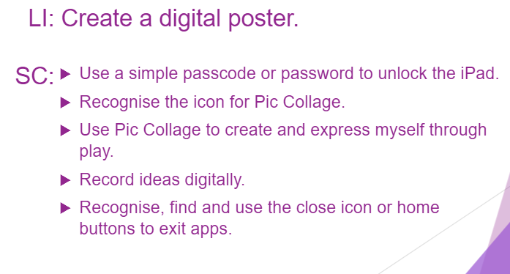

Aims

Slide 2
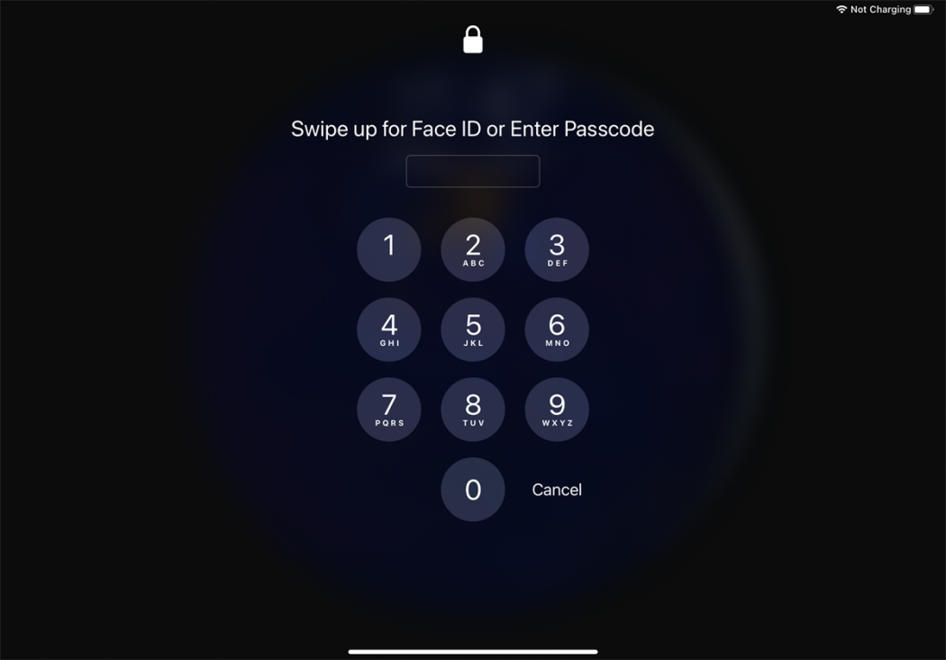

Unlock the iPad
Why do we have a passcode on the iPads?

Slide 3


Pic Collage
Find the icon for Pic collage and click on it.

Slide 4




Create and Record
Click on FREESTYLE
Scroll along

Slide 5

Create and Record
Choose what background you would like for your poster.
Click on Backgrounds

Slide 6
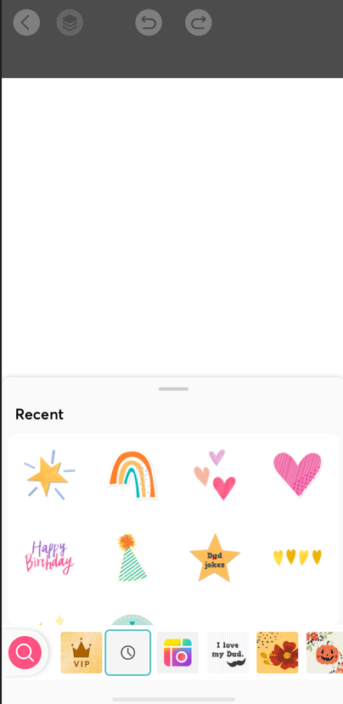
Create and Record
Choose what stickers you would like on your poster.
Click on Stickers

Slide 7
Create and Record
Click on Text to add some words. Try typing your name.
Click on Doodle and have a go at drawing something.

Slide 8
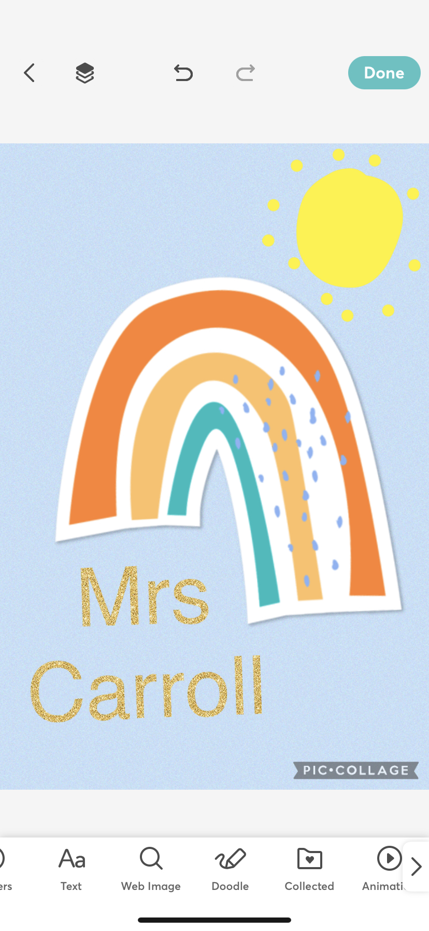
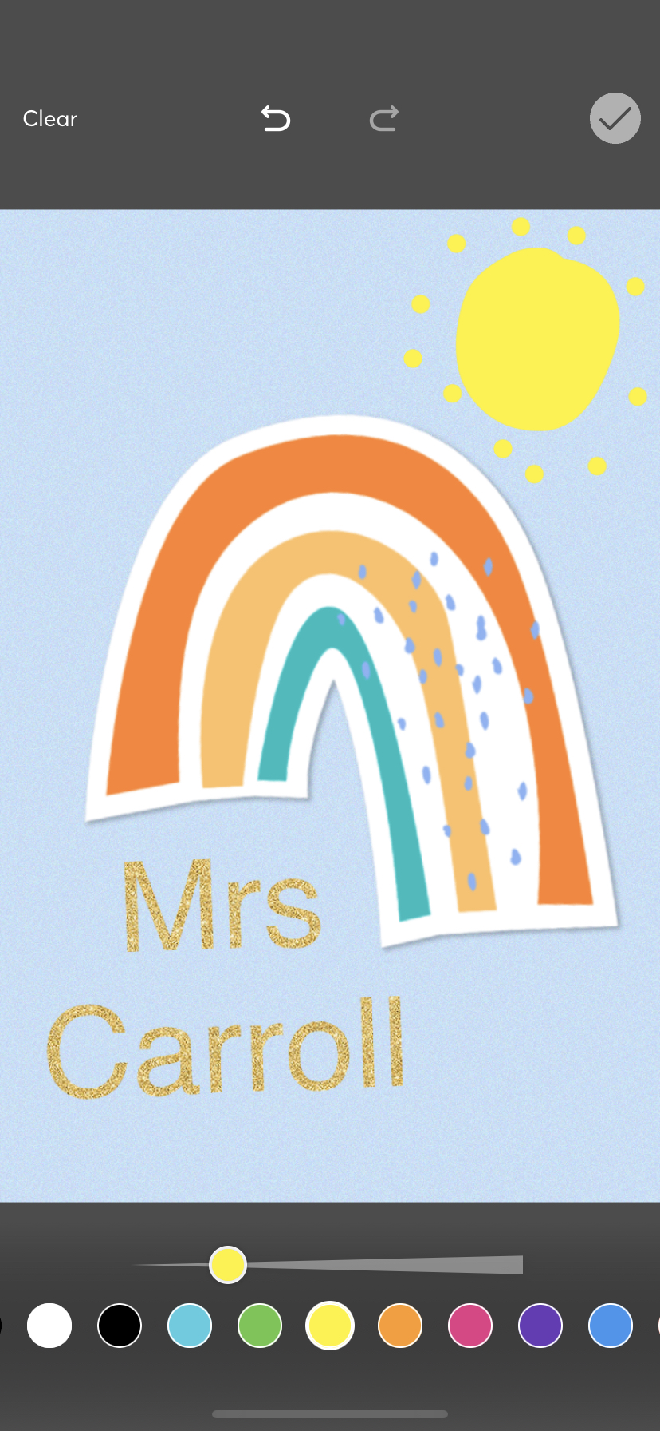
Save and Close
Click on Done to complete your creation.
Click on the tick to save your changes

Slide 9
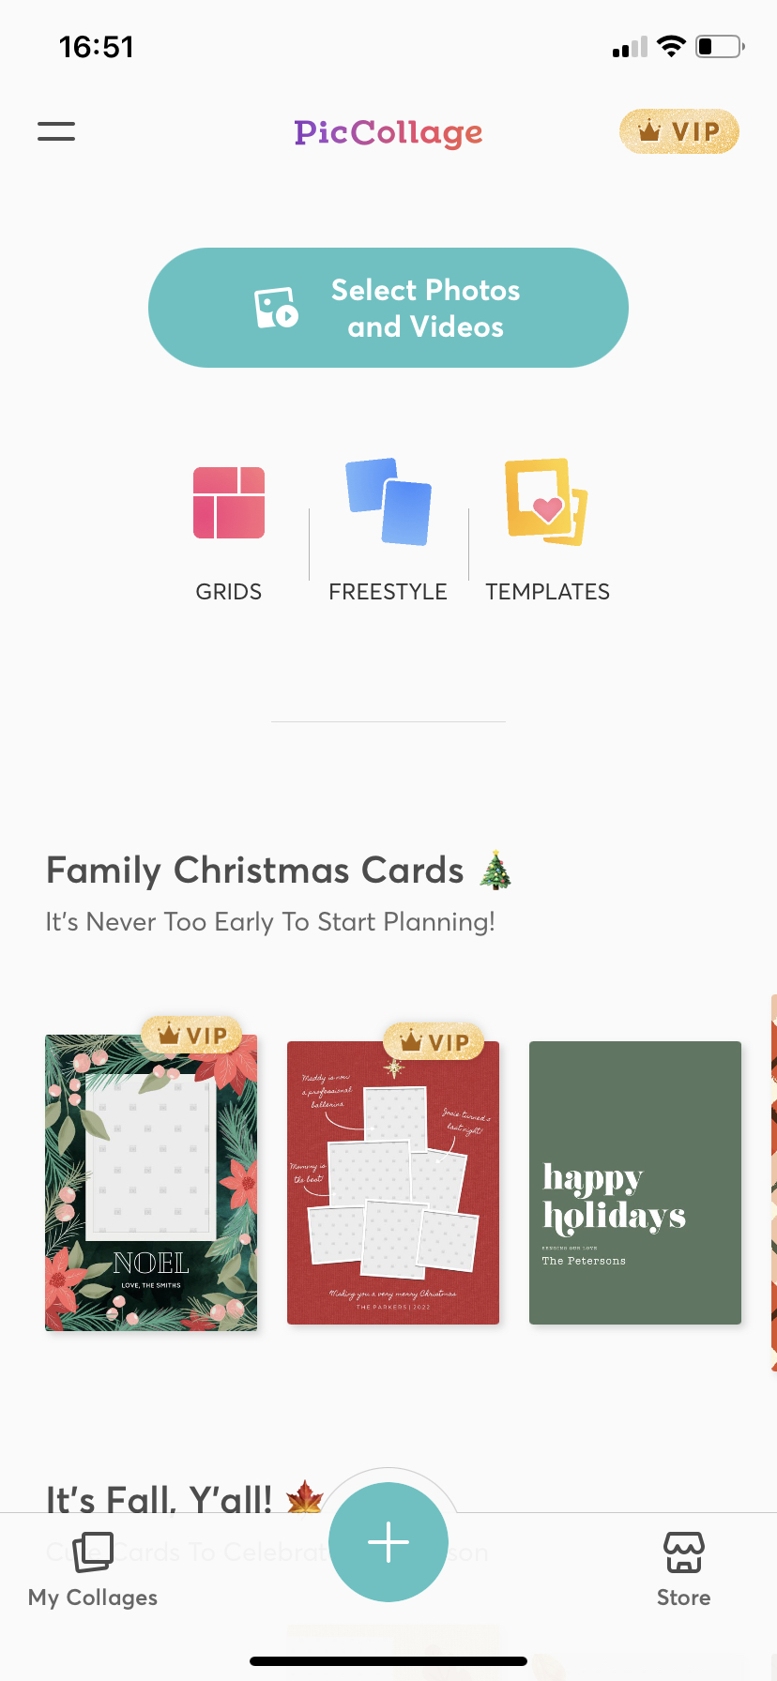
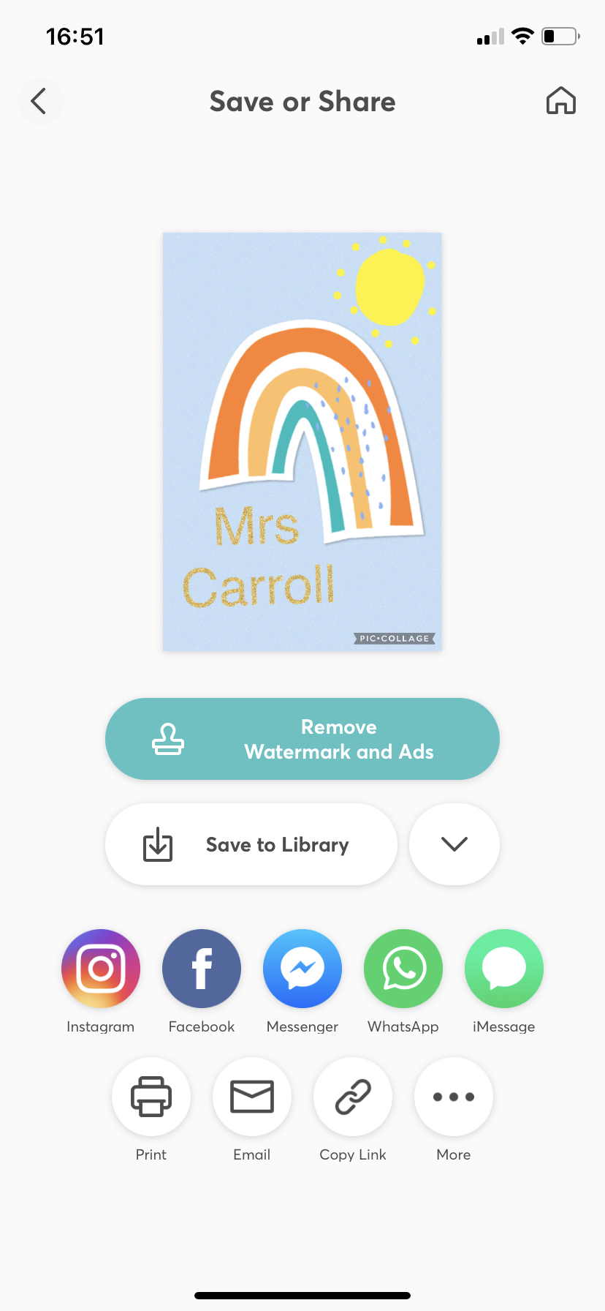
Save and Close
Click on Save to the Library to save your creation.
Swipe up from the bottom to close the app.

Slide 10
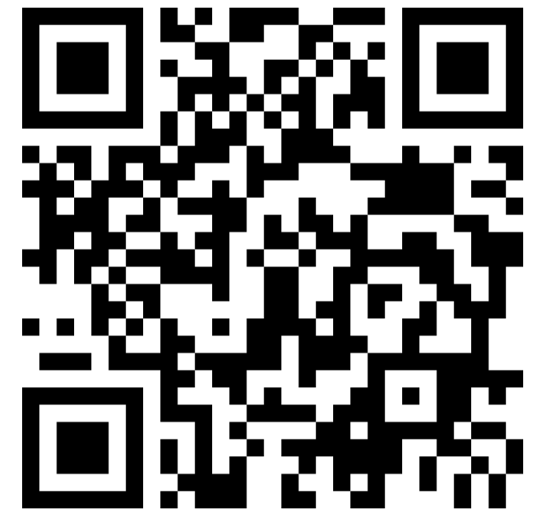
How do you feel about your learning today?
Plenary

