Slide 1


Creating a Sway Learning Journal

Slide 2
Aims:
Accessing Sway – how to get started
Adding content such as text, images, video & audio
Styling, viewing and sharing your Sway
Duplicating a Sway

Slide 3
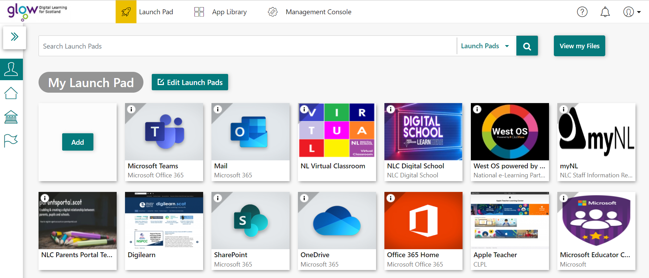


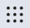
How to get started
If you do not have Office 365 Home, add new tile here.
You can also go to www.sway.com and sign in using your Glow login details or click on the waffle in any of the Microsoft applications.
Log into Glow to access your Glow Launch pad, then select Office 365 Home.

Slide 4
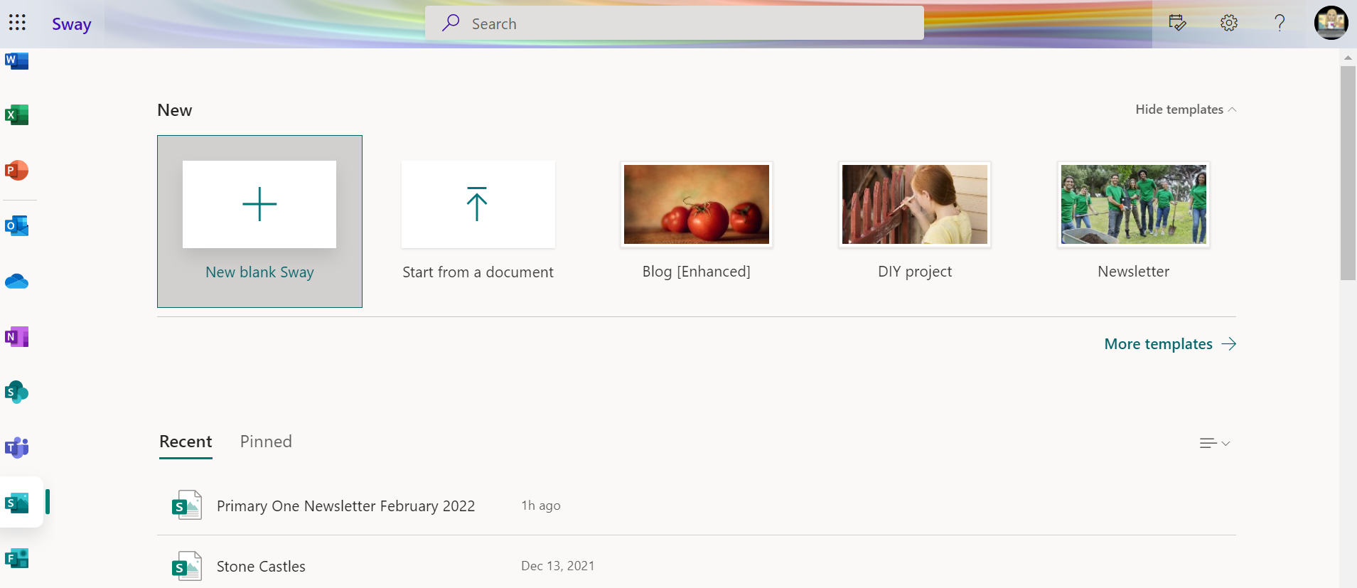
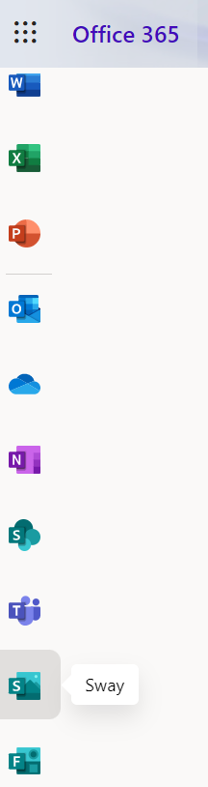

How to get started
If you are creating your Sway for the first time, click on + New Blank Sway or
+ Create New.
Once you’ve created your first Sway Learning Journal, you can use the template you will create today and update the information for your next one.
Scroll down the menu on the left hand side until you see the Sway logo and select it.

Slide 5
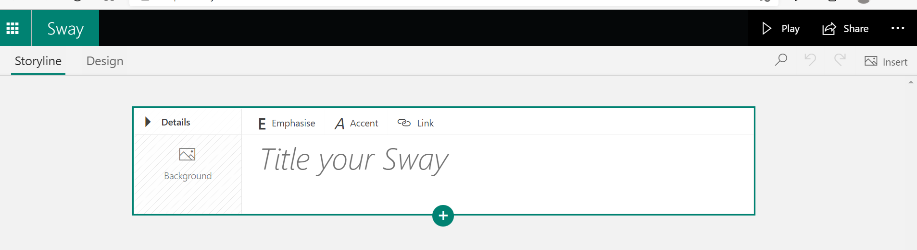
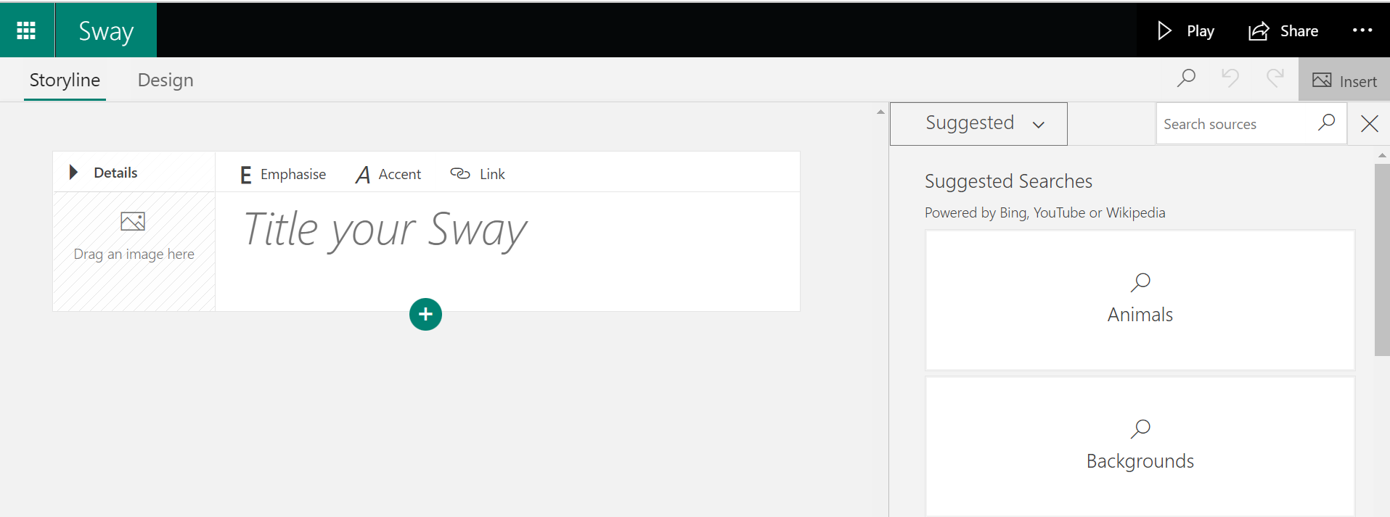
Adding Content
To add a background image to your title, find an image you have already saved or search for a suitable image by clicking on Insert and dragging it into the Background box.
Heading card - Type in what the title of your newsletter will be.
Click Suggested to access your files on your computer or One Drive. Type in the Search box to look for online images.

Slide 6
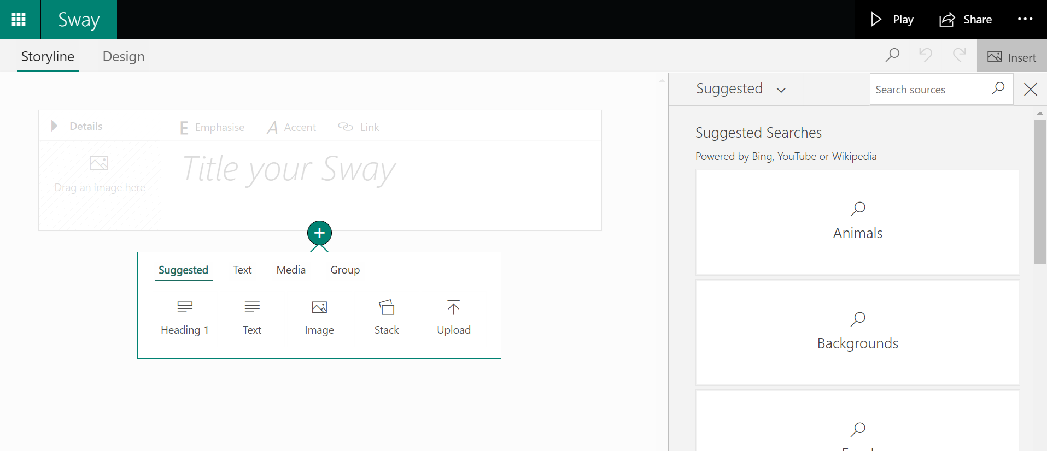
Adding Content
Click on the green plus sign to add a new card.
Use the Insert and then Suggested option to add content i.e images or videos.

Slide 7
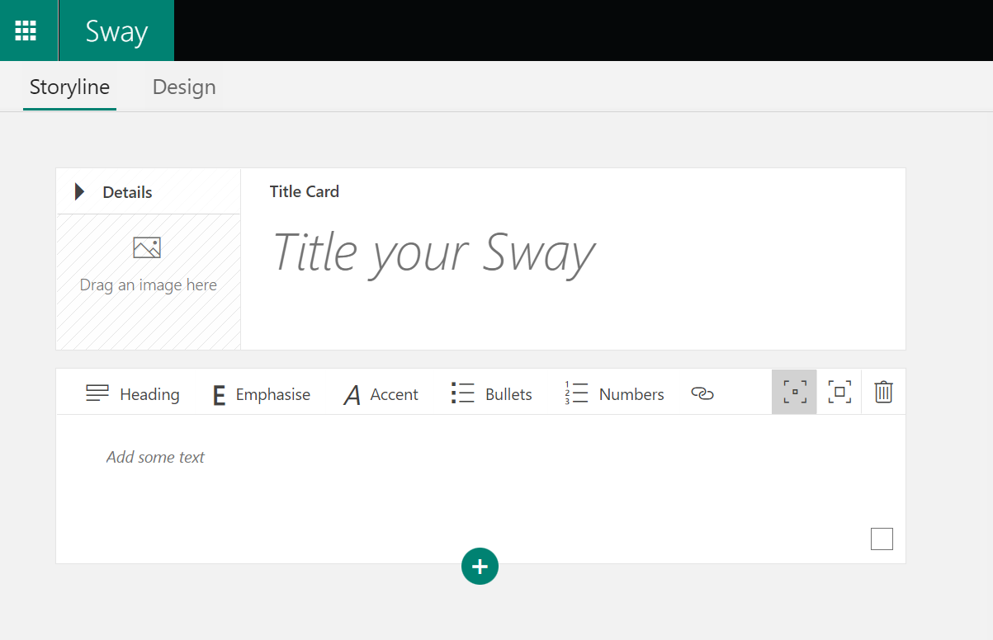


Adding Content - Text
See features:
Emphasise – make your text stand out (bold)
Accent – Differentiate this text from the text next to it (italics)
Bullets – Create a bullet point list
Numbers – Create a numbered list
- Create a link to a website
- Subtle or moderate emphasis
- Delete card
Choose the text option to insert a new card to type in a welcome message.

Slide 8
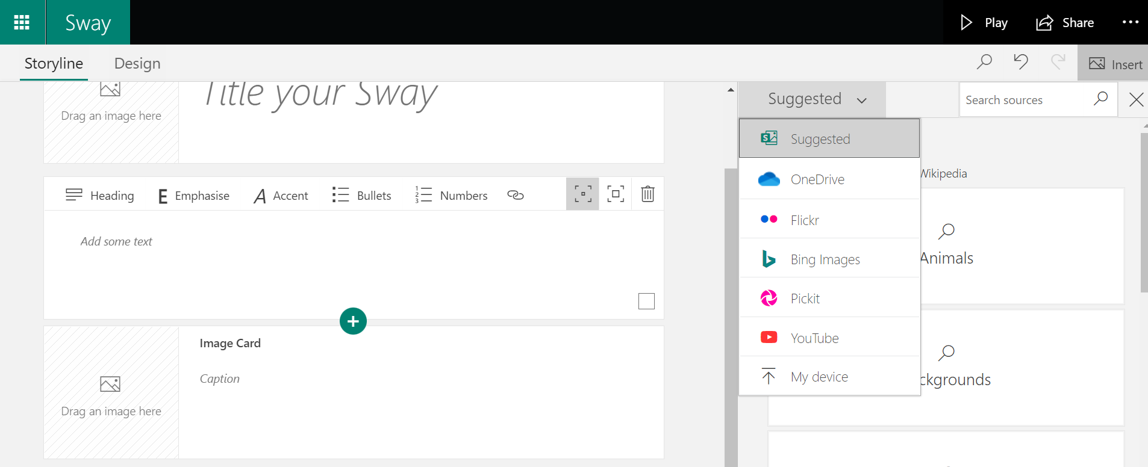
Adding Content - Images
Use the Insert and then Suggested option to add images or videos from the internet (Bing), your One Drive, Flickr, Pickit, You Tube or upload from your computer.
Choose the image option to insert a new card with an image embedded.
Tip: As you build and adjust your Sway, it's always good to view the Sway to see what the audience will experience. Select the Design tab to view the Sway as it will appear or select Play to view the Sway in full screen. To return to editing from the play view, select the Edit button at the top of the screen.

Slide 9
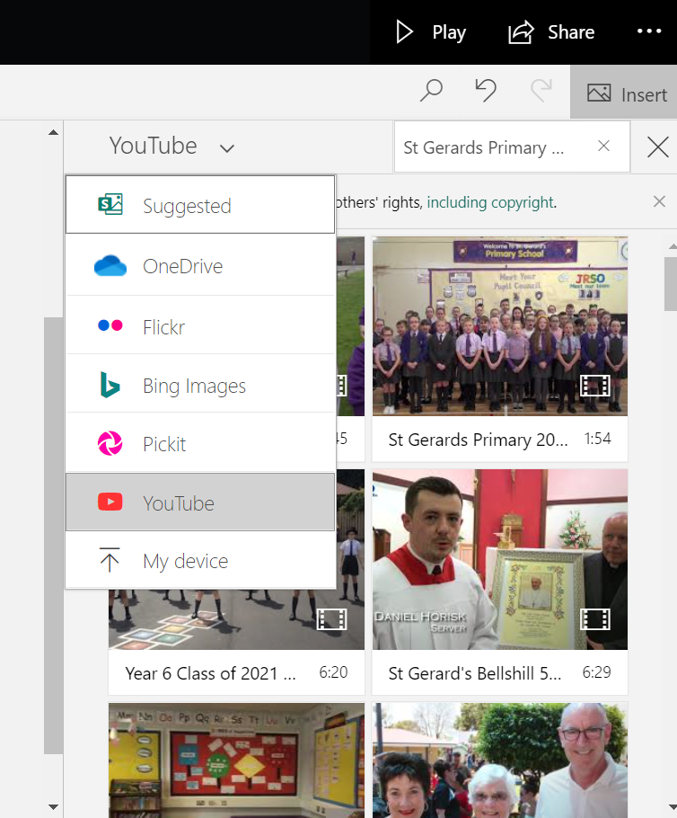
Adding Content - Video
Use the search to look for content.
Click the green plus sign and choose media from the pop up menu then video.
Tip: Remember Sway is an online tool and saves as you go.

Slide 10
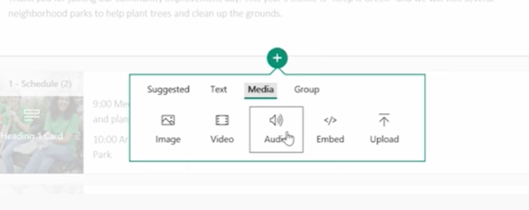
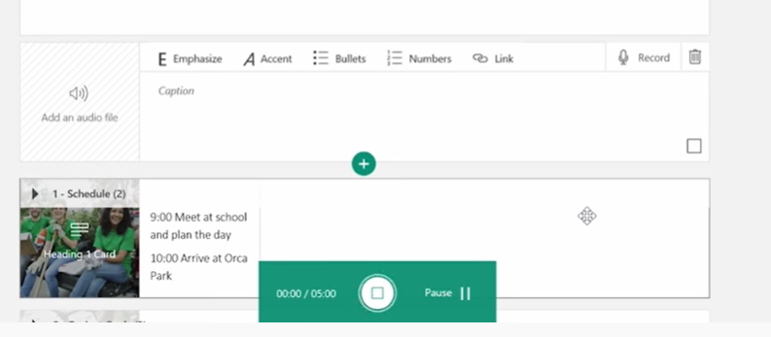
Adding Content - Audio
Click the green plus sign and choose media from the pop up menu then audio.
Use the search to look for audio in your files or record straight onto Sway using the record function.

Slide 11
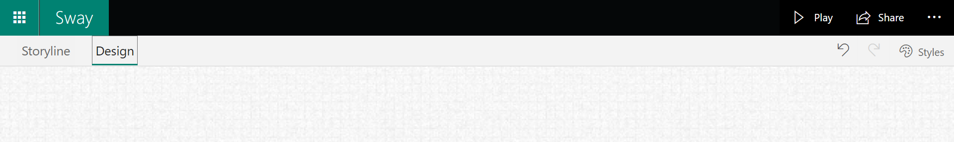
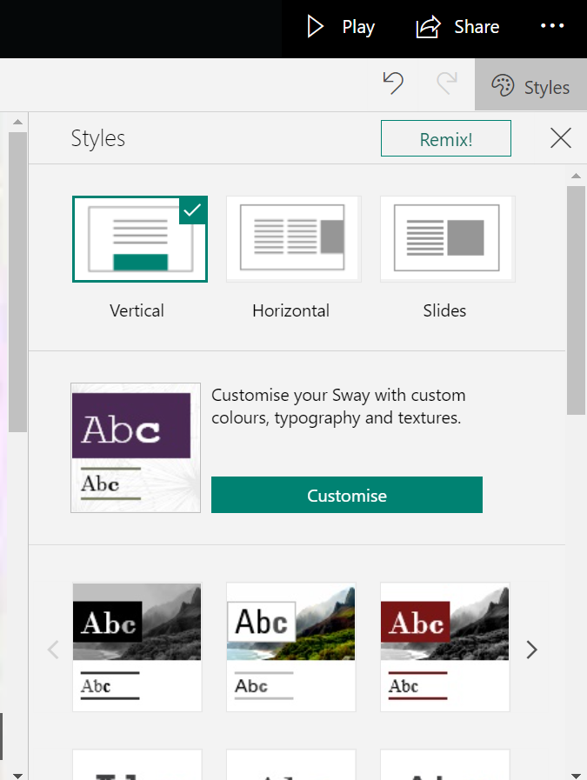
Styling your Sway
Sway has a built-in style gallery which lets you easily switch between the different styling options until you find the way you like. From the Storyline view, click the Design tab.
This allows you to spend time on the content of your Sway then remix the designs until you fine one that suits you. You can also scroll through the different styles and pick one from there.

Slide 12
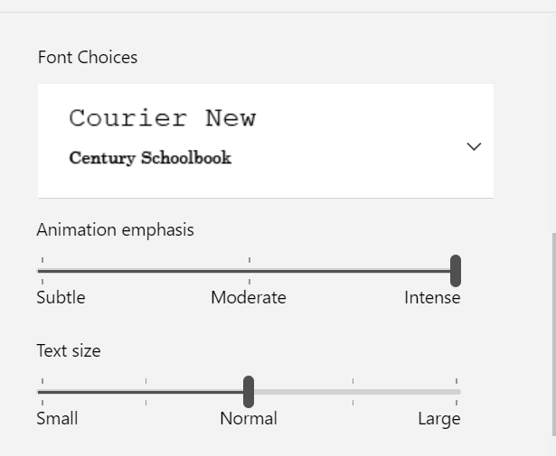
Styling your Sway
To make more changes to the design of your Sway, click on Customise.
This allows you to customise colours and choose the font and font size that you desire.

Slide 13
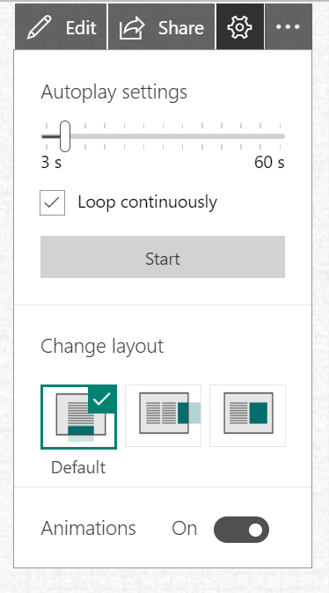
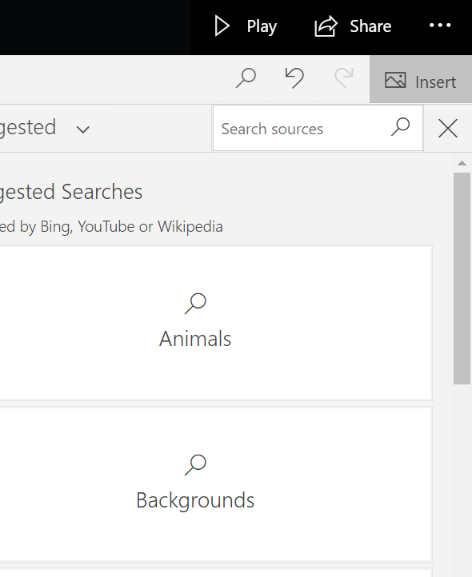
Viewing your Sway
Click play to see what your Sway will look like.
You can also change the Autoplay settings and layout by clicking on the cog.

Slide 14
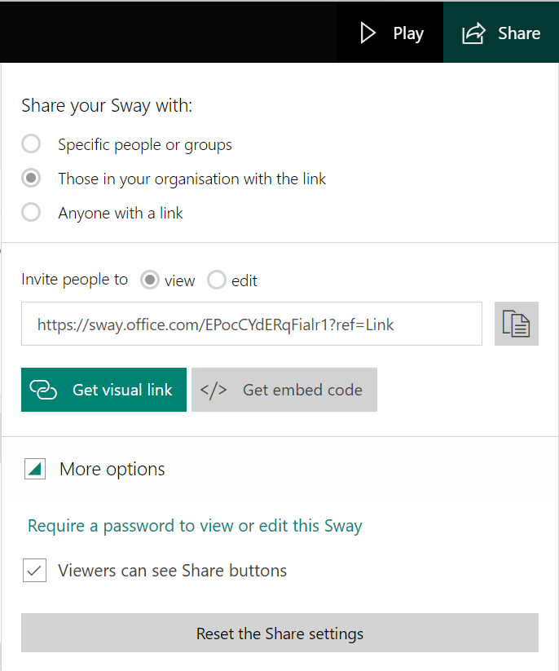
Sharing your Sway
Once you are happy with your Sway you are ready to share it with others. You have the option of sharing only within your organisation or school, specific people or groups or open it up for anyone to access your Sway.
From your Sway, click the Share button on the main toolbar.
Select who you want to share your Sway with from the options provided.
You can select if you want people to be able to view or edit your sway.
Copy the Link provided and paste this into an email, a class
Teams’ page or your preferred method to share this link.
You can also protect your Sway with a password.

Slide 15
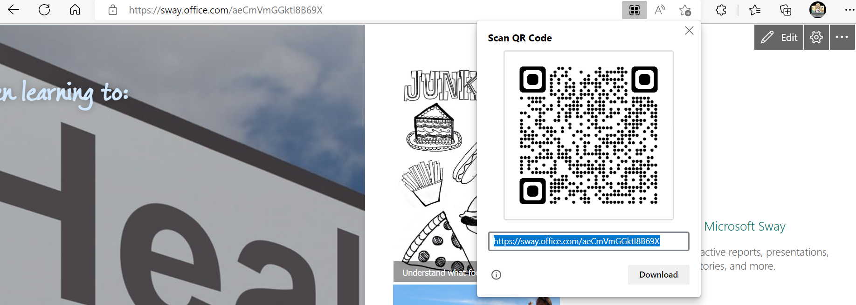
Sharing your Sway
Create a QR code for your Sway.
If you copy the URL in Edge or Chrome, it will give you the option to create a QR code on the URL bar.

