Slide 1



Creating a Sway Learning Journal
Lisa Carroll

Slide 2
Aims:
Accessing Sway – how to get started
Adding content such as text, images, video & audio
Styling, viewing and sharing your Sway with learners and parents
Duplicating a Sway
Sway Analytics

Slide 3

What is Sway?
Microsoft Sway is a mobile, adaptive digital storytelling tool that lets students and educators focus on content over format. This free Office 365 tool combines text, images, video, and other embedded content to tell a story. A Sway can be linked to a QR code for easy sharing, or a Sway can be embedded into a OneNote Class Notebook page. A Sway can be viewed and copied as a template, and the creator of the Sway can even track how many times their Sway has been viewed.

Slide 4
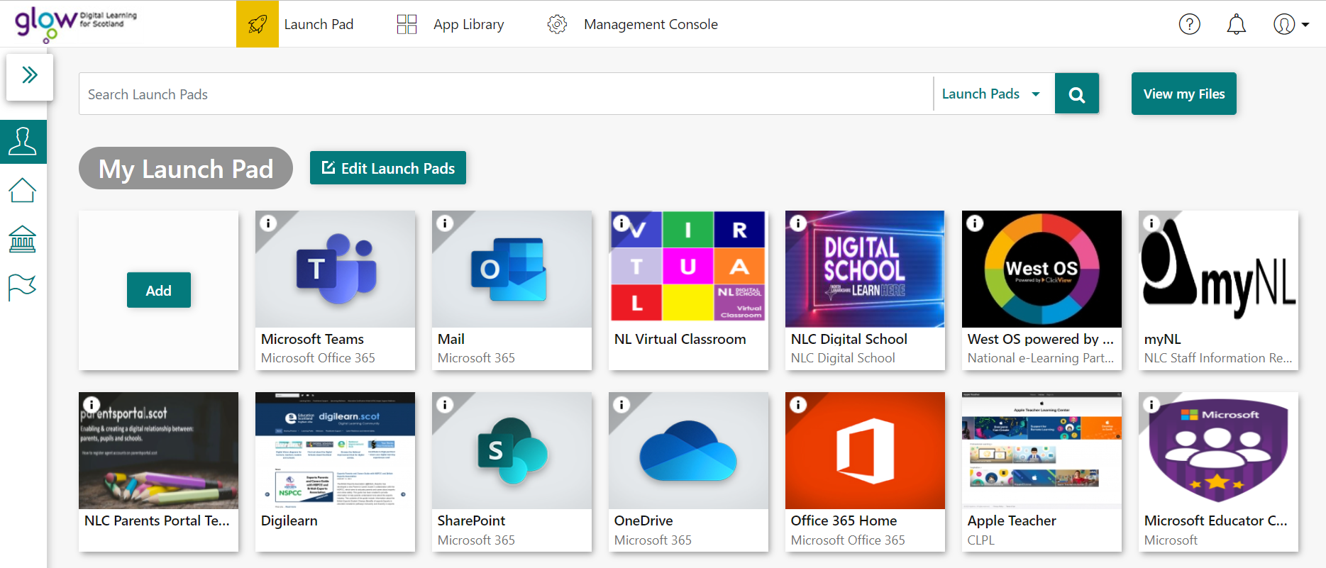


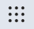
How to get started
If you do not have Office 365 Home, add new tile here.
You can also go to www.sway.com and sign in using your Glow login details or click on the waffle in any of the Microsoft applications.
Log into Glow to access your Glow Launch pad, then select Office 365 Home.

Slide 5
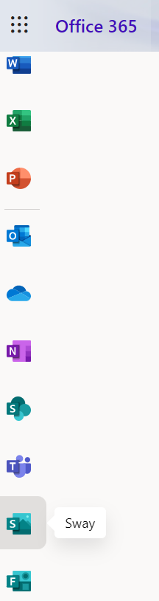

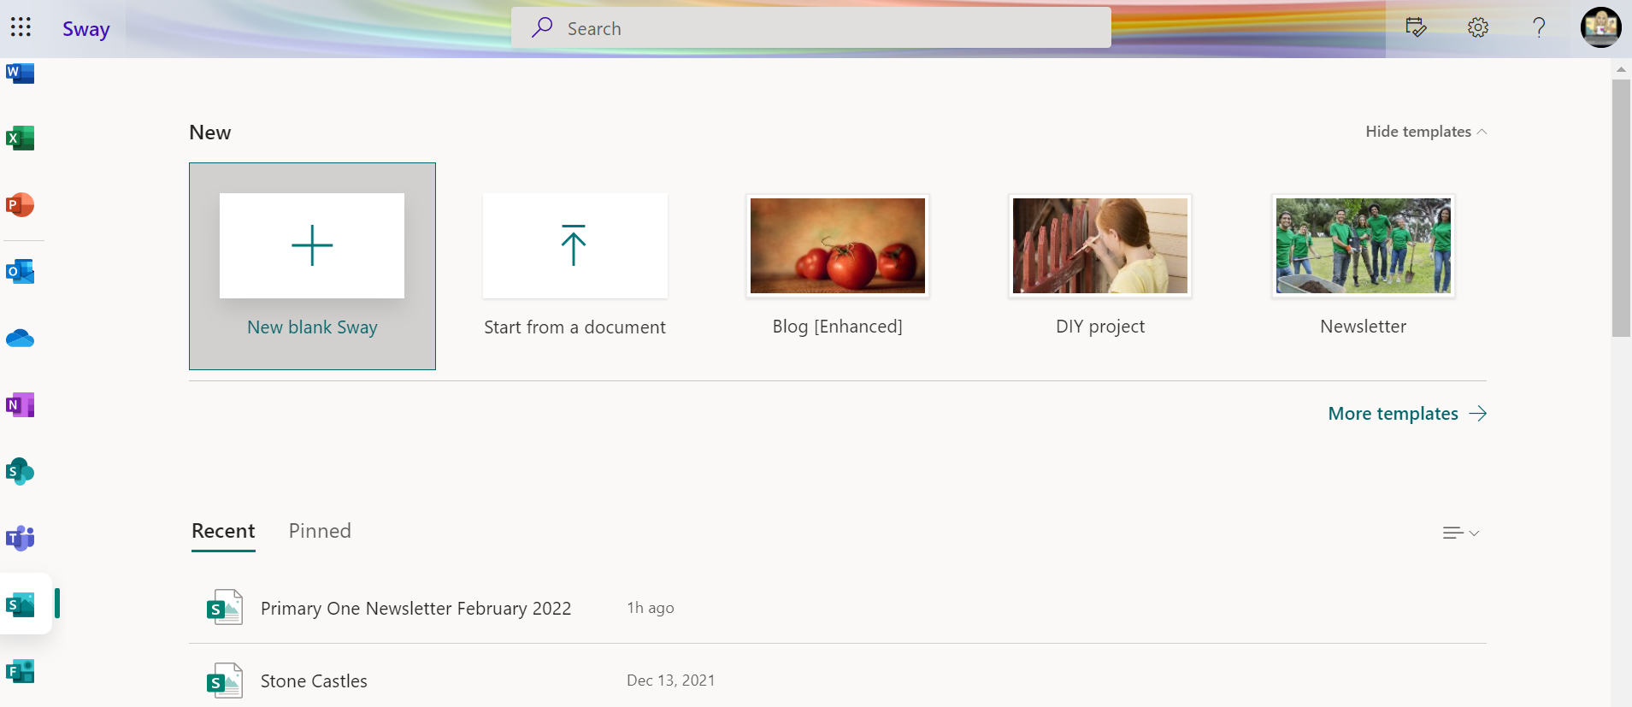

How to get started
Scroll down the menu on the left hand side until you see the Sway logo and select it.
If you are creating your Sway for the first time, click on + New Blank Sway or
+ Create New.
Once you’ve created your first Sway Learning Journal, you can use the template you will create today and update the information for your next one.
Click here for a video explanation on using the website.

Slide 6
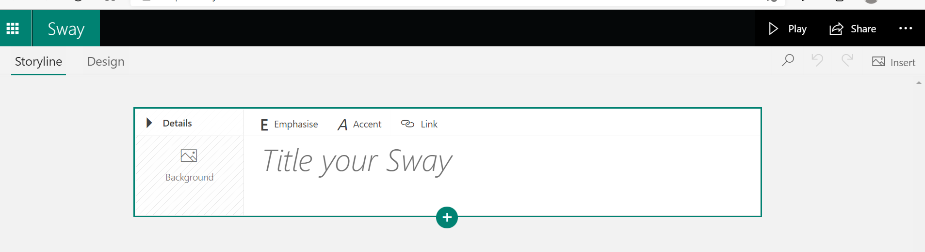
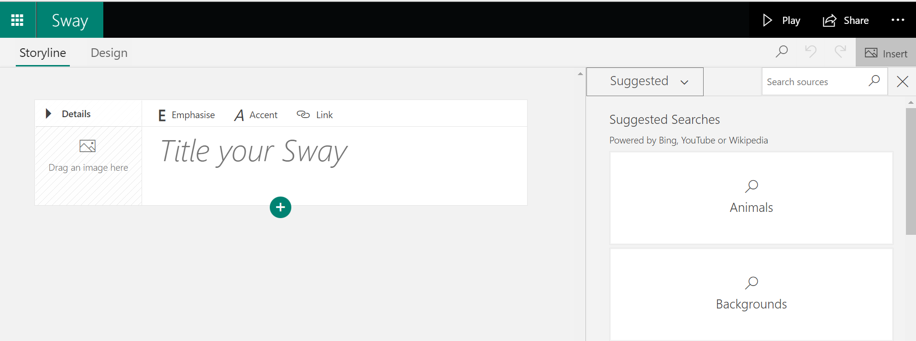
Adding Content
Microsoft Sway works off two main elements: the Storyline and Cards.
The Storyline represents the sequencing of your information whilst cards are the different types of elements you can include.
To add a background image to your title, find an image you have already saved or search for a suitable image by clicking on Insert and dragging it into the Background box.
Heading card - Type in what the title of your newsletter will be.
Click here for a video explanation on adding images.
Click Suggested to access your files on your computer or One Drive. Type in the Search box to look for online images.

Slide 7
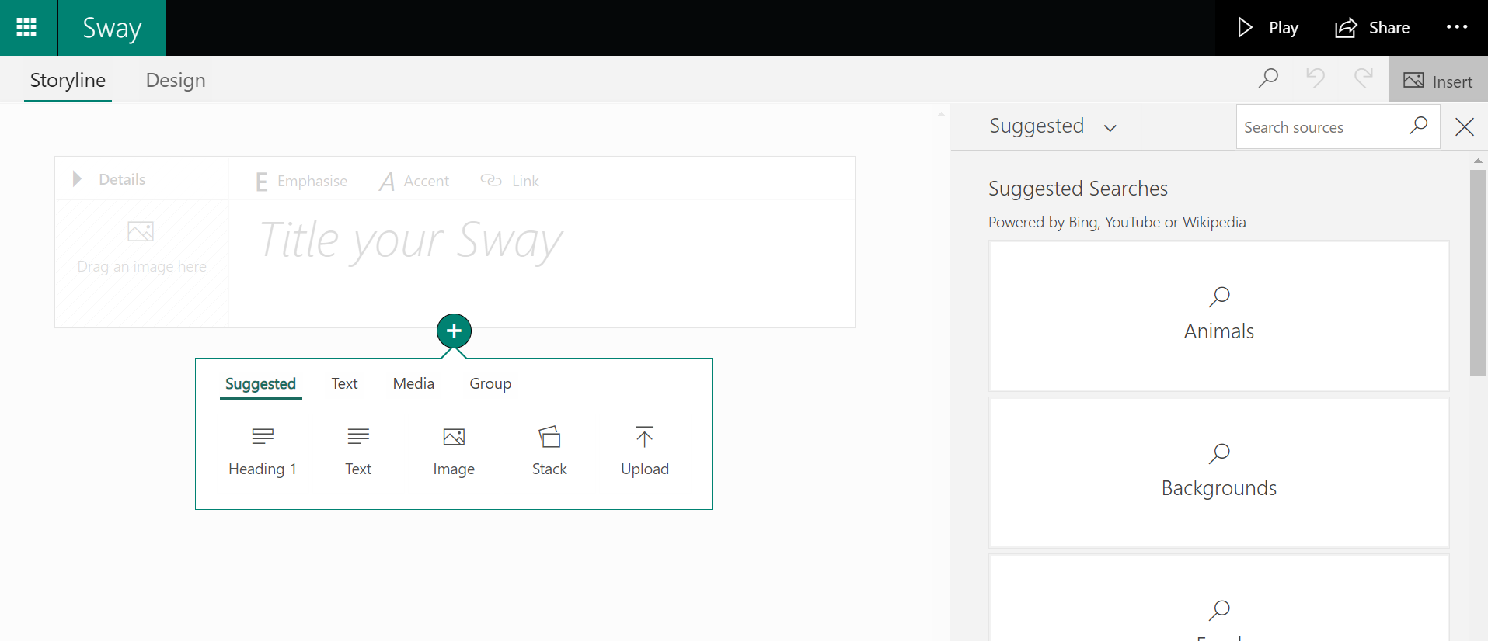
Adding Content
Click on the green plus sign to add a new card.
Use the Insert and then Suggested option to add content i.e images or videos.
Choose what type of card you would like to add in next from the pop up menu.

Slide 8
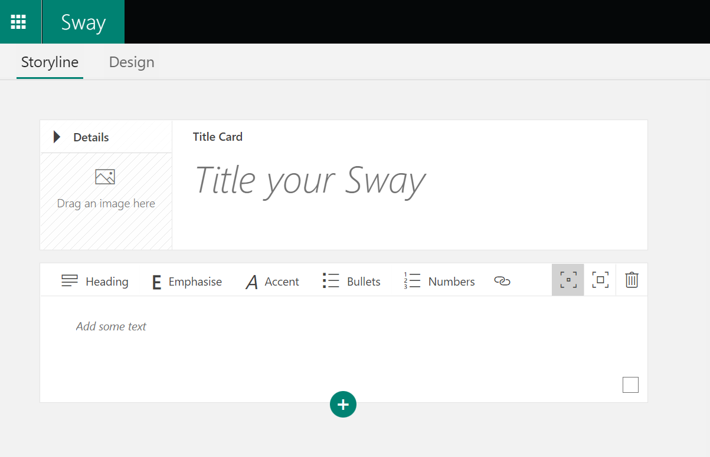



Adding Content - Text
Choose the text option to insert a new card to type in a welcome message.
See features:
Emphasise – make your text stand out (bold)
Accent – Differentiate this text from the text next to it (italics)
Bullets – Create a bullet point list
Numbers – Create a numbered list
- Create a link to a website
- Subtle or moderate emphasis
- Delete card

Slide 9
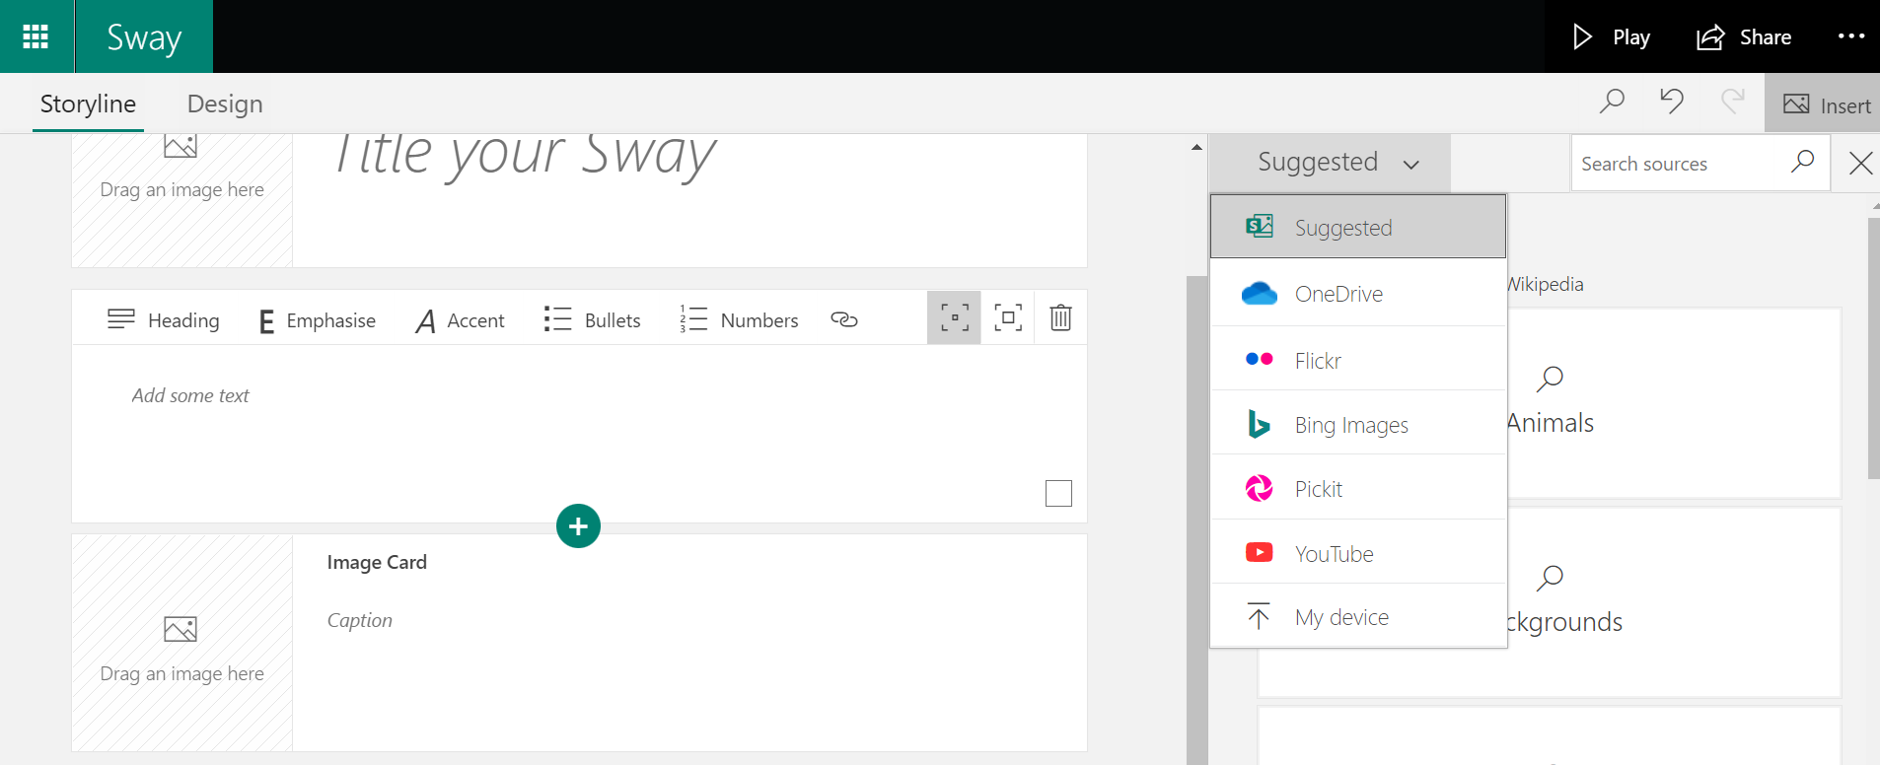
Adding Content – Images
Use the Insert and then Suggested option to add images or videos from the internet (Bing), your One Drive, Flickr, Pickit, You Tube or upload from your computer.
Choose the image option to insert a new card with an image embedded.
Tip: As you build and adjust your Sway, it's always good to view the Sway to see what the audience will experience. Select the Design tab to view the Sway as it will appear or select Play to view the Sway in full screen. To return to editing from the play view, select the Edit button at the top of the screen.
Click here for a video explanation on adding and viewing content.

Slide 10
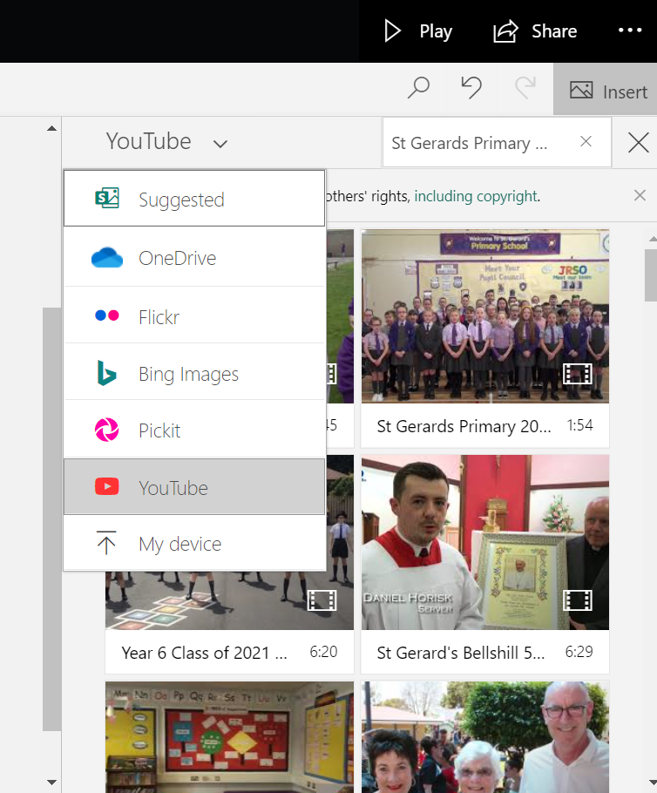

Adding Content - Video
Use the search to look for content. Remember if using YouTube, it is safer change that link to a video.link and embed the link instead.
Click the green plus sign and choose media from the pop up menu then video.
Click here for a video explanation on adding video content.
Tip: Remember Sway is an online tool and saves as you go.

Slide 11
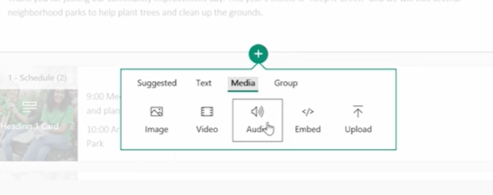
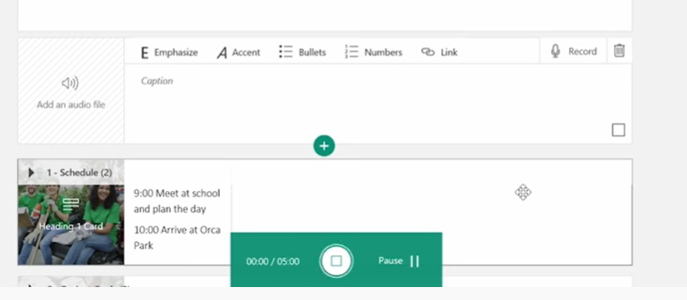
Adding Content - Audio
Click the green plus sign and choose media from the pop up menu then audio.
Use the search to look for audio in your files or record straight onto Sway using the record function.
Click here for a video explanation on adding audio content.

Slide 12
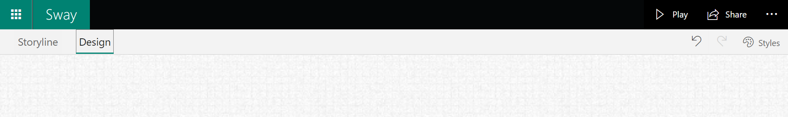
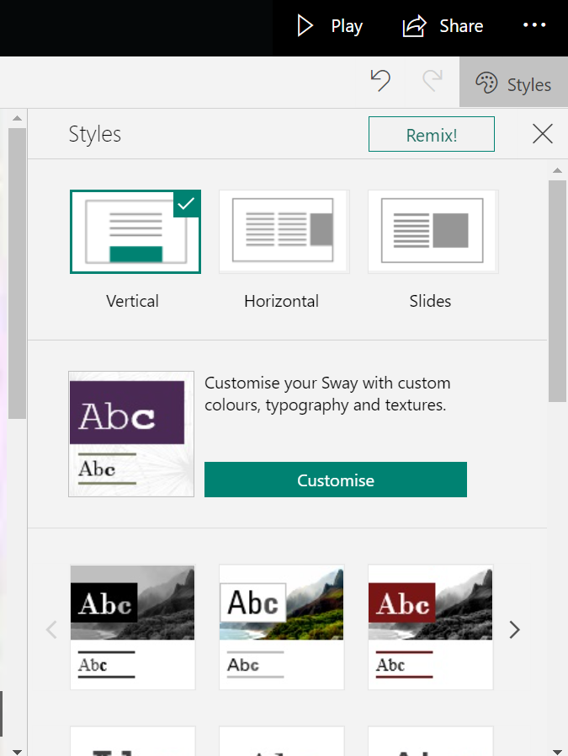
Styling Your Sway
Sway has a built-in style gallery which lets you easily switch between the different styling options until you find the way you like. From the Storyline view, click the Design tab.
This allows you to spend time on the content of your Sway then remix the designs until you fine one that suits you. You can also scroll through the different styles and pick one from there.

Slide 13
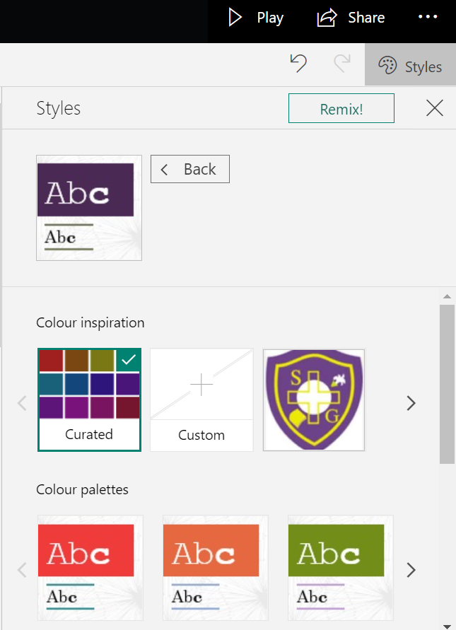
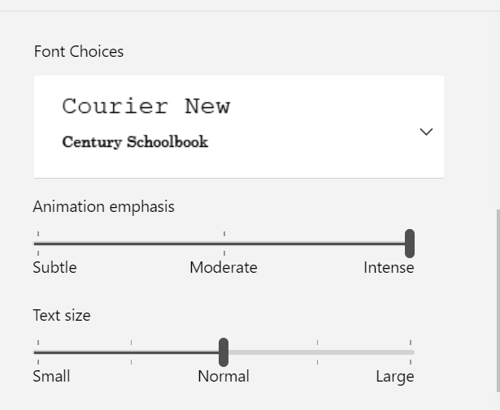
Styling Your Sway
To make more changes to the design of your Sway, click on Customise.
This allows you to customise colours and choose the font and font size that you desire.
Click here for a video explanation on styling your Sway.

Slide 14
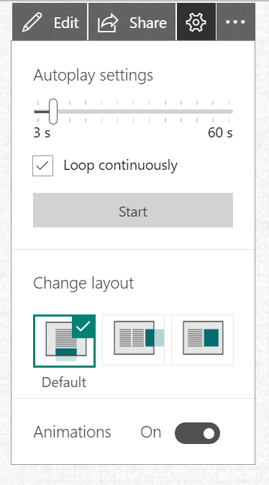
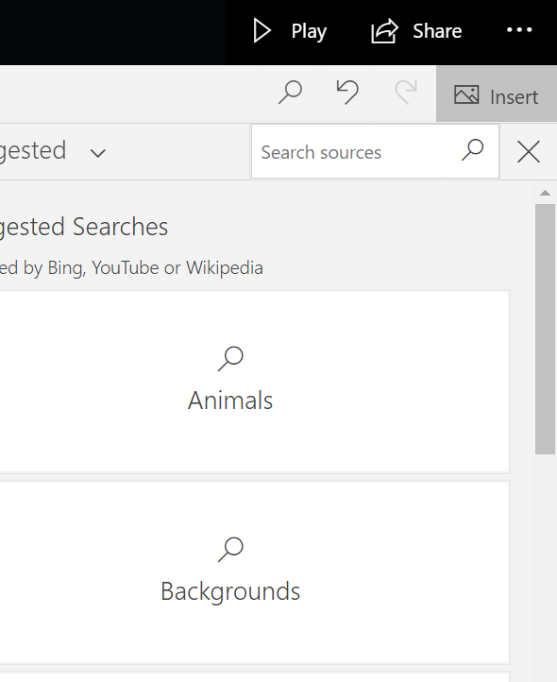
Viewing Your Sway
Click play to see what your Sway will look like.
You can also change the Autoplay settings and layout by clicking on the cog.
To be sure that a Sway is visible to all viewers, it is always a good choice to run the Accessibility Checker. This video clip explains how to find the Accessibility Checker in Sway.

Slide 15
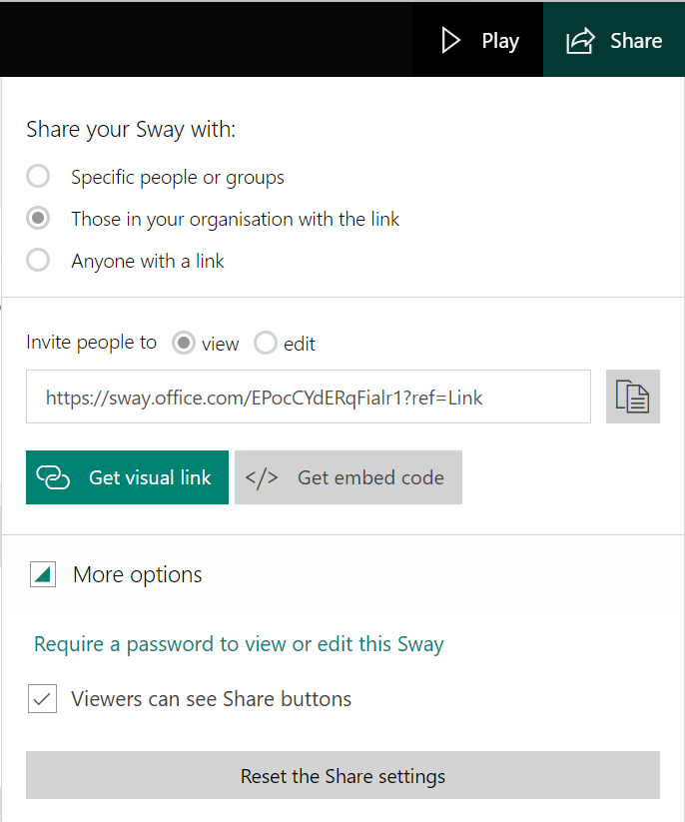
Sharing Your Sway
Once you are happy with your Sway you are ready to share it with others. You have the option of sharing only within your organisation or school, specific people or groups or open it up for anyone to access your Sway.
From your Sway, click the Share button on the main toolbar.
Select who you want to share your Sway with from the options provided.
You can select if you want people to be able to view or edit your sway.
Copy the Link provided and paste this into an email, a class
Teams’ page or your preferred method to share this link.
You can also protect your Sway with a password.

Slide 16
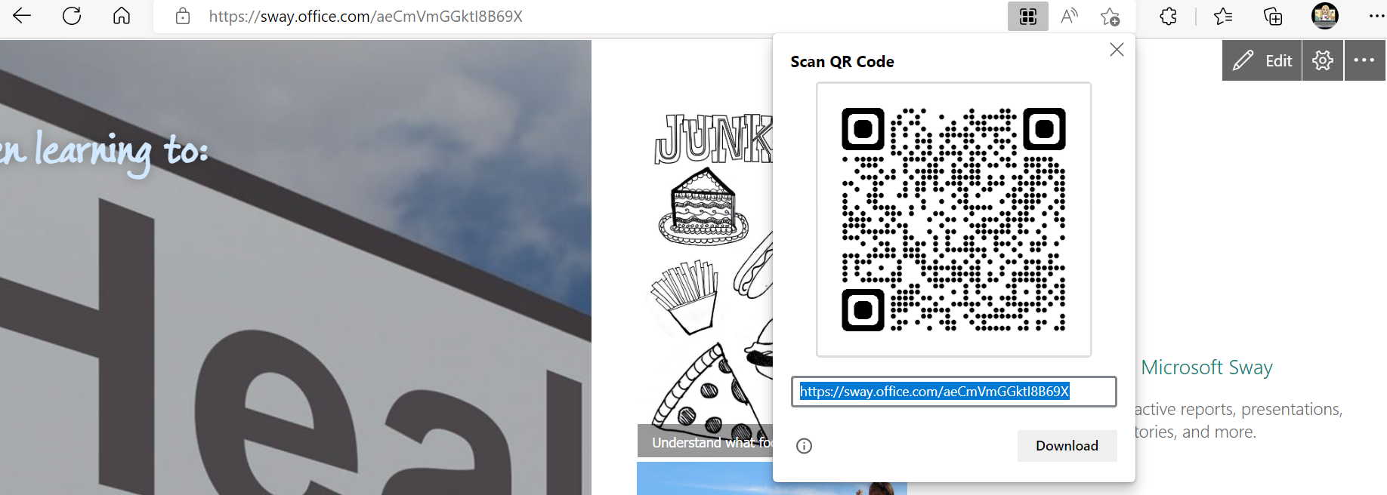
Sharing Your Sway
Create a QR code for your Sway.
If you copy the URL in Edge or Chrome, it will give you the option to create a QR code on the URL bar.

Slide 17
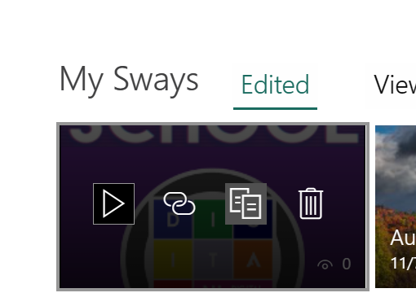
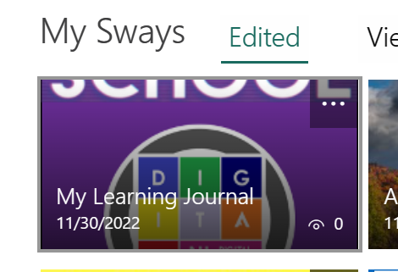

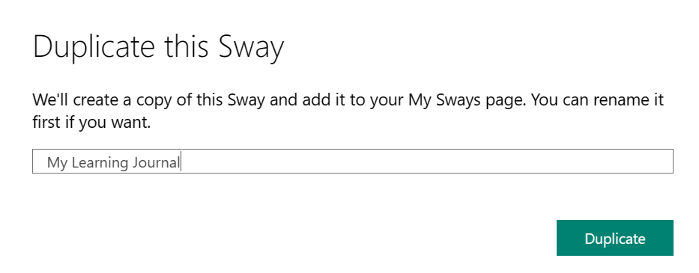
Duplicating a Sway
Once you have shared a Sway template with your pupils, they can click on the ellipsis on their Sway home page and choose to copy the Sway.
Change the name of your Sway
Then click on ‘Duplicate’

Slide 18
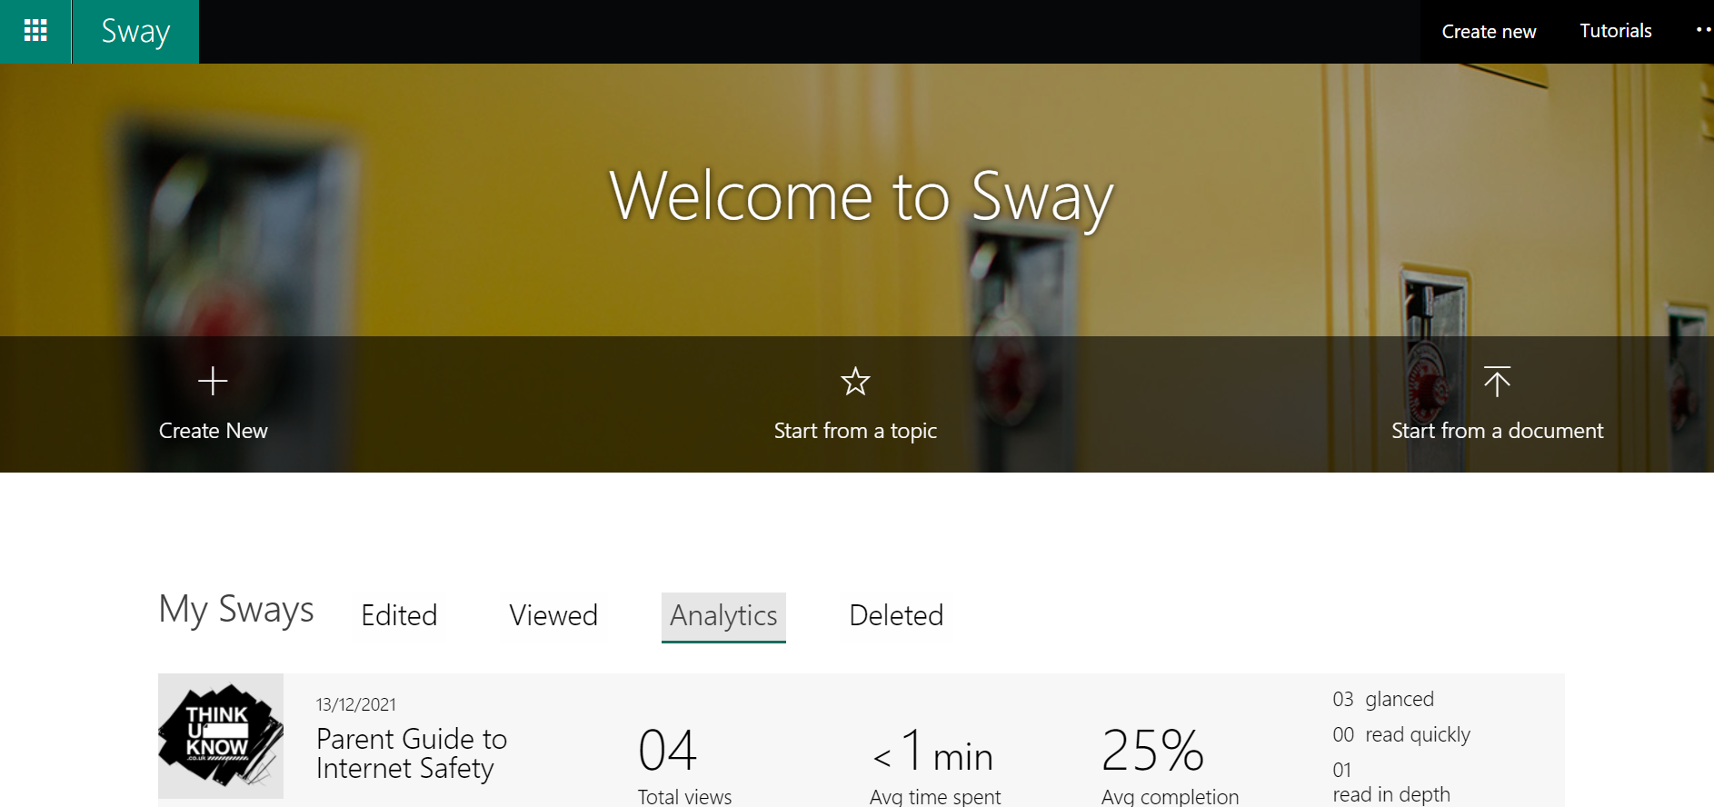
Sway Analytics
Once you have shared your Class Newsletter it is important to know if your audience is being reached, therefore Sway includes analytics. Analytics let you know if your digital story is being viewed by parents or students.
Select Analytics from the dashboard to view all your Sways and their viewing data. You will learn if people have glanced at the Sway, gave it a quick read, or spent more time giving it a deep read. This data can help you when preparing future Sways.

