Slide 1

Computing Science
Dykehead Primary

Slide 2
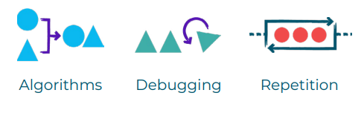


Session One
Learning Intention:
Create an algorithm.
Success Criteria:
I can follow the main steps in an everyday task/song/dance
I can identify the main steps in an everyday task/song/dance.
I can identify repetition.
I can sequence the main steps in an everyday task/song/dance.
I can check and if required, debug my algorithm.

Slide 3
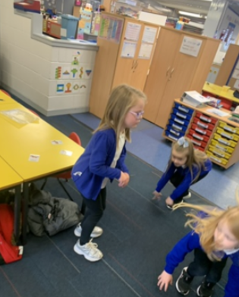
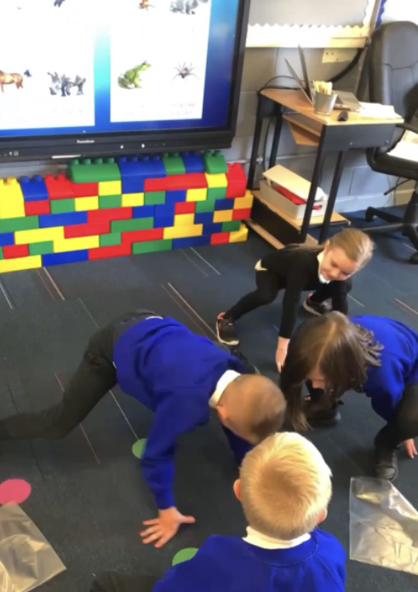
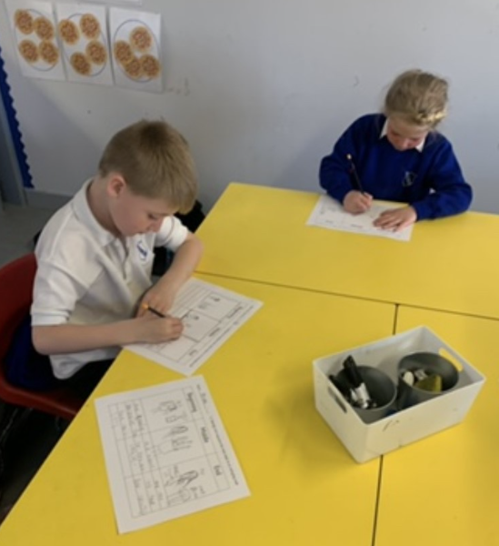
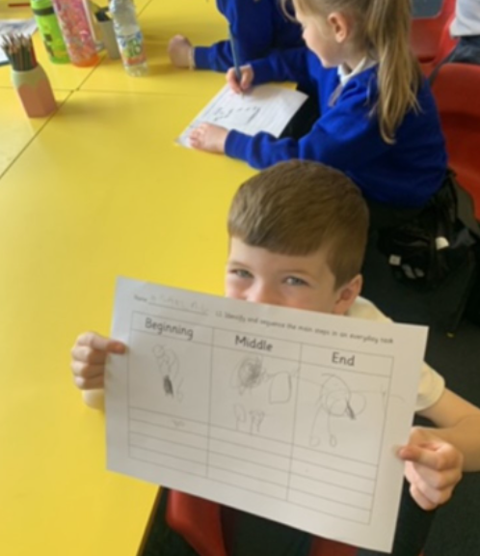
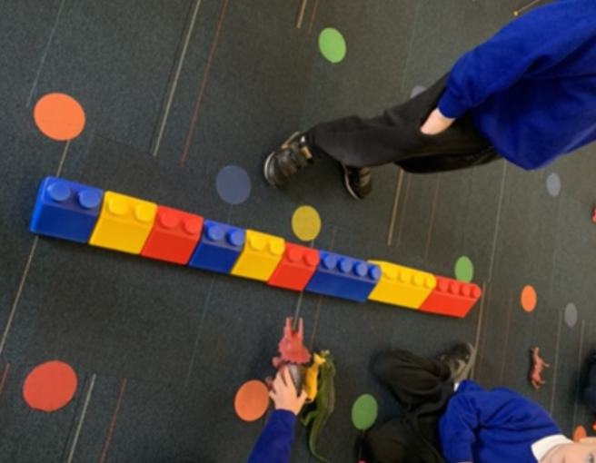
Session ONE

Slide 4


Session Two part 1
Learning Intention:
Sort and group objects.
Success Criteria:
I can say what is the same.
I can say what is different.
I can sort the pictures/objects into groups.
I can talk about why.

Slide 5
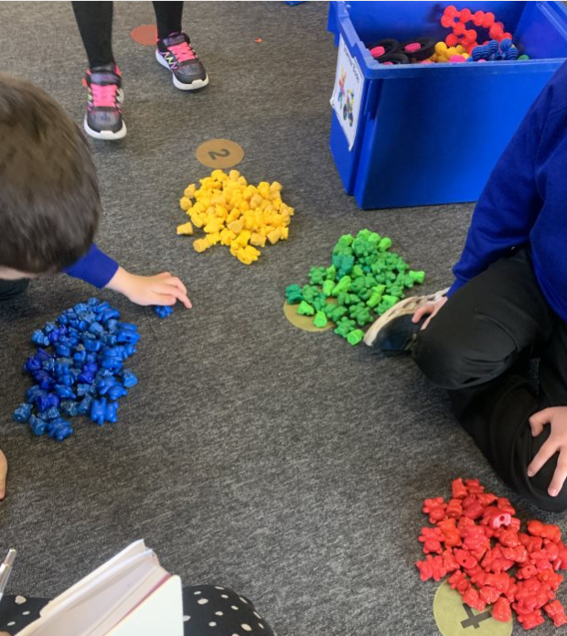
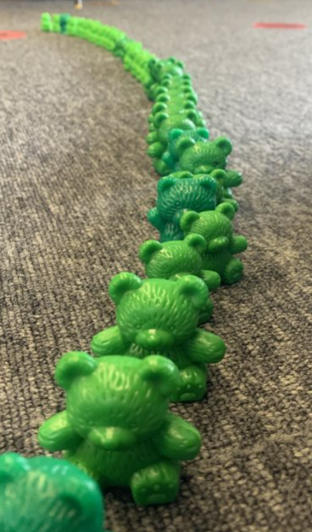
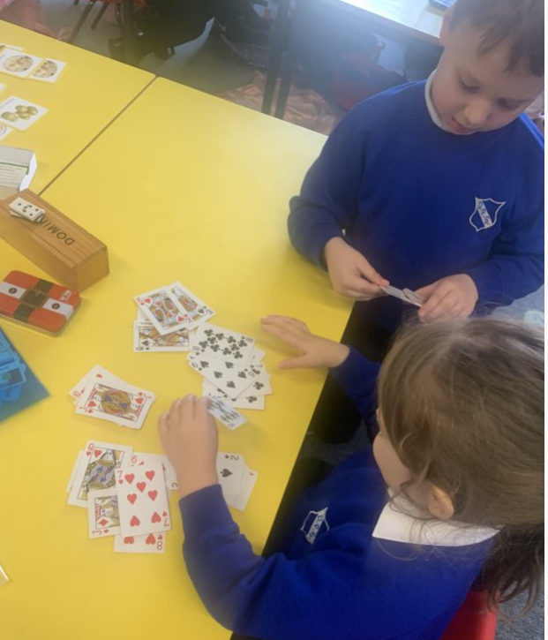
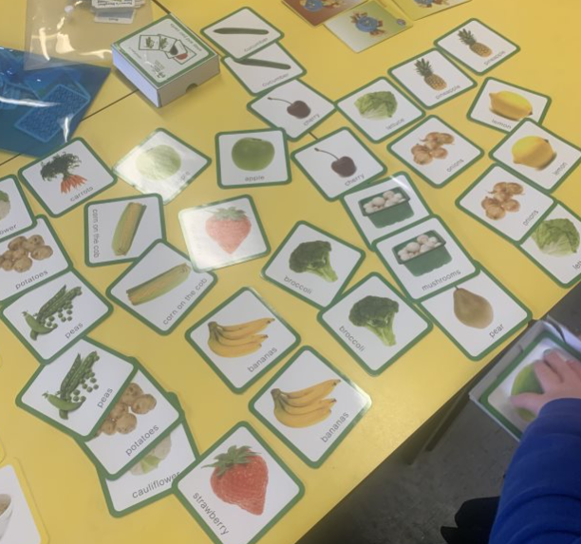
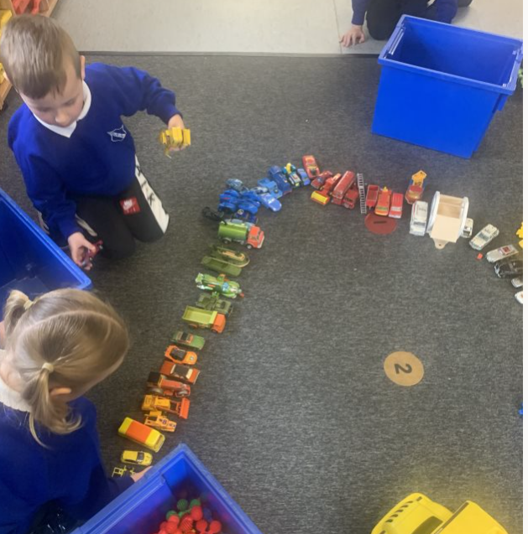
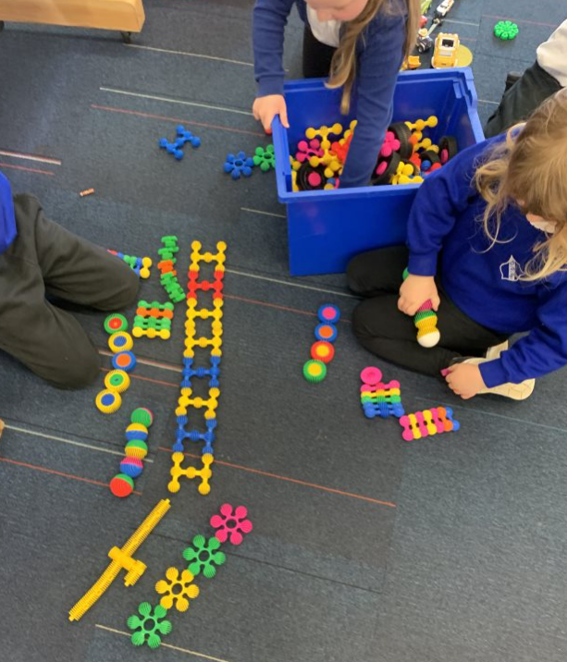
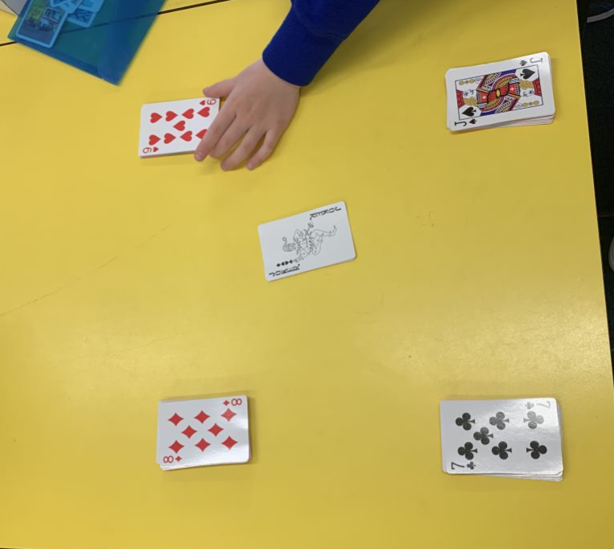
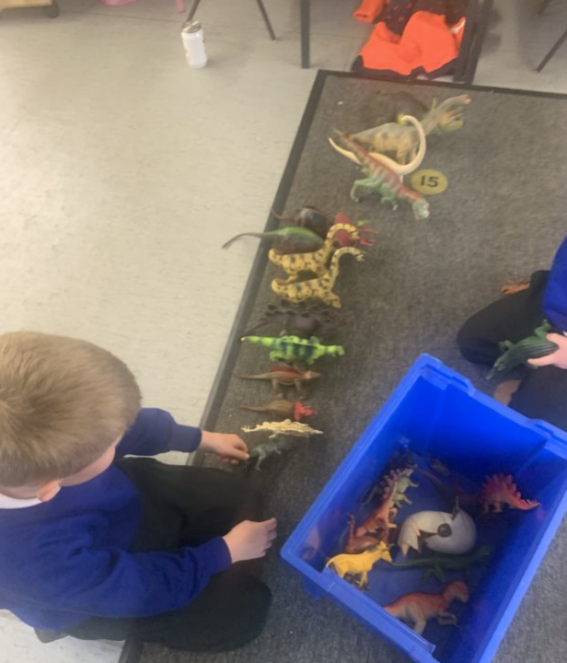
Session Two

Slide 6


Session Two PART 2
Learning Intention:
Complete a pattern.
Success Criteria:
I can say what is the same.
I can say what is different.
I can identify repetition.
I can continue the sequence of a pattern.

Slide 7


Session ThREE PART 1
Learning Intention:
Identify computing devices.
Success Criteria:
I understand a computing device must be electronic.
I can say what is the same.
I can say what is different.
I can identify computing devices.
I can identify which devices that have hidden technology.
I can discuss uses for computing devices in the
world around me.

Slide 8

Session ThREE PART 2
Learning Intention:
Control different computing devices.
Success Criteria:
I can control a device by touch.
I can control a device by pressing buttons.
I can control a device with voice.
I can predict what will happen when I
interact with a device.

Slide 9
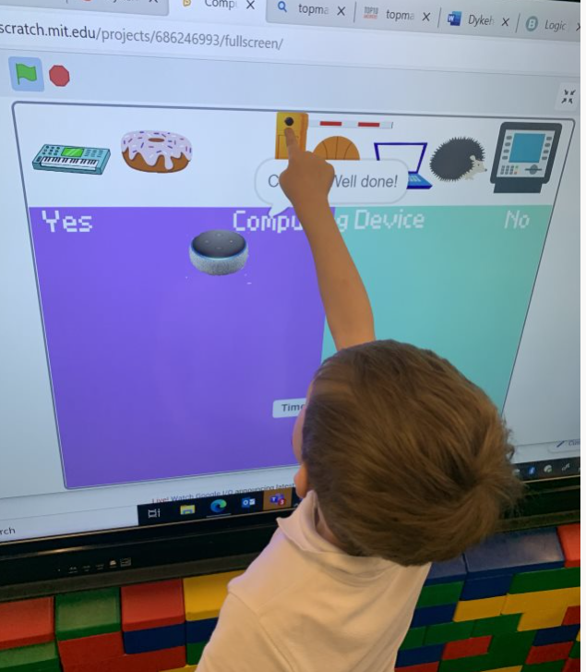
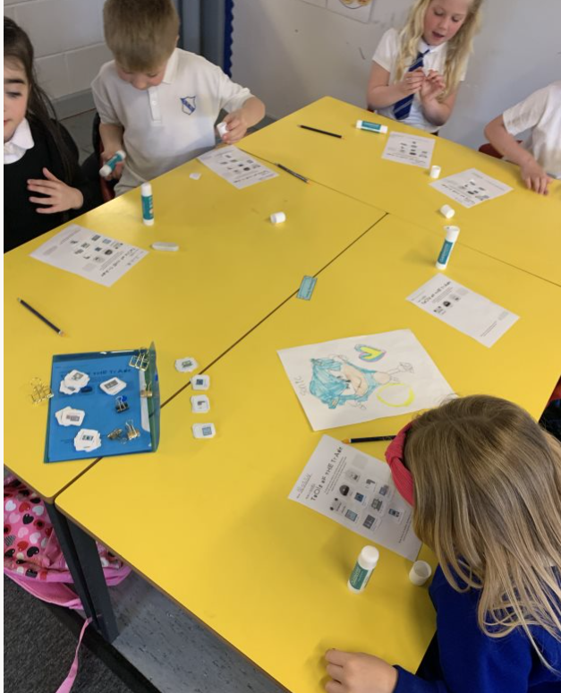
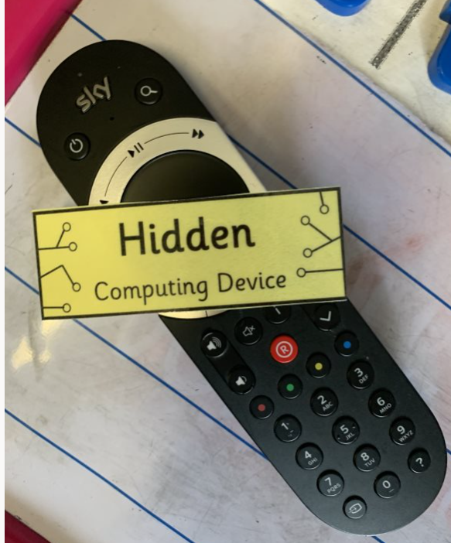
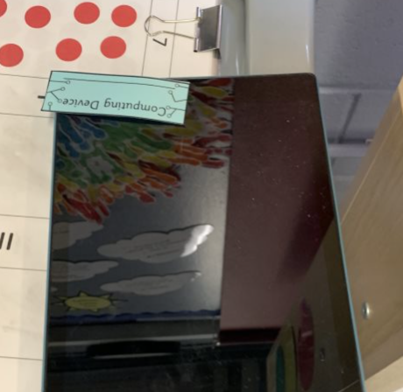
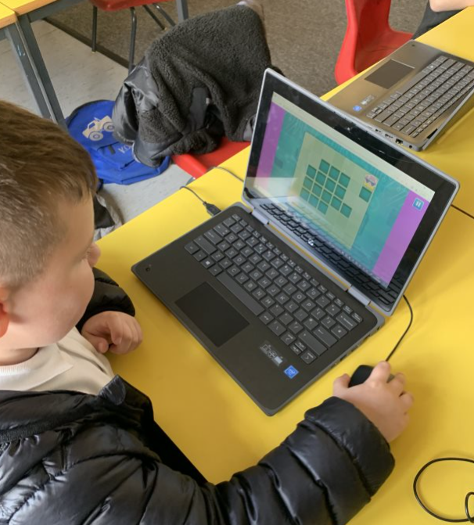
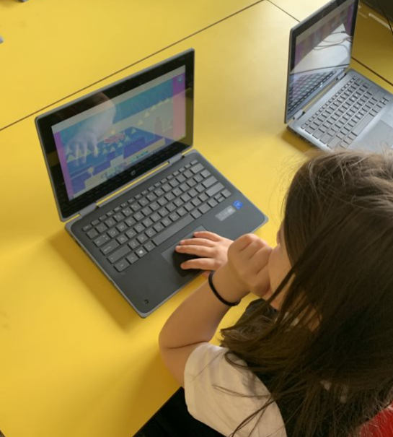
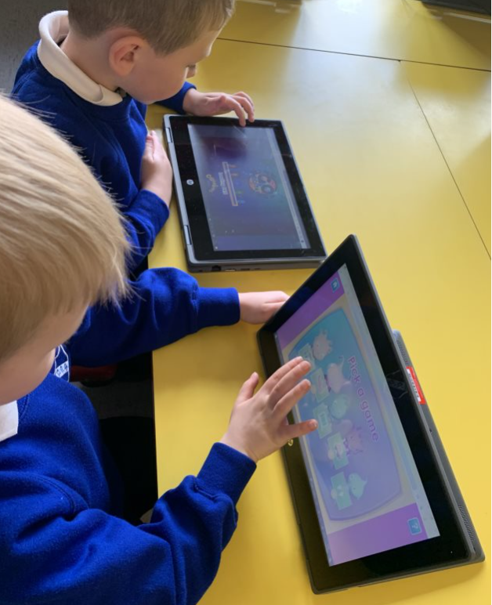
Session THREE

Slide 10






Session four
Learning Intention:
Follow and provide a sequence of directional instructions.
Success Criteria:
I can understand simple directional language.
I can follow simple directional language.
I can tell someone where to go using directional language.
I can programme a BeeBot using directional instructions.
I can identify a problem and debug.

Slide 11





Directional language
Turn left
Turn right
Move forward
Move left
Move right
Move backwards

Slide 12
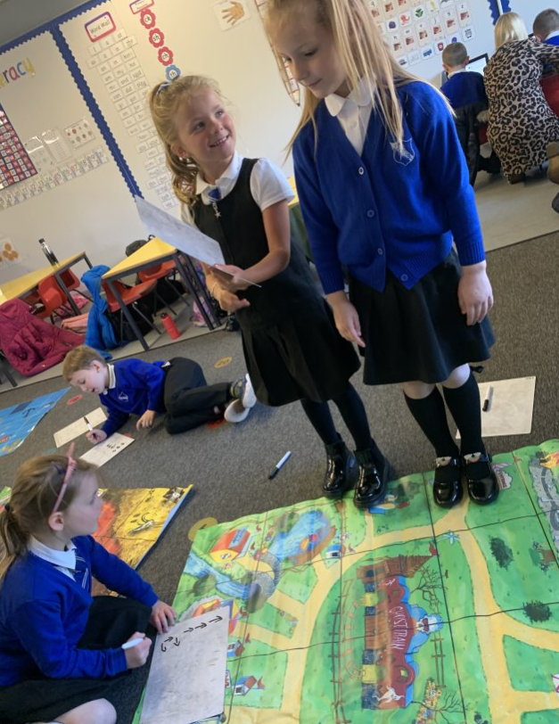
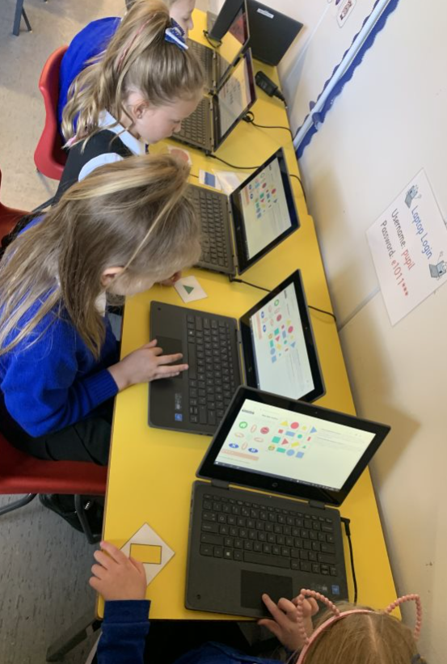
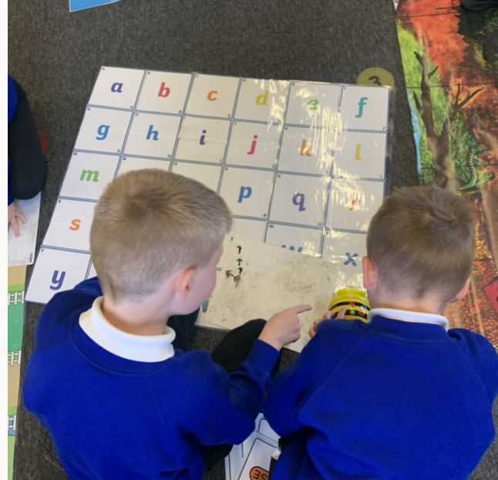
Session FOUR

